Slide 1
Cyberinfrastructure Promoting Collaborative Publication, Interoperability, and Reuse of iUTAH Data and Research Products
Jeffery S. Horsburgh
Amber Jones and the iUTAH CI Team
Fall 2016 All Hands Meeting
“Focus on Facilities”

Slide 2
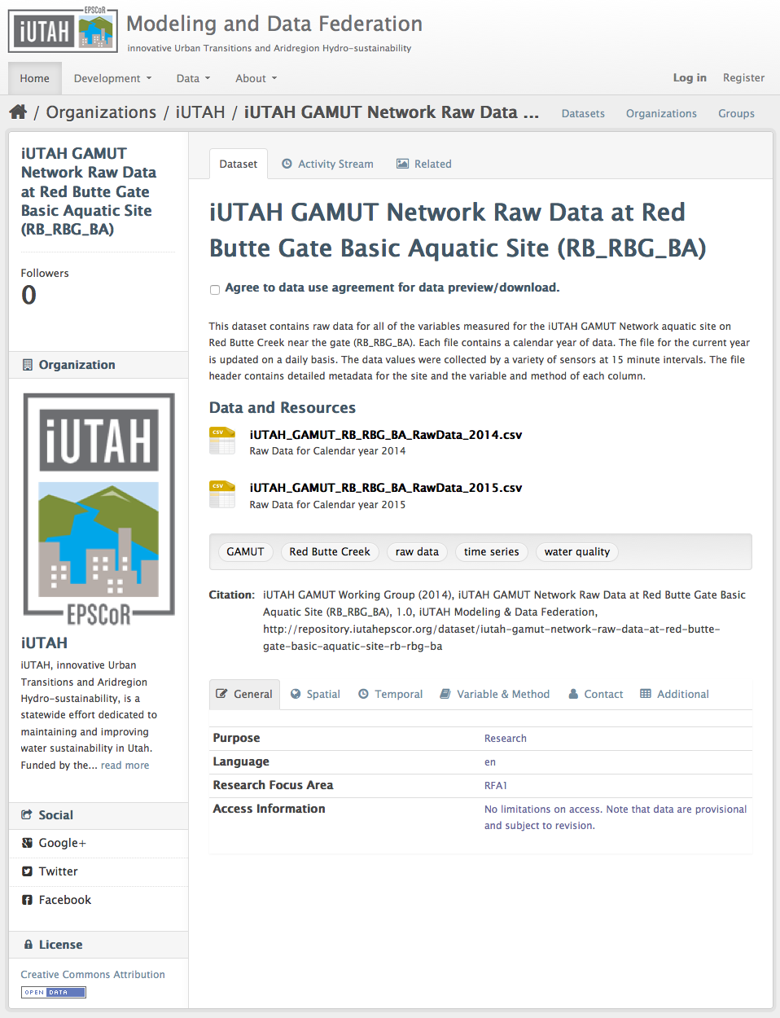
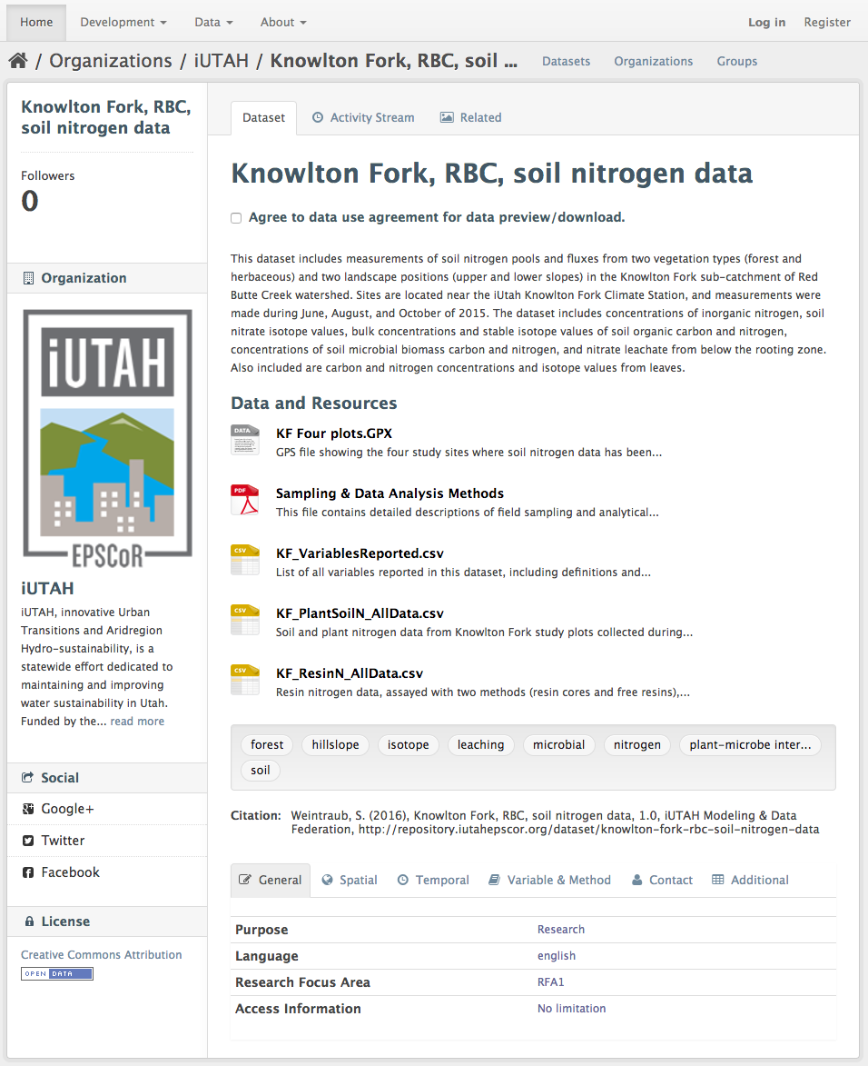
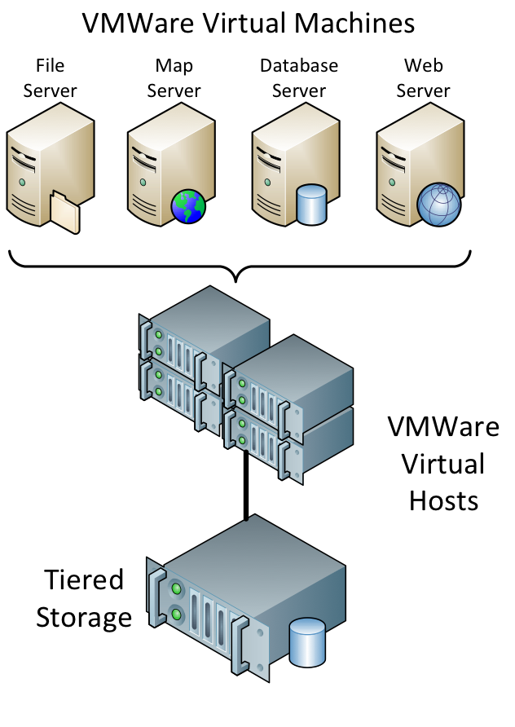
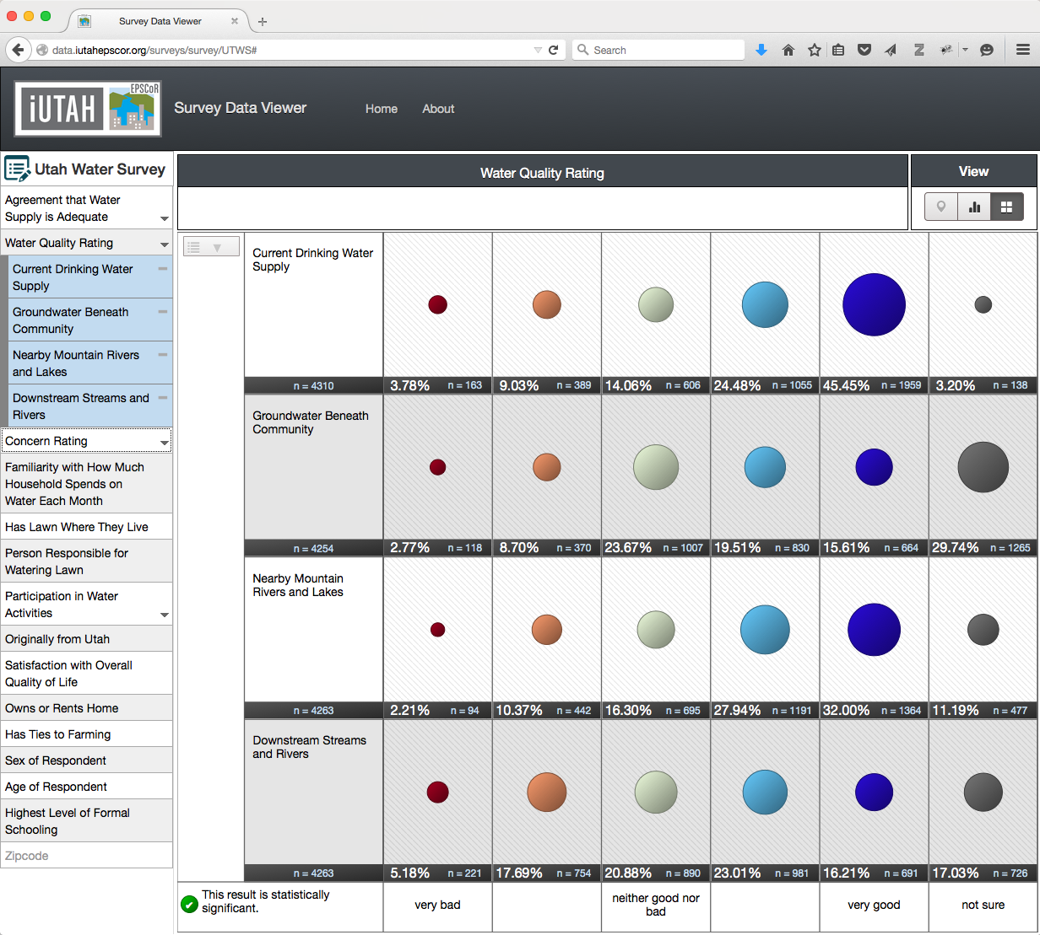
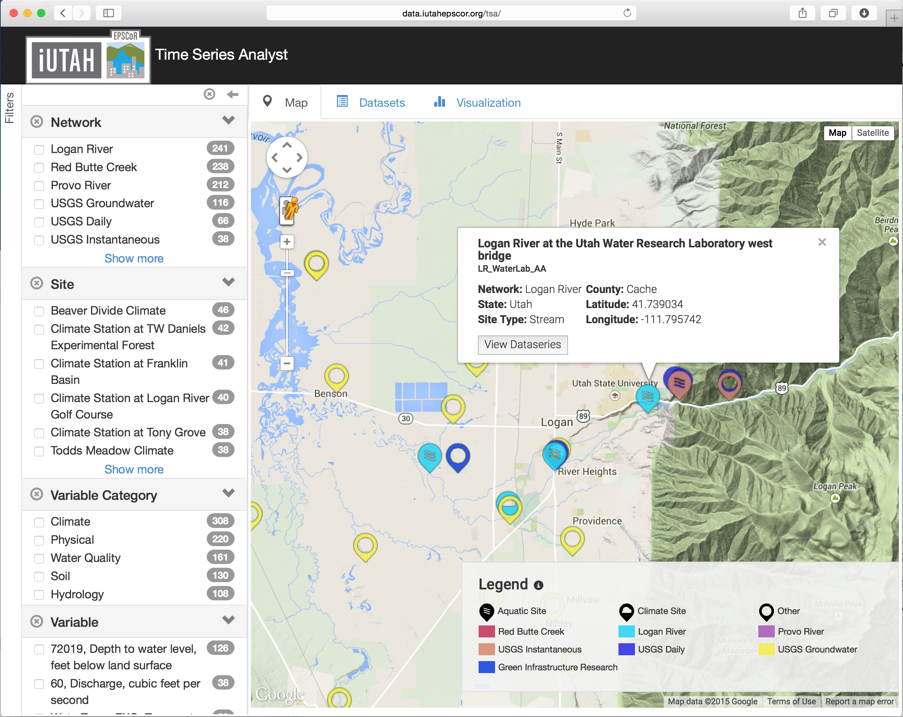
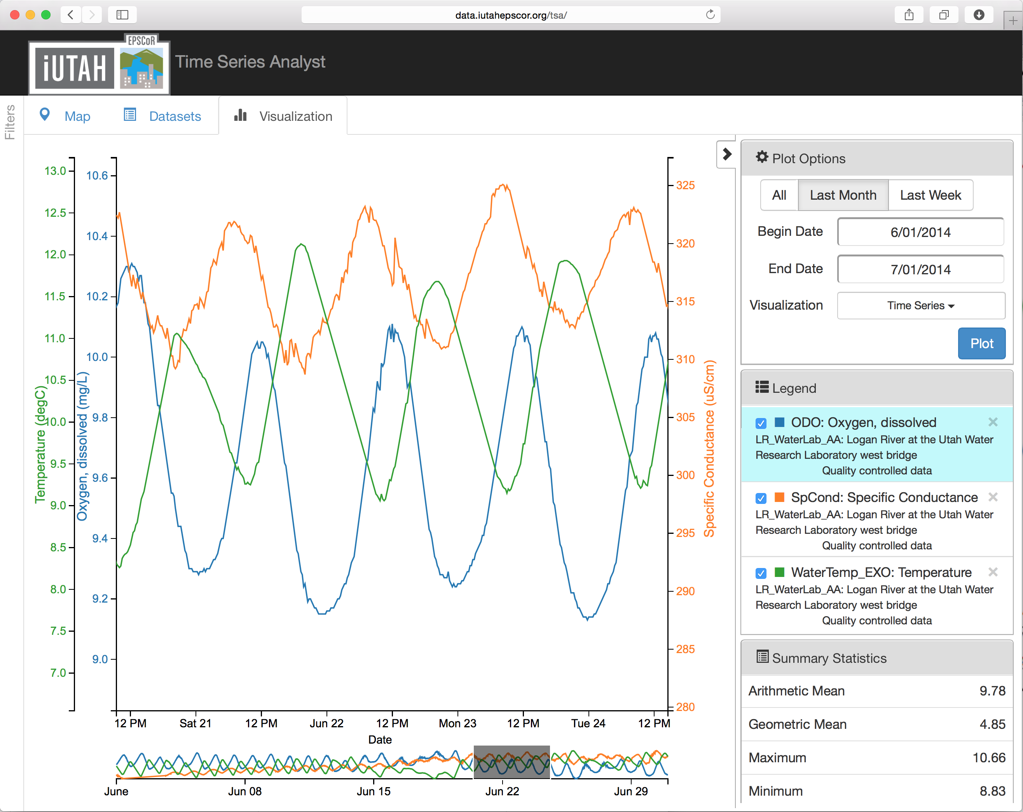
Major CI Components
Software for Data Sharing, Publication, and Visualization
Hardware (Servers and Storage)
Operational Data Management
(GAMUT Workflow)

Slide 3
iUTAH Data Repository http://repository.iutahepscor.org
Dataset upload and publication
Dataset landing page
Permanent URL and citation
Limited curation process
Limitations
Not flexible (enough)
Hard to maintain
No real collaboration capabilities
No DOI for published resources

Slide 4
What do we want to do?
Easily create a digital instance of a dataset or model
Quickly share it with colleagues (perhaps privately at first)
Add value through collaboration, annotation, and iteration
Describe with metadata
Eventually…share publicly or formally Publish
DOI
META
Data and models are “social objects” shared among scientists
Notes:
Focusing in on one generalized workflow for doing science:
the tools we have available to use to do this can still be difficult to string together, and it isn’t clear how to get from point A to point B
There’s collaboration that happens along the way, and the tools that we have available to us now don’t foster that collaboration

Slide 5
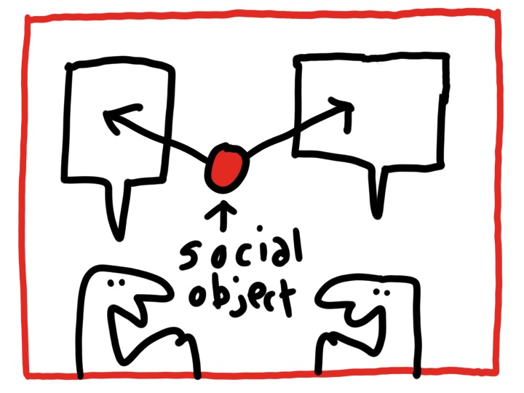
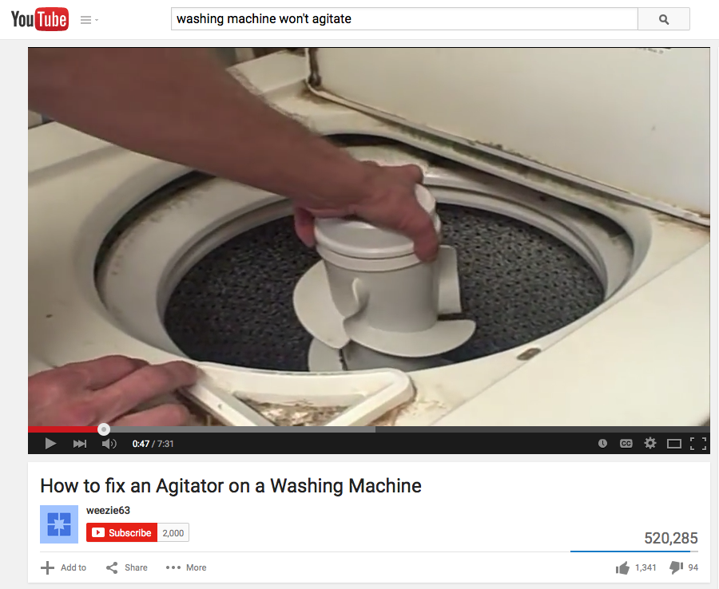
Social Objects
“Objects around which social networks form”
Jyri Engeström
Hugh MacLeod
http://sharinglab.dk/what-is-a-social-object/
Notes:
We recognize that hydrologic data and models are social objects around which we collaborate.

Slide 6
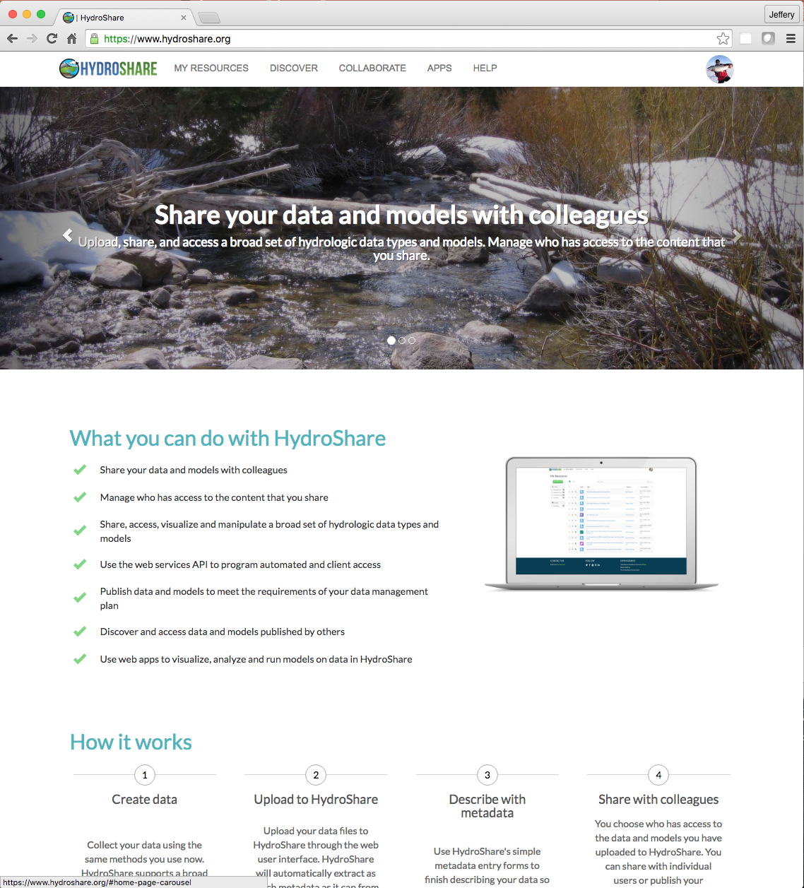
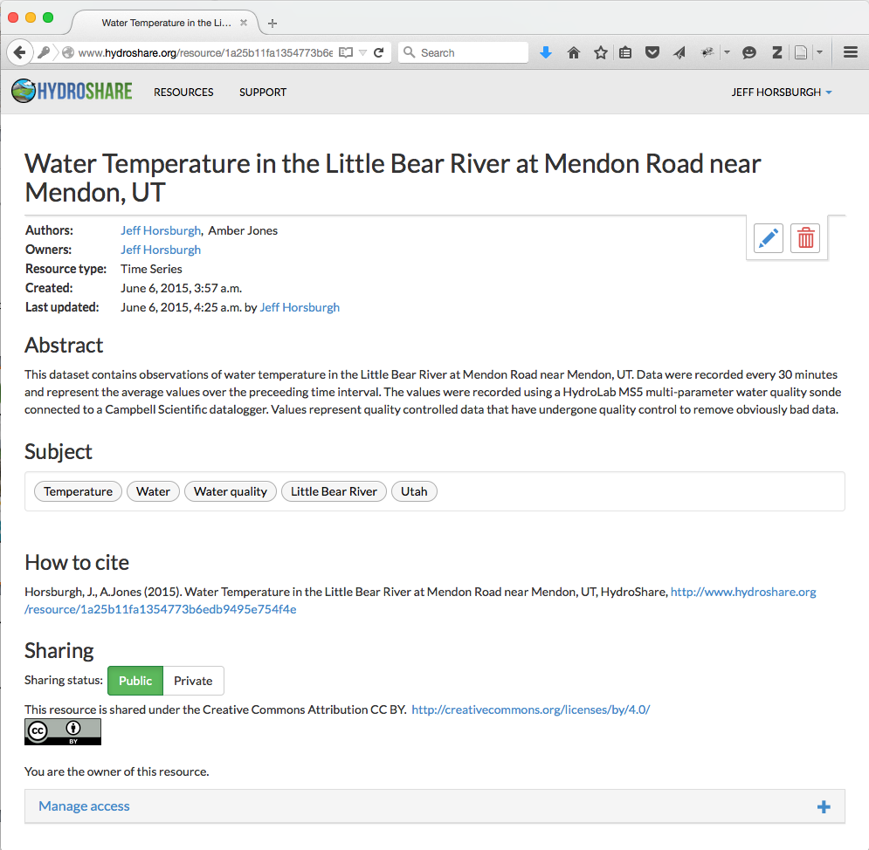
http://www.hydroshare.org
Collaborative development project that started about the same time as iUTAH
Sharing and collaborating around diverse data types used by water scientists
HydroShare’s goal: Enable scientists to create social objects that add value
Notes:
HydroShare changes the game for a much broader class of hydrologic data and models. We can create them, upload them, share them, comment on them, rate them and eventually formally publish them in a way that they can be formally cited.

Slide 7
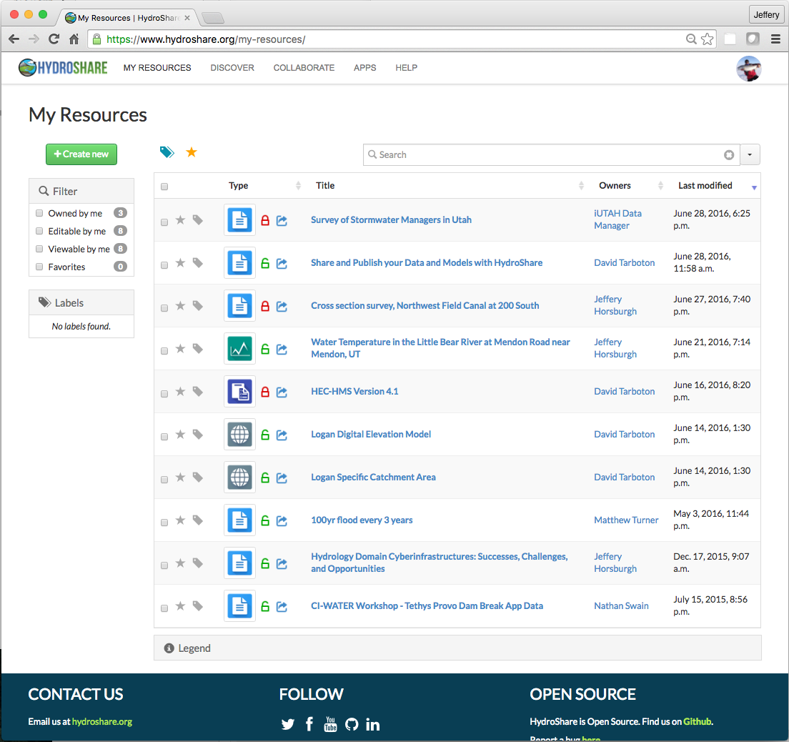
HydroShare “Resources”
Resources can be datasets, models, or other digital content
Resource = primary unit of digital content
Create
Share
Own
Access
Filter
Discover
Publish

Slide 8
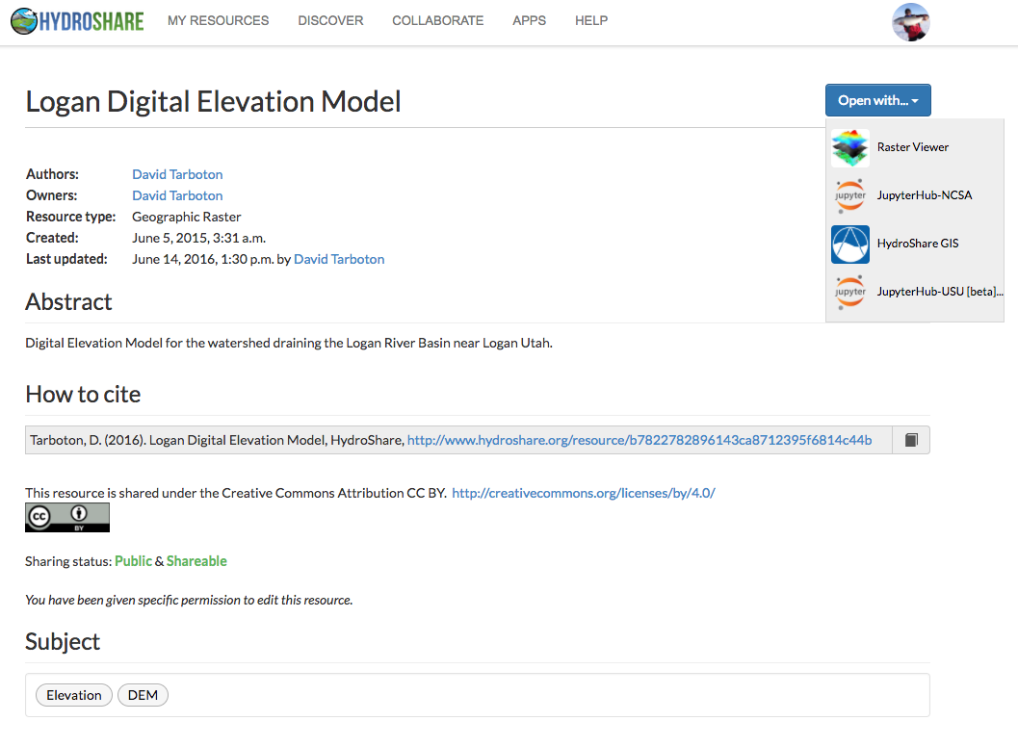
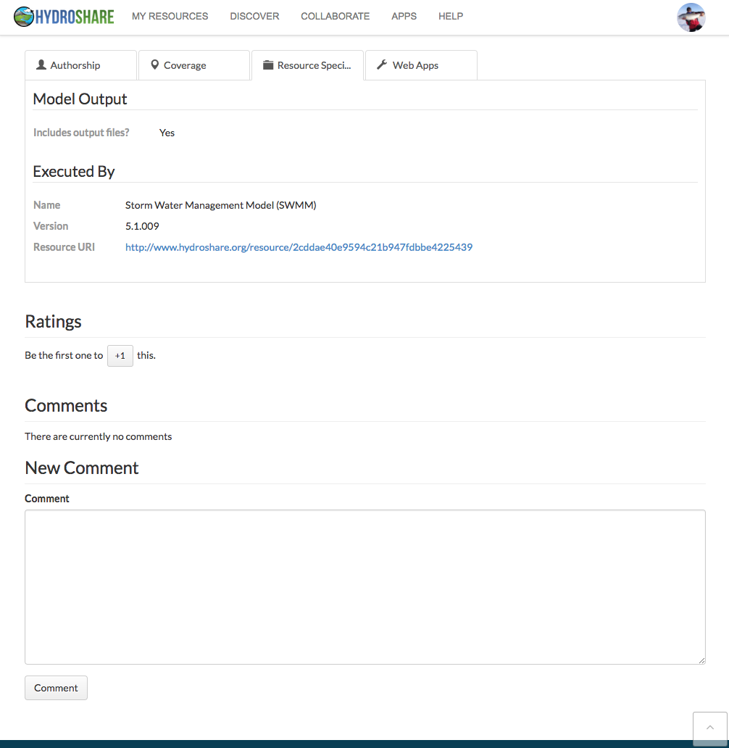
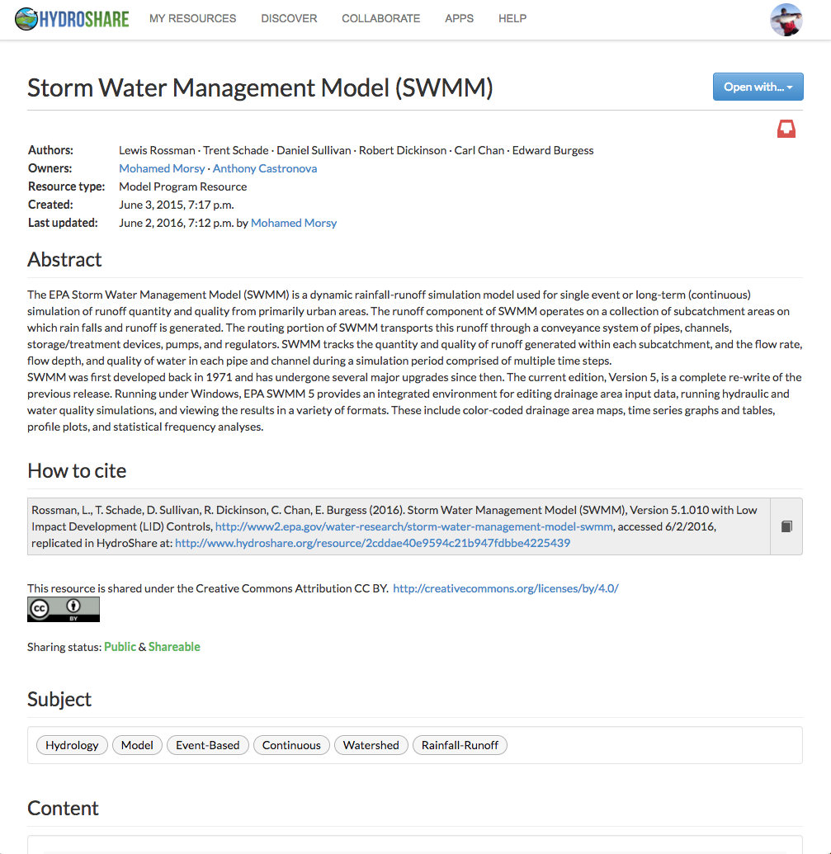
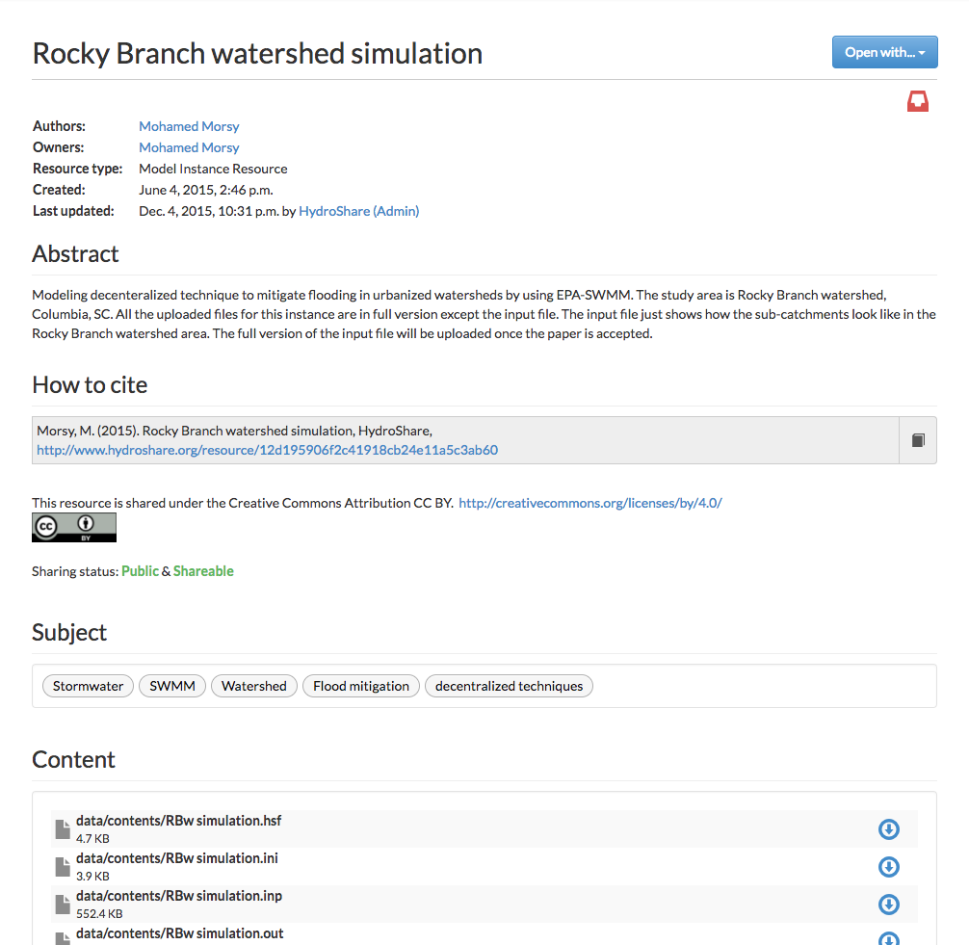
Resource Types in HydroShare
Generic
Multidimensional (NetCDF)
Collections
Geographic
Raster
Feature (ESRI Shapefiles)
Time Series
Time Series
Referenced Time Series
Modeling
Model Program
Model Instance
SWAT Model Instance
MODFLOW Model Instance
Script
Specific Resource types have:
A specific metadata description
An expected file format and structure
Link it to a specific model program
You can create a model instance resource
A geographic
Raster Resource
And describe the model
program as a resource
Is automatically
recognized by apps

Slide 9
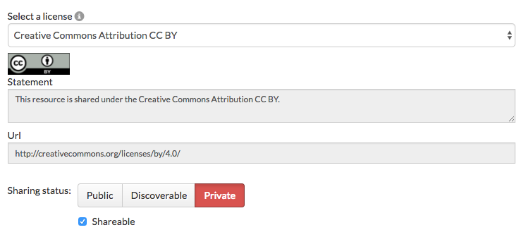
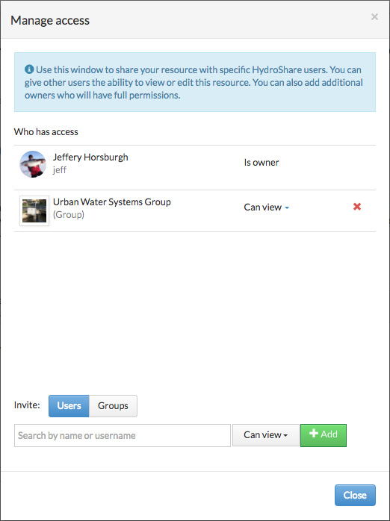
Resource Sharing in HydroShare
You control who has access
5 Options:
Private – Only individual users you have given access can view metadata or access content
Discoverable – Anyone can view the metadata, but only users with permission can access content
Public – Anyone can view the metadata and access content
Published – Same as public, but the resource is made immutable and a DOI is assigned
Shareable – Other users can grant access at their same level of access
Share with individuals or groups

Slide 10
The Scientific Workflow
API
Iterates and versions
using Python code
Shares code and iterates
with colleagues
DOI
Creates and
verifies metadata
Cites code
Uploads to Hydroshare
Shares with colleagues
META
Publishes
dataset
Cites dataset
Creates
dataset
Writes paper
DOI
Notes:
And when we teach them how to integrate things like HydroShare and Python programming and GitHub into their personal cyberinfrastructure, their scientific workflow starts to look a lot different, more social, more collaborative, easier to track, and more reproducible.

Slide 11
DEMO: Creating a Resource in HydroShare

Slide 12
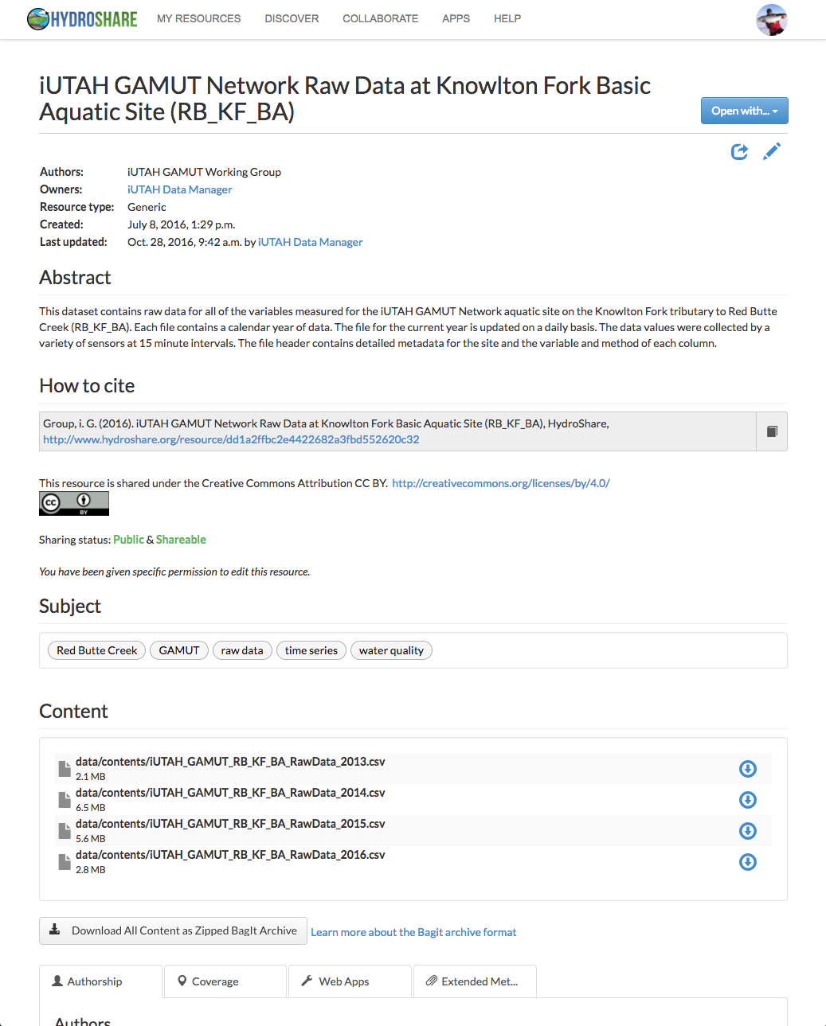
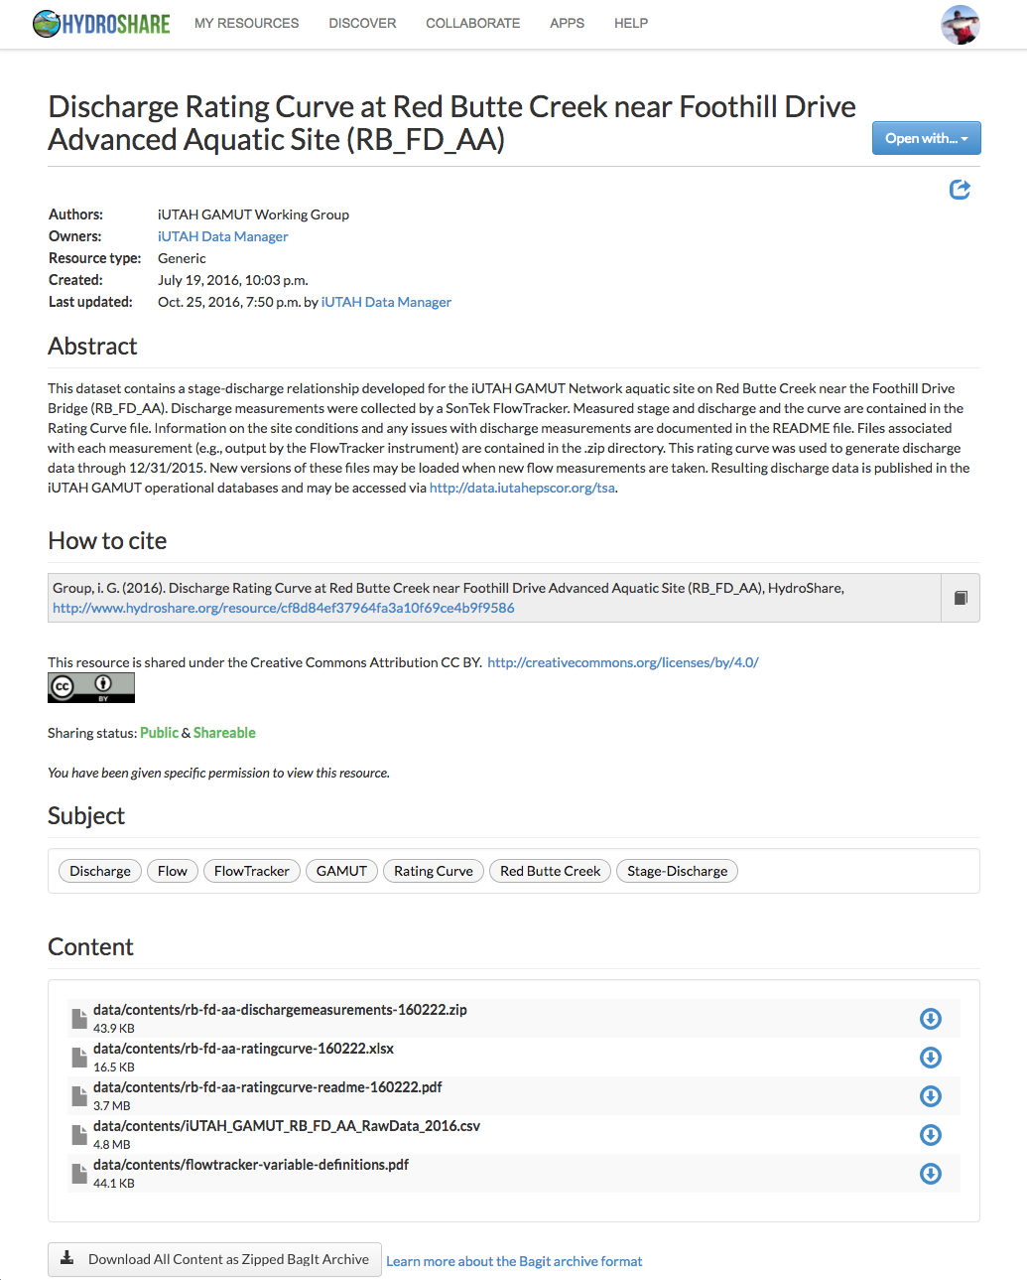
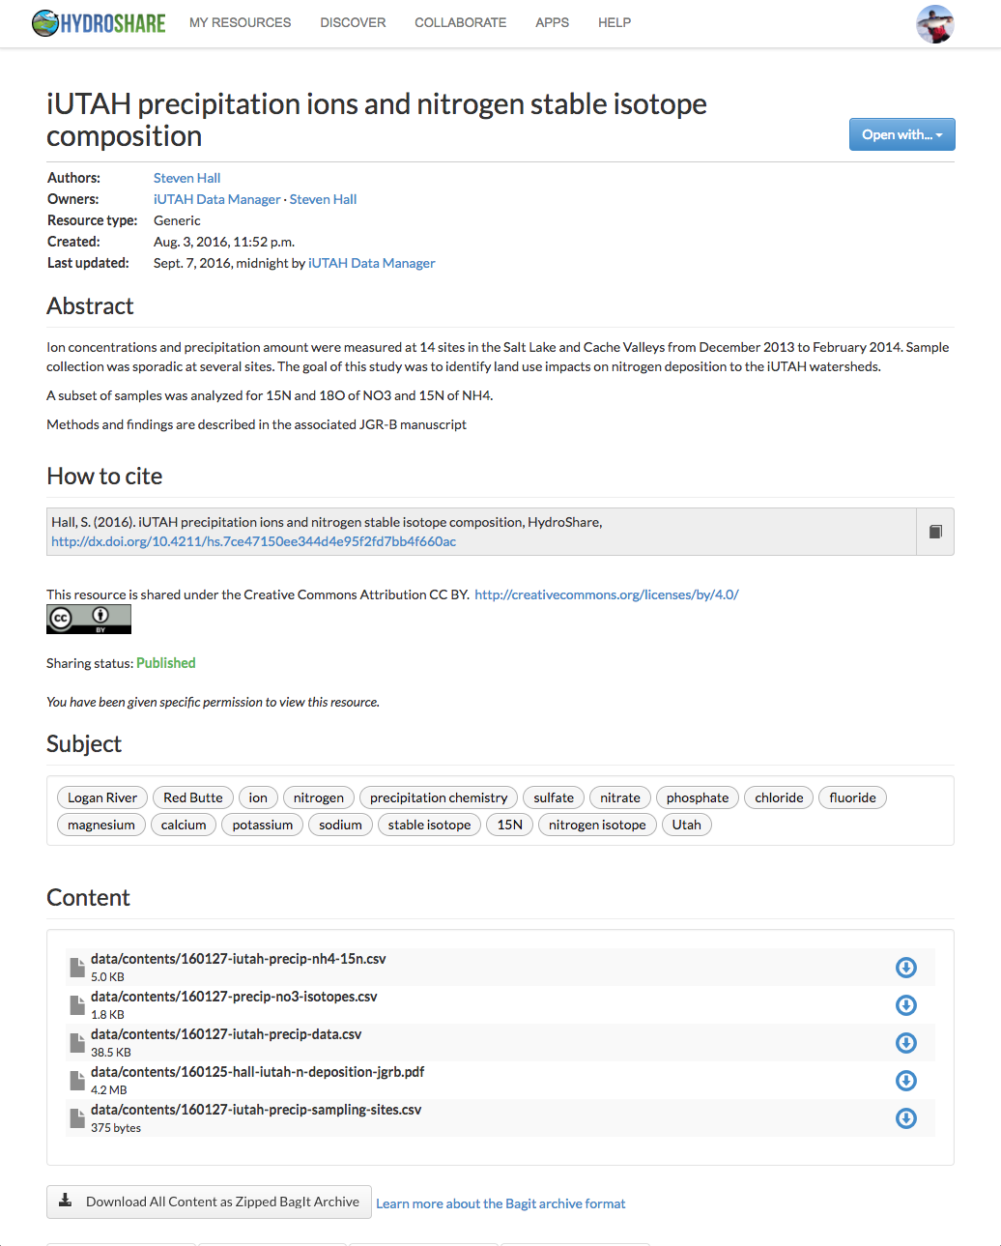
iUTAH Resources in HydroShare
GAMUT Raw and QC1 Datasets
GAMUT Discharge Rating Curves
Individual Investigator Datasets

Slide 13
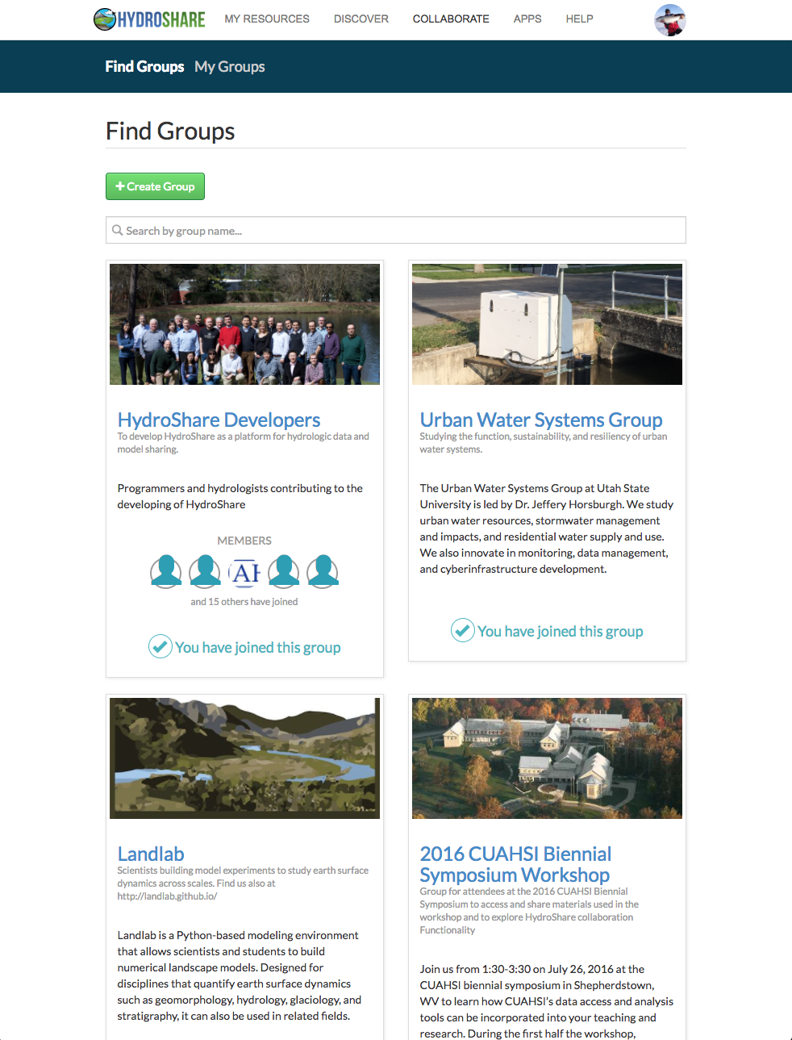
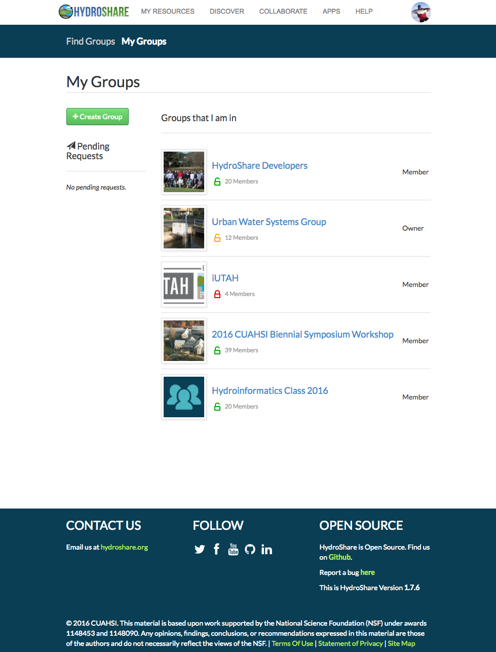
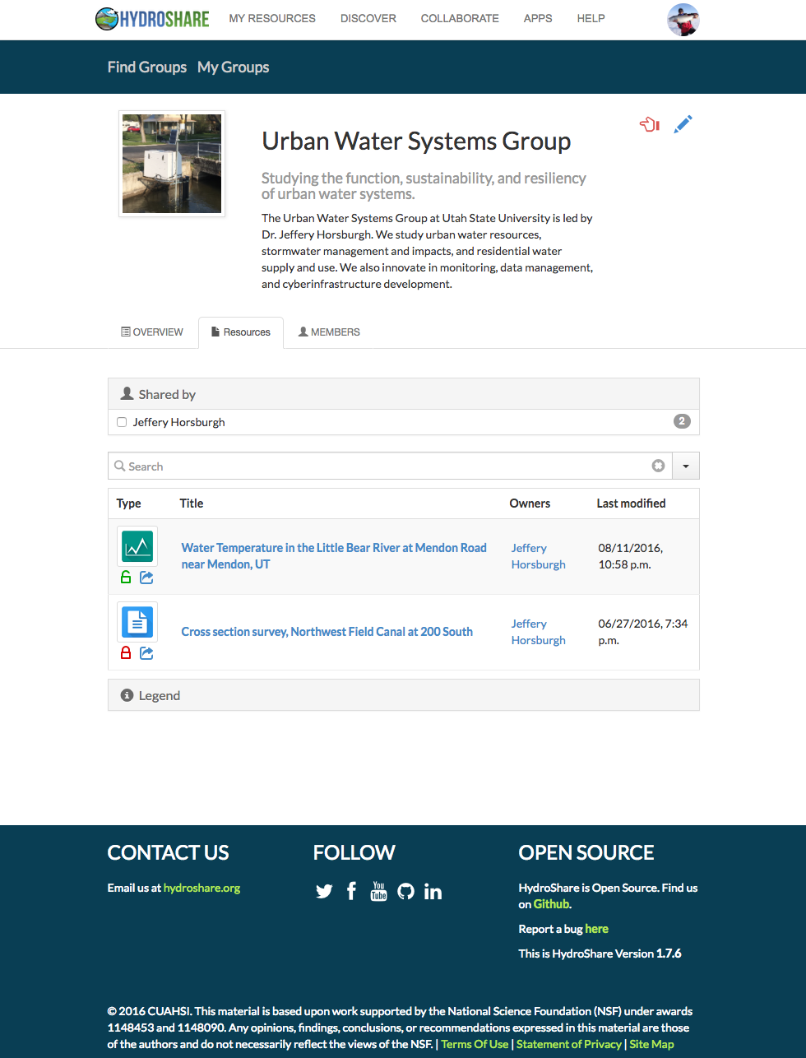
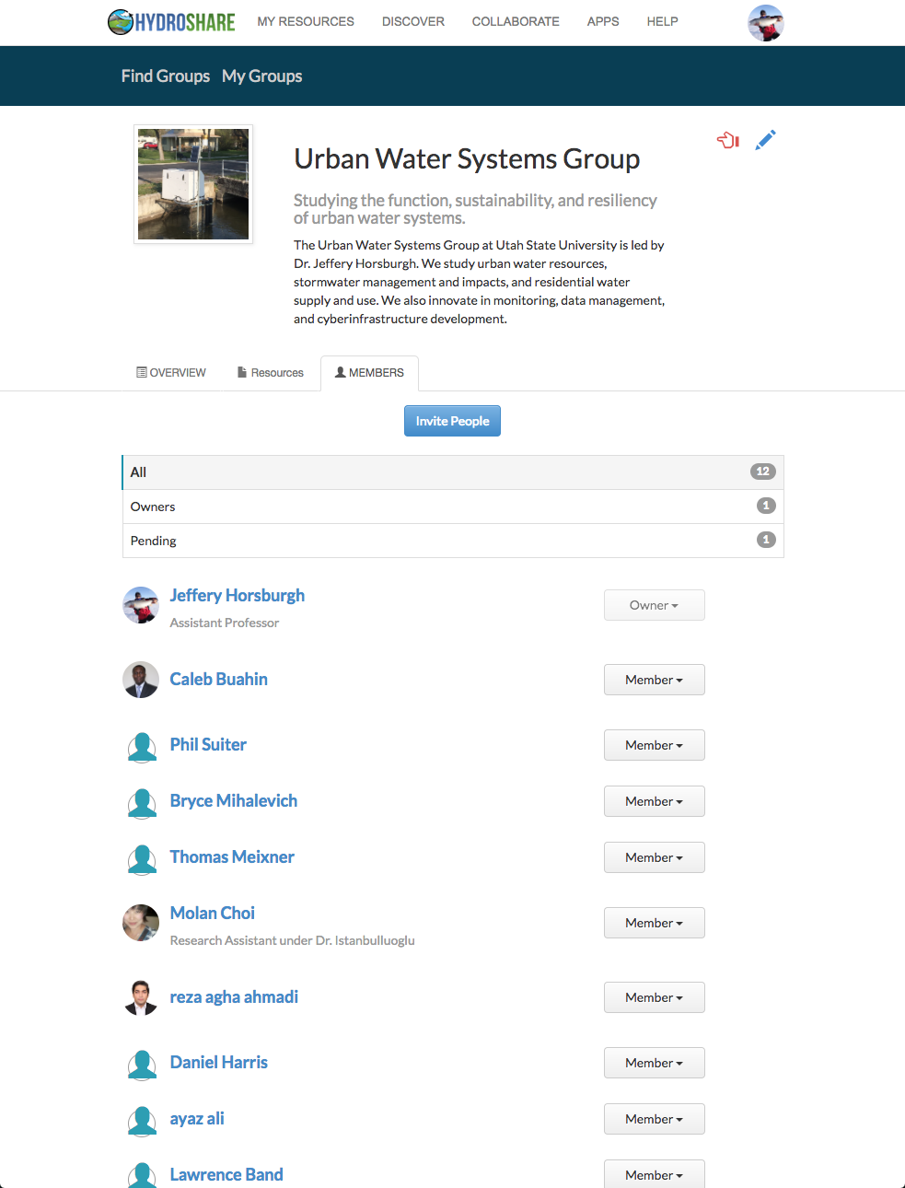
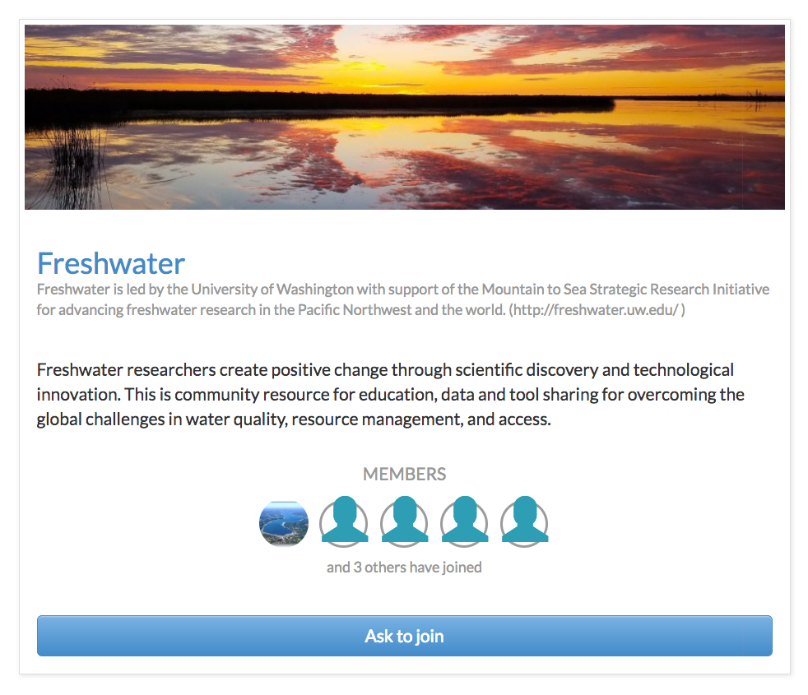
Collaborative Groups
Create a collaborative group
Share resources with a group
Manage group membership
Find groups you are interested in
Request group membership

Slide 14
Collaborative Capabilities of HydroShare
Dataset/model creation as a “Resource” – the Social Objects!
Resource sharing (public and private)
Collaborative groups and sharing within groups
Resource versioning
Formal Publication of resources and assignment of DOIs
Rating and commenting on resources

Slide 15
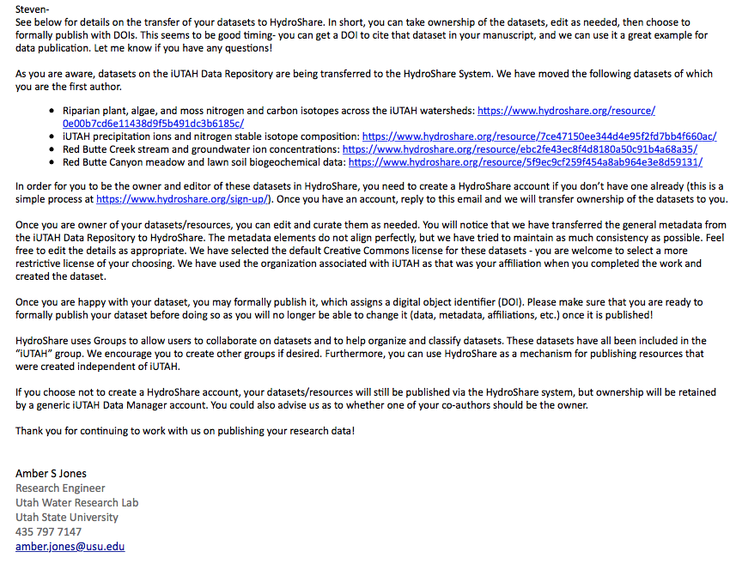
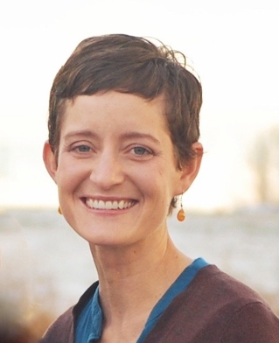
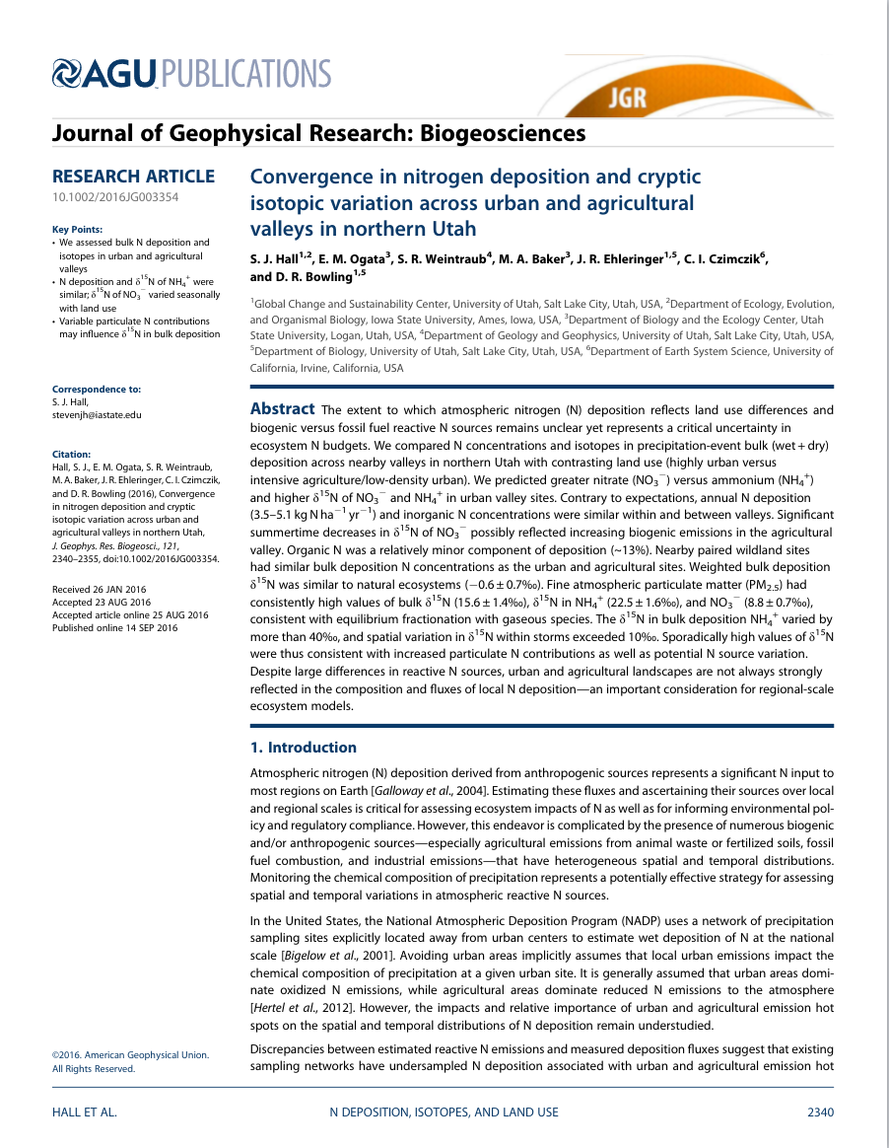
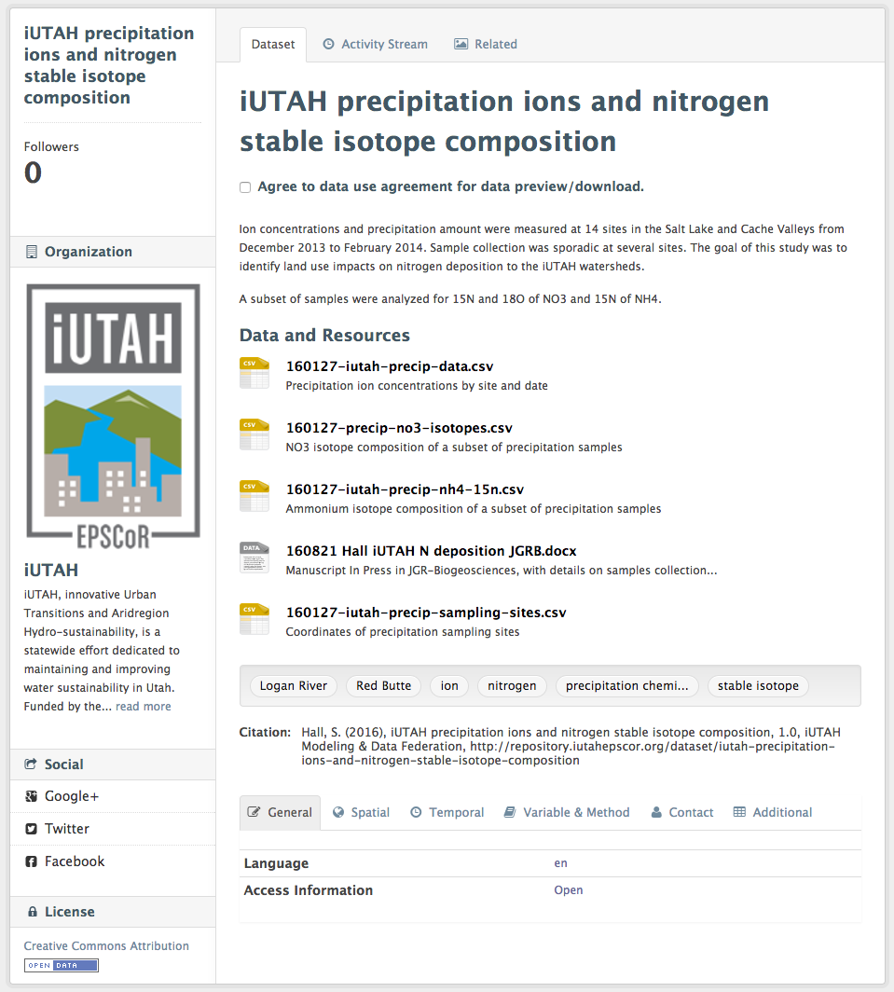
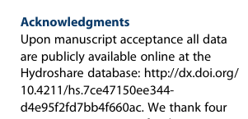
The Steven Hall Story
Amber sent Steven instructions for taking ownership of his data in HydroShare
Steven verified his data and metadata were correct but kept the data private
Amber and Abby moved Steven’s Datasets to HydroShare
Steven published his data and received a DOI
Steven published his paper and cited published data in HydroShare
Steven submitted his paper for publication and responded to reviews
Steven deposited his data in the iUTAH Repository

Slide 16
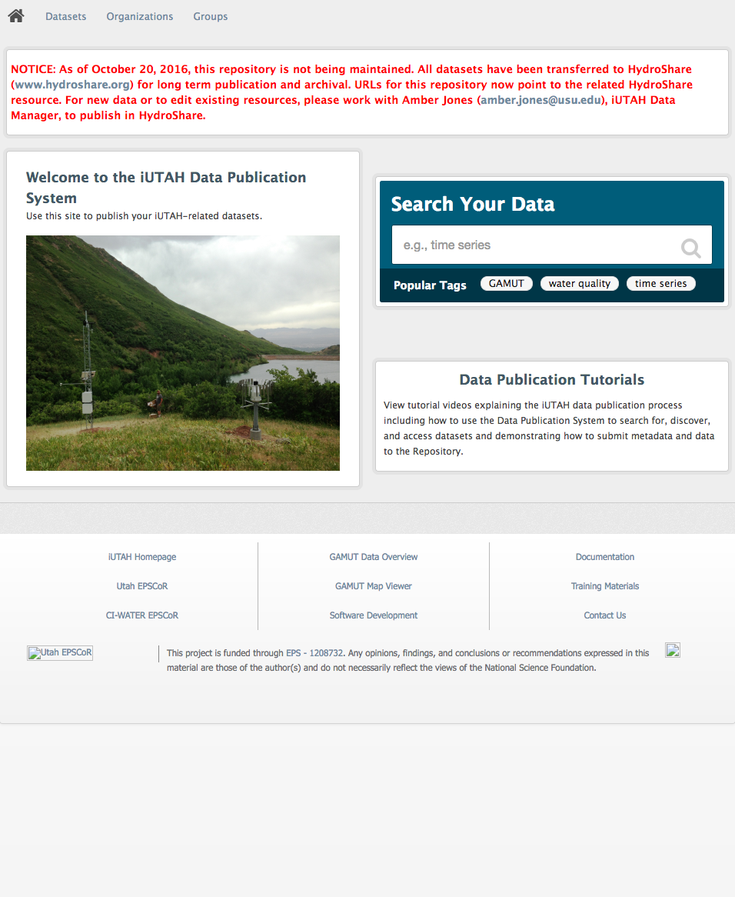
Moving iUTAH Repository to HydroShare: Next Steps
Your data collection plans are still valid and your datasets still need to be published
Modelers – there is now a way for you to share your results!
If you had a dataset in http://repository.iutahepscor.org - we have moved it to HydroShare for you
You will receive an email from the iUTAH Data Manager with specific instructions for:
Creating an account in HydroShare
Asserting ownership of your resource
Publishing your dataset
If you have not submitted your data yet
Work directly with Amber to get it set up in HydroShare
We’ll be making some instructional videos

Slide 17
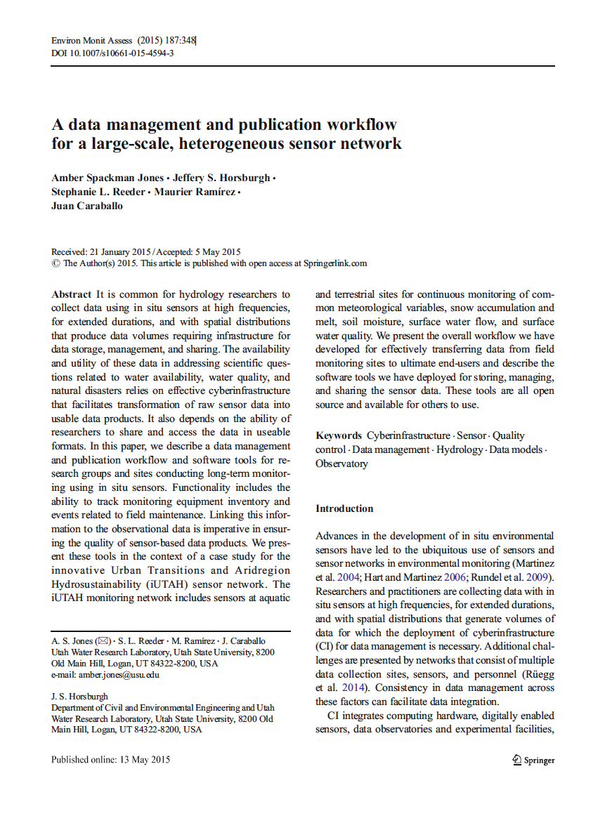
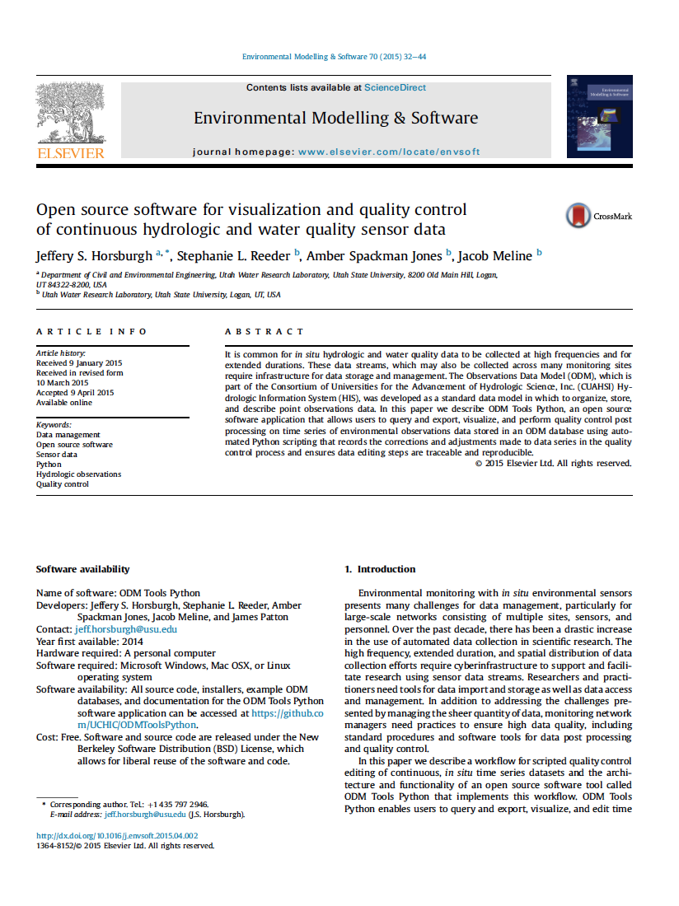
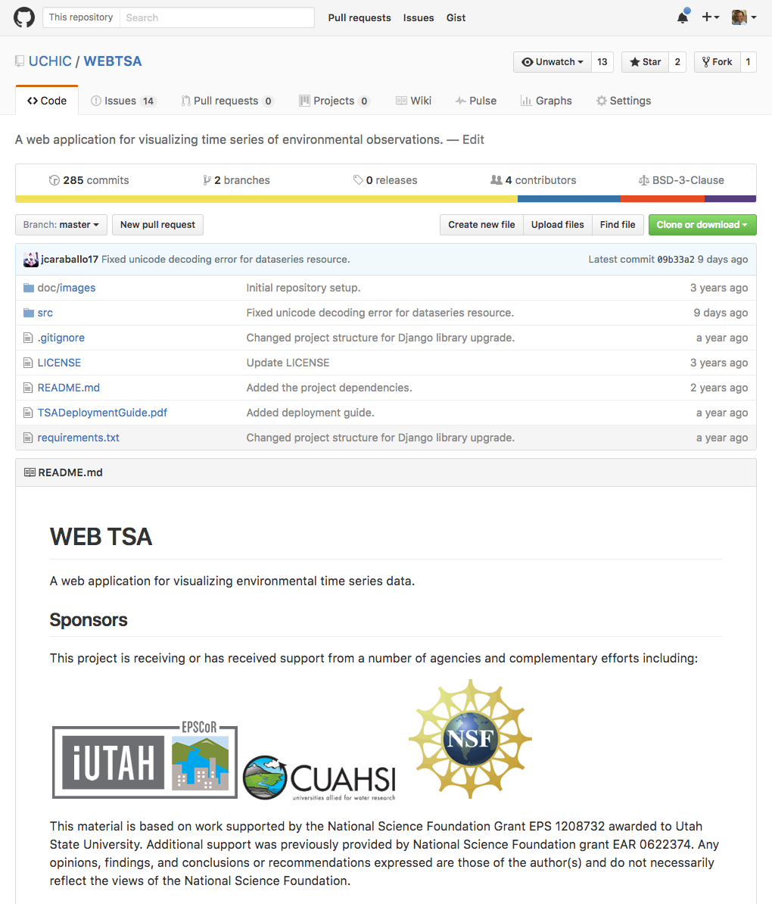
Reusability of CI Components
We have worked hard to ensure that what we have developed for iUTAH is reusable
All of our source code is in open source code repositories in GitHub
We have published papers about many of the things we have done

Slide 18
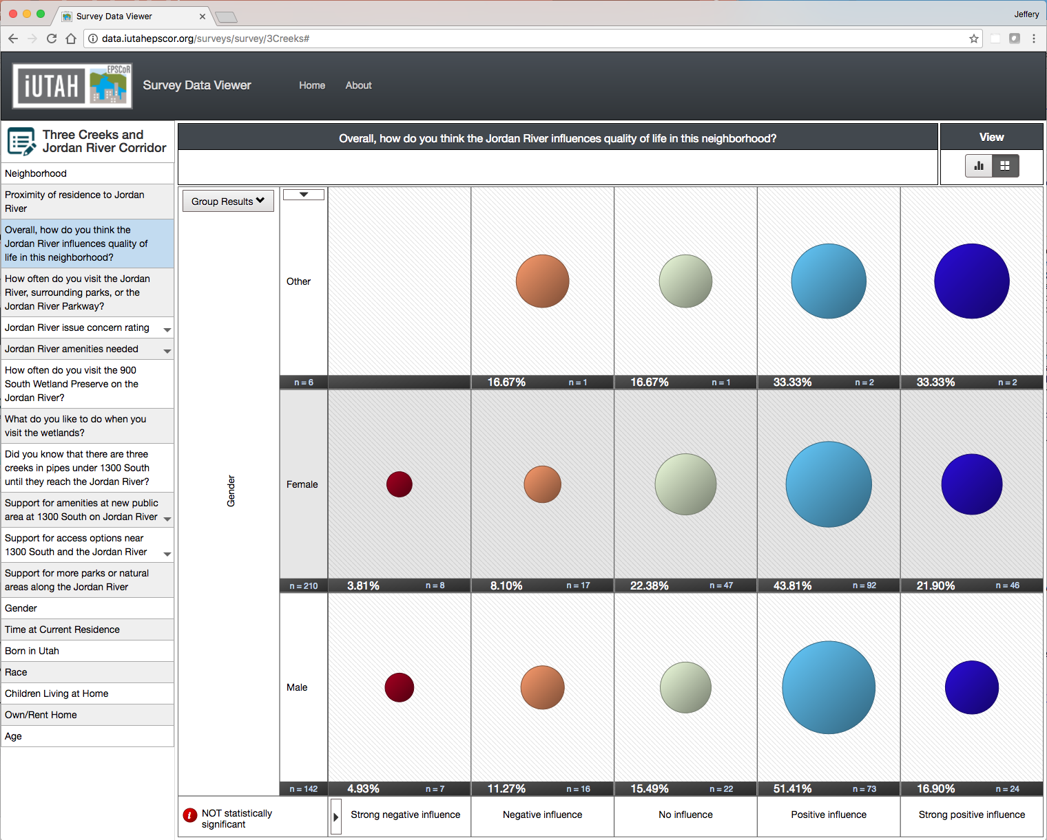
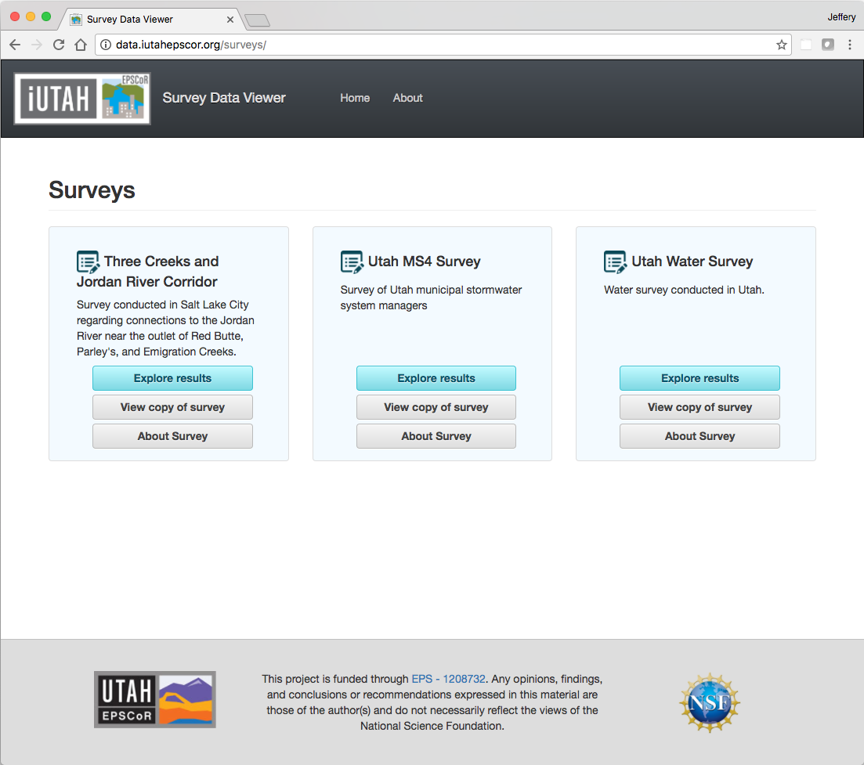
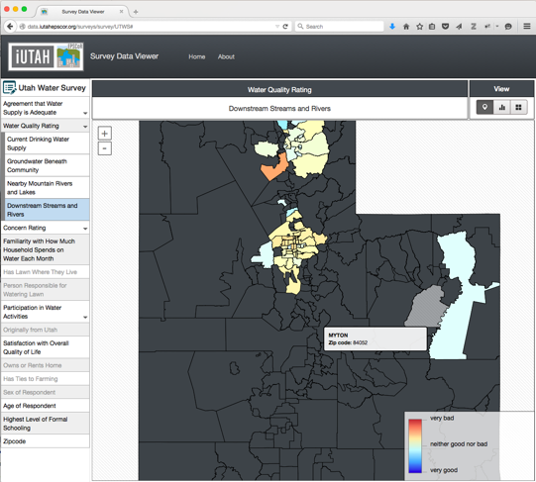
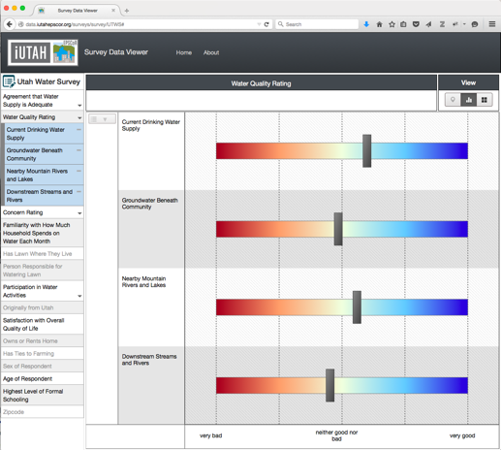
Example 1: iUTAH Survey Data Viewer
Jones, A. S., Horsburgh, J. S., Jackson-Smith, D., Ramirez, M., Flint, C. G., Caraballo, J. (2016). A web-based, interactive visualization tool for social environmental survey data, Environmental Modelling & Software, 84, 412-426,http://dx.doi.org/10.1016/j.envsoft.2016.07.013

Slide 19
Example 2: iUTAH Virtual Machines
We now have 2 virtualization clusters
6 Virtualization Hosts
Dual quad core processors
72 GB of RAM
~50(ish) TB of Shared Storage
Hosting our production servers
Also useful for “medium-scale” computation
Ability to stand up any operating system

Slide 20
Opportunities
Better tools for working with heterogeneous data
Software/apps/systems that enhance our “personal cyberinfrastructure”
Freedom to move data and models from one platform/app/software to another
Training a next generation of “cyber-savvy” engineers and scientists
An enhanced, cloud connected, and social scientific workflow
Notes:
We have some opportunities:
We still need better tools
But beyond better tools, we need to integrate them into our personal cyberinfrastructure, which means that we need to know how to use them, and we need to teach our students

