Slide 1
Simple and Effective Methods for Managing and Sharing Scientific Data
Jeffery S. Horsburgh
Civil and Environmental Engineering

Slide 2
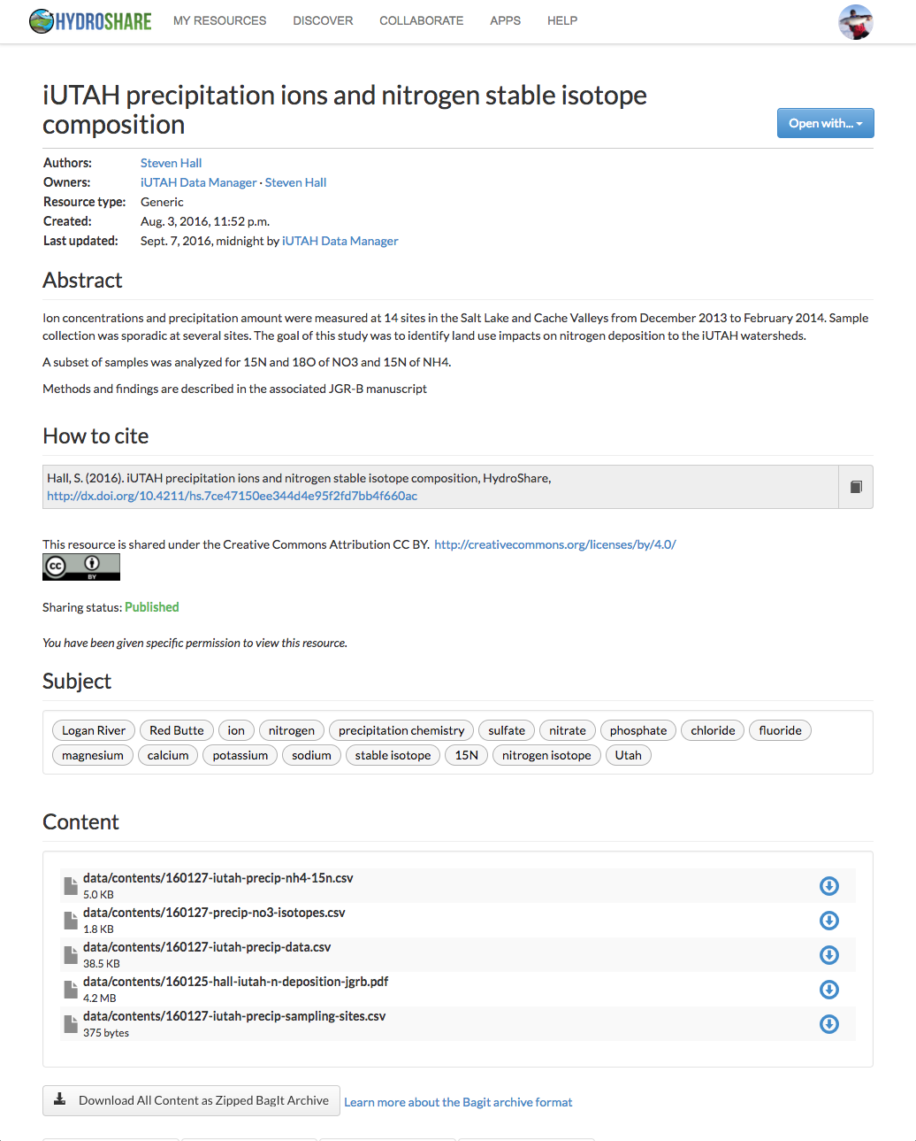
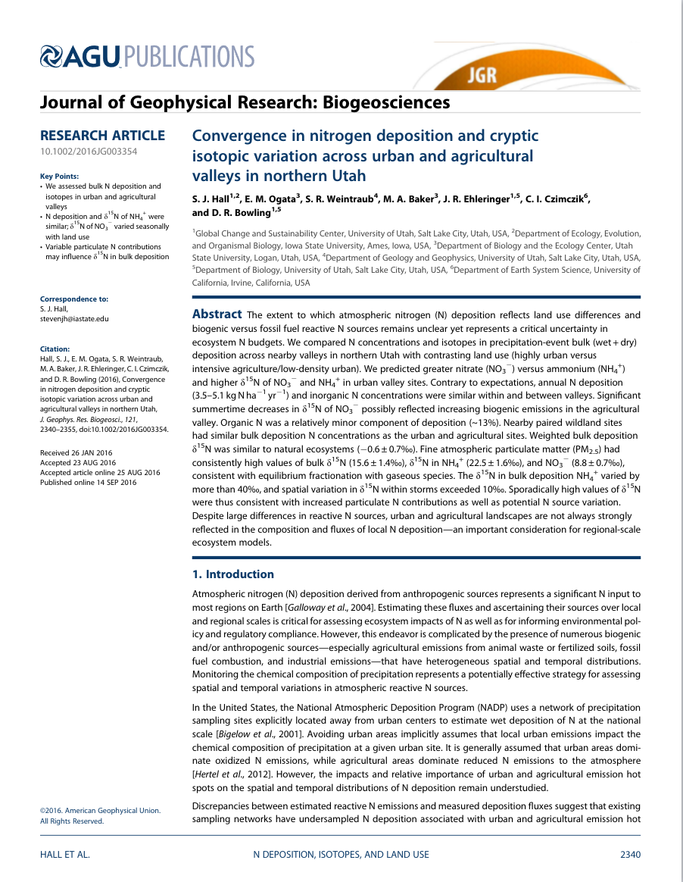
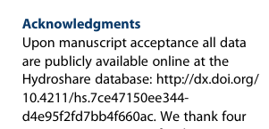
The Steven Hall Story
Steven verified his data and metadata were correct but kept the data private
Steven submitted his paper for publication and responded to reviews
With a little help, Steven deposited his dataset in the online HydroShare repository
Steven published his data in HydroShare and received a DOI
Steven collected his data in the field and transformed into a sharable format
Steven published his paper and cited published data in HydroShare

Slide 3
Data Management 101
Simple guidelines to improve data management
Benefits
Improved data organization – facilitates analysis
Improved reproducibility
Improved capacity for data re-use
Borer, E.T., E.W. Seabloom, M.B. Jones, and M. Schildhauer (2009). Some simple guidelines for effective data management, ESA Bulletin, 90(2):205-214, http://dx.doi.org/10.1890/0012-9623-90.2.205

Slide 4
1. Don’t Mess with the Raw Data
Always store uncorrected data with all of its “bumps and warts”
Do not make any corrections to this
You could change something that was actually correct
You could make mistakes while correcting other mistakes
Script QA/QC procedures and write results to a new file/copy of the data

Slide 5
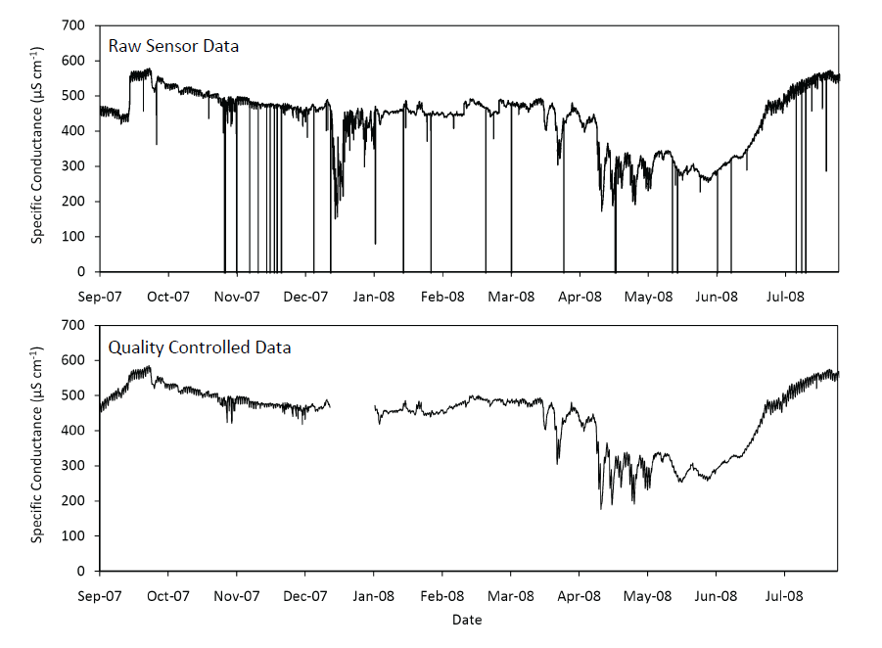
An Example

Slide 6
An Example
Removal of a calibration shift

Slide 7
An Example
Removal of anomalous, out of range values

Slide 8
An Example
Removal of “bad data” – sensor malfunction

Slide 9
2. Use Descriptive File Names
Use only plain ASCII characters
Brief, but descriptive of content
Generally – avoid spaces in file names
Include a “readme” file when using many files in a directory

Slide 10
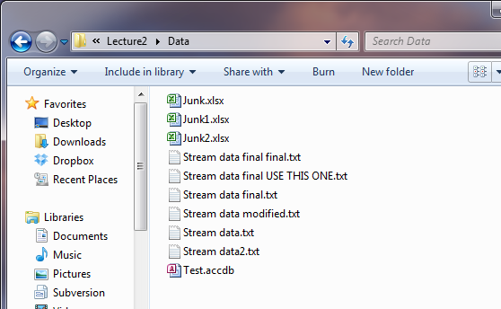
This might not be the best system…
How could we make this better?

Slide 11
3. Use Descriptive Headers in Files and Tables
Standard convention for many software applications
Excel understands that the first line in a file is the header line
Subsequent lines are interpreted as data
Encapsulate data and descriptive metadata together

Slide 12
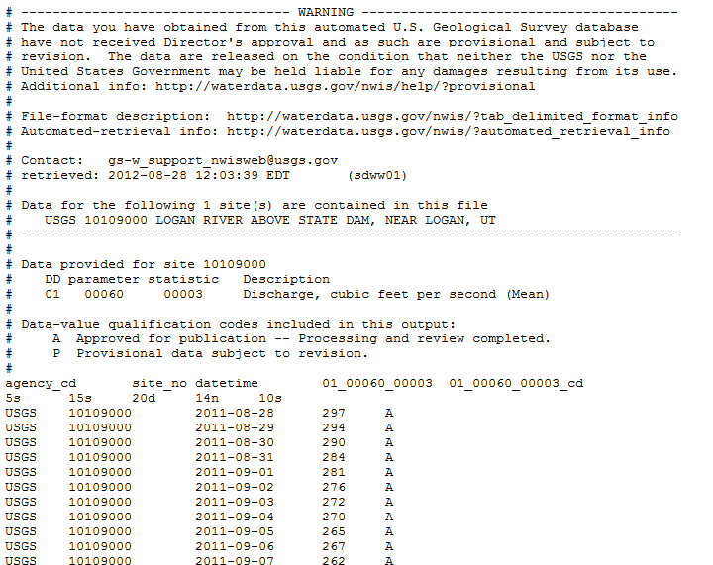
Streamflow Data from USGS

Slide 13
4. Do Not Mix Data Types in Table Columns
Numeric, strings, date/time, boolean
Different software packages will handle mixed data types inconsistently
Can be more difficult to detect errors in the data
Can cause erroneous results

Slide 14
Data Collection Includes Data Entry
Recording observations and notes in a field notebook
Transcribing field notebooks and sheets into digital forms
Automated processing of sensor data streams into a database

Slide 15
Strategies for Data Entry
When you create data entry tools
Use pre-designed forms or templates
Electronic or paper
Use lists of valid values rather than free form text entry
Use validation checks (e.g., range checks)
Example: pH must be between 0 and 14. If it’s not – there is a problem!

Slide 16
5. Archive Data in Non-Proprietary Data Formats
Microsoft Excel is widely available and used now, but what about in 10 years? 20 years?
How many other software programs can open your data?
Will your data disappear if the file format/software become obsolete?

Slide 17
What format to use?
Store it in a file format that can be used by many different software programs
Text files – e.g., comma separated values (CSV) for tabular data
Use a standard file format accepted by your scientific community
Consider both format and syntax (e.g., the structure within the file)

Slide 18
For Tabular Data
Use standard table formats
Each row should have a single observation
Each column should represent a single variable
Every cell should have a single value
There should be only one column for each type of information
Use standard formats within cells
Be consistent
Avoid special characters
Avoid using your column delimiter in the data
Use standard date formats (e.g., YYYY-MM-DD)
Use null and NoData values correctly to represent empty or missing data values
White, E.P, Baldridge, E., Brym, Z.T., Locey, K.J., McGlinn, D.J., and S.R. Supp (2013). Nine simple ways to make it easier to (re)use your data, PeerJ PrePrints, http://dx.doi.org/10.7287/peerj.preprints.7v2

Slide 19
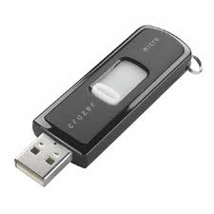
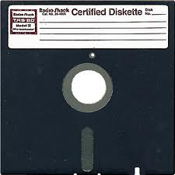
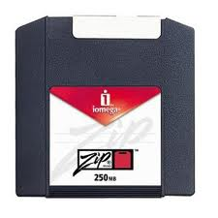
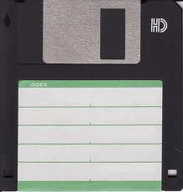
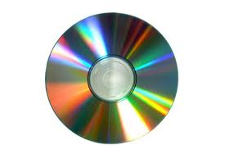
6. Consider Media
CDs?
DVDs?
External hard drives?
Don’t strand your data!!!
2000
1995
1976
1986
1994
1985

Slide 20
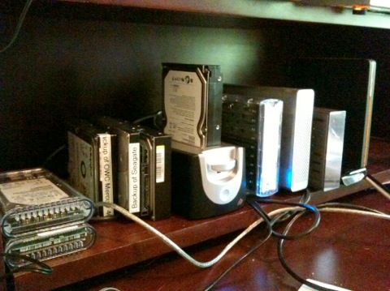
Preservation/Backup Media
How are you preserving your data now?
Does Your Office Look Like This?
What are the potential problems?
What are some potential solutions?

Slide 21
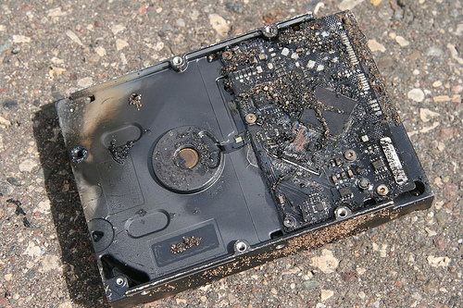
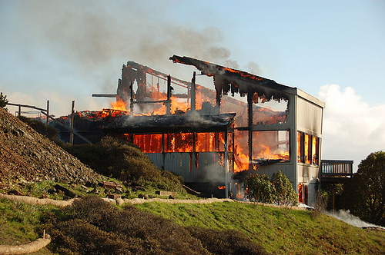
Data Loss
Natural disaster
Facilities infrastructure failure
Storage failure
Server hardware/software failure
Application software failure
External dependencies
Format obsolescence
Legal encumbrance
Human error
Malicious attack by human or automated agents
Loss of staffing competencies
Loss of institutional commitment
Loss of financial stability
Changes in user expectations and requirements
CC image by Sharyn Morrow on Flickr
CC image by momboleum on Flickr
Slide courtesy DataONE.

Slide 22
Backups
Have a plan
Stick to your plan
Test your plan – preferably under non-failure conditions!
Don’t trust/rely on hardware redundancy

Slide 23
Preserve
What will be preserved?
Where will it be preserved?
Back ups?
Version control?
Policies for access, sharing, and reuse
Obligations for sharing
Security and access control
Sensitive data
How long?
Intellectual property issues
Responsible parties

Slide 24
To the Cloud!
Convenience
Accessibility anywhere
Cross platform
Enhanced sharing
Low cost
But…
Privacy???????
Delay (slow or non-existent internet)
Storage, but not much else
File formats and semantics still matter
Disclaimer: Use of these logos is not authorized by, sponsored by, or associated with Microsoft, Google, or Dropbox.

Slide 25
USU Box Service http://box.usu.edu
Upload and share files
Sync to your computer
Collaborate using shared documents
Automatic revision control
Faculty and staff get UNLIMITED GB, students get 50 GB (which you can keep when you leave USU)
Secure for FERPA data
More info: http://it.usu.edu/box/

Slide 26
New Opportunities for Data Sharing and Preservation
Emerging data archives/repositories
Functionality for collaboration and archival/preservation
Still very much discipline specific
Impact is higher if you choose carefully!
CUAHSI
HIS
Sharing hydrologic data

Slide 27
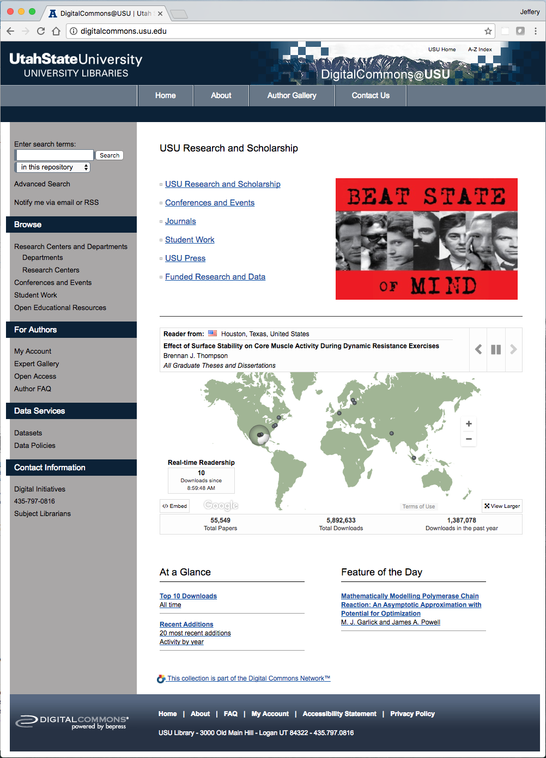
USU’s Digital Commons
USU Libraries
Becky Thoms – Digital Initiatives and Digital Commons

Slide 28
7. Automate Analyses
Code creates reproducible results
Code is a record of the steps involved in processing and analyzing data
Code can be shared
Code can be re-executed at any time

Slide 29
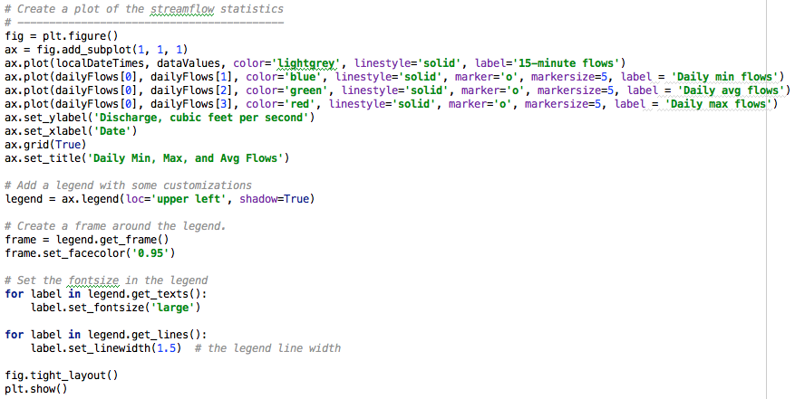
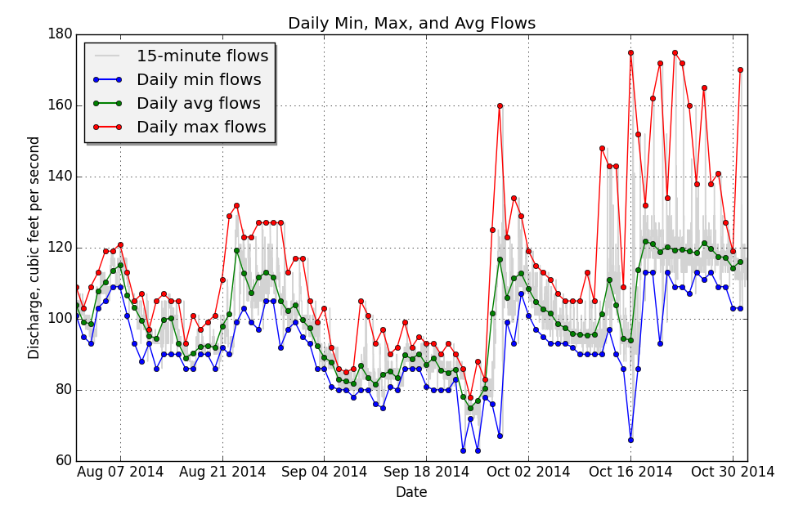
Reproducible Visualization in Python

Slide 30
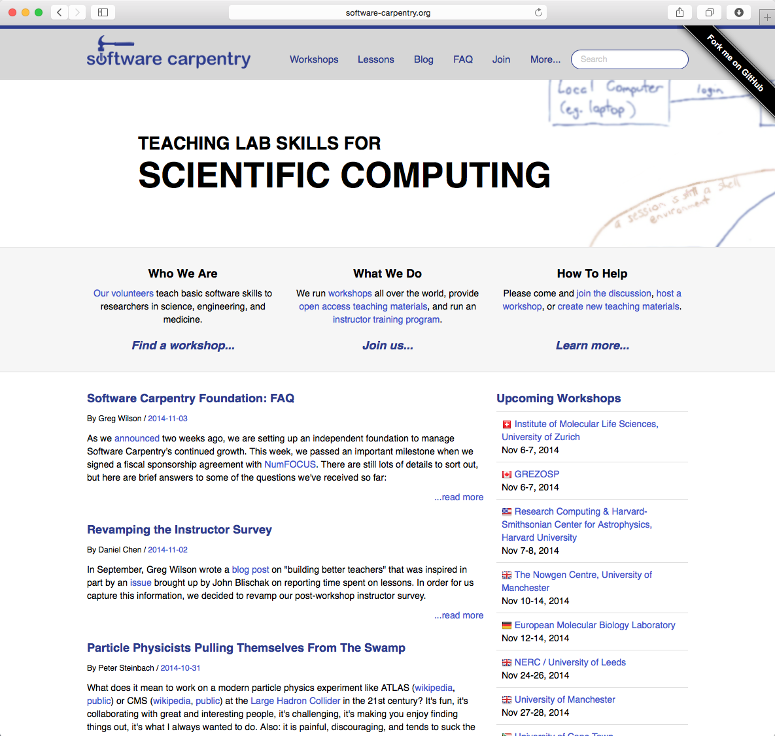
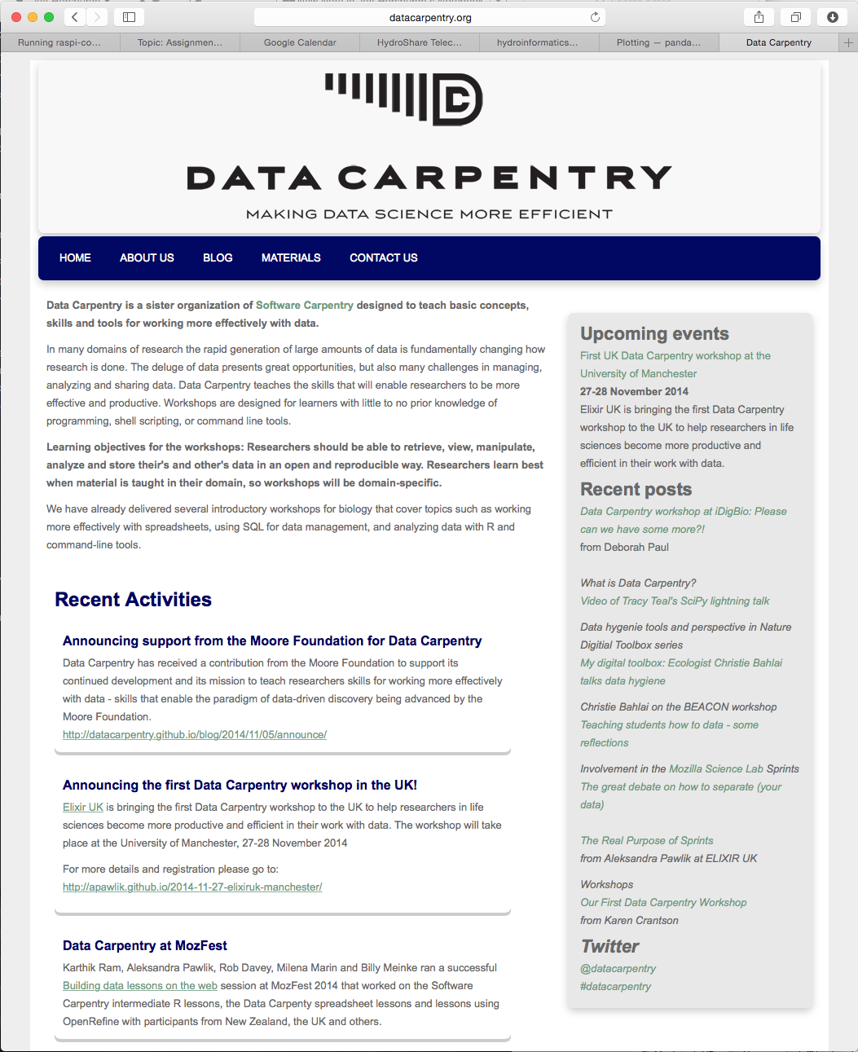
Scripting Environments and Resources
Python
R
Matlab

Slide 31
Analyze
Spreadsheets
Workflows
Statistical computing
Scripting/coding environments
Database management systems

Slide 32
8. Maintain Metadata
Borer et al.: “Do not underestimate your ability to forget details about a study!”
When did the tree that was stuck in my stream cross section get removed????
You may not analyze your data until years down the road
Exact details of methods, names, files, etc. will become fuzzy

Slide 33
What is Metadata?
Metadata is “Information about Data”
WHO created the data?
WHAT is the content of the data?
WHEN were the data created?
WHERE is it geographically?
WHY were the data developed?
HOW were the data developed?
Content, quality, condition, and other characteristics
Notes:
Greek --- with, about, between, or among; typically used as prefix to mean “one level of description higher”

Slide 34
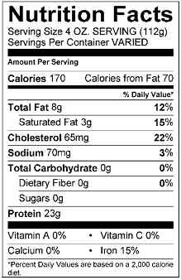
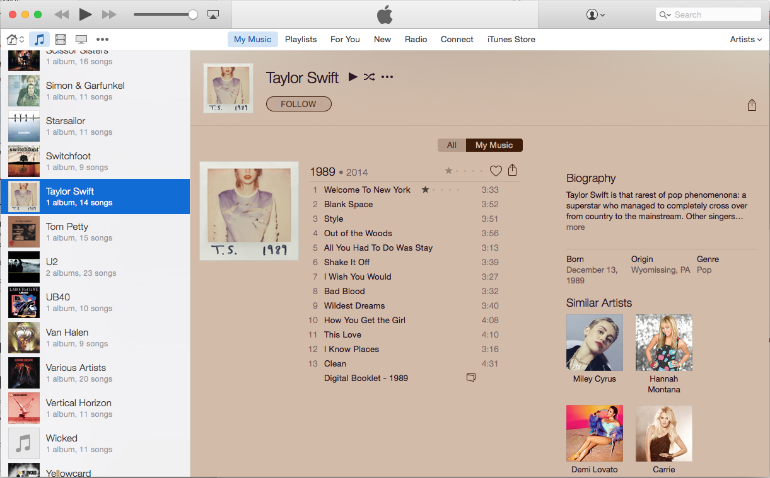
Metadata is All Around
CC image by USDAgov on Flickr
Details about the songs in your MP3 library.
Details about the cereal you ate for breakfast this morning.

Slide 35
Metadata Content and Format
What metadata are needed?
Details that make data meaningful
How will metadata be created?
Lab notebooks?
Automatically generated by a sensor or instrument?
What format will be used for the metadata?
Standards may be chosen by community or dictated by an agency

Slide 36
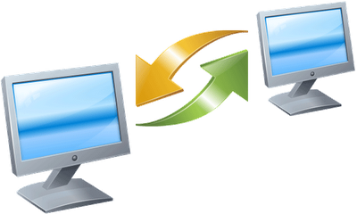
Sharing Data: The Golden Rule
When you provide data to someone else, what types of information would you want to include with the data?
When you receive a dataset from an external source, what types of details do you want to know about the data?

Slide 37
Sharing Data
Providing data:
Why were the data created?
What limitations do the data have?
What does the data mean?
How should the data be cited if it is re-used in a new study?
Receiving data:
What are the data gaps?
What processes were used for creating the data?
Are there any fees associated with the data?
In what scale were the data created?
What do the values in the tables mean?
What software do I need in order to read the data?
What projection are the data in?
Can I give these data to someone else?

Slide 38
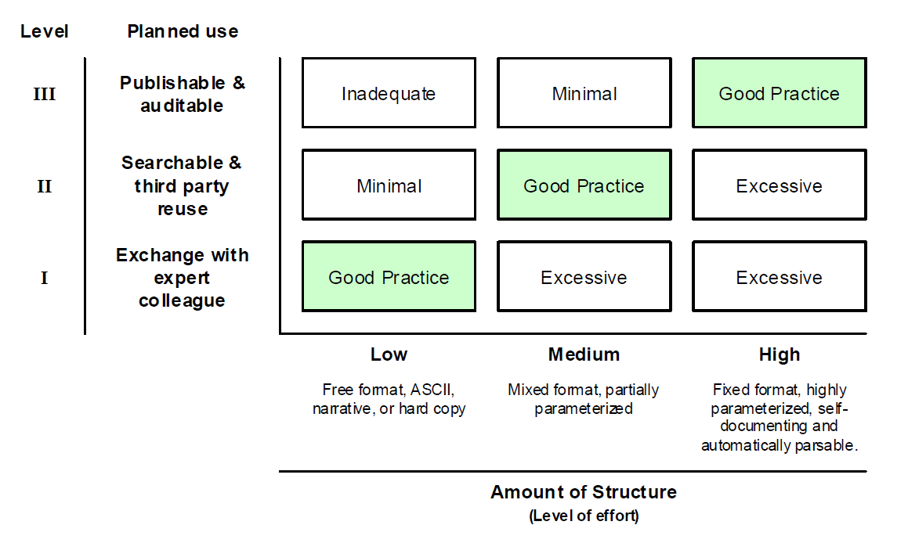
Necessary Meta/data Structure
The degree of metadata format and structure necessary for different levels of projected secondary data utilization. (adapted from Michener et al., 1997).

Slide 39
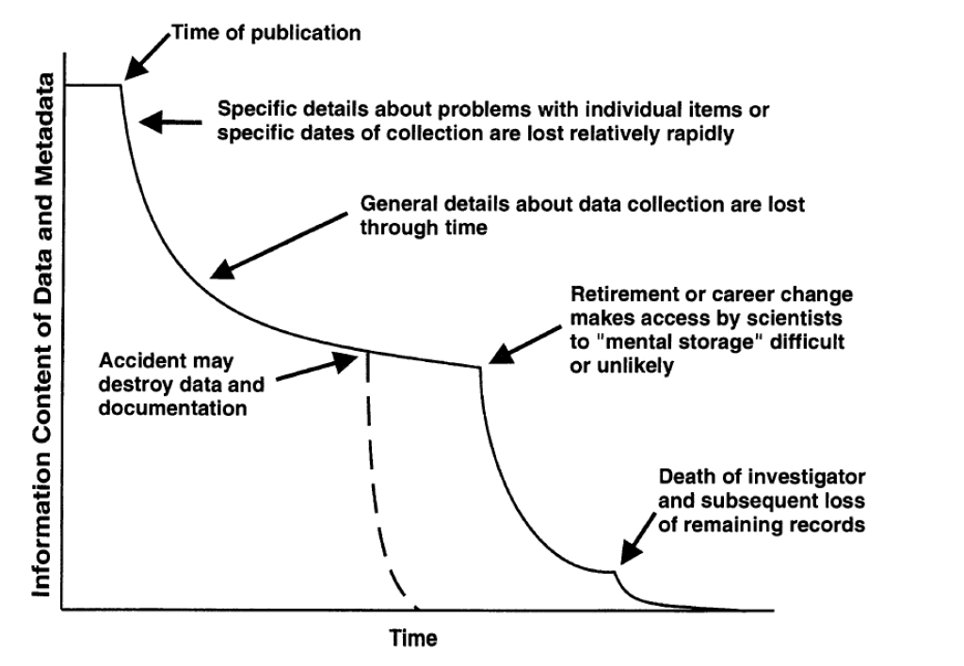
Information Entropy
Example of the normal degradation in information content associated with data and metadata over time (“information entropy”). (Figure taken from Michener, 2006).

Slide 40
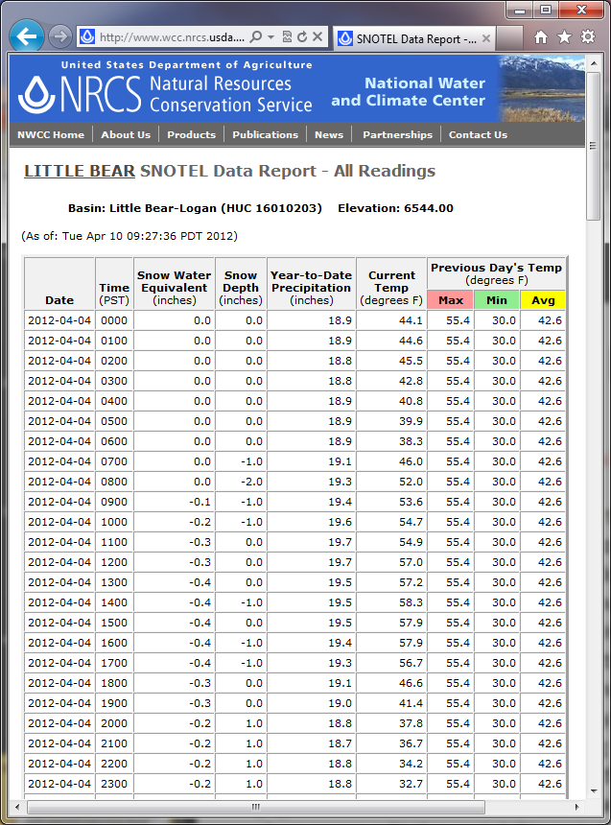
Data Use Case – NRCS SNOTEL
Notes:
Jeff – relay story…

Slide 41
Data Use Case – NRCS SNOTEL
“I am trying to obtain a record of hourly precipitation. Your sites have data for precipitation accumulation, but I cannot use that to back calculate precipitation for each hour because there are frequently losses in precipitation. For example, the accumulated precipitation might go from 7.5 to 7.4 to 7.3 and then increase again to 7.5. Can you offer any advice on obtaining the incremental rather than accumulated precipitation?”
Notes:
Jeff – relay story…

Slide 42
An Interesting Response from NRCS
“The short answer to your question is: don't use it. its all crap. The long answer is: the sensor used to detect precipitation and snow water equivalent is a pressure transducer modified from reading pressures of up to 2000 psi down to reading pressures of 0 to 5 psi and does not have the necessary stability in either accuracy or precision to measure hourly values of 0.1 inches especially within the environment of its setting with varying temperatures, barometric pressure, expansion and contraction of the precip gage itself, frost heave and the list goes on. These data on an hourly incremental basis are not stable. On a daily basis measured from midnight to midnight are sufficiently accurate for our purposes of water supply forecasting and hydrologic modeling - but even then can be plus/minus 0.5 inches at some of the more variable sites. As the time increment increases, the accuracy of the gage increases as well. daily values are decent, weekly more so and monthly pretty close as we edit the variability out. Hourly are crap.
Bottom line - don't use hourly pcp data for anything other than amusement or instructional value of knowing/teaching what your data are, how they are collected and what they represent.”
Notes:
Jeff – relay story…

Slide 43
Summary
Don’t mess with the raw data
Use descriptive file names
Use descriptive file headers
Do not mix data types in table columns
Archive data in non-proprietary data formats
Consider media
Automate analyses
Maintain metadata

Slide 44
References
Borer, E.T., E.W. Seabloom, M.B. Jones, and M. Schildhauer (2009). Some simple guidelines for effective data management, ESA Bulletin, 90(2):205-214, http://dx.doi.org/10.1890/0012-9623-90.2.205
Michener, W.K. (2006). Meta-information concepts for ecological data management, Ecological Informatics, 1(1), 3-7, http://dx.doi.org/10.1016/j.ecoinf.2005.08.004.
Michener, W.K., J.W. Brunt, J.J. Helly, T.B. Kirchner, S.G. Stafford (1997). Nongeospatial metadata for the ecological sciences, Ecological Applications, 7(1), 330-342, http://dx.doi.org/10.1890/1051-0761(1997)007[0330:NMFTES]2.0.CO;2
White, E.P, Baldridge, E., Brym, Z.T., Locey, K.J., McGlinn, D.J., and S.R. Supp (2013). Nine simple ways to make it easier to (re)use your data, PeerJ PrePrints, http://dx.doi.org/10.7287/peerj.preprints.7v2

