Slide 1
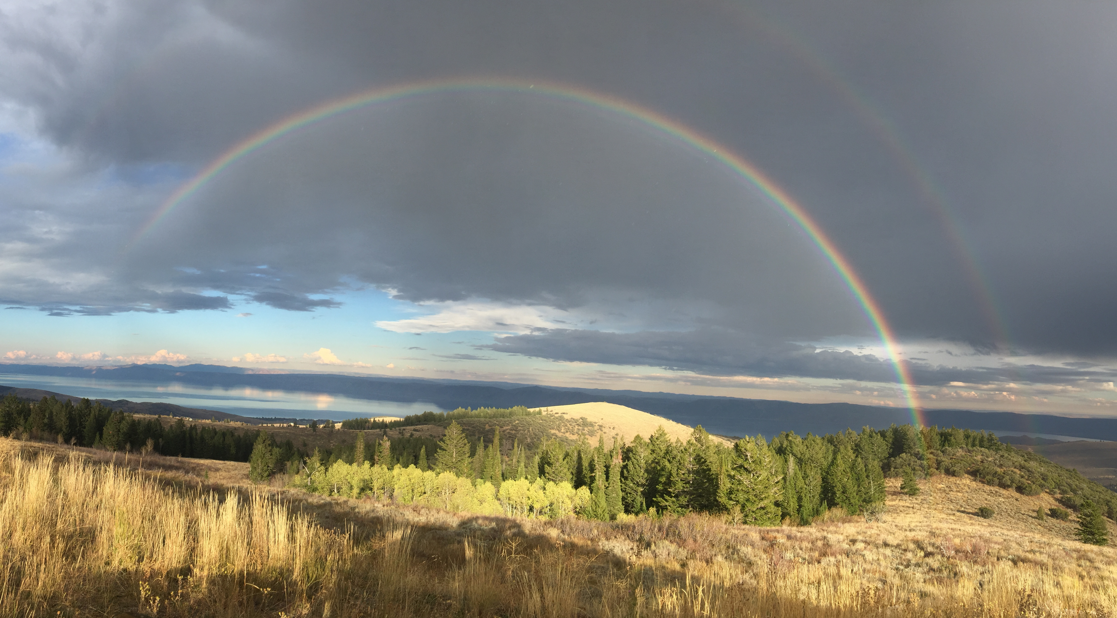
Cyberinfrastructure to Support Large Scale, Collaborative Water Research in Utah: Critical Outcomes from the iUTAH Project
Jeffery S. Horsburgh
Amber Spackman Jones
And the iUTAH Cyberinfrastructure Team

Slide 2
Strategic Plan Objectives
Increase capacity for data collection, organization, management, sharing, and synthesis to higher-level products
Increase capacity for integration of data and models
iUTAH Mission:
Enhancing Utah’s research capacity and competitiveness in the science of interactions between society and the biophysical environment

Slide 3
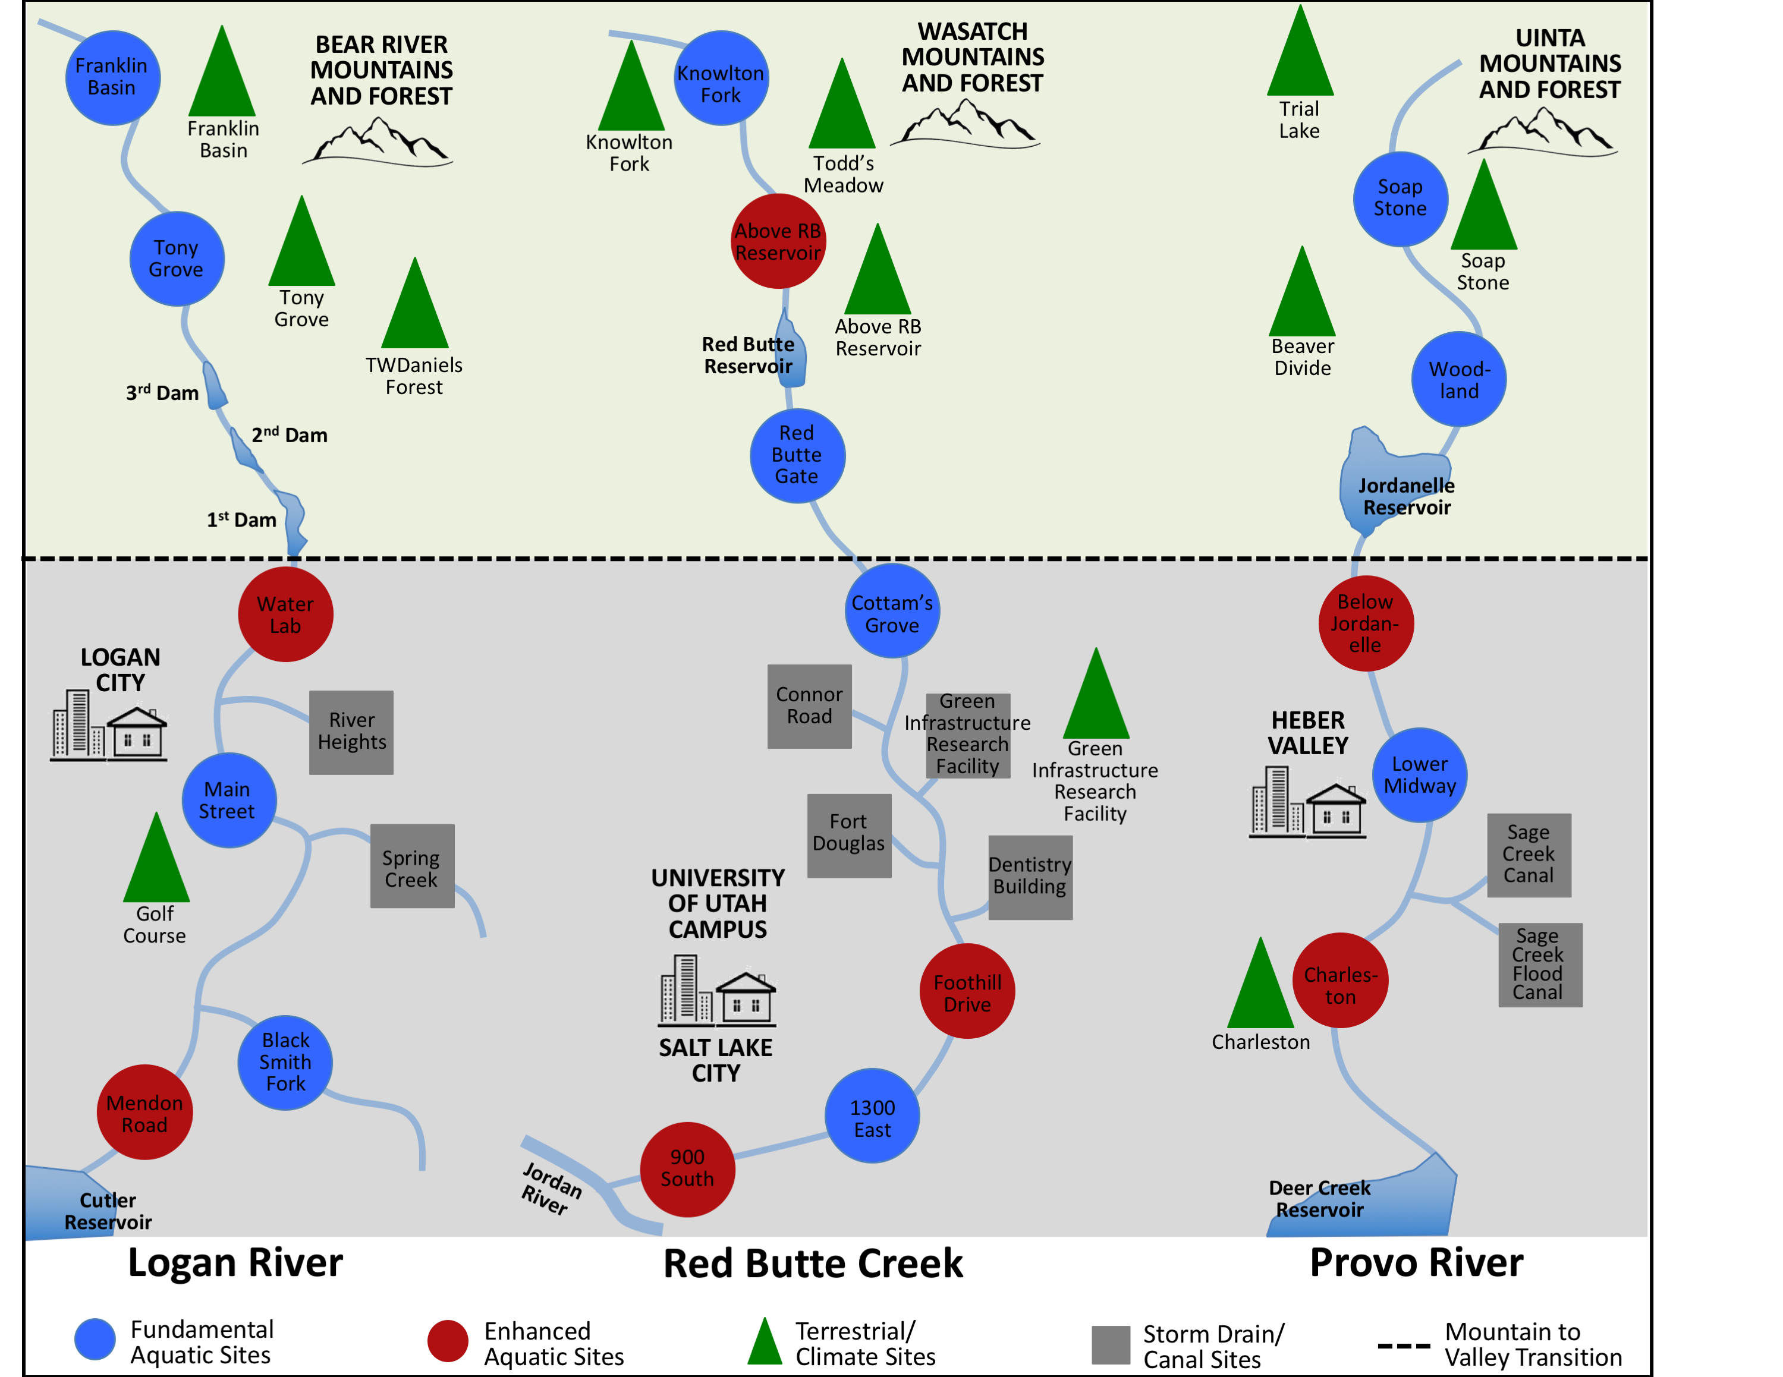
GAMUT: Gradients Along Mountain to Urban Transitions
40 sites
2000 data series
200 million+ values over 4 years

Slide 4
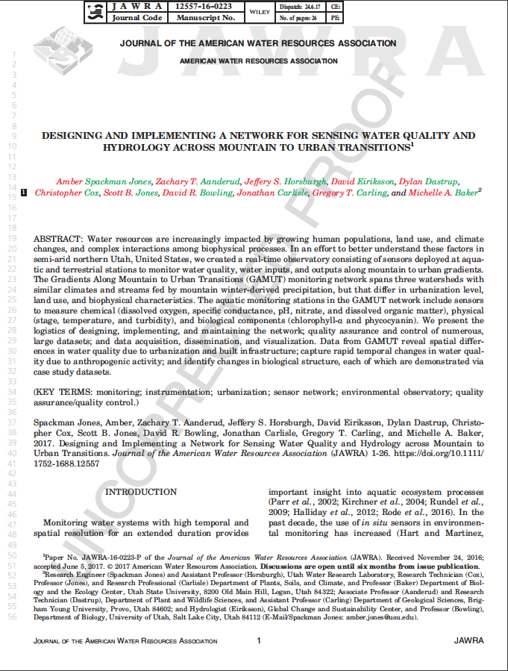
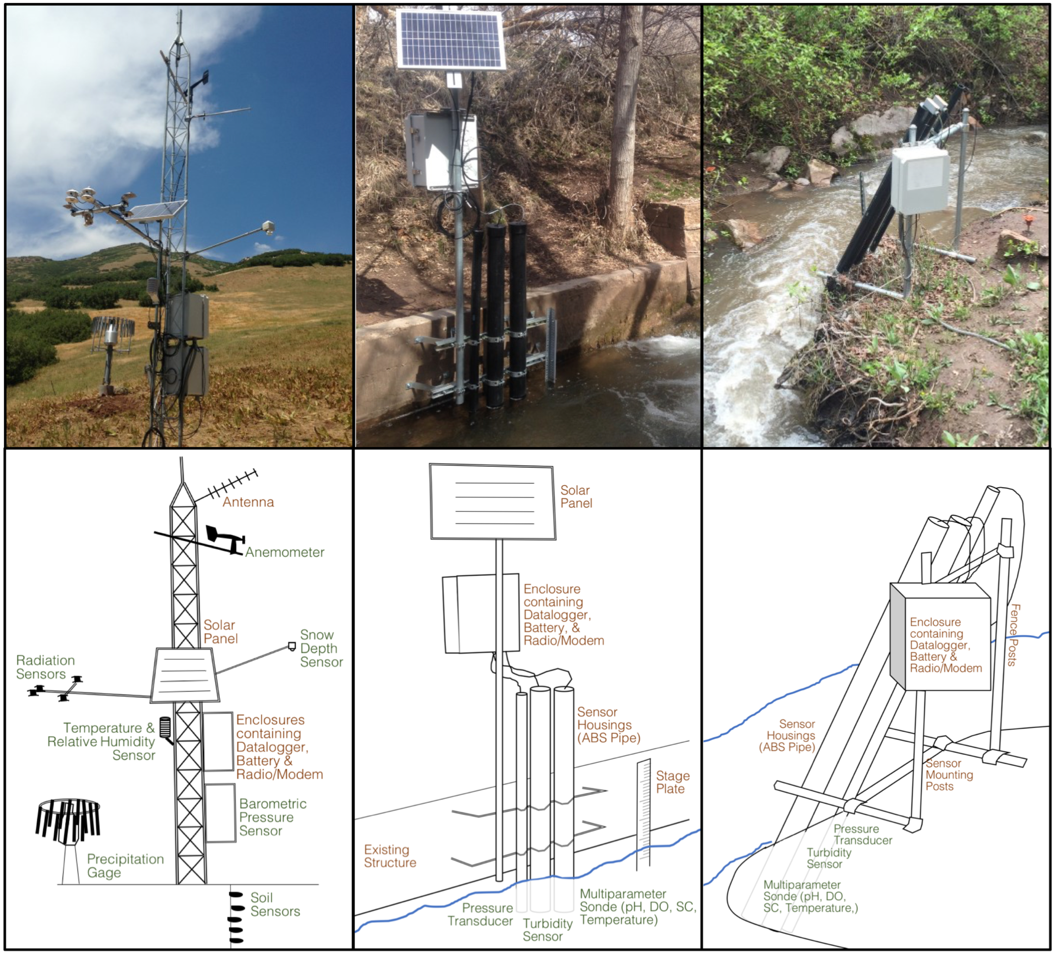
GAMUT: Gradients Along Mountain to Urban Transitions
Standardized site design and programming
Standardized sensor suite
Observed variables:
Streamflow
Temperature
pH
Specific Conductance
Dissolved Oxygen
Turbidity
fDOM
Chlorophyll
Phycocyanin
Nitrate
Hired a field technician for each watershed
Notes:
Basic vs. Enhanced wq sites

Slide 5
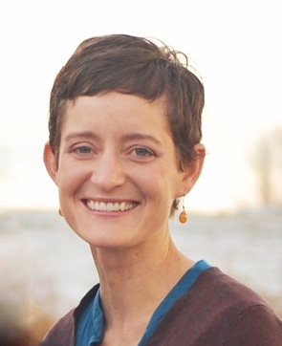
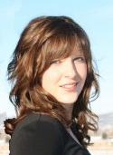
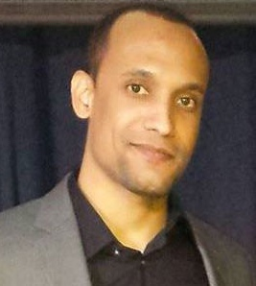
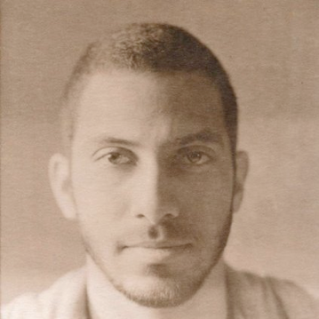
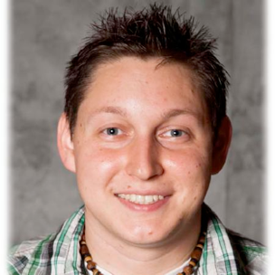
Formalized GAMUT Data Workflow
CUAHSI
HIS
Sharing hydrologic data
Building on the CUAHSI Hydrologic Information System
Jones, A.S., J. S. Horsburgh, S.L. Reeder, M. Ramirez, J. Caraballo (2015). A data management and publication workflow for a large-scale, heterogeneous sensor network, Environmental Monitoring and Assessment, 187:348, http://dx.doi.org/10.1007/s10661-015-4594-3.

Slide 6
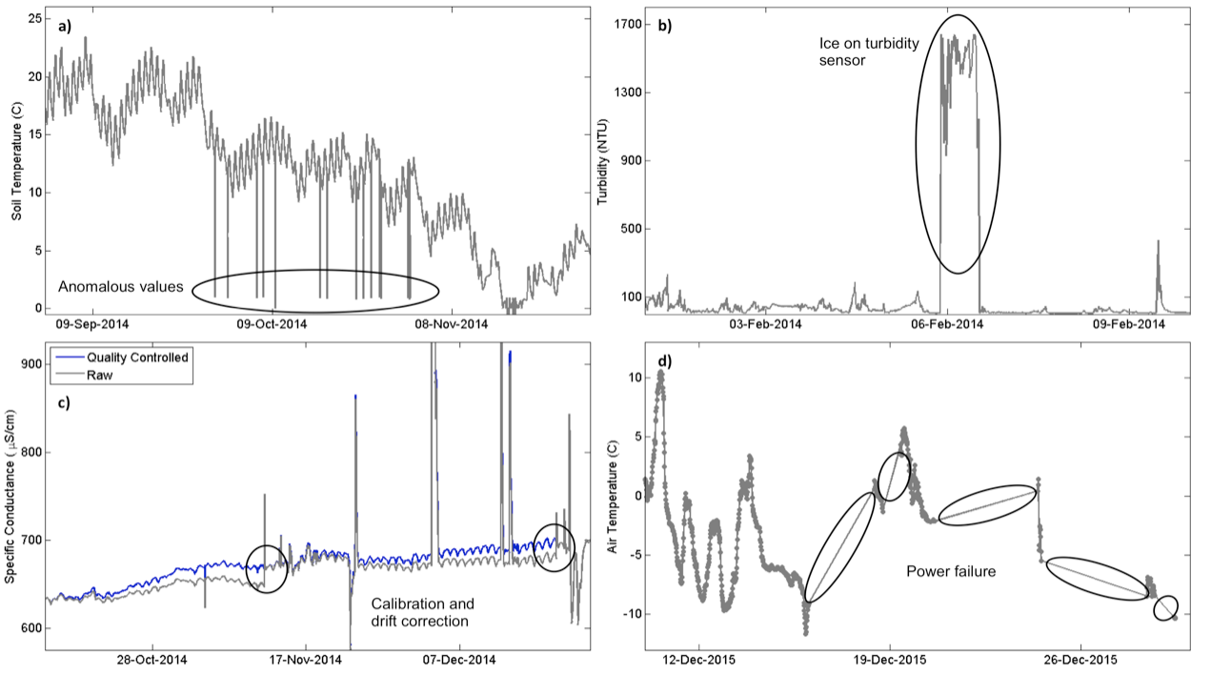
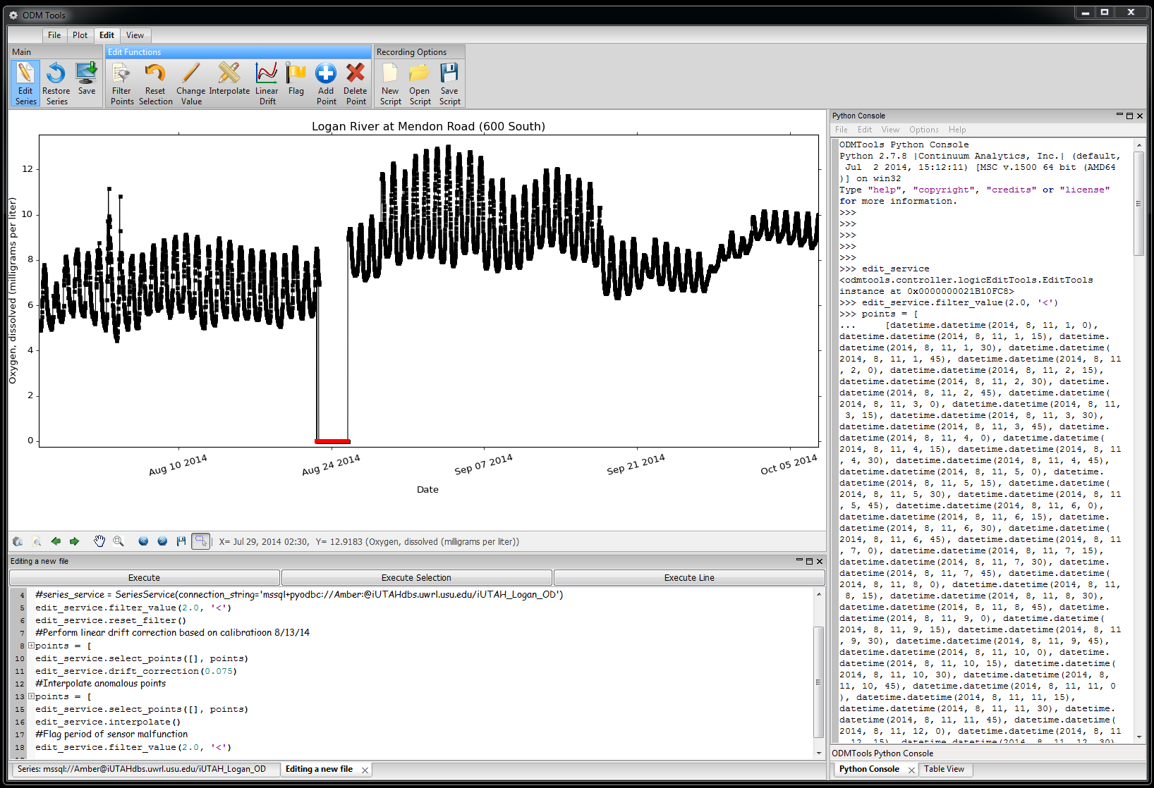
Quality Control of Sensor Data
Continuous, high frequency data require post processing
Modifications to correct for common data errors
Sensor Drift
Fouling
Power failure
Icing
Anomalies
Horsburgh, J. S., Reeder, S. L., Spackman Jones, A., Meline, J. (2015). Open source software for visualization and quality control of continuous hydrologic and water quality sensor data, Environmental Modelling & Software, 70, 32-44, doi:10.1016/j.envsoft.2015.04.002.
Notes:
Combine with next slide.

Slide 7
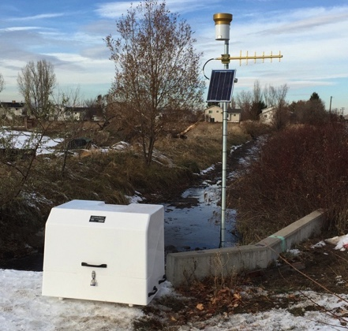
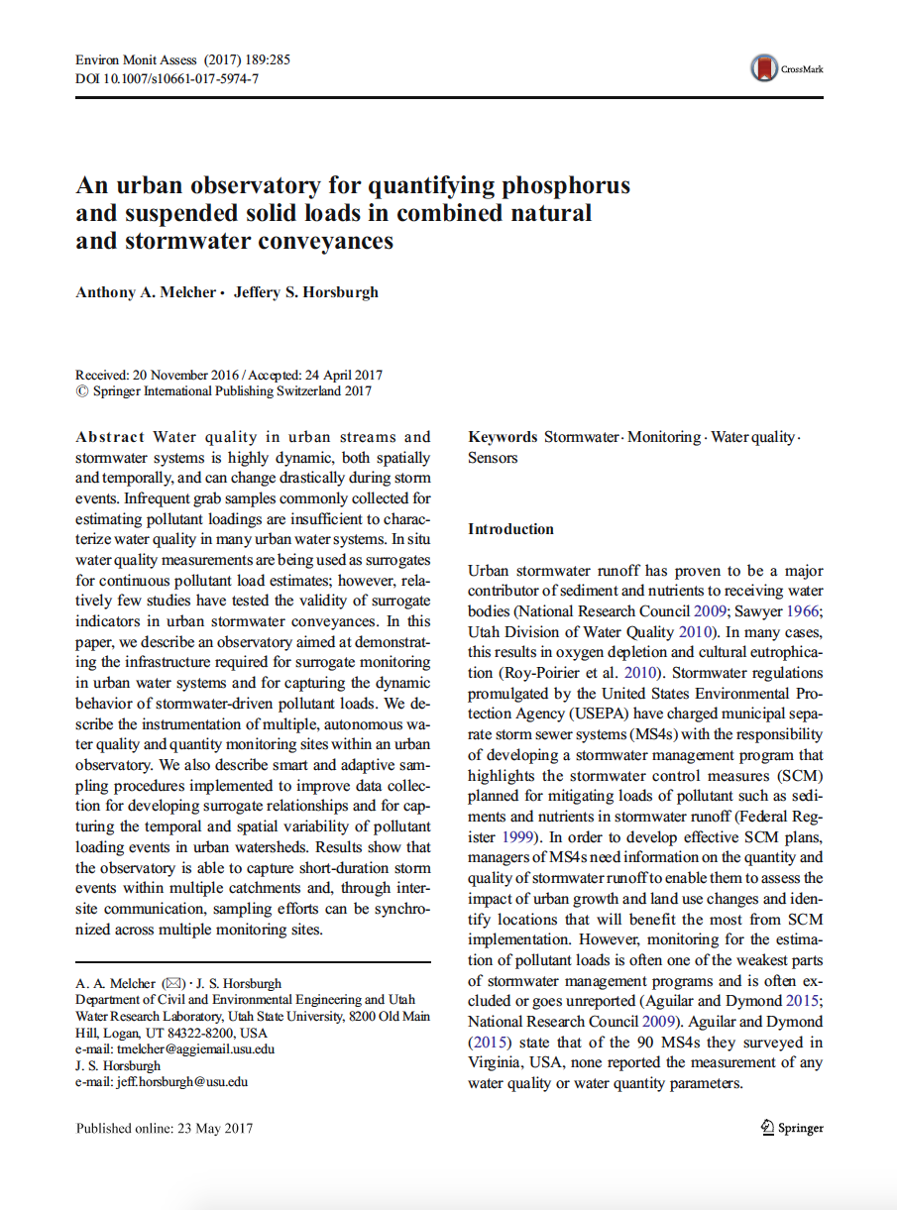
GAMUT Extensions: Additional WQ Efforts
Stormwater/canal network
New studies built on GAMUT infrastructure

Slide 8
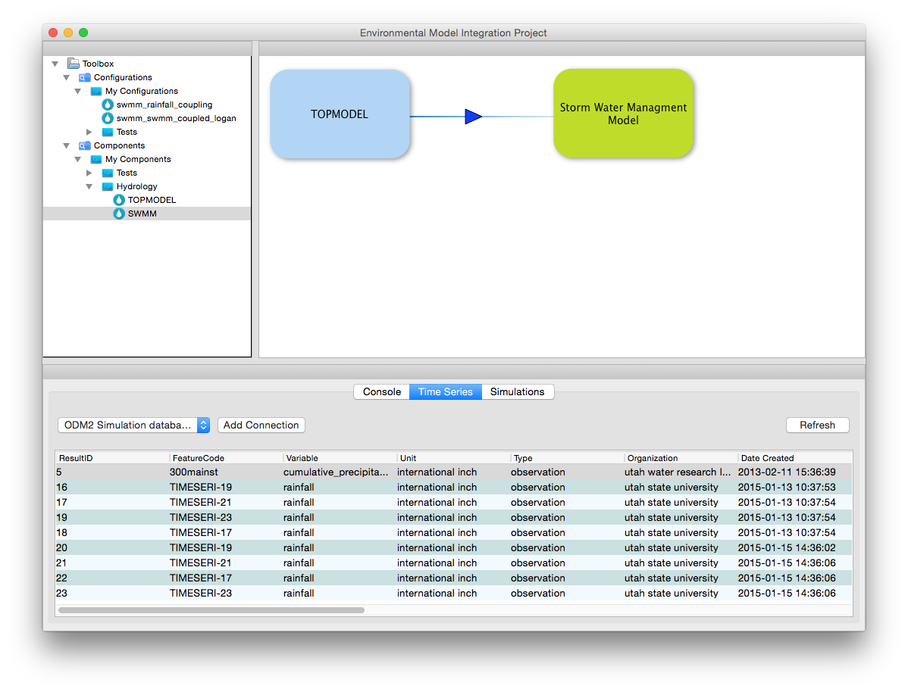
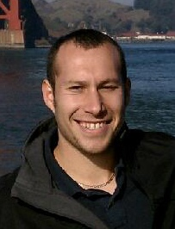
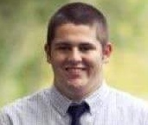
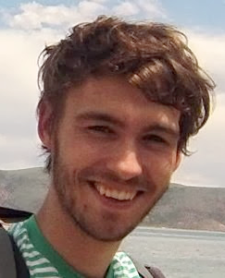
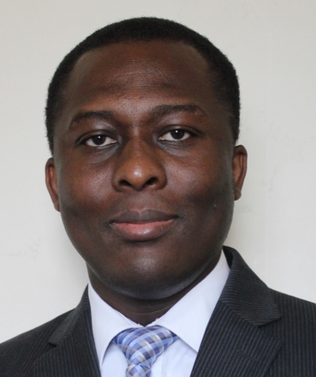
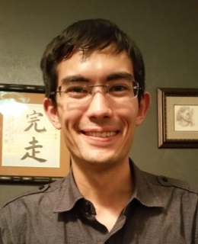
Software for Coupling Environmental Models
Technical Challenges of Model Coupling and Strategies for overcoming:
Coupling strategies
Inconsistency in programming languages
Space and time mismatches
Transferring data between models
Computational penalties
Mass balance errors
Modeling Environment
Wrapper API
spatial transformation
Wrapper API
Model1
Model2
temporal
transformation
unit
conversion
Buahin, C.A., J.S. Horsburgh (2015). Evaluating the simulation times and mass balance errors of component-based models: An application of OpenMI 2.0 to an urban stormwater system, Environmental Modelling & Software, 72, 92-109, doi:10.1016/j.envsoft.2015.07.003.
Wrapper API
Model3
Notes:
Combine with next slide.

Slide 9
- iUTAH Proposal Data Management Plan
“All of the primary datasets collected as part of this project will be made freely and publicly available…”

Slide 10
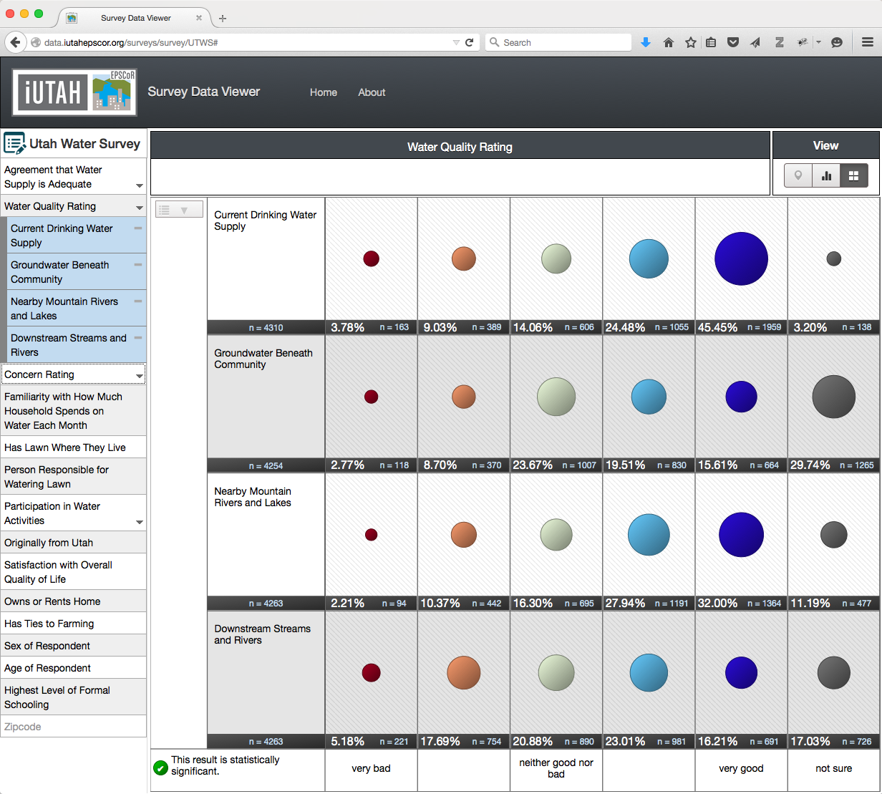
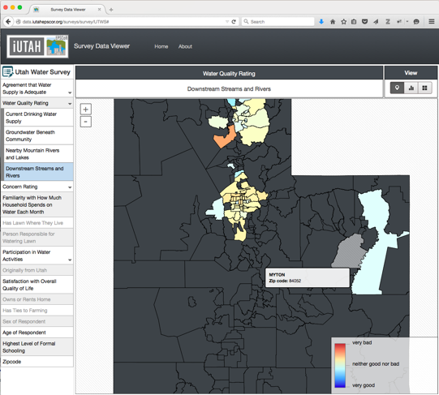
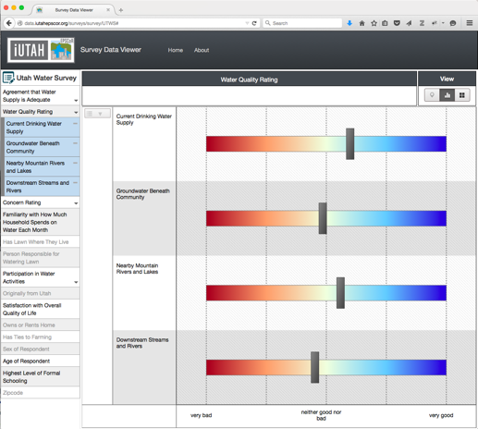
Visualizing Social Science Survey Results
Visualization of public intercept survey results
Generic and reusable survey template
Open source code
http://data.iutahepscor.org/surveys/
Jones, A. S., Horsburgh, J. S., Jackson-Smith, D., Ramirez, M., Flint, C., Caraballo, J. (2016). A Web-based, interactive visualization tool for social environmental survey data, Environmental Modelling & Software, 84, 412-426, doi:10.1016/j.envsoft.2016.07.013.

Slide 11
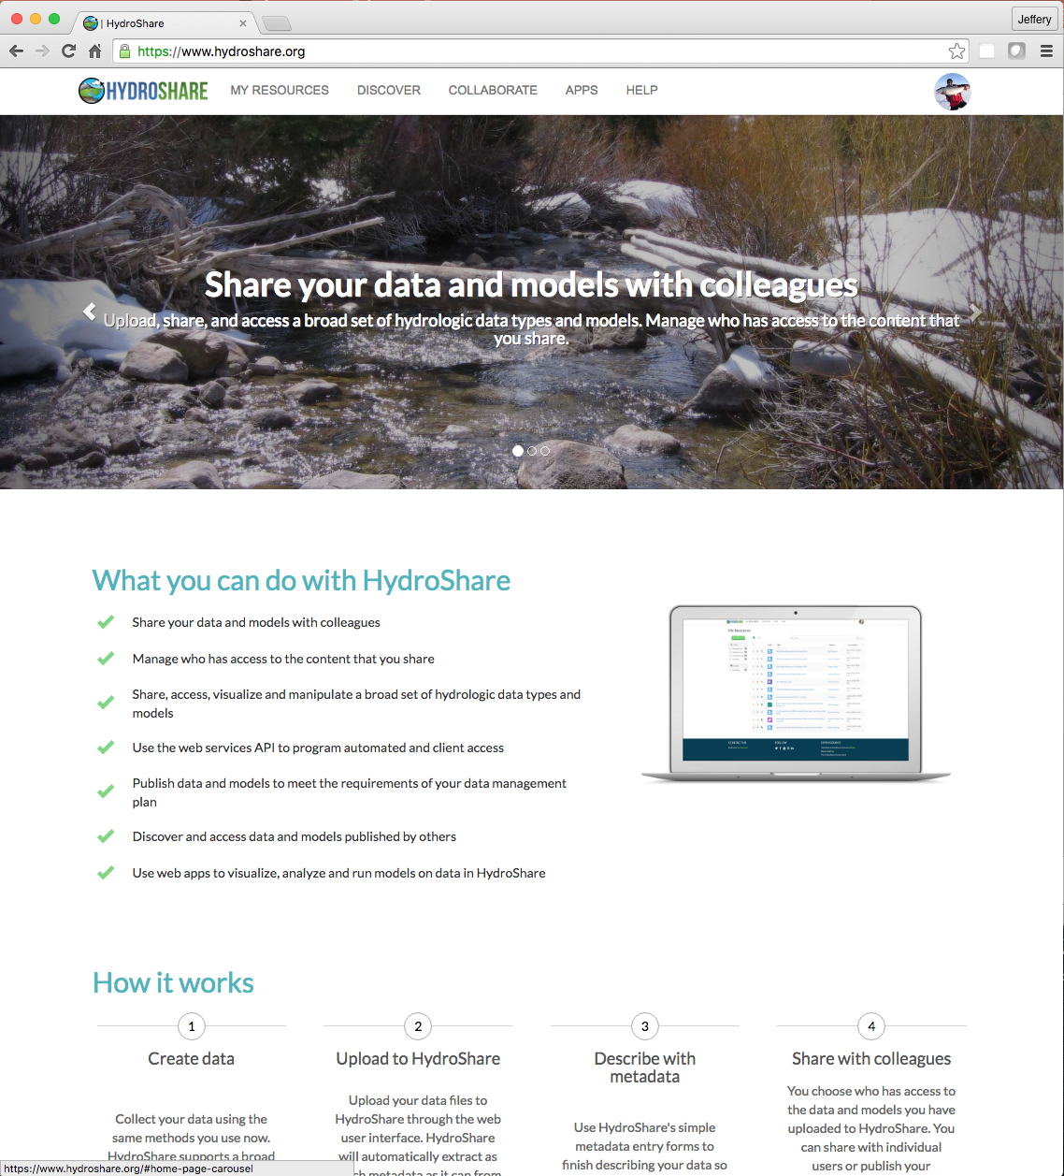
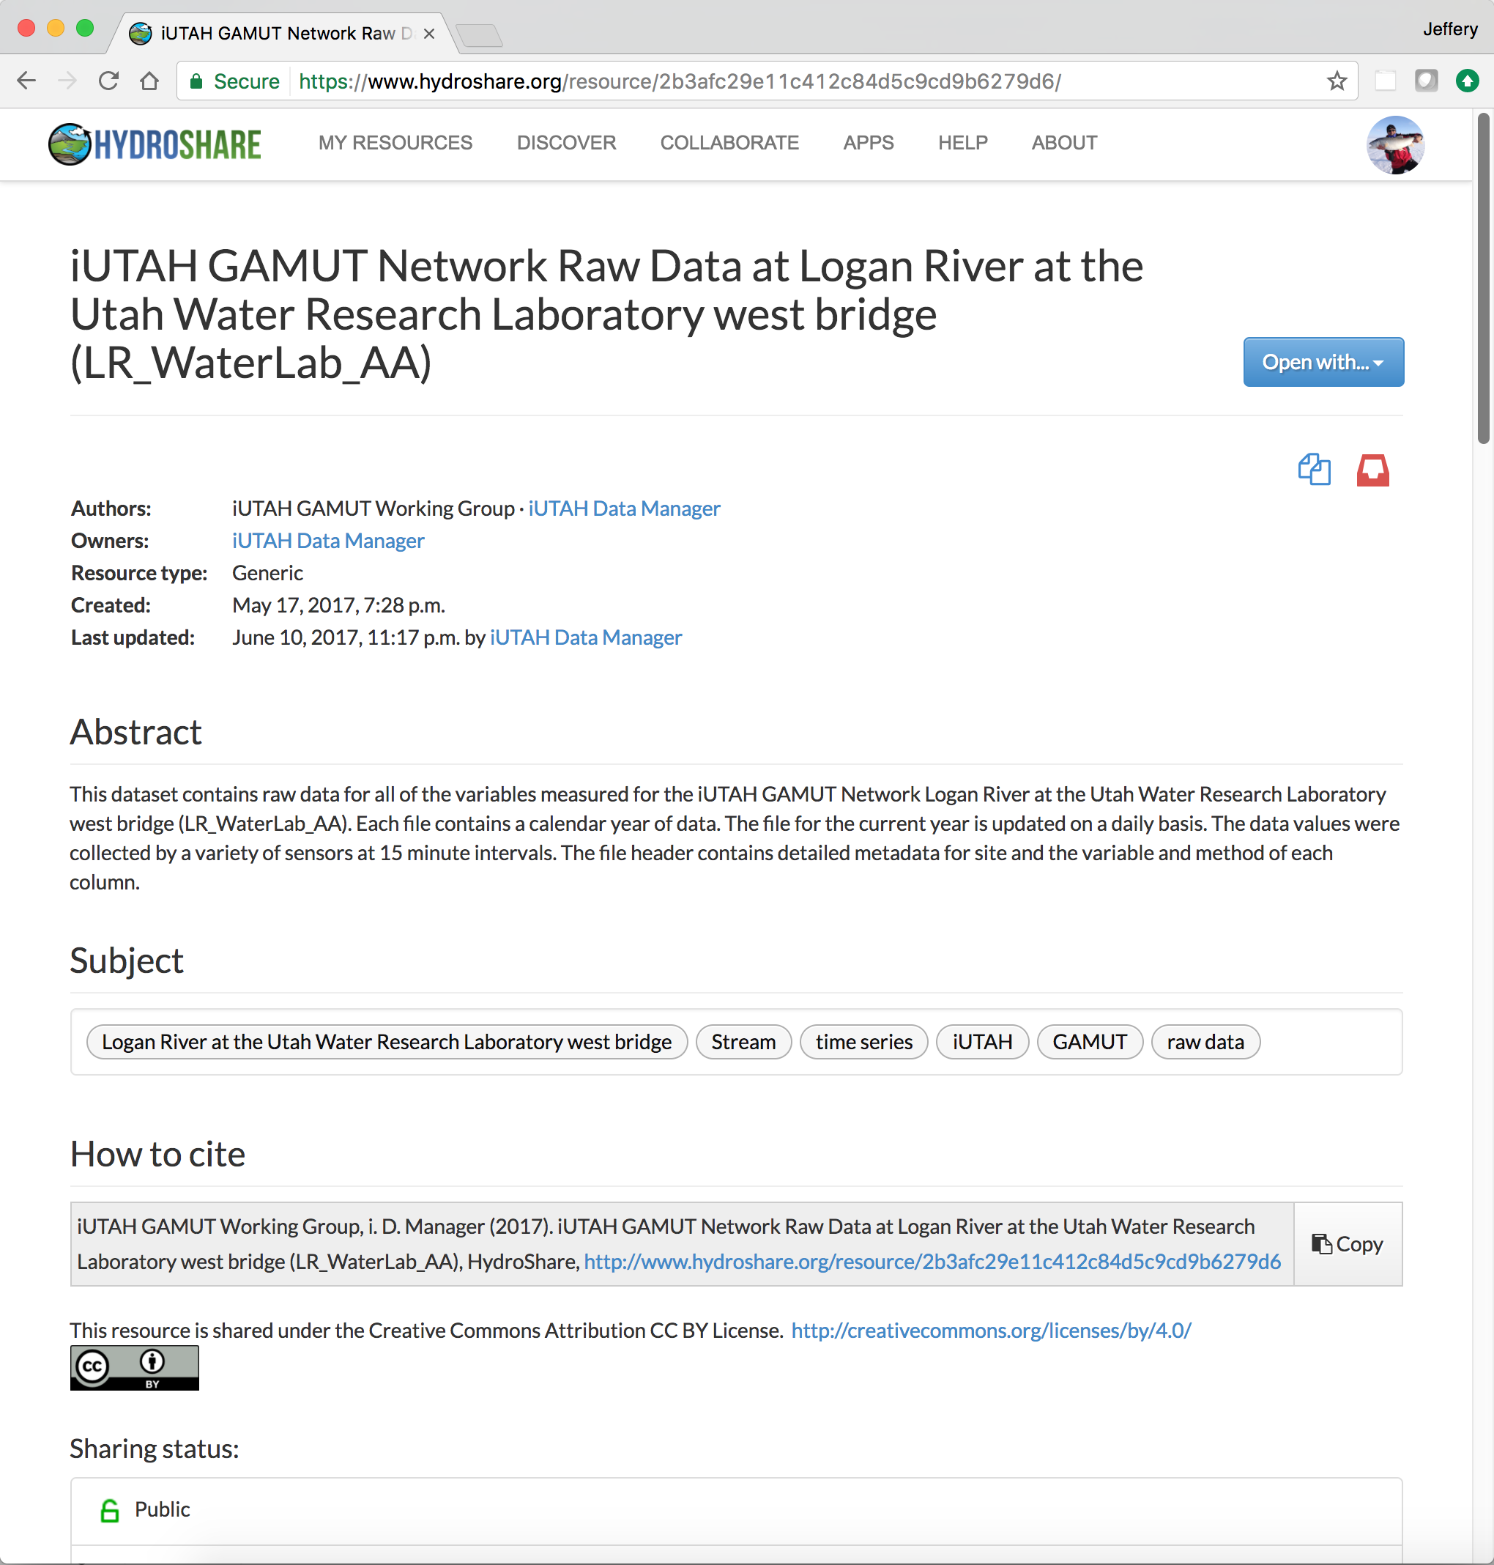
Sharing Diverse Data
Sharing and collaborating around diverse data types used by water scientists
Biophysical
Social
iUTAH data use cases drove some of the design for HydroShare
http://www.hydroshare.org
Notes:
Change screen shot to an IUTAH resource.
HydroShare developed in Parallel
We are using it now as our primary repository for research data and models
If you aren’t already, you should get familiar with it!!

Slide 12
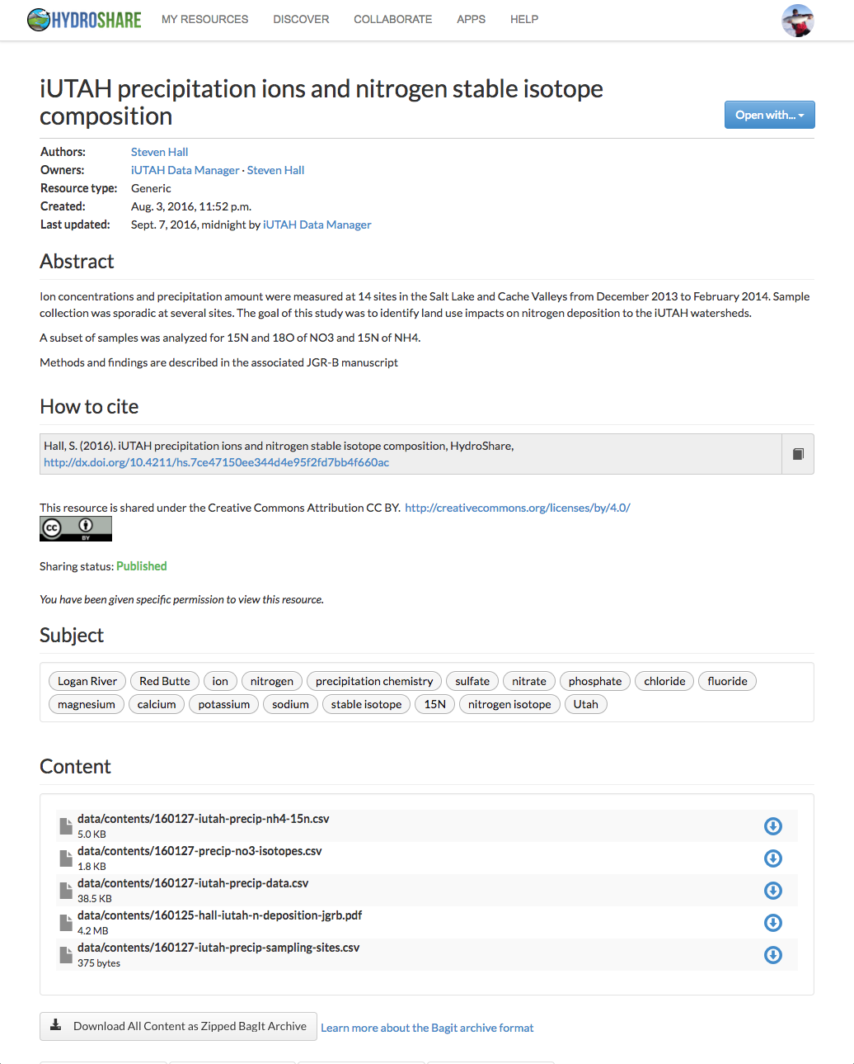
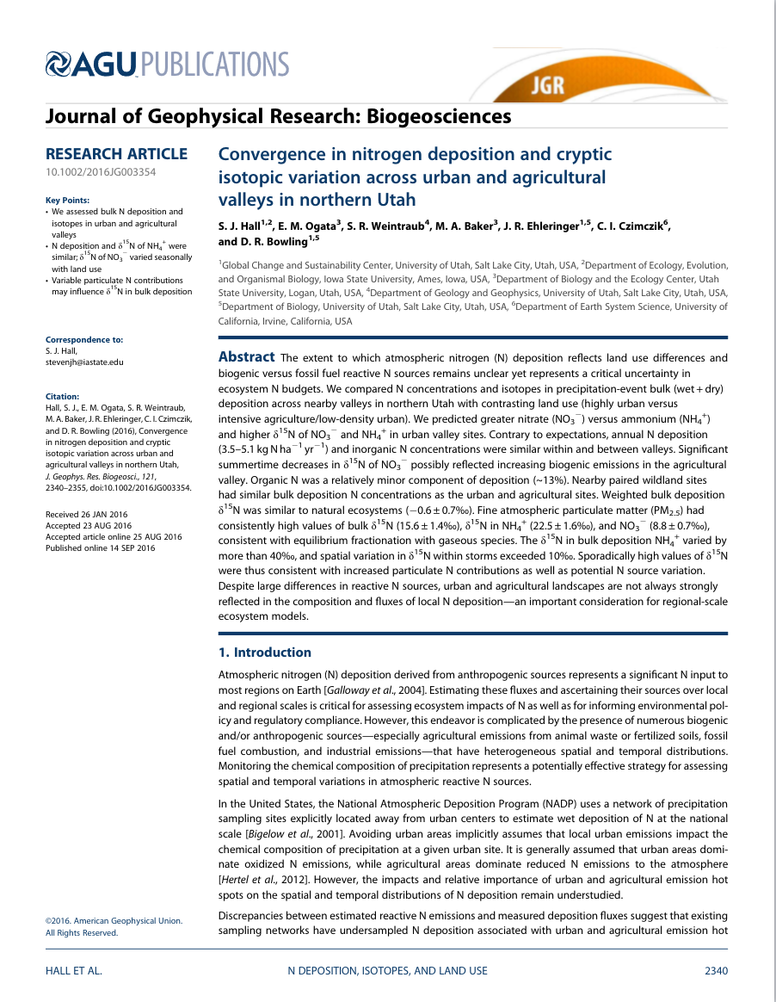
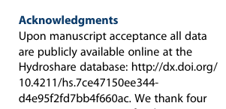
The Steven Hall Story
We want this to be your story!
Steven verified his data and metadata were correct but kept the data private
Steven submitted his paper for publication and responded to reviews
With a little help, Steven deposited his dataset in the online HydroShare repository
Steven published his data in HydroShare and received a DOI
Steven collected his data in the field and transformed into a sharable format
Steven published his paper and cited published data in HydroShare
Notes:
Get a silhouette picture.

Slide 13
Publishing iUTAH Data
Review your data collection plan
Create one or more resources in HydroShare
Upload your files and describe with metadata
Share!
Contact Amber Jones or Jeff Horsburgh if you have questions about:
Data collection plans
Creating resources
Resource types
File formats
Organization of your data
!

Slide 14
Additional Objectives
Leading research, training and education in coupled human-natural water resource systems
Recruiting and training a diverse STEM workforce and the next generation of researchers
Providing a lasting human and physical infrastructure

Slide 15
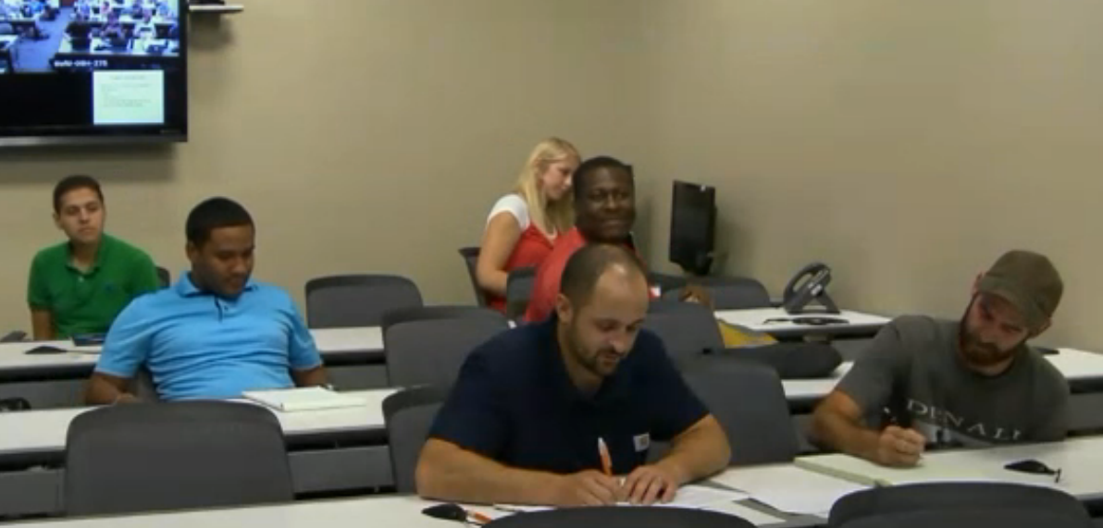
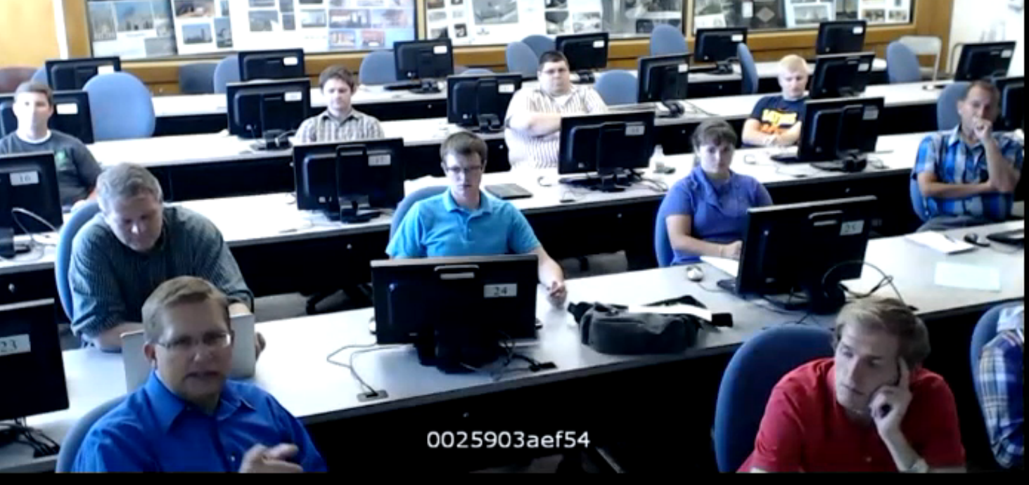
Hydroinformatics Course
3 to 5 partner universities
30 - 45 students total across the campuses
We focus on:
Data and the data life cycle
Databases and data models
Data visualization, transformation, analysis, and modeling
Technologies we use:
Relational database management systems
Structured query language
Python Programming
R Statistical Computing
“My team used basic concepts from almost every class period and topic section in our term project. It was cool to see how all the individual skills added up to help us create and maintain hydrologic information.”

Slide 16
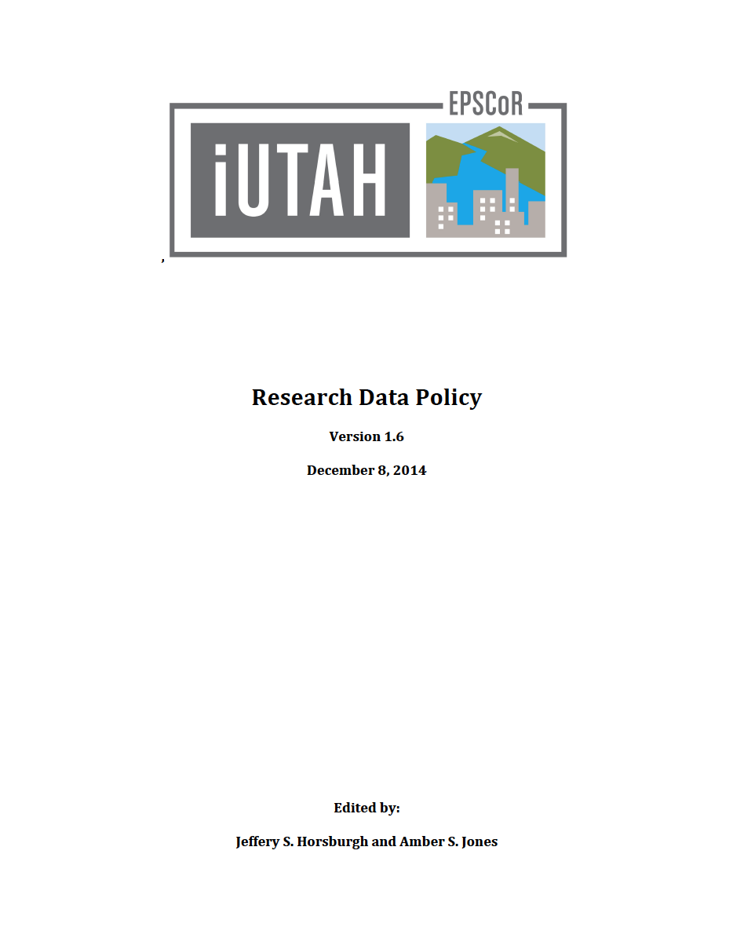
Data Policy and Data Management Training
Raising awareness of data management needs and requirements across iUTAH
Conducted training, including:
Visualizing sensor data streams
Scripted and reproducible quality control of sensor data streams
Quality control workflow
Data publication tutorials
Changing the culture from “My Data” to “Our Data”

Slide 17
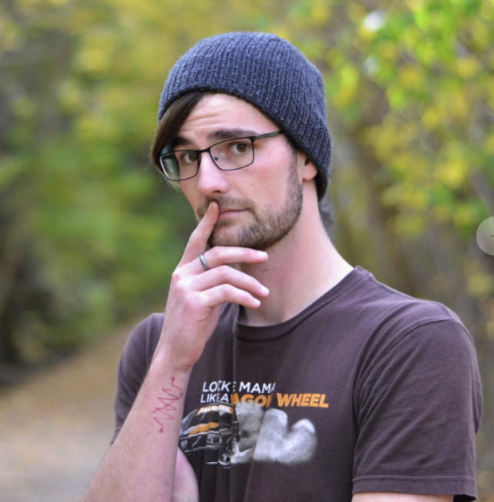
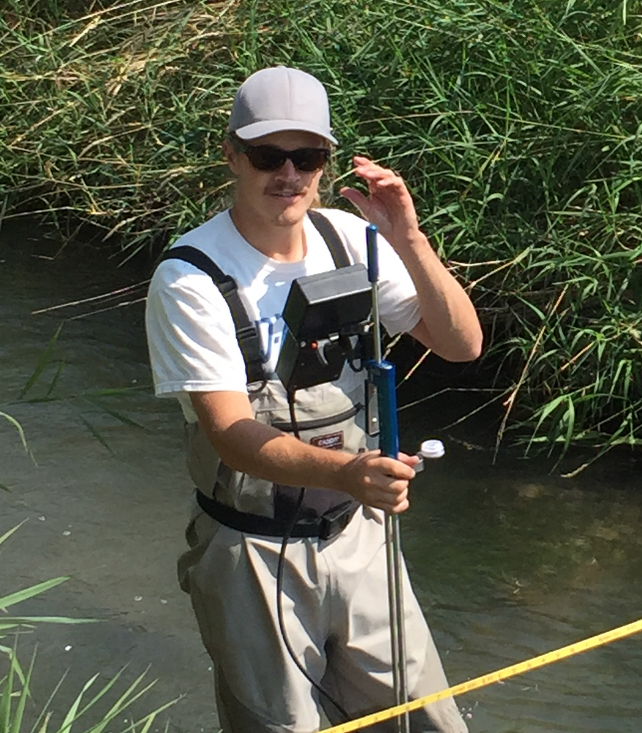
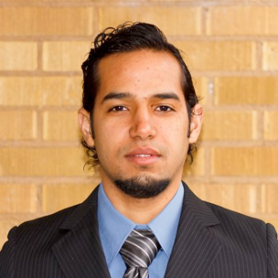
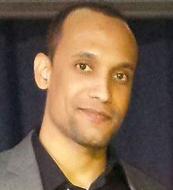
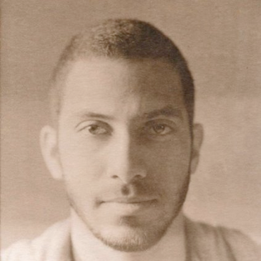
Undergraduate Training
Creating the next generation of “Cyber-savvy” engineers and scientists
Prototyping and developing new software applications
Collaborating with iUTAH scientists
Co-authoring CI-related papers
Gaining practical experience and improving job prospects

Slide 18
Questions?
Open Source Code Repositories
Jeff Horsburgh
jeff.horsburgh@usu.edu
435-797-946
Amber Jones
amber.jones@usu.edu
435-797-7147
WEBTSA – GAMUT time series data visualization
https://github.com/UCHIC/WEBTSA
ODM Streaming Data Loader
https://github.com/ODM2/ODM2StreamingDataLoader
ODM Tools Python – Sensor data management and QC
https://github.com/UCHIC/ODMToolsPython
ODM2 Sensor – Sensor equipment management
https://github.com/UCHIC/ODM2Sensor
iUTAH Utilities – Automated alerts, etc.
https://github.com/UCHIC/iUtahUtilities
iUTAH Survey Data Viewer – Visualization of survey data
https://github.com/UCHIC/SurveyDataViewer
iUTAH Data – Modeling and Data Federation Website
https://github.com/UCHIC/iUTAHData

