Slide 1
Water Quality Surrogates: Development of Surrogate Relationships, Review of Recent Advances, and Applications
Amber Spackman Jones Jeffery S. Horsburgh
National Nonpoint Source Monitoring Workshop• Salt Lake City, UT• August 24, 2016
Notes:
We’ve done work on surrogate relationships and used them to estimate concentrations and loads for the Little Bear River here in Utah. I’ll be presenting some of those results in the context of the past 5-10 years of research on surrogate methods including some of the most recent developments in literature and guidance from federal entities.

Slide 2
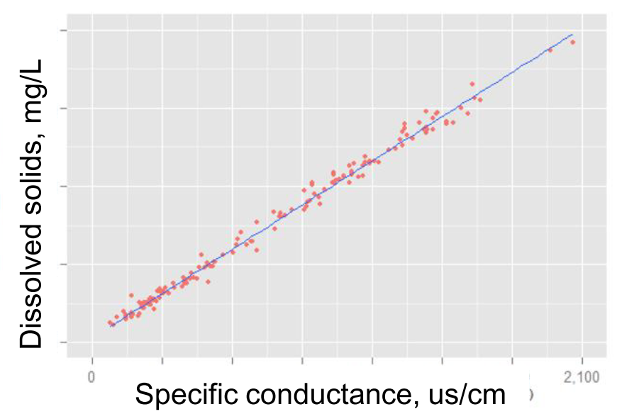
Surrogate Relationships
One parameter (easily measured at high frequency)
used as a proxy to estimate
Another parameter (difficult to measure directly)
Discharge was the first surrogate, and is still used, but has been shown inadequate to capture the behavior of most constituents (especially particle-based) due to hysteresis.
Turbidity (for particle-based constituents), Specific conductance (for dissolved constituents), fDOM successfully being used as surrogates.
Notes:
Flow was the first surrogate and is still somewhat commonly used. But there is a fairly large body of evidence that flow alone is an inadequate to capture the behavior of most constituents due to hysteresis especially particulate-based constituents.

Slide 3
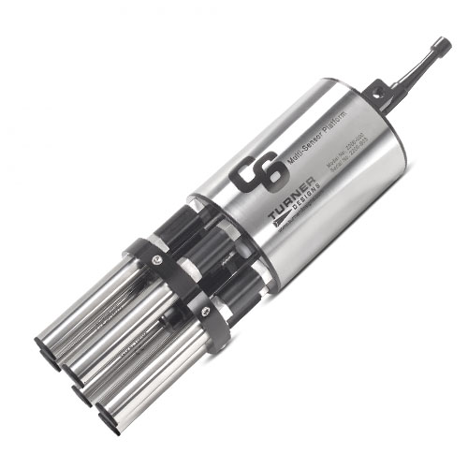
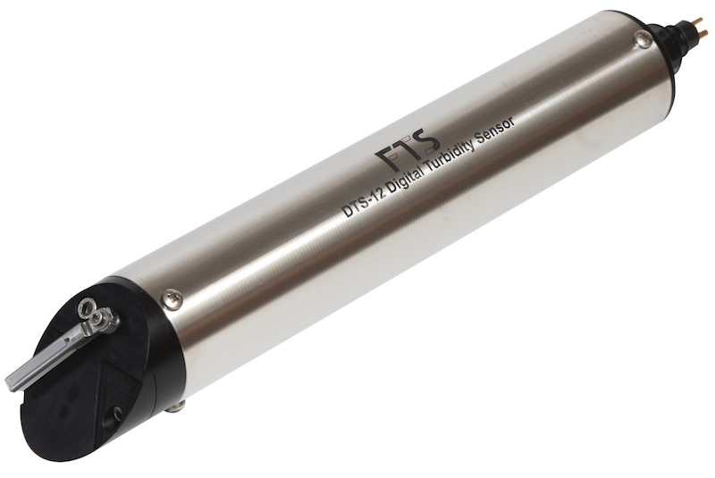
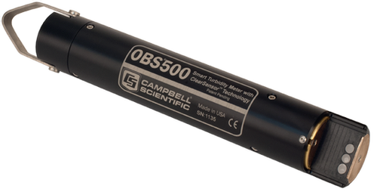
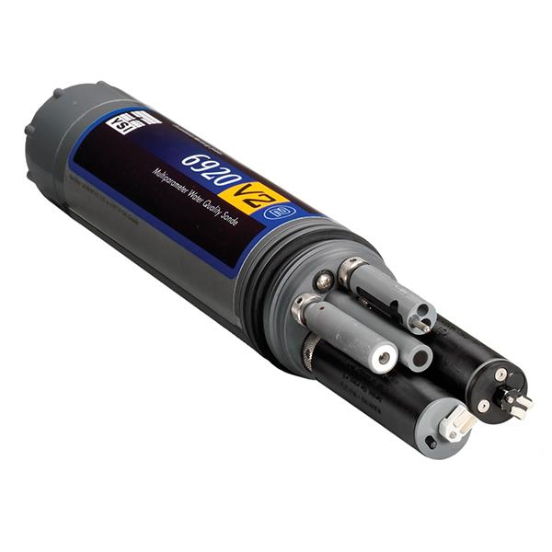
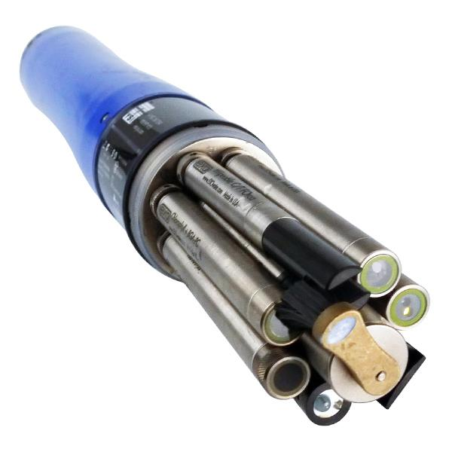
In Situ Sensors
In situ sensors increasingly common
Multi-parameter sondes and single parameter sensors
Generate high frequency data
Deployment and maintenance can be intensive
Data maintenance is also significant
Notes:
Need to mention that deployment and maintenance can be intensive. Data quality maintenance also significant.

Slide 4
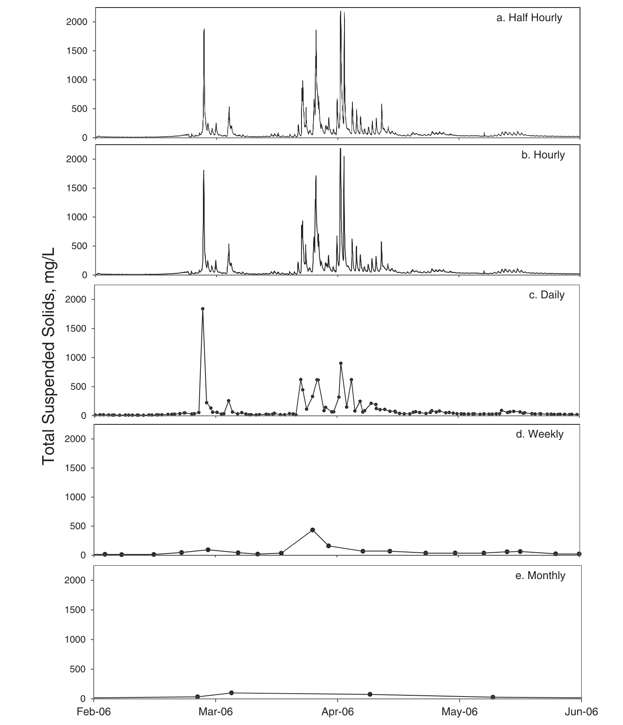
High Frequency Monitoring
Capture short term dynamics and important events, seasonal and annual patterns, longer term behavior and trends.
Improved understanding of hydrological, chemical, and biological processes.
Better quantification of concentrations, loads, and transport.
Source tracking and evaluation of the effects of mitigation measures for both point and nonpoint sources.
From Jones et al., 2012
Notes:
Why is high frequency monitoring important?
For suspended sediment, for some rivers, ~70-90% of the flux occurs during high flow events. This plot shows high frequency estimates of TSS in the Little Bear River here in Utah for a few spring months. Randomly subsampling the half-hourly data at daily, weekly, and monthly intervals shows the nearly-complete loss of information from reduced sampling frequency. What is lost that is captured by the high frequency data?
Short term dynamics and important events.
Seasonal and annual patterns
Longer term behavior and trends
Improved understanding of the relevant processes
Better quantification of concentration, loads, and transport
Ability to track sources and examine effects of mitigation.
Van Geer etal 2016:

Slide 5
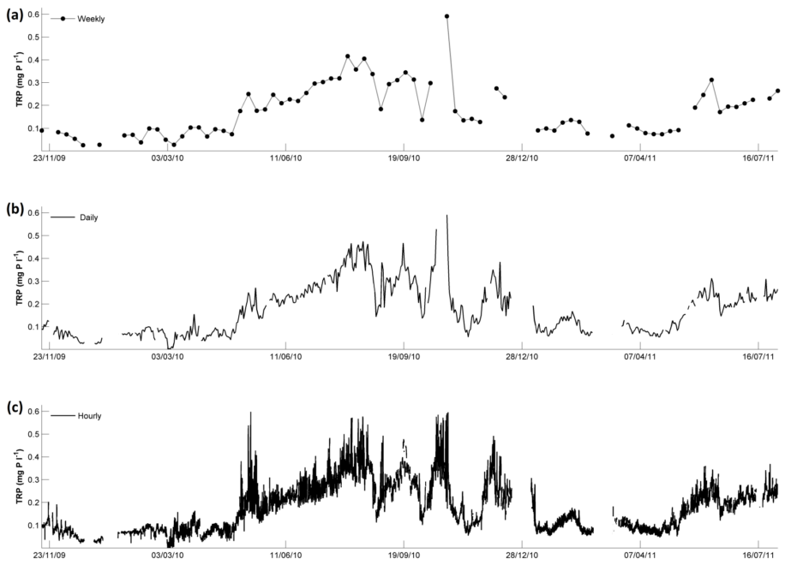
High Frequency Monitoring
From Wade et al., 2012
Notes:
Wade et al. We have a great deal of water quantity data at high frequencies, extended durations, and broad spatial coverage. Not so much with wq data.
Kirchner et al (2004) compared this to a musical symphony- can’t deduce much from a few scattered notes- like sampling infrequently. Neither can we have a good perspective with listening just a snippet of the piece as we might only sampling a single storm event..

Slide 6
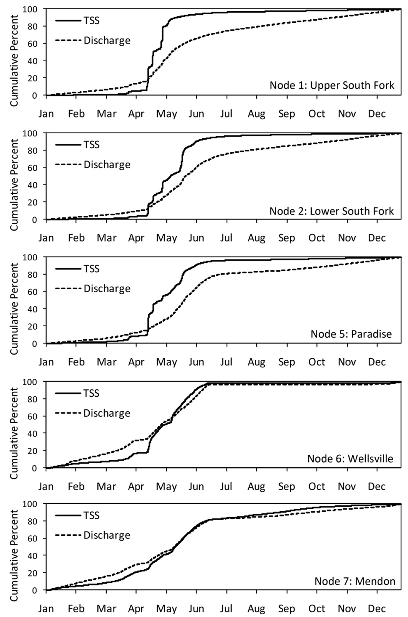
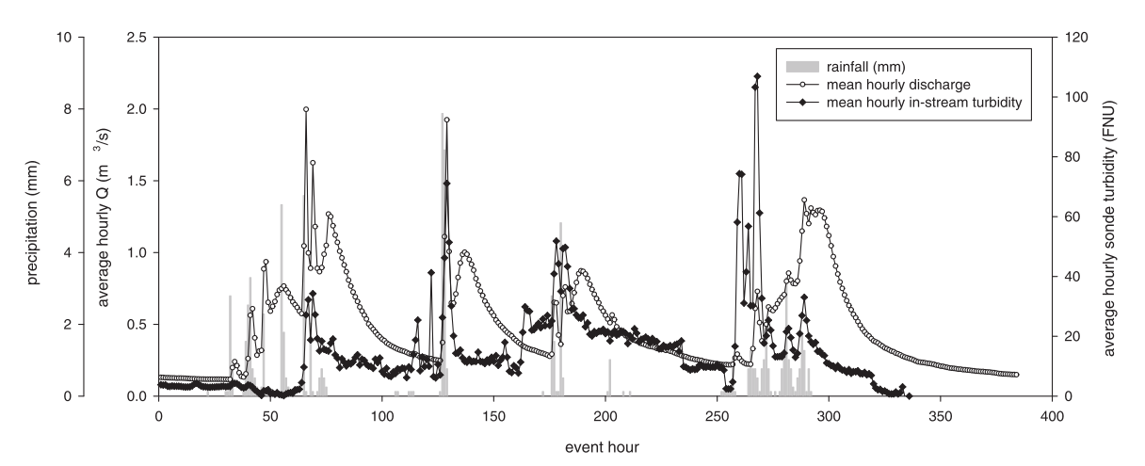
High Frequency Monitoring
From Horsburgh et al., 2010
Notes:
Figure from Horsburgh etal 2010 shows that loading can occur in a very short time window that traditional monitoring might miss entirely. Episodic events carry large portion of the load in *some* systems, sites, or watersheds, and determining accurate loads or yields are dependent on these important time periods.

Slide 7
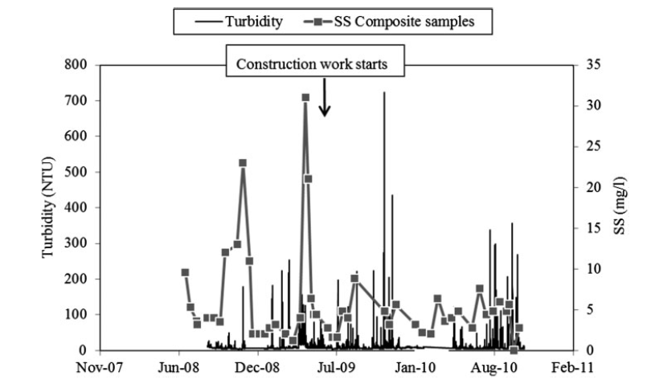
High Frequency Monitoring
From Skarbovik and Roseth, 2015
Notes:
In this figure from Skarbovik and Roseth, grab samples after a construction event seem to indicate a decrease in sediment loading, but the turbidity data show otherwise.

Slide 8
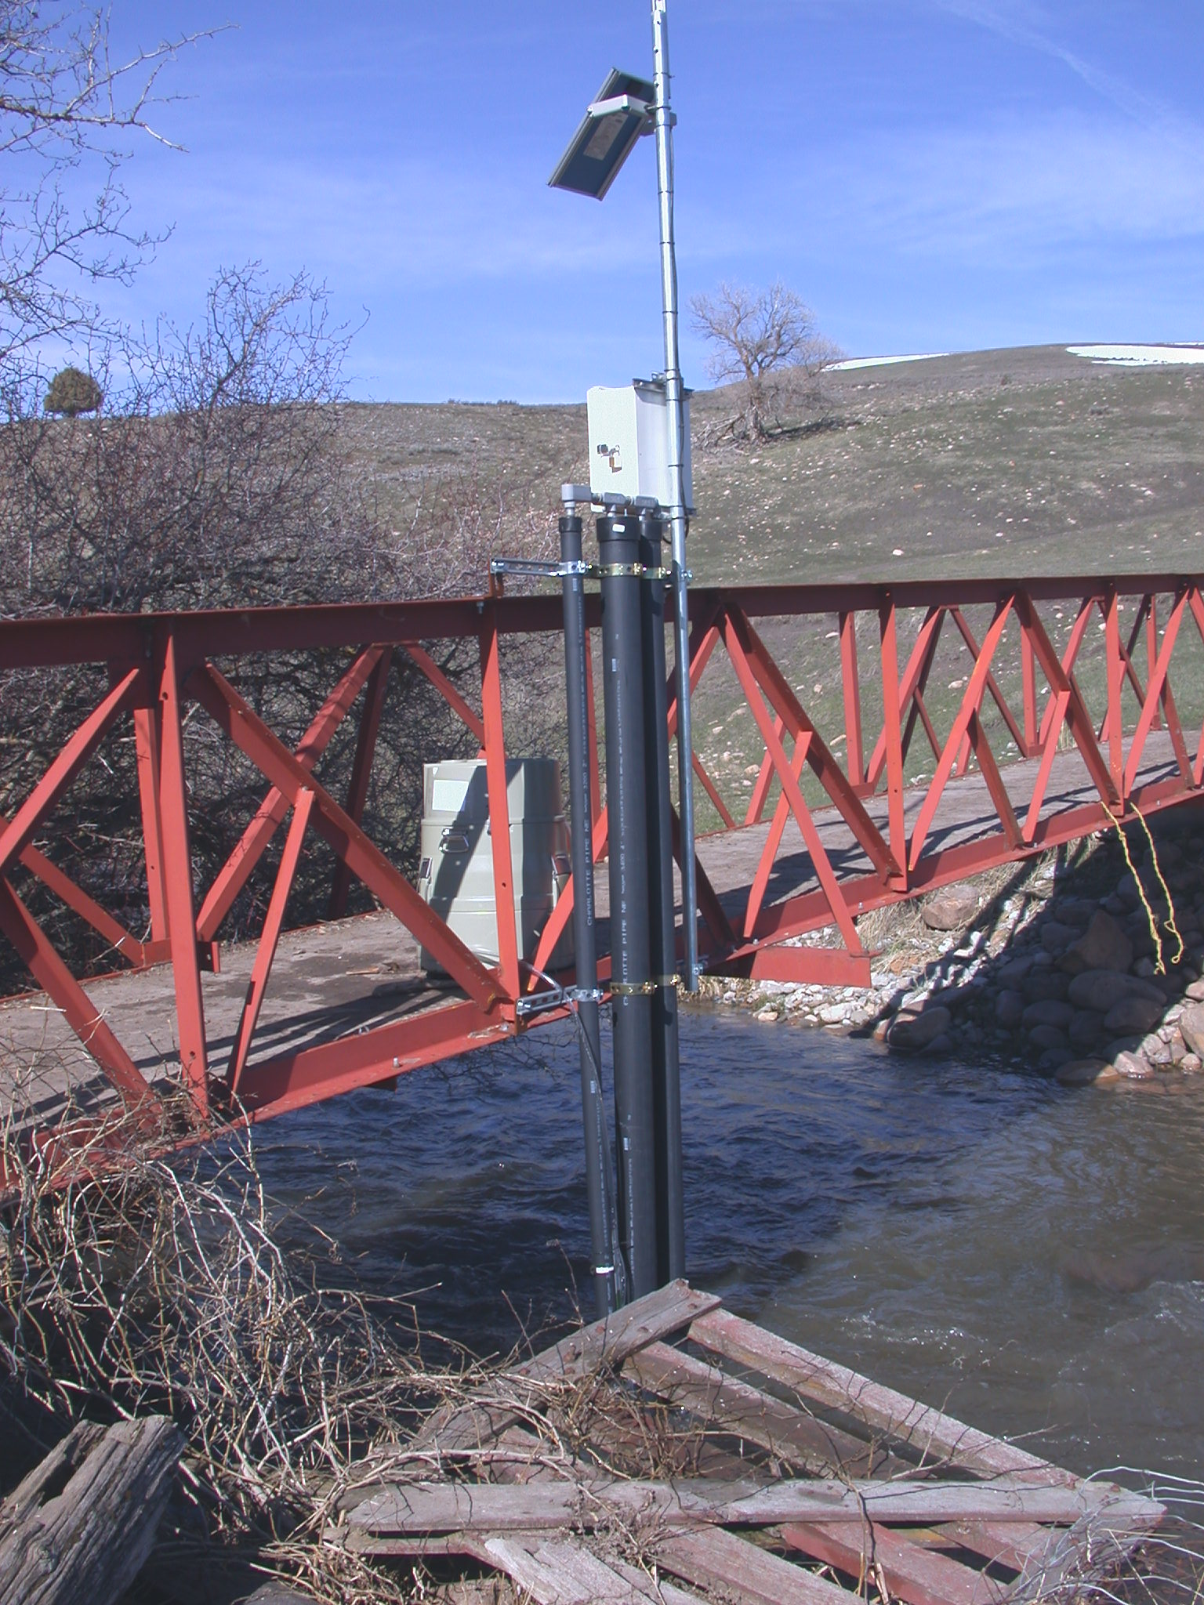
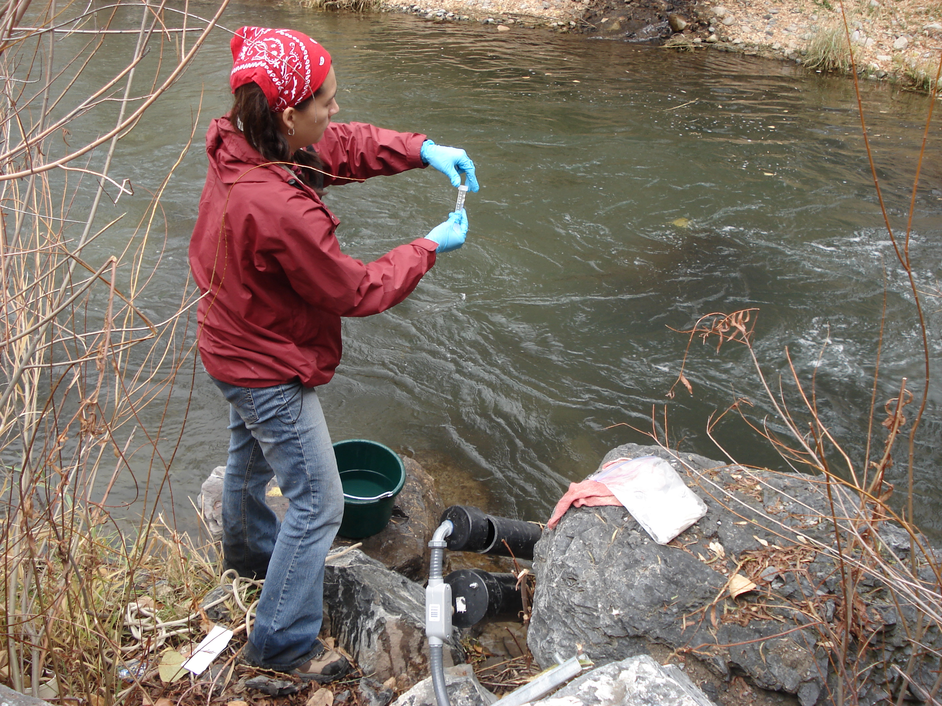
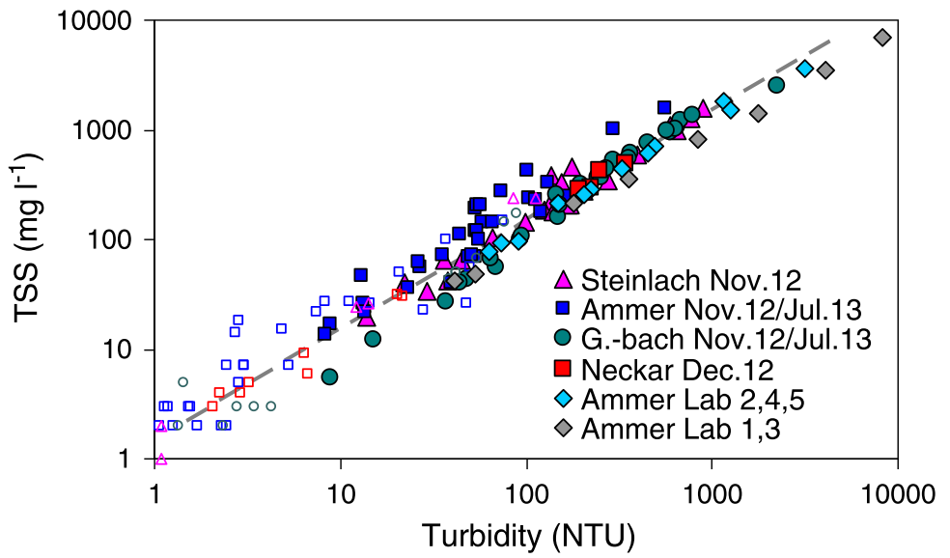
Surrogate Relationship Development
Deploy sensors
Collect/analyze samples
Match sensor and sample values
Develop regression relationships
From Jones et al., 2011
From Rugner et al., 2014
Notes:
SURROGATE RELATIONSHIPS have the potential to extend the benefits of high frequency data resolution to other parameters.
HOW IS IT DONE?
In general: deploy sensors, collect samples, match values, develop regression relationships.
This slide shows some of the exploratory steps- visually and quantitatively comparing TP to other measured values, looking at related sites and events, plot shows very tight relationship. (Rugner et al 2014)
Sounds simple, right?

Slide 9
Surrogate Relationship Development
How many samples are necessary? How frequent and for what duration should they be collected? Should samples be collected during runoff events?
How should non-detects be handled?
How should outliers be addressed?
Which explanatory variables should be investigated?
What types of models should be investigated?
What statistical tests should be used to evaluate models?
How to choose between multiple models?
Is it ok to estimate values outside of the model range?
How should an existing model be updated as new samples are collected?
Notes:
SAMPLES: Need to collect samples through the range of possible values. That may mean collecting during events.
MODELS: Use regression methods to determine an appropriate model. Many have used simple linear regression. In some cases, a log relationship may be more appropriate, but there are considerations- log transformations should only be used to achieve independence and constant variance in residuals, and log relationships require retransformation. Others have used power relationships and some have used linear at lower ranges and power at higher ranges. Some have used more complex but potentially more robust methods (Linear mixed models- Lessels and Bishop)
STATISTICAL TESTS; Use various methods to determine goodness of fit (R2, RMSE, check residuals, visual analysis, validate with other data, confidence intervals, PRESS Statistic, Nash-Sutcliffe coefficient of efficiency)

Slide 10
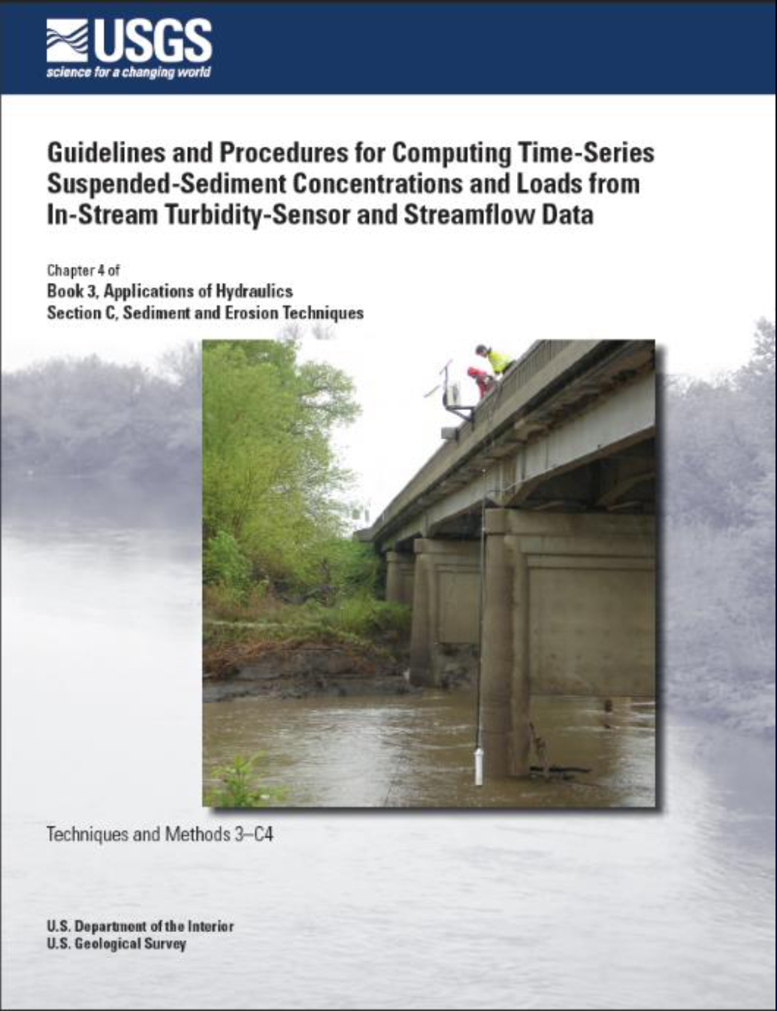
Surrogate Relationship Development
Notes:
There is some guidance on some of these questions- the USGS has published a Techniques and Methods Document on using turbidity as a surrogate for suspended sediment, and a parallel document is being developed for using surrogate measures to estimate other constituents. Furthermore, there is a growing body of literature on the use of surrogates, particularly using turbidity as a surrogate. However, not all sources are consistent in their approach to those questions

Slide 11
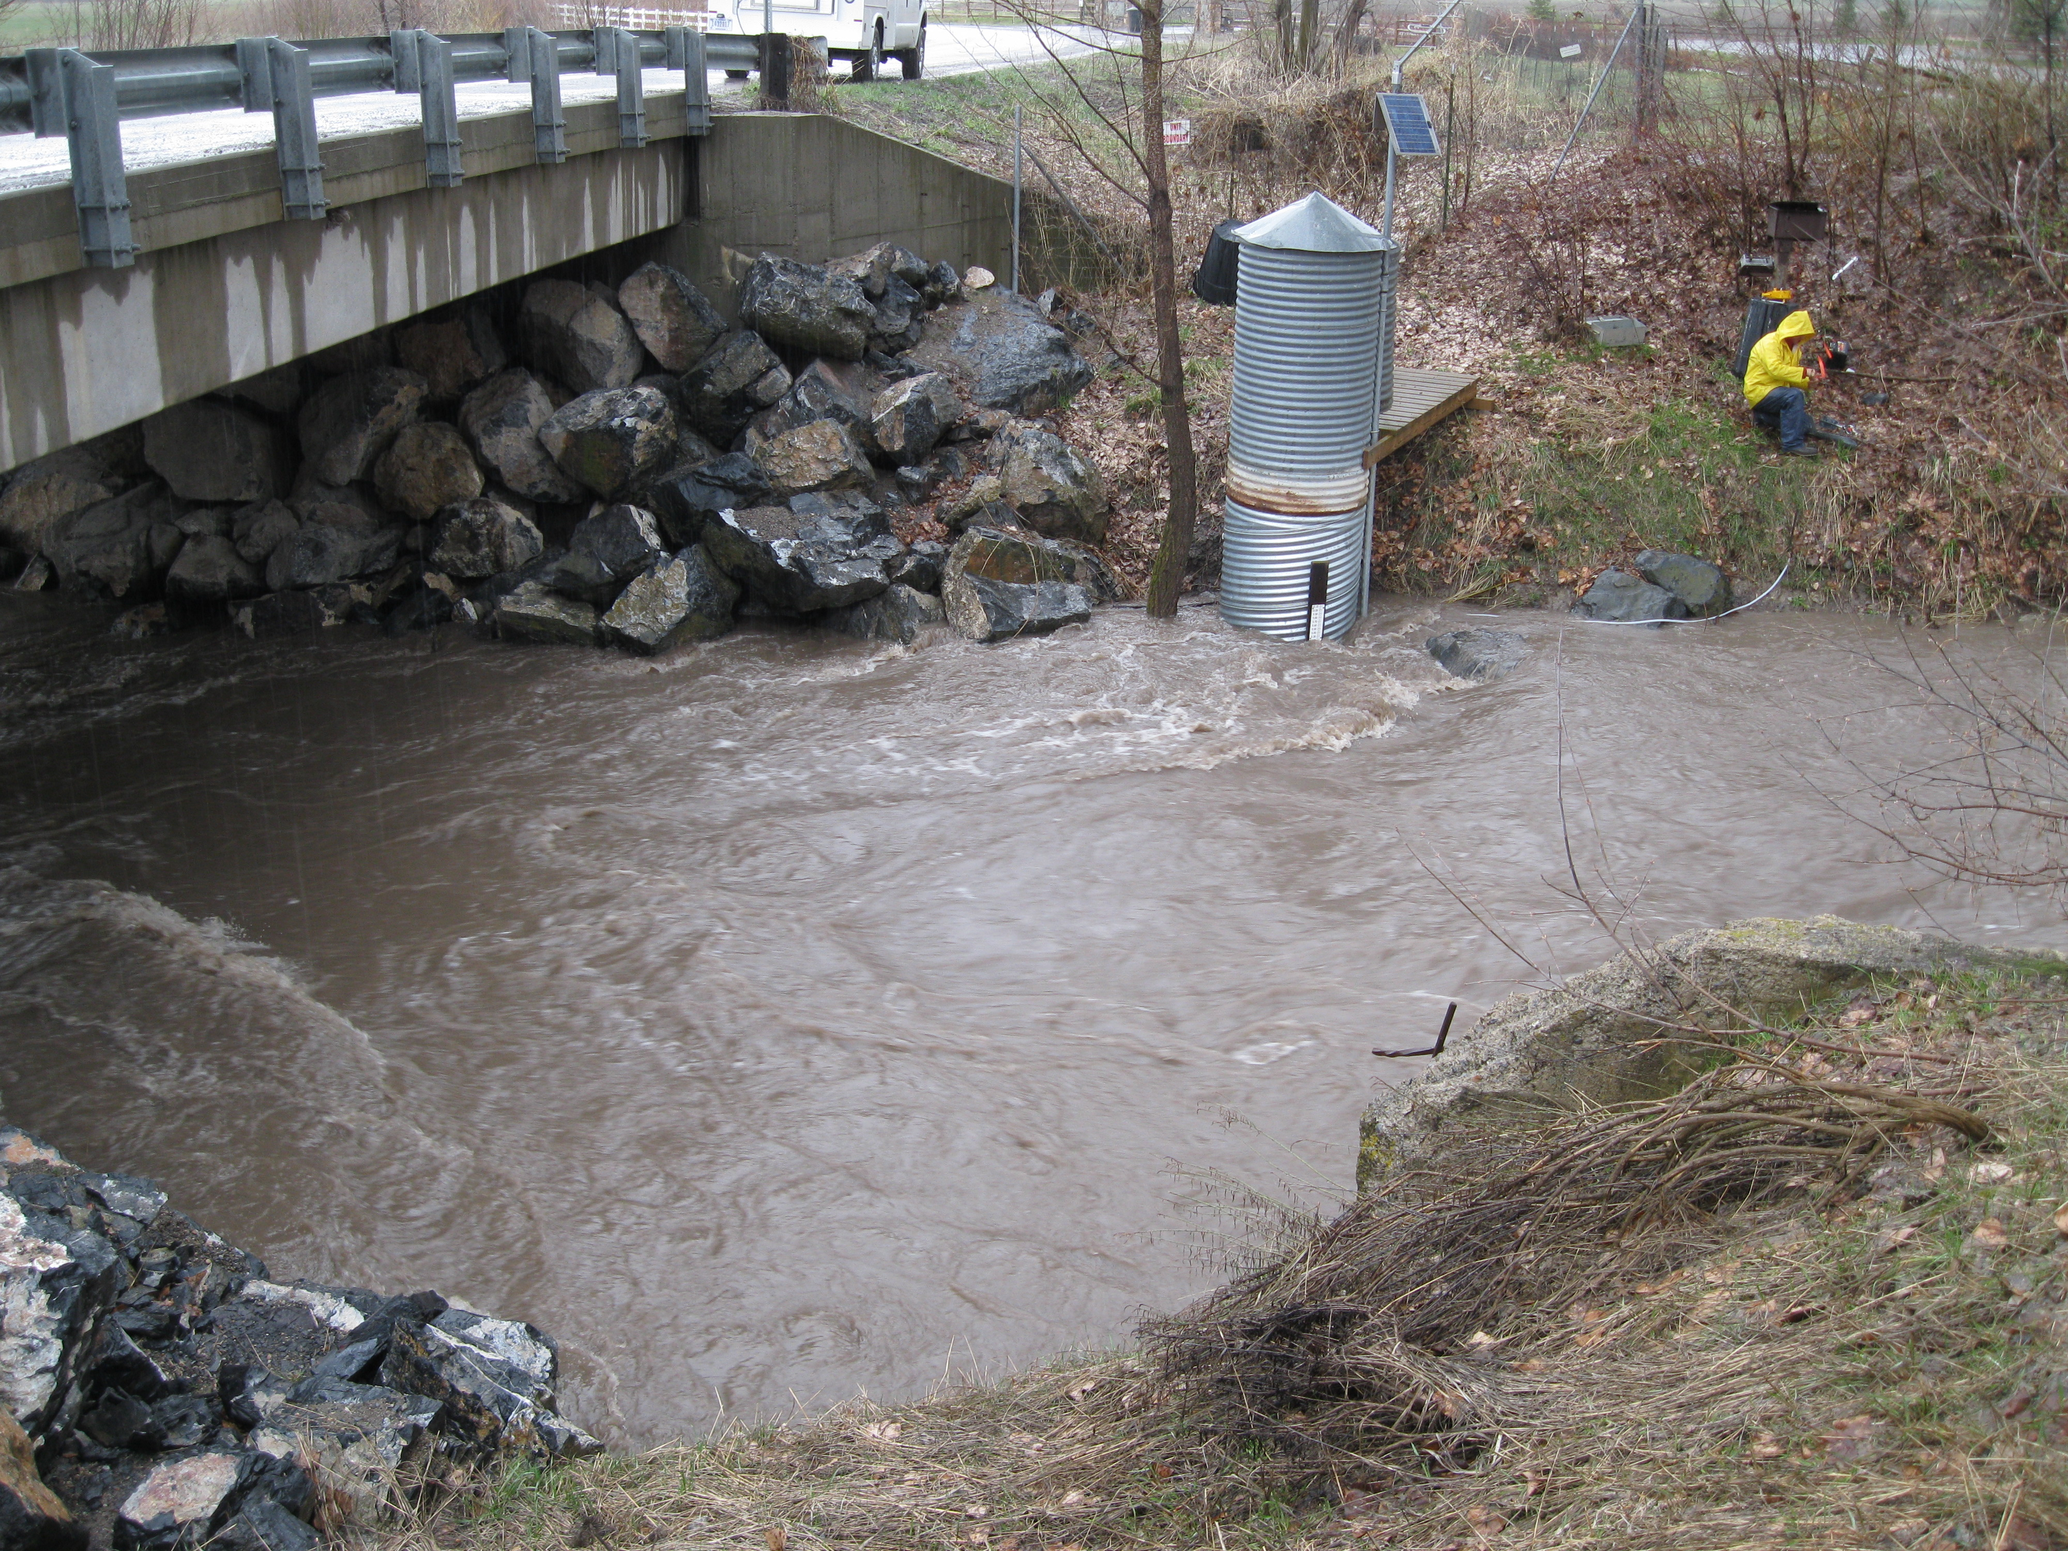
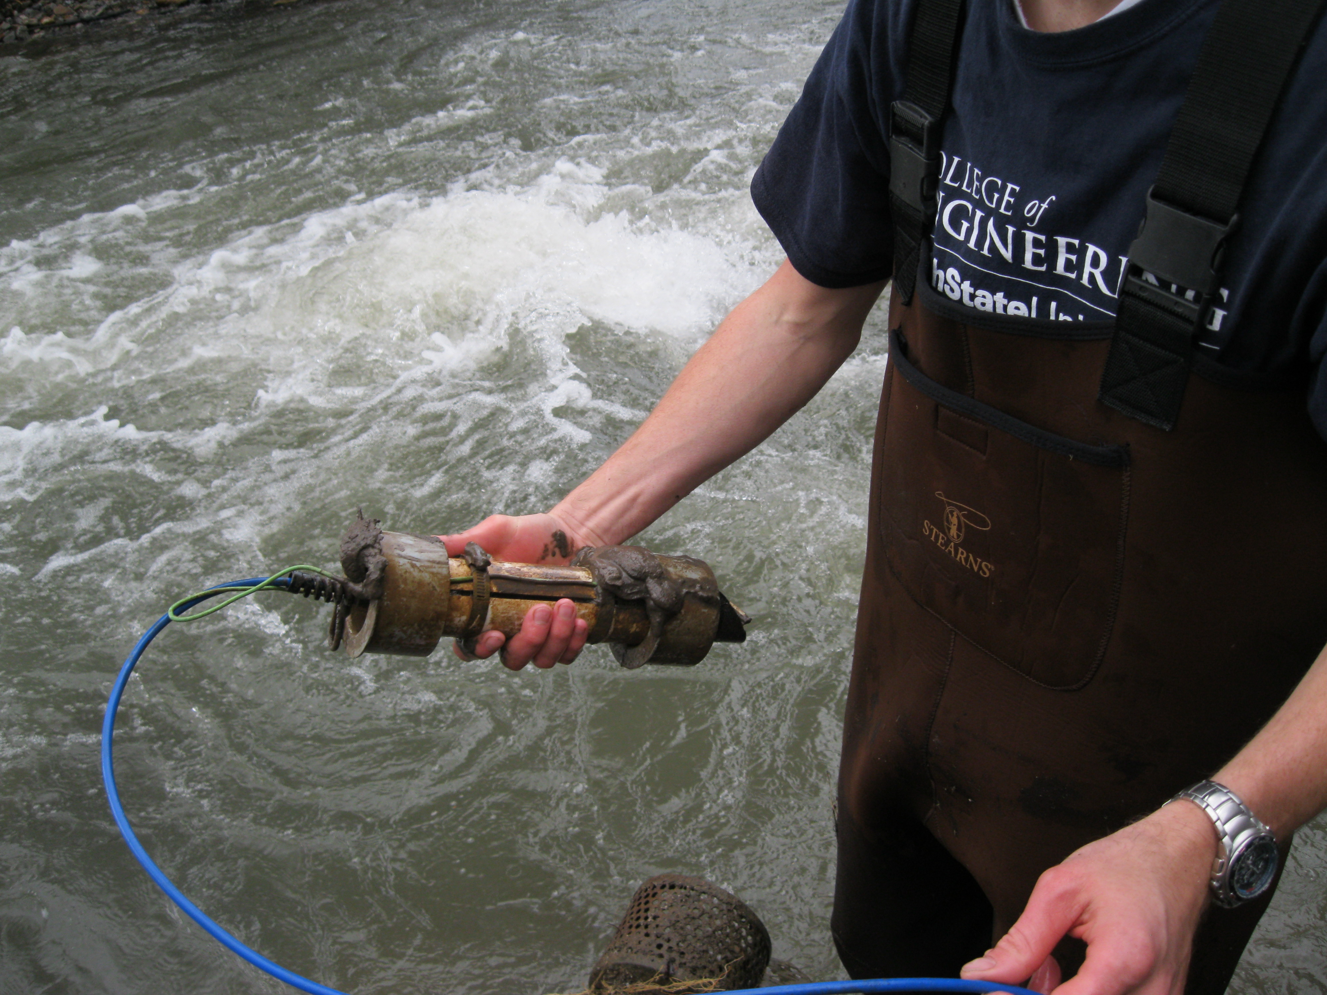
Turbidity as Surrogate
Notes:
Turbidity is well-established as a surrogate for TSS/SSC.
Turbidity itself may be more important than sediment mass loading because of biological effects, ability to monitor small particle sizes, etc.
However, turbidity cannot be directly translated to mass loading i.e. for TMDLs, can also be affected by humic substances and organic matter
The relationship between turbidity and the amount of suspended solids depends on the size, density, shape and type of the particles, so the same mass of SS can give different turbidity readings.
Because of particle size effects, there may be spatio-temporal variability, so relationships should be examined as site specific and different time periods may also be significant.

Slide 12
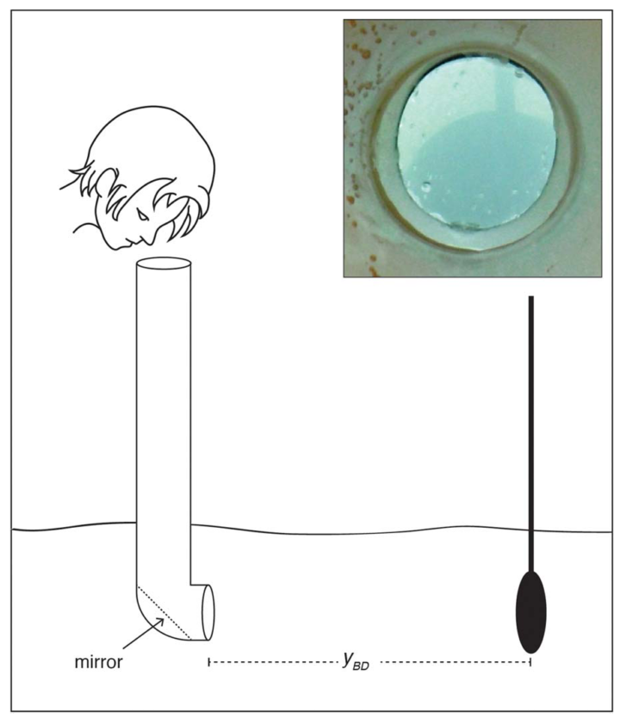
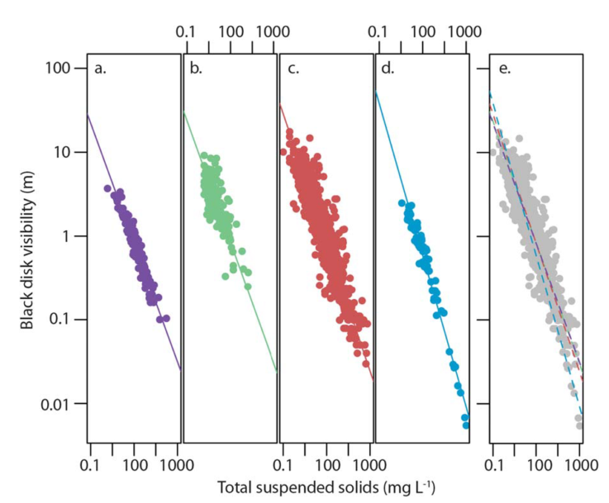
Black Disc Visibility
From West and Scott, 2016
Notes:
A different type of surrogate for suspended solids- black disc visibility- which (authors) found had a stronger relationship with TSS than did turbidity at multiple sites. Not continuous data, but might be of interest for citizen science monitoring.
West and Scott (2016)

Slide 13
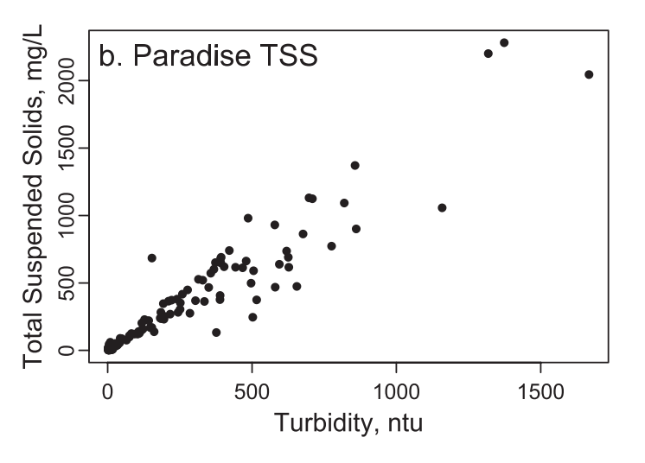
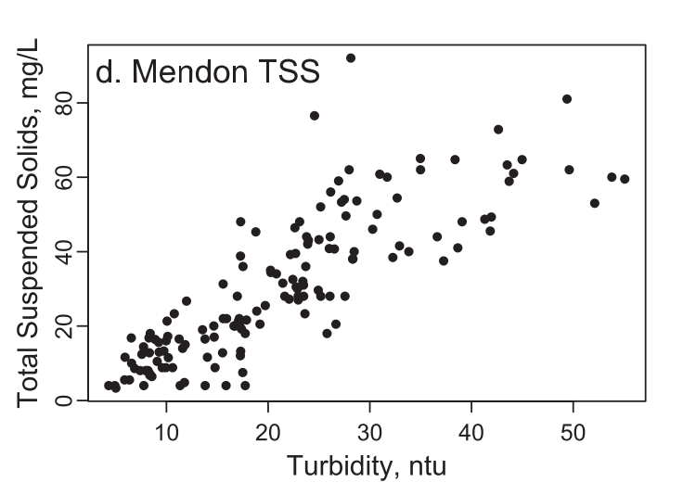
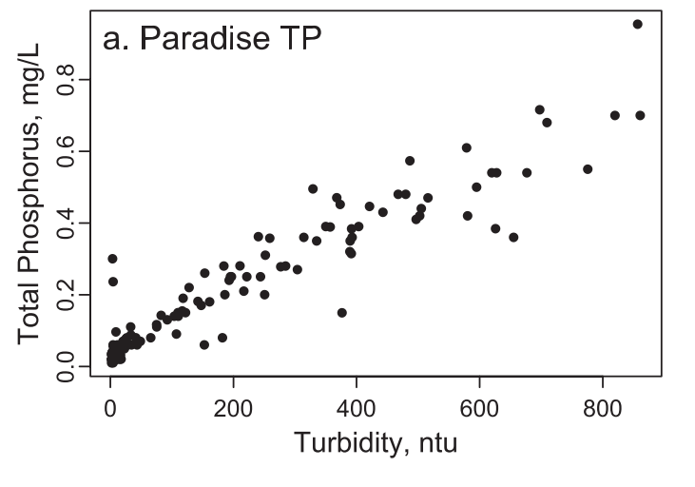
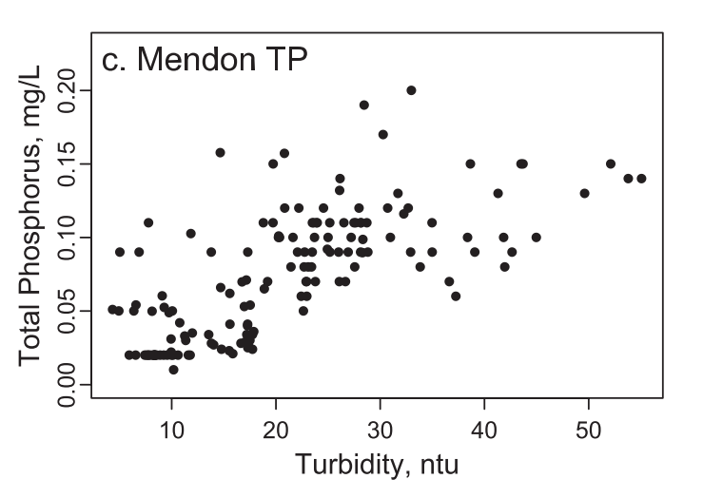
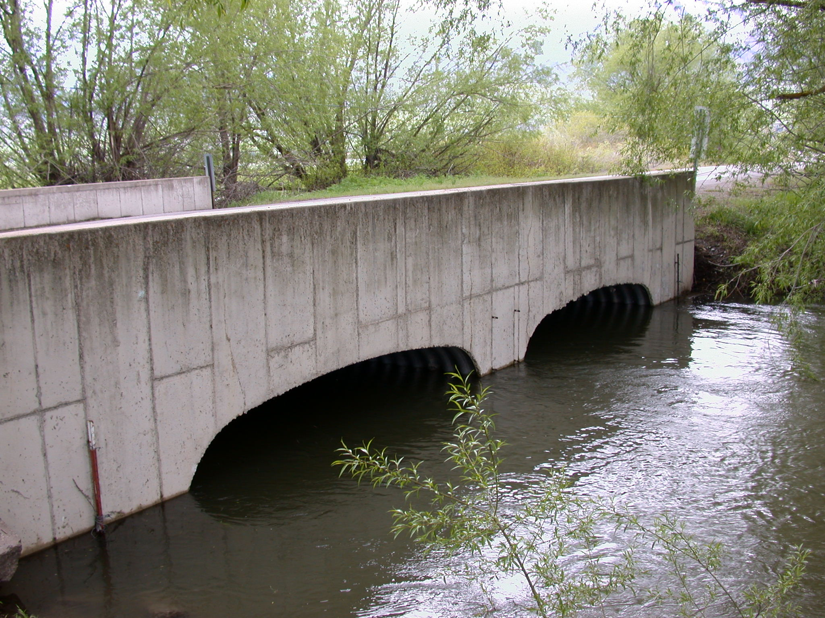
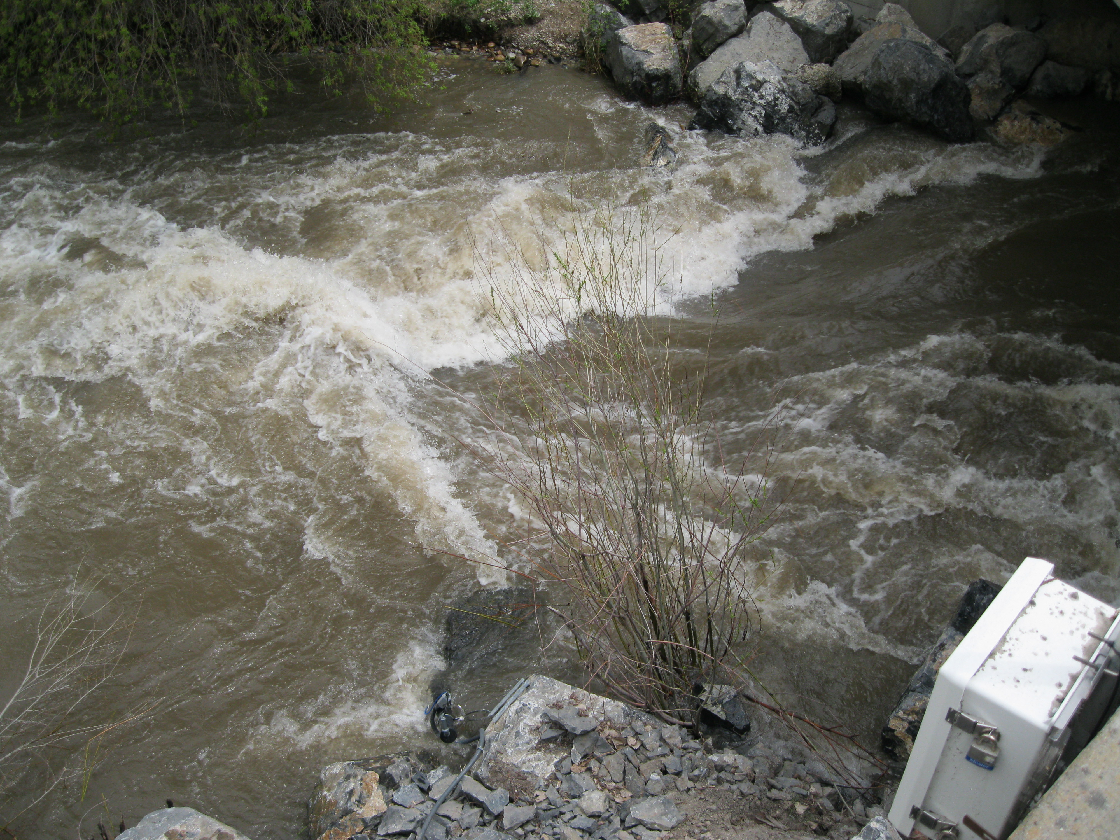
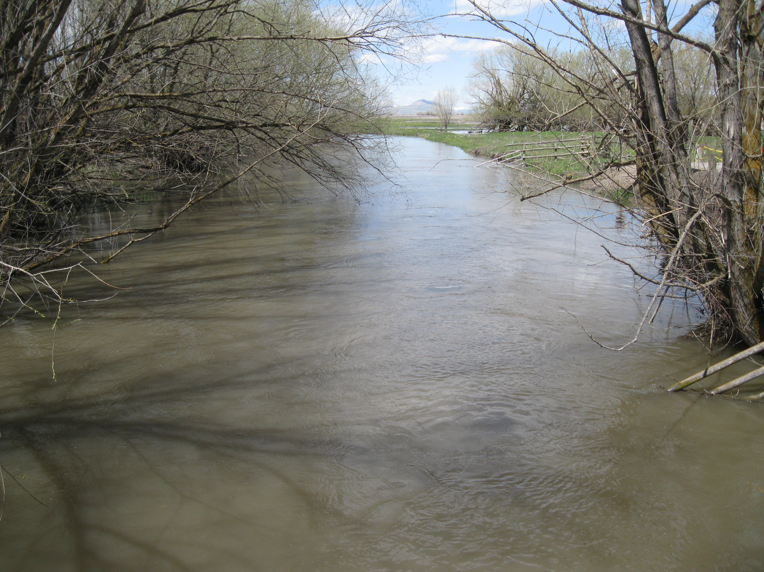
Understand SpatioTemporal Characteristics
Paradise
From Jones et al., 2011
Mendon
Notes:
As mentioned, surrogate relationships, particularly with turbidity should be site specific, so the relationships can help shed light on watershed (or temporal) characteristics.
Higher ranges at Paradise, tighter correlation with turbidity.
Regression developed more complex at Mendon- included more variables.
Attributed to different sediment characteristics: finer sediments at Mendon
Attributed to different P sources: more of the P is dissolved at Mendon
Sometimes the inclusion of a temporal variable in the relationship helps explain some of these differences.
In the Little Bear River, we found that spring snowmelt runoff vs baseflow was a significant variable for TP, but storm events were not a significant variable.

Slide 14
Understand SpatioTemporal Characteristics
From Jones et al., 2012
Paradise
Mendon
Notes:
Table has reactivity indices (flow or sediment transported in 2% of the time) and the time to transport 50% of the sediment load based on loads determined by results of surrogate measures. The time equivalent is telling- for Paradise it is 9 days to transport half of the sediment and for Mendon it is 114 days (for two years). Comparing these numbers to some other studies- Mendon’s characteristics were similar to larger rivers.

Slide 15
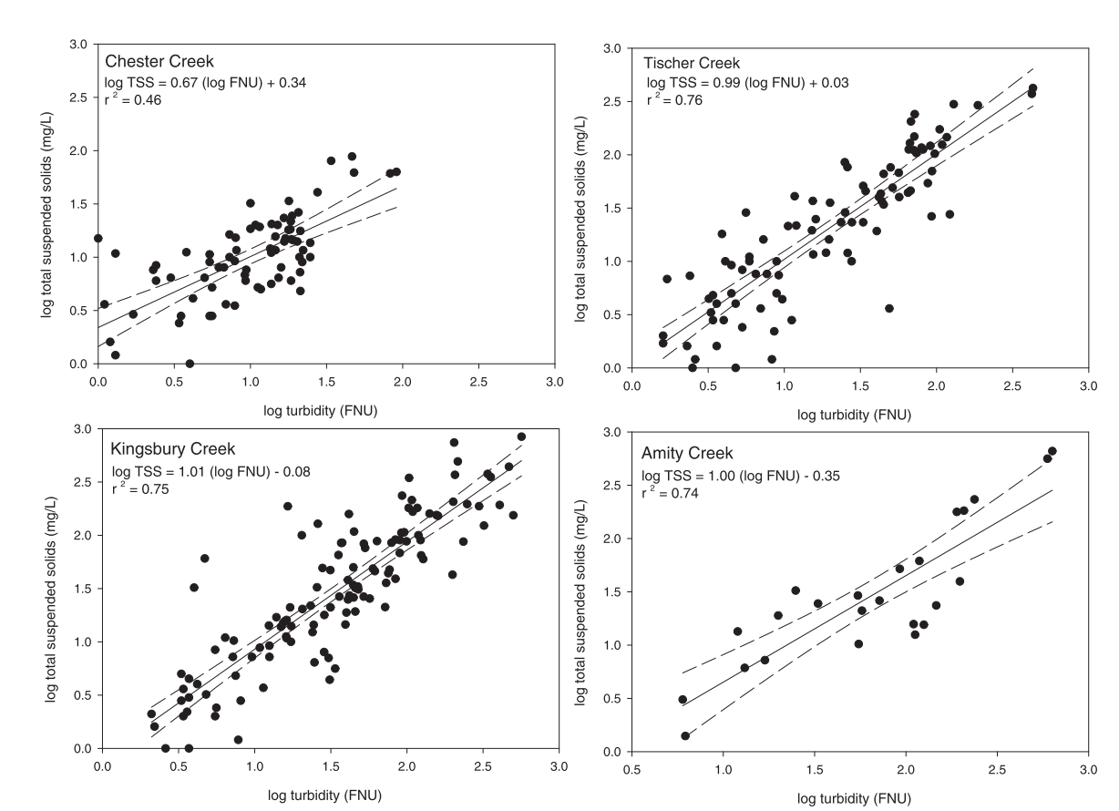
Understand SpatioTemporal Characteristics
From Ruzycki et al., 2014
Notes:
Ruzycki etal 2014 found similar slopes between turbidity and SS in three out of four creeks. The different ratio of the outlier creek warrants additional analysis into source.

Slide 16
Understand SpatioTemporal Characteristics
From Alberto et al., 2016
Notes:
Another example:
Alberto etal found runoff volume, storm intensity, and season to be significant explanatory variables, and could determine which sites were more susceptible to erosion/loading when event volume high vs. intensity is high.
Also performed particle size analysis of the rain event suspended sediment sample, which indicated significant differences between the three rivers that would have accounted for differences in the SSC-turbidity relationships.

Slide 17
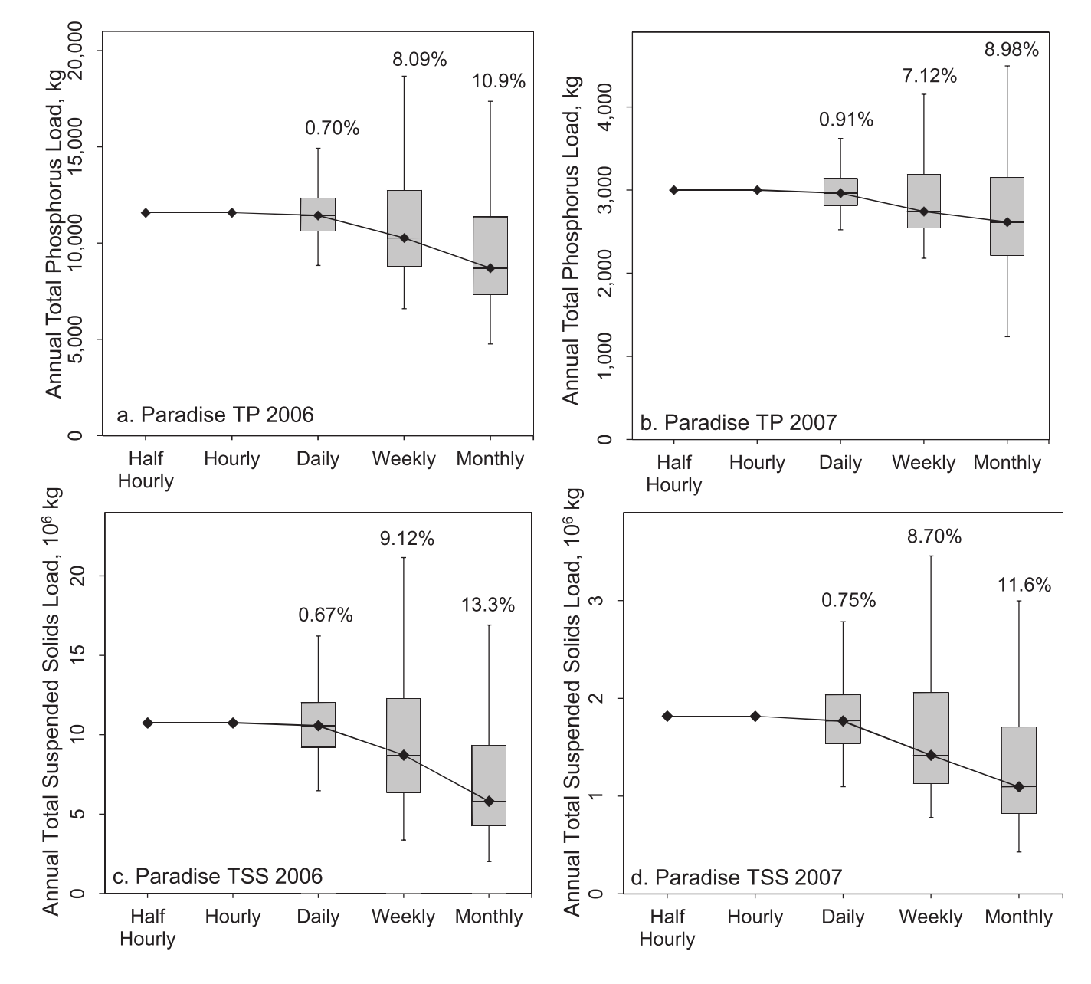
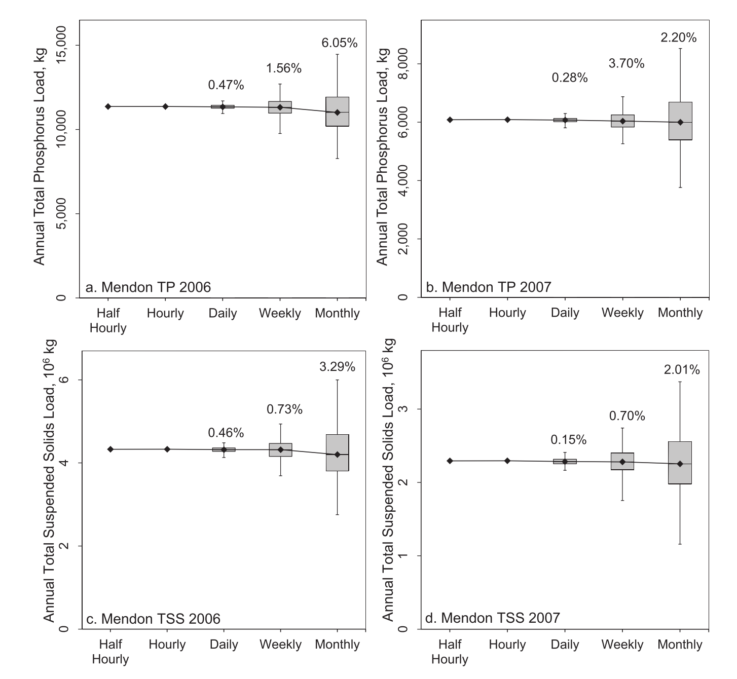
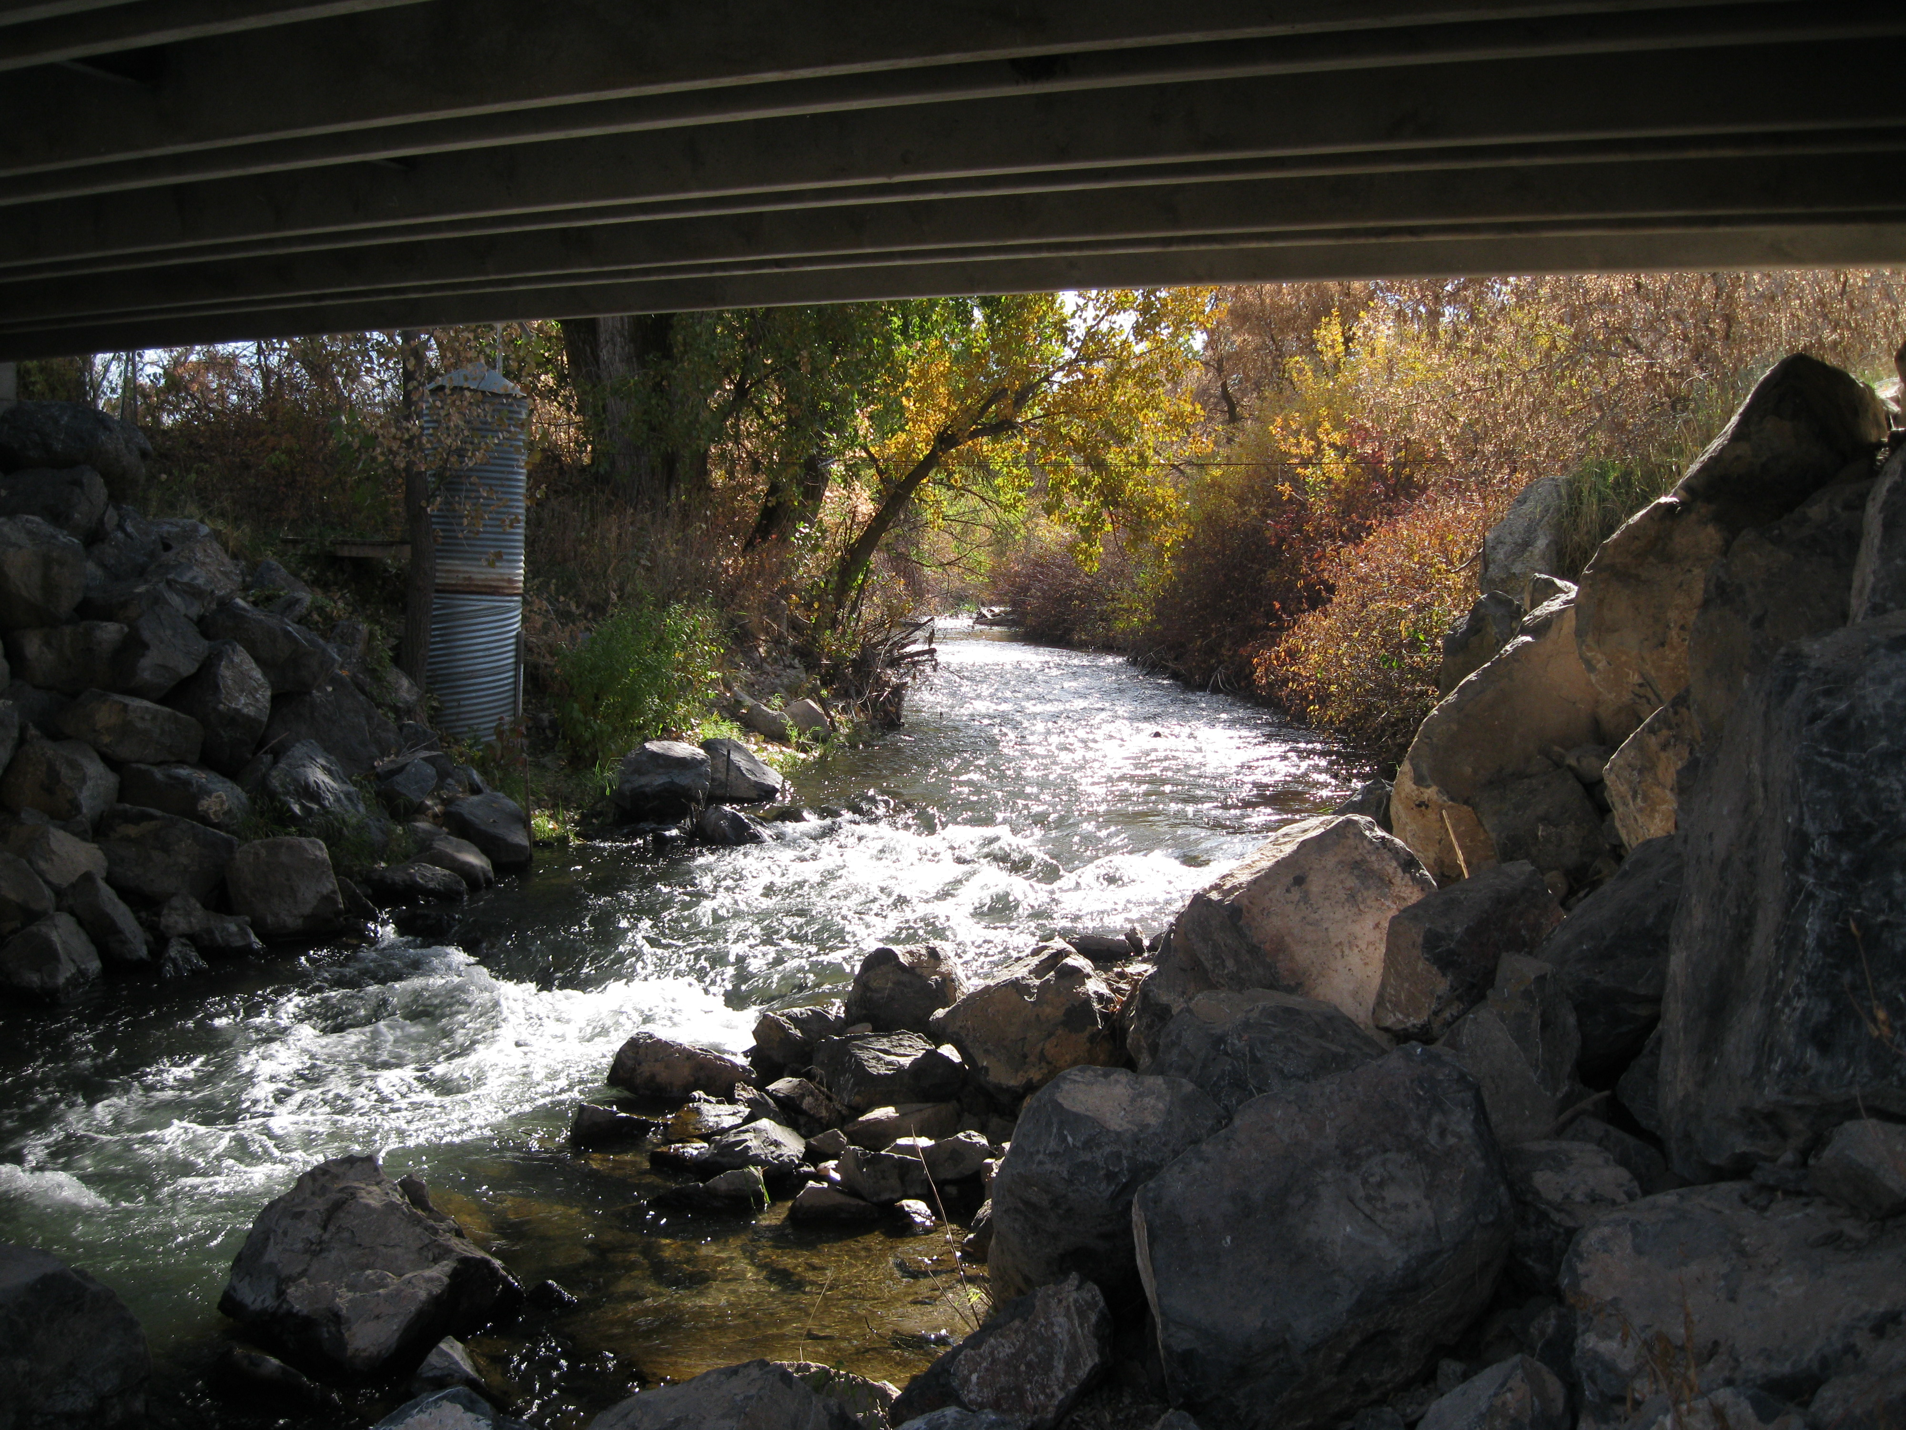
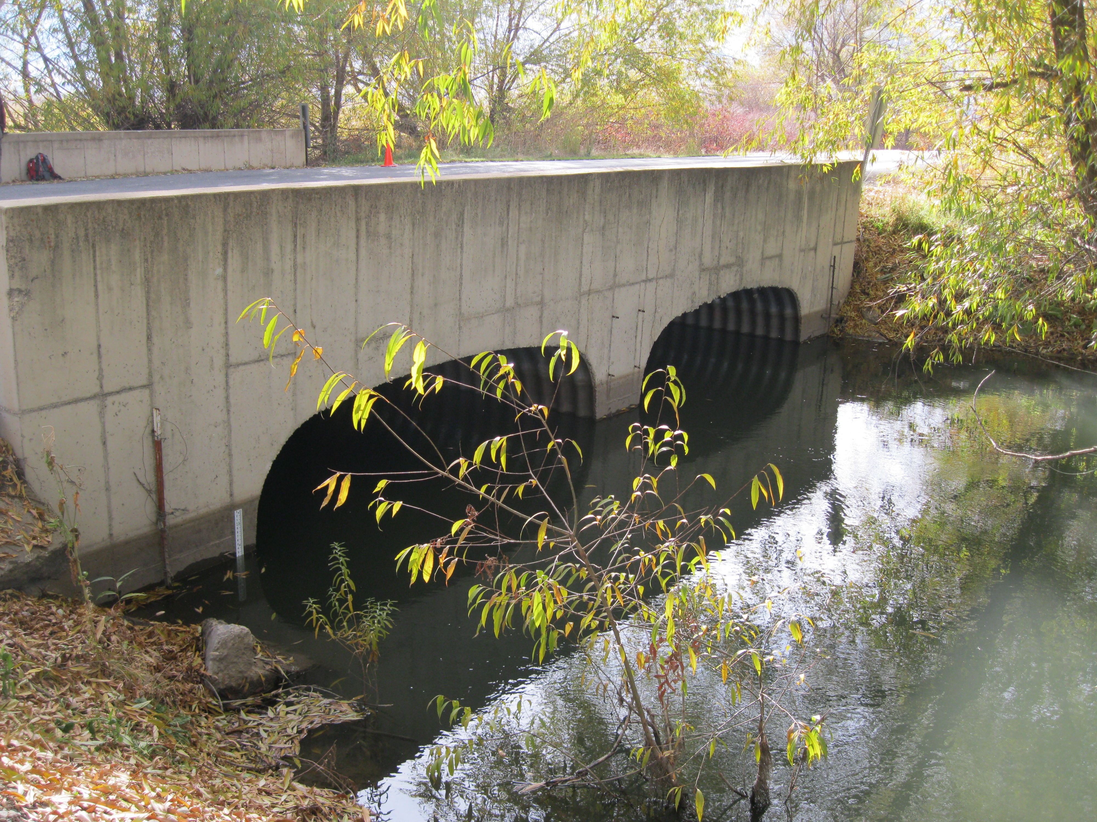
Investigate Effects of Sampling Frequency on Load Estimation
Paradise
From Jones et al., 2012
Mendon
Notes:
We used loads estimated by high frequency surrogate measures as a “gold standard” and compared loads at decreased sampling frequency. We performed this 10,000 times to explore a possible range of sampling scenarios. Wide range of possible loads as sampling frequency decreases- high likelihood of underestimation with possibility of grossly overestimating.
We also found differences in loads between day and night sampling and even day of the week.
This indicates that for a flashy site such as Paradise, high frequency data is more important, but for a more consistent site like Mendon, less frequent data collection may be acceptable- depending on permissible level of uncertainty in load calculation.

Slide 18
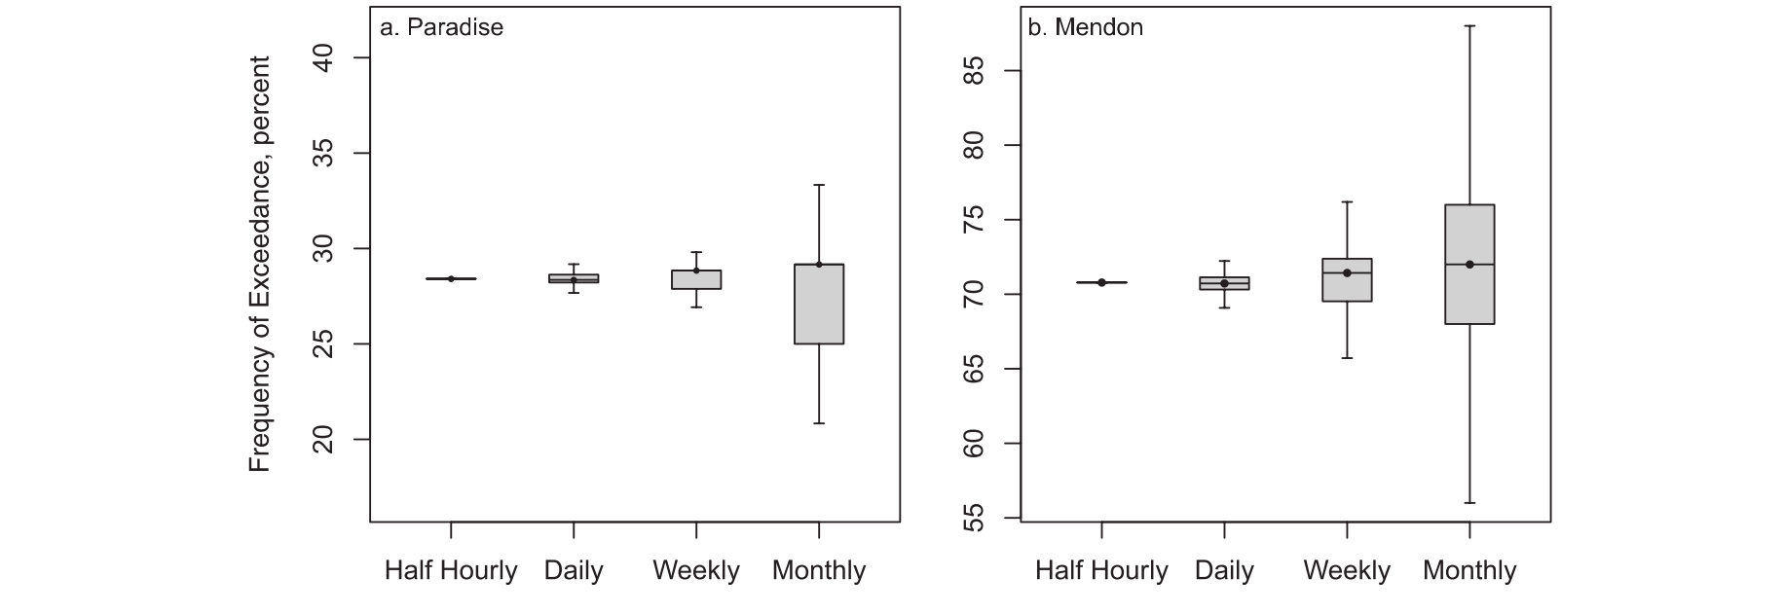
Assess Compliance with Numeric Criteria
From Jones et al., 2012
Paradise
Mendon
Notes:
From the loads that we calculated, we determined the frequency of exceedance of the TP criterion of 0.05 mg/L at the two sites. At all sampling frequencies, the central tendency of the frequency of exceedance is consistent, but there is wide spread in possible determinations for less frequent sampling.
In this case, it looks like the spread is greater at Mendon, indicating that high frequency monitoring may be more important, however, it depends on the acceptable frequency of exceedence. 70% indicates that the standard is probably exceeded!

Slide 19
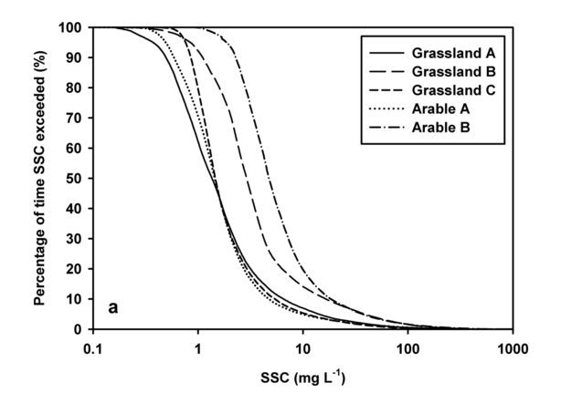
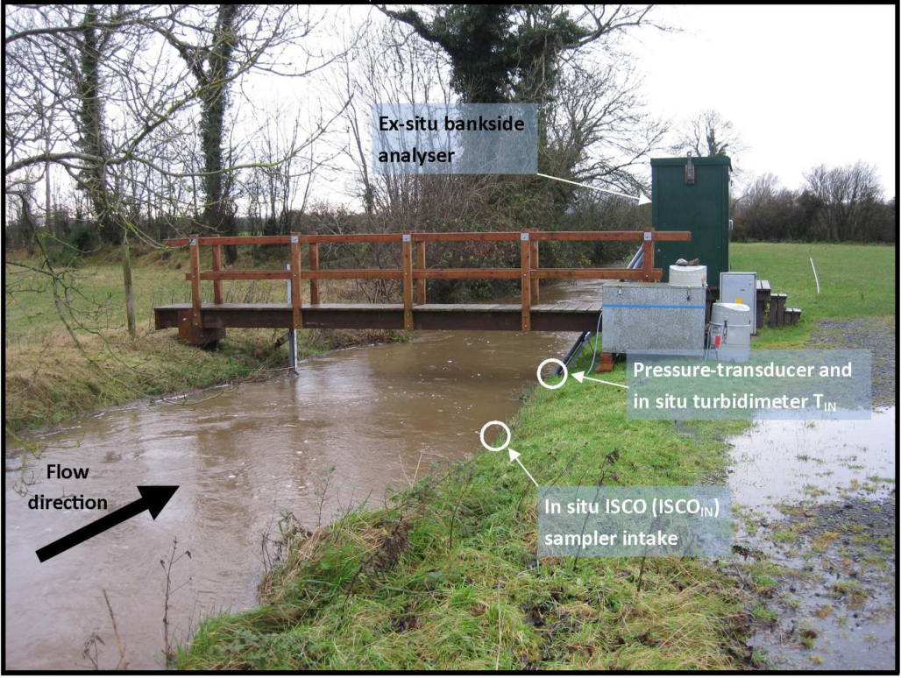
Assess Compliance with Numeric Criteria
From Sherrif et al., 2015
Notes:
Simple example- from Sherrif etal 2015 showing five different sites/watersheds. Criteria is 25 mg/L- exceeded 1-11% of time, depending on the watershed.

Slide 20
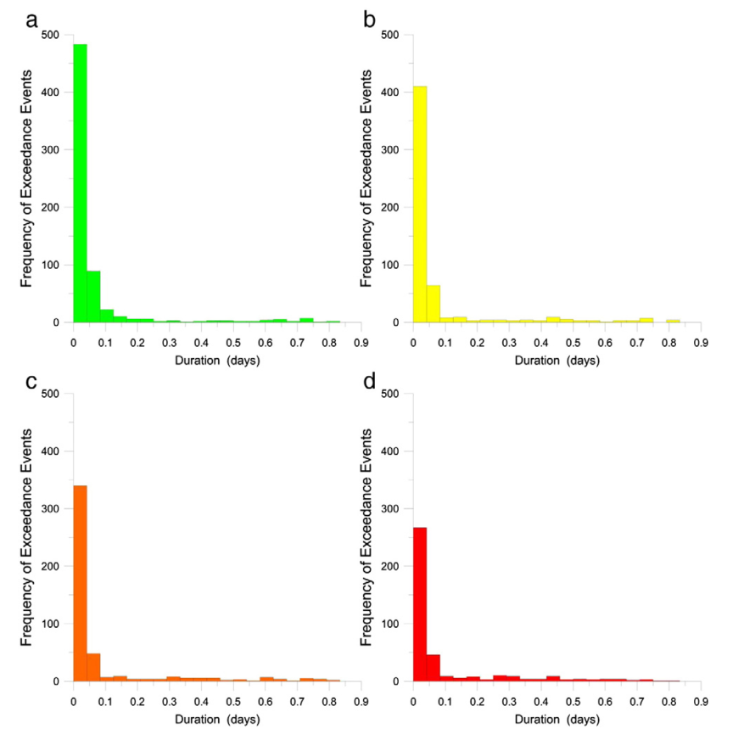
Assess Compliance with Numeric Criteria
From Thompson et al., 2013
Notes:
Another example from Thompson etal. One site with the exceedance of four different criterion levels and the duration of those exceedances. With more stringent criteria, the frequency of exceedance increases, but the duration of the exceedance decreases.

Slide 21
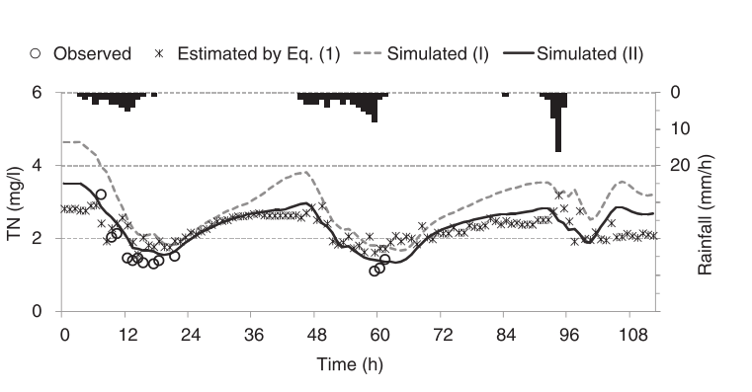
Comparison to WQ Models
From Kim and Furumai, 2013
Notes:
Kim and Furumai 2013 Used turbidity and specific conductance to estimate TN, data which they then used to calibrate parameters of a rainfall-pollutant-runoff model.

Slide 22
Surrogate Measures for Increasing Number of Eco-Regions and Stream Types
Alberto et al., 2016: Prince Edward Island: 3 different rivers, snow cover in winter, row crops, low slopes.
Ballantine and Davies-Colley, 2016: Intensively-agricultural (dairy) New Zealand watershed. Used for TN, TP, E.coli, DRP, NO3.
Ruzycki et al. 2014: Flashy, coldwater lake Superior streams. Forested, under urban development
Skarvobik and Roseth, 2015: Norwegian streams affected by road construction and road salt.
Valkami and Ruth, 2016: Watershed in Finland- showed method for deploying turbidity sensor under ice.
Slaets etal 2014: Mountainous watershed in Vietnam with tropical monsoon climate.

Slide 23
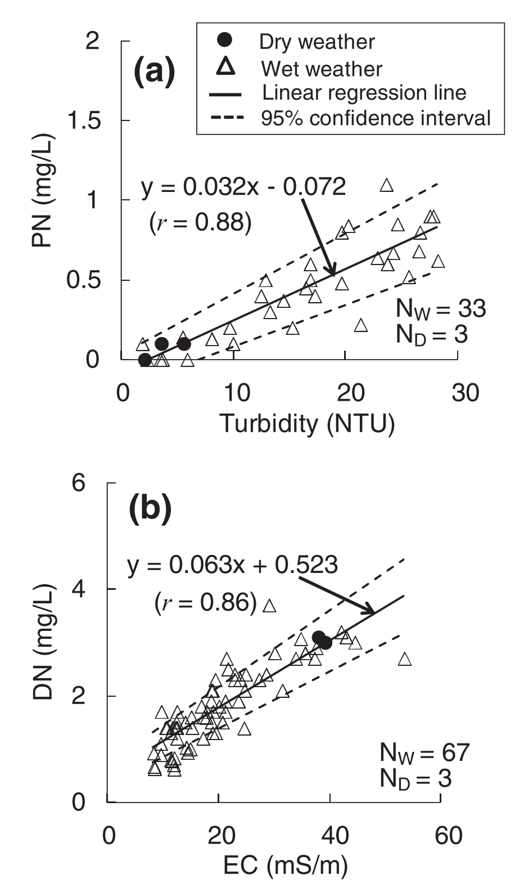
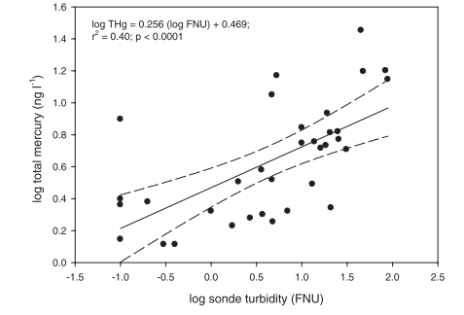
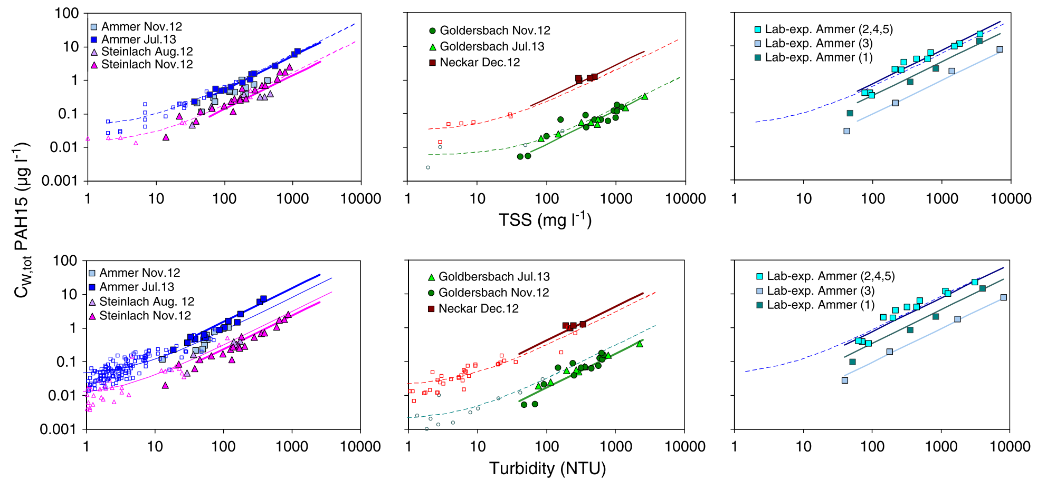
Surrogate Measures for Increasing Number of Constituents
Surrogate | Constituent
Turbidity | Total Phosphorus, Total Organic Carbon, Total Mercury, E. coli, Metals, Hydrophobic Organic Compounds, Total Nitrogen, Suspended Solids
Specific conductance | Dissolved Solids, Alkalinity, Chloride, Calcium, Potassium, Sodium, Magnesium, Orthophosphate, Pesticides, Dissolved Nitrogen
fDOM | Dissoved Organic Carbon, Methyl Mercury
UV-Vis | Total Kjeldahl Nitrogen, Total Phosphorus, Orthophosphate, Salinity, Nitrate, Dissolved Organic Carbon, Suspended Solids
From Ruzycki et al., 2011
From Rugner et al, 2014
From Kim and Furumai, 2013
Notes:
Etheridge etal 2014 used a UV-vis sensor and used models to relate the response at various wavelengths to estimate a large number of constituents.
Ruzycki etal 2014 documented relationship between turb and total Mercury for forest/urban Minnesota streams
Rugner et al documented relationship between turb/TSS and PAHs (for German Rivers)
Kim and Furumai 2013 used turb for PN and spcond for DN and summed
Water temperature, day of the year, discharge (and related components), other temporal variables may be used.

Slide 24
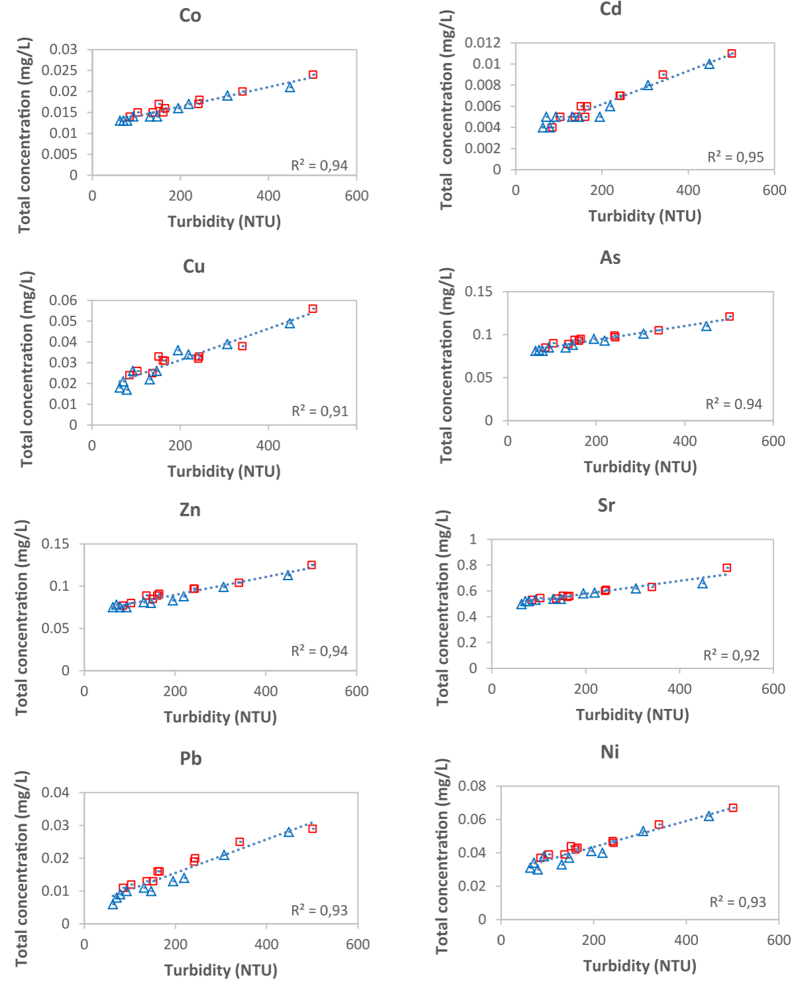
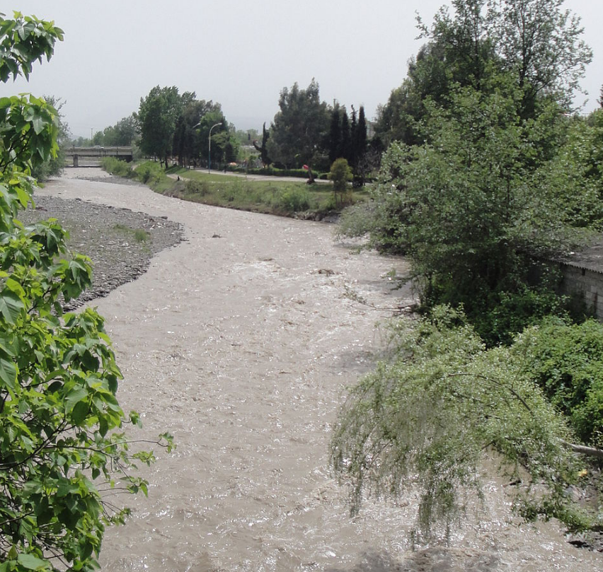
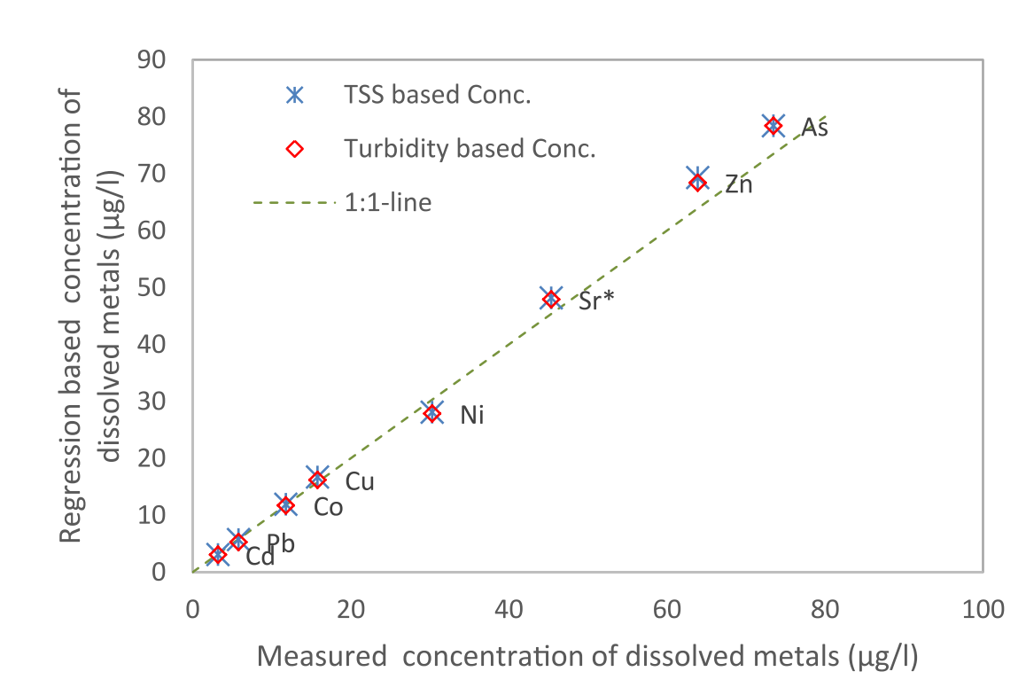
Surrogate Measures for Increasing Number of Constituents
From Nasrabadi et al., 2016
Notes:
Nasrabadi etal 2016 found significant relationships between 8 metals and turbidity across flow ranges in an Iranian River in a mostly agricultural area with prevalent gravel/sand operations.
Compared dissolved concentrations to intercept values on relationships. Slope should represent the concentration associated with sediment.
Does this prevalence mean that it works everywhere? Not necessarily- a lot depends on the watershed/site and the variables of interest.

Slide 25
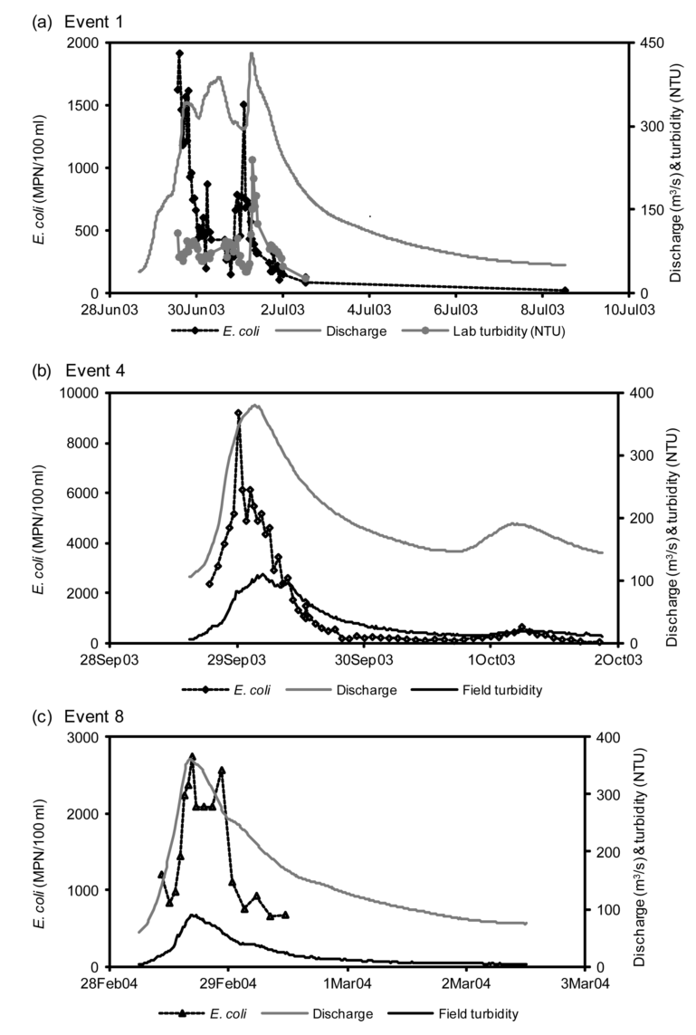
From McKergow and Davies-Colley, 2010
Notes:
Some instances where common surrogates DON”T work well… Mckergow and davies colley used surrogates to derive EMCs for E. coli. Some studies have found good relationships between E.coli and turbidity, but in this case, turbidity was NOT a very good surrogate- probably because the catchment too large because of geographically separated sources of Ecoli and sediment.

Slide 26
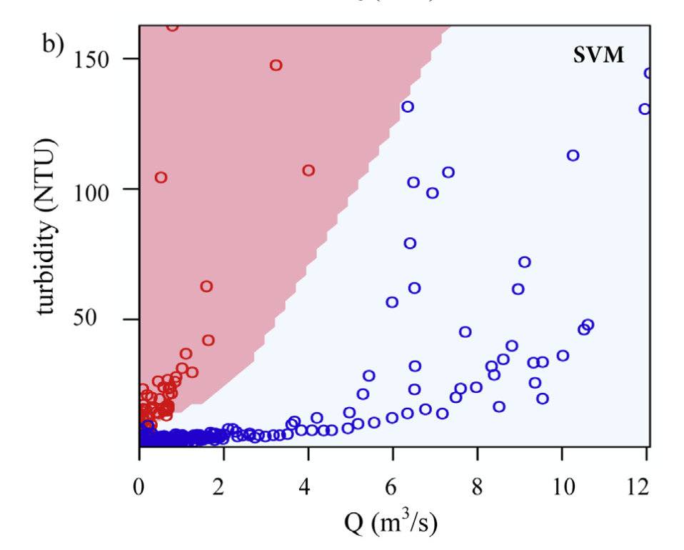
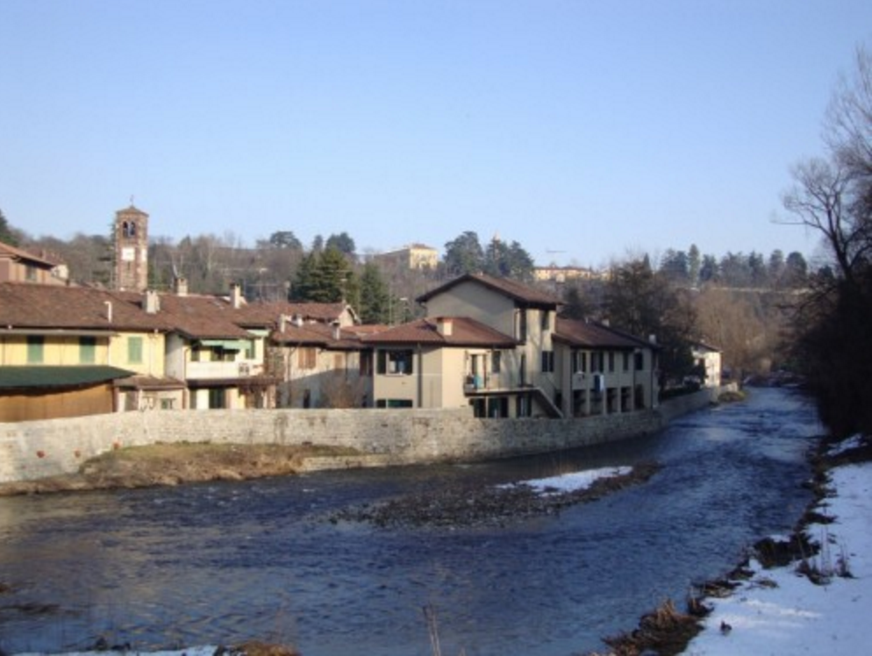
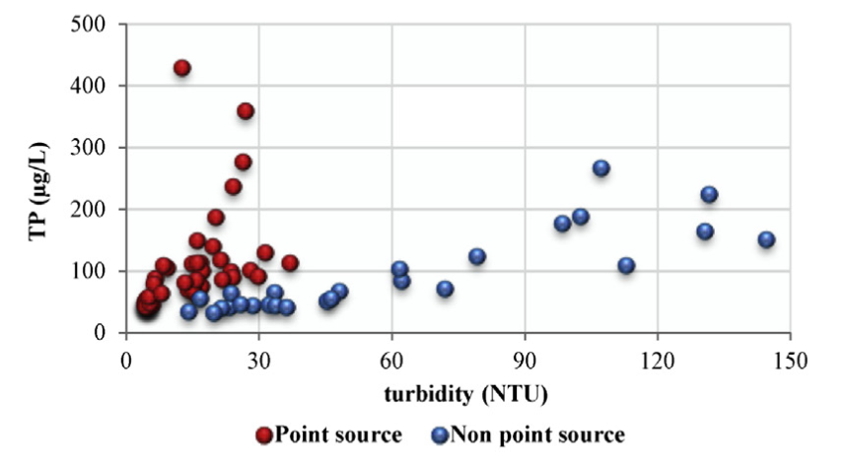
Source Tracking
From Viviano et al., 2014
Notes:
Viviano etal attempted to develop a surrogate relationship for TP in a highly urbanized watershed with prevalent sewer overflows in Italy. Turbidity was not an adequate predictor, nor were any of the other potential explanatory variables. However, they were able to use caffeine to distinguish between point and non point sources of phosphorus and then develop two separate relationships between turbidity and TP. The combination of flow and turbidity can be used to determine whether to use the point or nonpoint relationship.

Slide 27
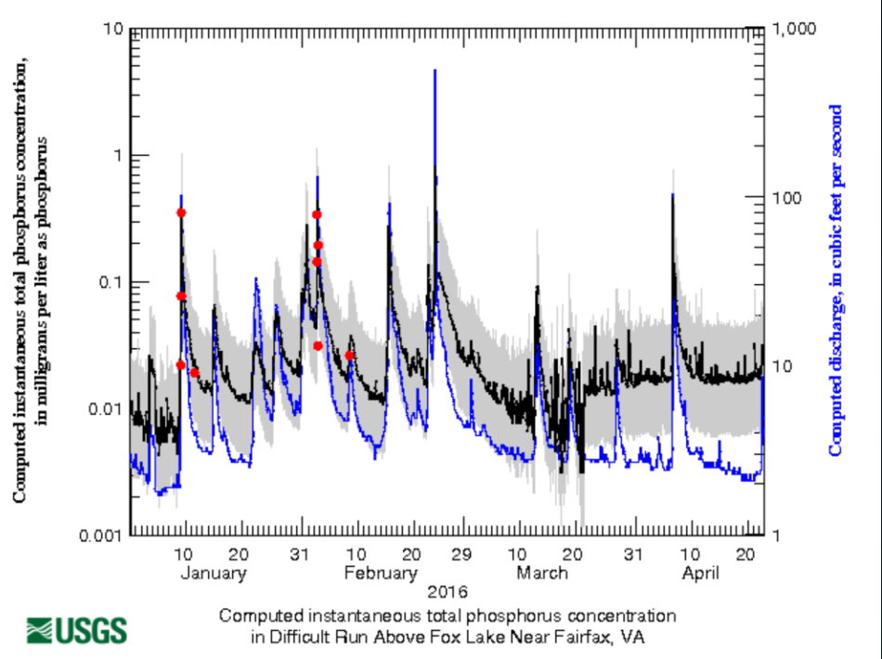
Uncertainty in Surrogate Relationships
From Ruzycki et al., 2014
From Horsburgh et al., 2010
Notes:
All of this sounds great for surrogate measures, however, the validity of the estimated concentrations and loads may depend on the acceptable levels of uncertainty in relationships.
The USGS recommends determining prediction intervals on concentration.

Slide 28
USGS guidance on implementation and R package
Require following USGS protocols for sensor and sample data.
Collect minimum of 36 samples for one explanatory variable (48 for two):
Half fixed interval, half event sampling
Over three years recommended
Sample range of conditions
R package to assist with model development:
Residuals must have constant variance, normally distributed
Exclude outliers when shown to be errors
Includes measures of statistical diagnostics to evaluate models
Produces Model Archive Summary
Model submitted to two qualified colleague reviewers
Ongoing sampling should verify model (8 samples/year) with annual model review
Allows USGS staff to generate concentration and load estimates with more streamlined documentation.
From Rasmussen et al., 2016

Slide 29
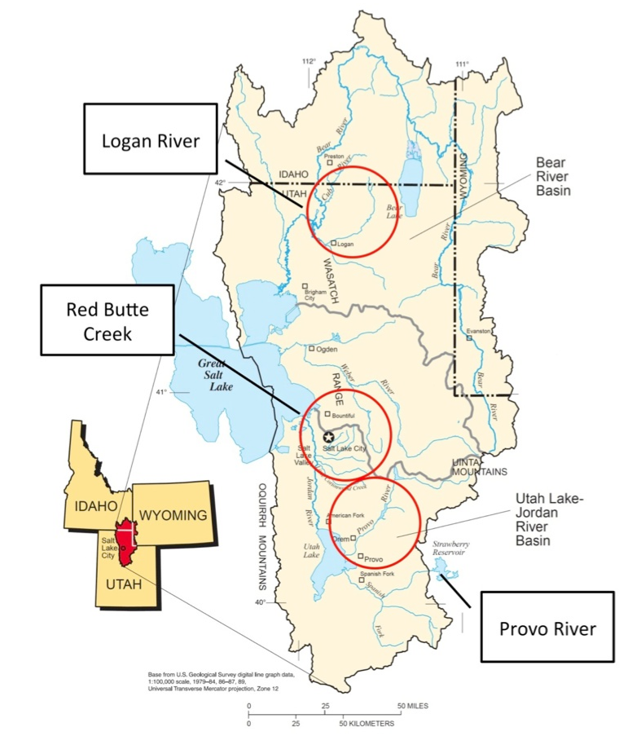
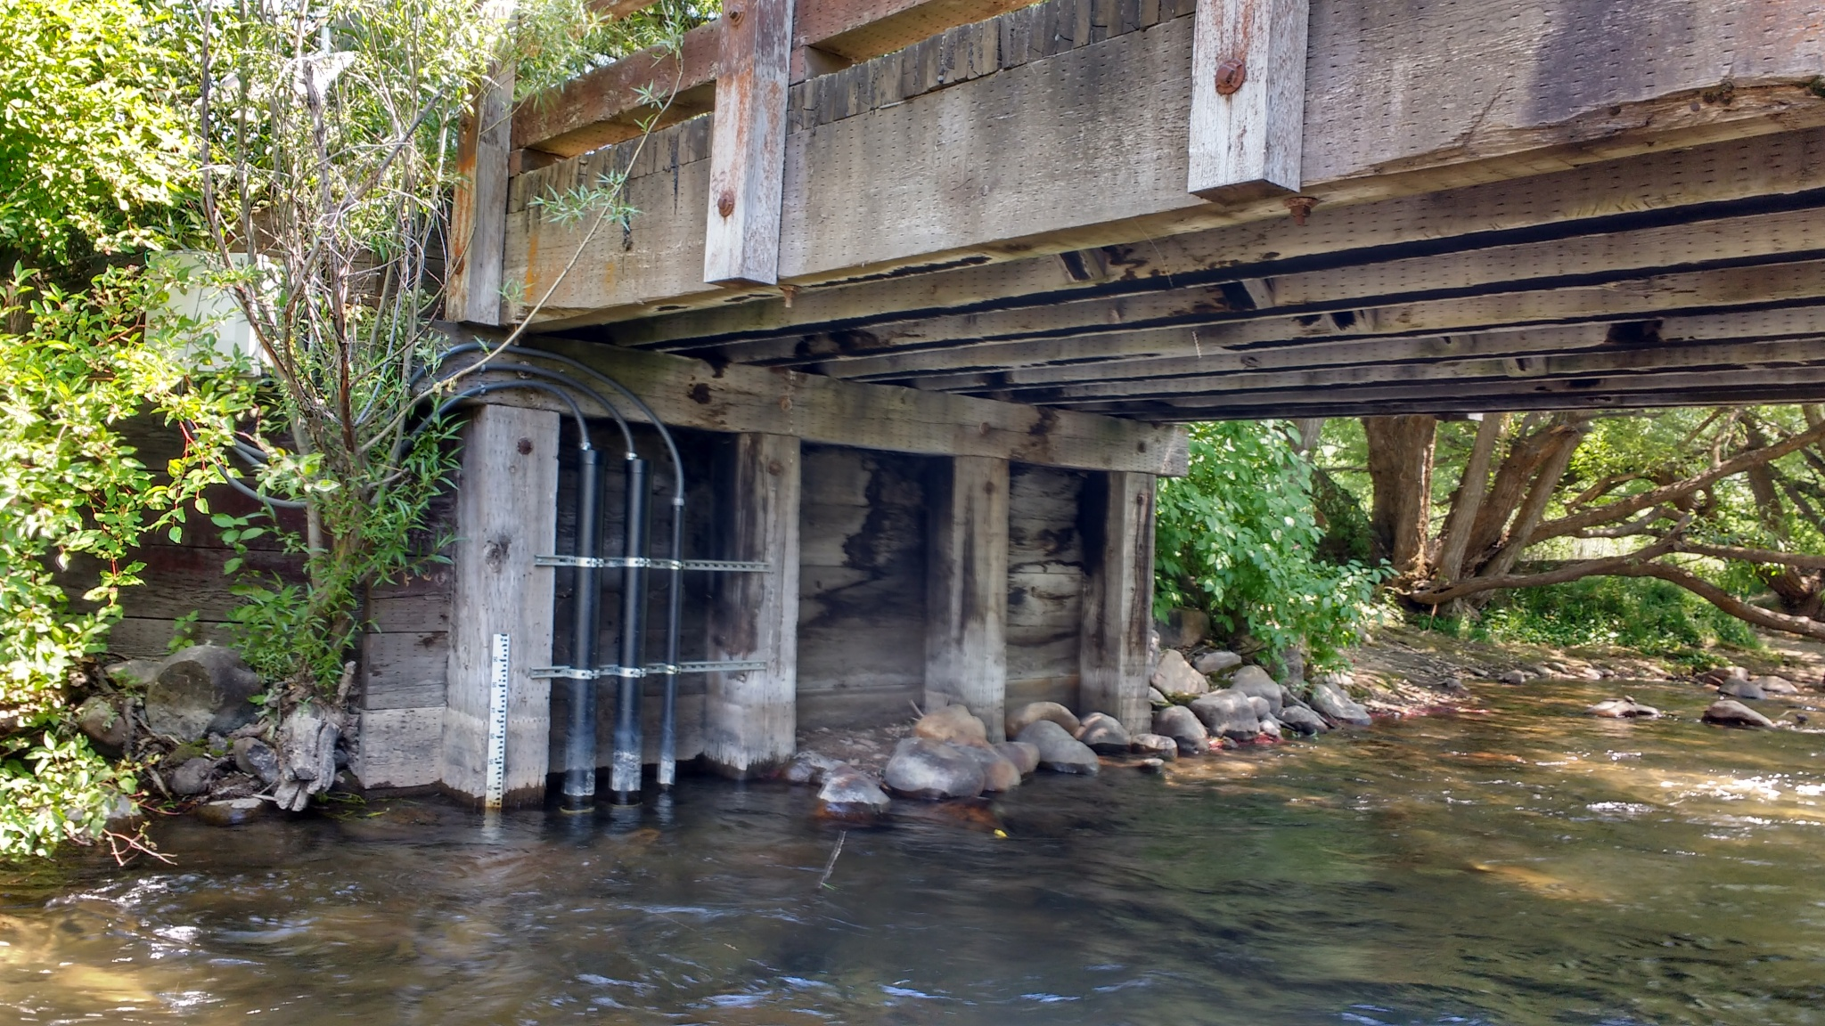
Surrogate Relationships for iUTAH GAMUT
iUTAH: innovative Urban Transitions and Aridregion Hydrosustainability
GAMUT: Gradients Along Mountain to Urban Transitions
Ecohydrologic observatory deployed in 3 watersheds in northern Utah, USA: Logan River, Red Butte Creek, Provo River
Watersheds with similar water source (high elevation snow) but different land use transitions

Slide 30
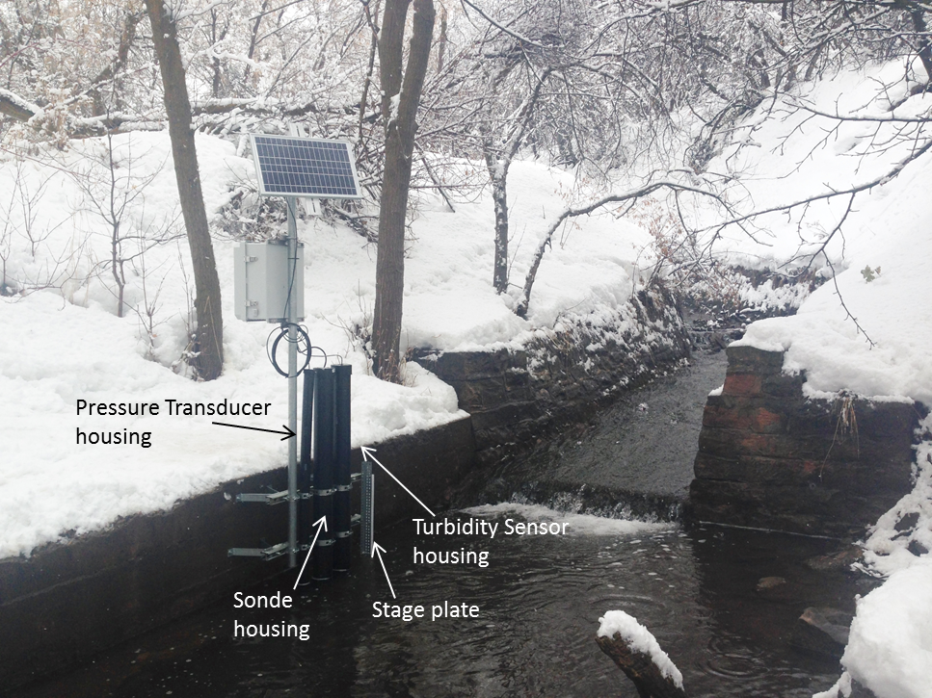
Surrogate Relationships for iUTAH GAMUT
In situ sensors making measurements every 15 minutes for ~ 3 years at 4 sites in 3 watersheds
Samples collected biweekly and analyzed for water quality parameters
Plan to investigate surrogate relationships for suspended sediment, phosphorus species, nitrogen species, E. coli, and DOC
Plan to employ USGS R package for model development
Relationships may be used to provide better insight into constituent transport, source tracking of water and constituents
Notes:
Now have body of data available for the determination of surrogate relationships

Slide 31
Challenges of Surrogate Approach
Detection limits of sensors
Sensor fouling
Sensor operation during extreme conditions: ice, flooding, sediment burial, etc.
Data management and data quality control
Doesn’t account for variability across channel or at various depths
Site specificity of relationships- strength influenced by site characteristics
Need for determination of uncertainty- is it acceptable for objective of monitoring program?
Notes:
We’ve done work to try to overcome many of these challenges.

Slide 32
References
Alberto, A., St-Hilaire, A., Courtenay, S.C., van den Heuvel, M.R., 2016. Monitoring stream sediment loads in response to agriculture in Prince Edward Island, Canada. Environ. Monit. Assess. 188. doi:10.1007/s10661-016-5411-3
Ballantine, D.J., Davies-colley, R.J., 2016. Nitrogen , phosphorus and E . coli loads in the Sherry River, New Zealand. New Zeal. J. Mar. Freshw. Res. 47. doi:10.1080/00288330.2013.815640
Etheridge, J.R., Birgand, F., Osborne, J.A., Osburn, C.L., Burchell, M.R., Irving, J., 2014. Using in situ ultraviolet-visual spectroscopy to measure nitrogen , carbon , phosphorus , and suspended solids concentrations at a high frequency in a brackish tidal marsh. Limnol. Oceanogr. Mehods 12, 10–22. doi:10.4319/lom.2014.12.10
Horsburgh, J.S., Spackman Jones, A., Stevens, D.K., Tarboton, D.G., Mesner, N.O., 2010. A sensor network for high frequency estimation of water quality constituent fluxes using surrogates. Environ. Model. Softw. 25, 1031–1044. doi:10.1016/j.envsoft.2009.10.012
Jones, A.S., Stevens, D.K., Horsburgh, J.S., Mesner, N.O., 2011. Surrogate measures for providing high frequency estimates of total suspended solids and total phosphorus concentrations. J. Am. Water Resour. Assoc. 47, 239–253. doi:10.1111/j.1752-1688.2010.00505.x
Kim, J., Furumai, H., 2013. Improved calibration of a rainfall-pollutant-runoff model using turbidity and electrical conductivity as surrogate parameters for total nitrogen. Water Environ. J. 27, 79–85. doi:10.1111/j.1747-6593.2012.00328.x
McKergow, L.A., Davies-colley, R.J., 2010. Stormflow dynamics and loads of Escherichia coli in a large mixed land use catchment. Hydrol. Process. 24, 276–289. doi:10.1002/hyp.7480
Nasrabadi, T., Ruegner, H., Sirdari, Z.Z., Schwientek, M., Grathwohl, P., 2016. Using total suspended solids (TSS) and turbidity as proxies for evaluation of metal transport in river water. Appl. Geochemistry 68, 1–9. doi:10.1016/j.apgeochem.2016.03.003
Rügner, H., Schwientek, M., Egner, M., Grathwohl, P., 2014. Monitoring of event-based mobilization of hydrophobic pollutants in rivers : Calibration of turbidity as a proxy for particle facilitated transport in fi eld and laboratory. Sci. Total Environ. 490, 191–198. doi:10.1016/j.scitotenv.2014.04.110
Ruzycki, E.M., Axler, R.P., Henneck, J., Will, N.R., Host, G.E., 2011. Estimating mercury concentrations and loads from four western Lake Superior watersheds using continuous in-stream turbidity monitoring. Aquat. Ecosyst. Heal. Manag. 14, 422–432. doi:10.1080/14634988.2011.624863
Ruzycki, E.M., Axler, R.P., Host, G.E., Henneck, J.R., Will, N.R., 2014. ESTIMATING SEDIMENT AND NUTRIENT LOADS IN FOUR WESTERN LAKE SUPERIOR STREAMS. JAWRA J. Am. Water Resour. Assoc. 50. doi:10.1111/jawr.12175
Sherriff, S.C., Rowan, J.S., Melland, A.R., Jordan, P., Fenton, O., O hUallachain, D., 2015. Investigating suspended sediment dynamics in contrasting agricultural catchments using ex situ turbidity-based suspended. Hydrol. Earth Syst. Sci. 19, 3349–3363. doi:10.5194/hess-19-3349-2015
Skarbøvik, E., Roseth, R., 2015. Use of sensor data for turbidity, pH and conductivity as an alternative to conventional water quality monitoring in four Norwegian case studies. ACM Queue 65. doi:10.1080/09064710.2014.966751
Slaets, J.I.F., Schmitter, P., Hilger, T., Lamers, M., Piepho, H.-P., Vien, T.D., Cadisch, G., 2014. A turbidity-based method to continuously monitor sediment, carbon and nitrogen flows in mountainous watersheds. J. Hydrol. 513, 45–57. doi:10.1016/j.jhydrol.2014.03.034
Thompson, J., Cassidy, R., Doody, D.G., Flynn, R., 2013. Assessing suspended sediment dynamics in relation to ecological thresholds and sampling strategies in two Irish headwater catchments. Sci. Total Environ. 468-469, 345–357. doi:10.1016/j.scitotenv.2013.08.069
Viviano, G., Salerno, F., Manfredi, E.C., Polesello, S., Valsecchi, S., Tartari, G., 2014. Surrogate measures for providing high frequency estimates of total phosphorus concentrations in urban watersheds. Water Res. 64, 265–277. doi:10.1016/j.watres.2014.07.009
Wade, A.J., Palmer-Felgate, E.J., Halliday, S.J., Skeffington, R.A., Loewenthal, M., Jarvie, H.P., Bowes, M.J., Greenway, G.M., Haswell, S.J., Bell, I.M., Joly, E., Fallatah, A., Neal, C., Williams, R.J., Gozzard, E., Newman, J.R., 2012. Hydrochemical processes in lowland rivers : insights from in situ , high-resolution monitoring. Hydrol. Earth Syst. Sci. 16, 4323–4342. doi:10.5194/hess-16-4323-2012
West, A.O., Scott, J.T., 2016. Black disk visibility, turbidity, and total suspended solids in rivers : A comparative evaluation. Limnol. Oceanogr. Methods. doi:10.1002/lom3.10120

Slide 33
Questions?
Amber Spackman Jones
Utah Water Research Laboratory Utah State University Logan UT
amber.jones@usu.edu

