Slide 1
Hydroinformatics and Cyberinfrastructure: Innovative Management, Integration, and Visualization for iUTAH's Data Products and Resources

Slide 2
Strategic Plan Objectives
Goals
Increase capacity for data collection, organization, management, sharing, and synthesis to higher-level products
Increase capacity for integration of data and models

Slide 3
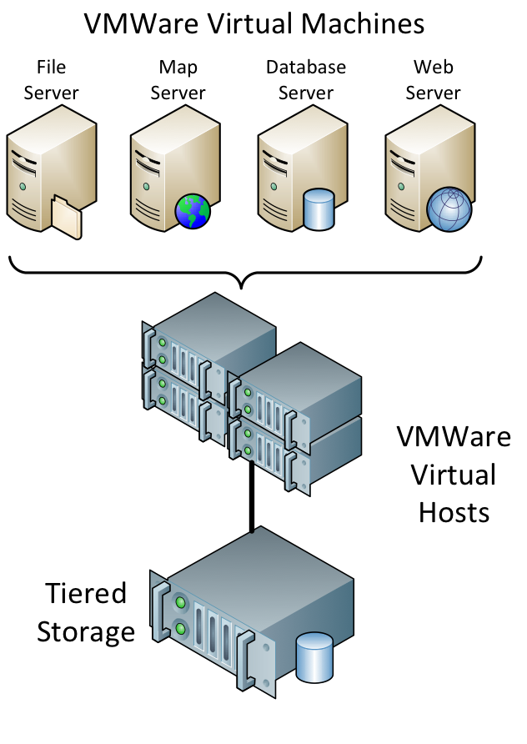
Virtualization Hardware We Built
Services and applications hosted by the iUTAH Modeling and Data Federation are all virtualized
We now run two clusters of virtualization hosts – one for production machines and one for research/testing
We have approximately 70 TB of tiered storage space for virtualization needs

Slide 4
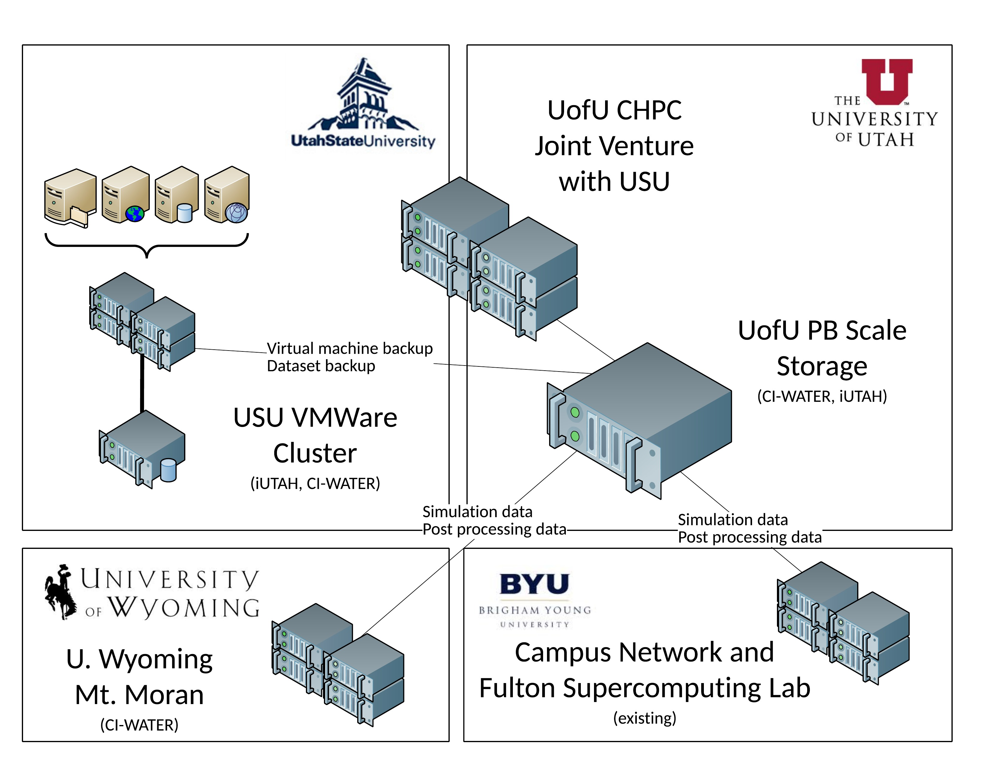

Slide 5
Core Questions
What is an effective design for the cyberinfrastructure that enables standardized data collection and management for a network of aquatic and terrestrial monitoring sites managed by a consortium of disparate organizations?

Slide 6
Formalized GAMUT Data Workflow
CUAHSI
HIS
Sharing hydrologic data
Building on the CUAHSI Hydrologic Information System

Slide 7
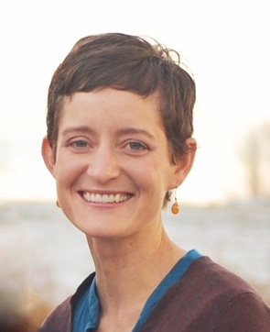
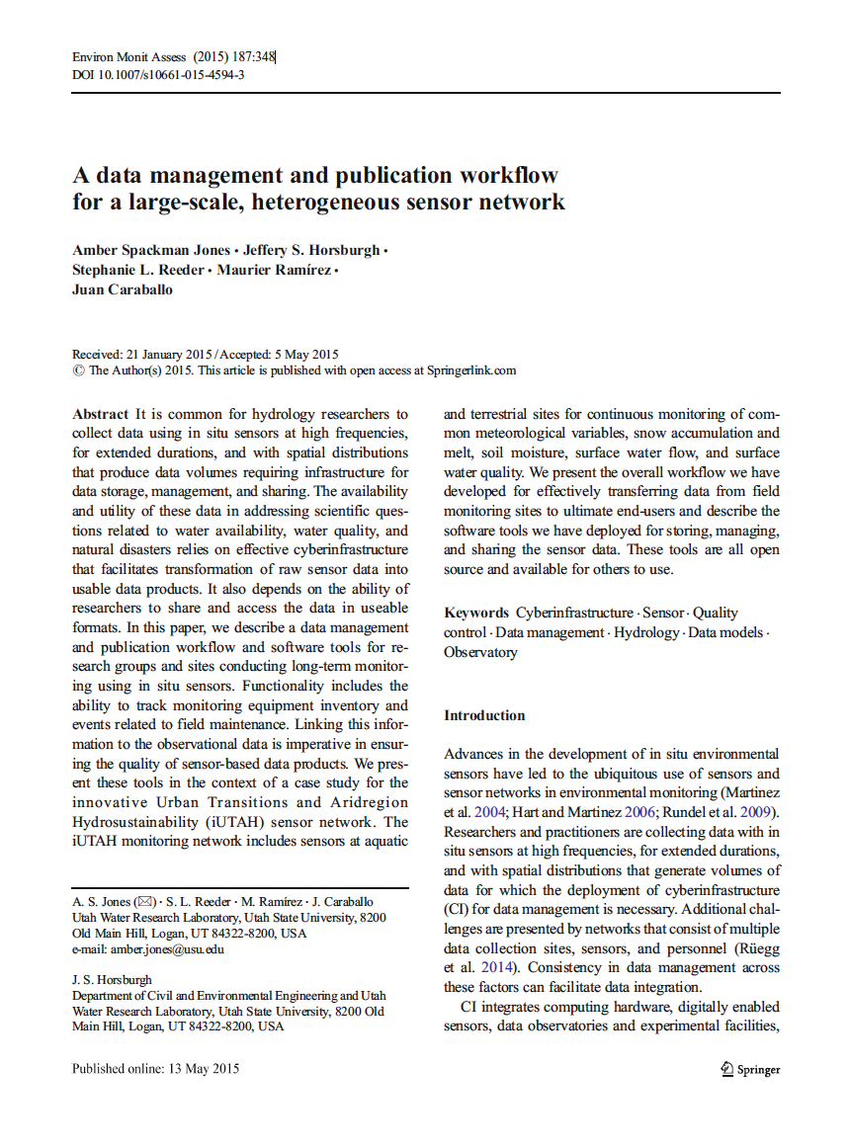
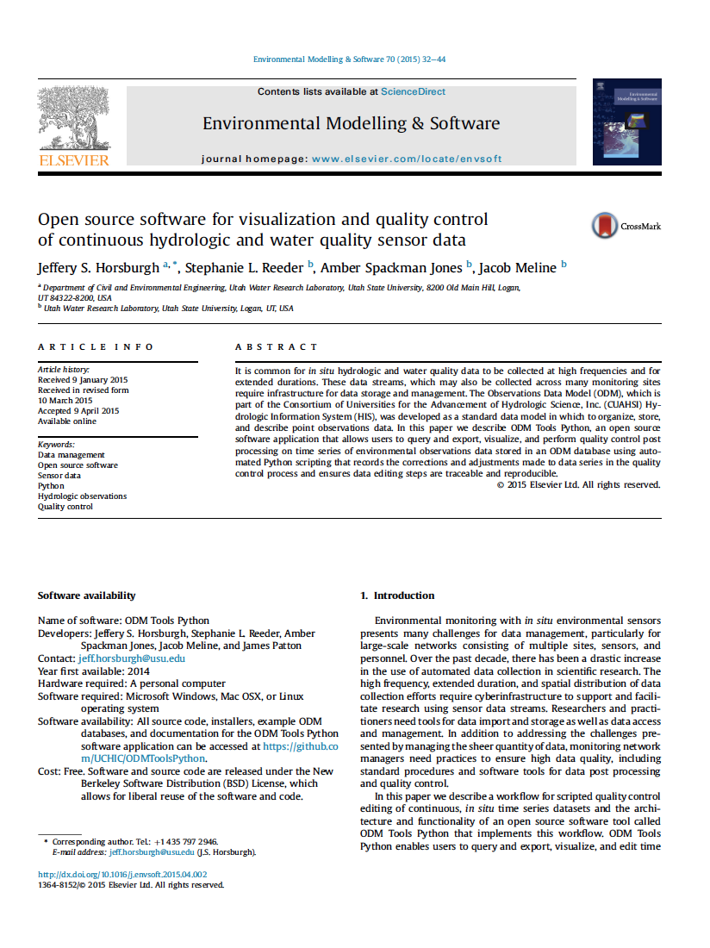
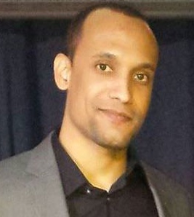
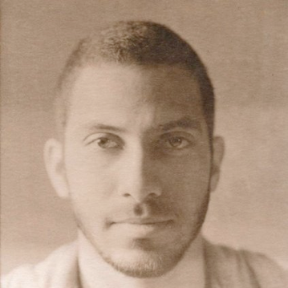
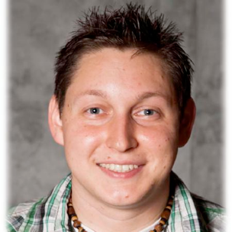
GAMUT Data Workflow and Software
Hardware and software CI workflow used for managing GAMUT data
Describing how others could implement similar CI
Scripted quality control of sensor data
Open source, cross platform
Undergraduate student co-authors
Jones, A.S., J.S. Horsburgh, S.L. Reeder, M. Ramirez, J. Caraballo (2015). A data management and publication workflow for a large-scale, heterogeneous sensor network, Environmental Monitoring and Assessment, 187:348, doi:10.1007/s10661-015-4594-3.
Horsburgh, J. S., S. L. Reeder, A. Spackman Jones, J. Meline (2015). Open source software for visualization and quality control of continuous hydrologic and water quality sensor data, Environmental Modelling & Software, 70, 32-44, doi:10.1016/j.envsoft.2015.04.002.

Slide 8
Core Questions
What are the technical challenges to coupling interdisciplinary environmental models and how can they be overcome?

Slide 9
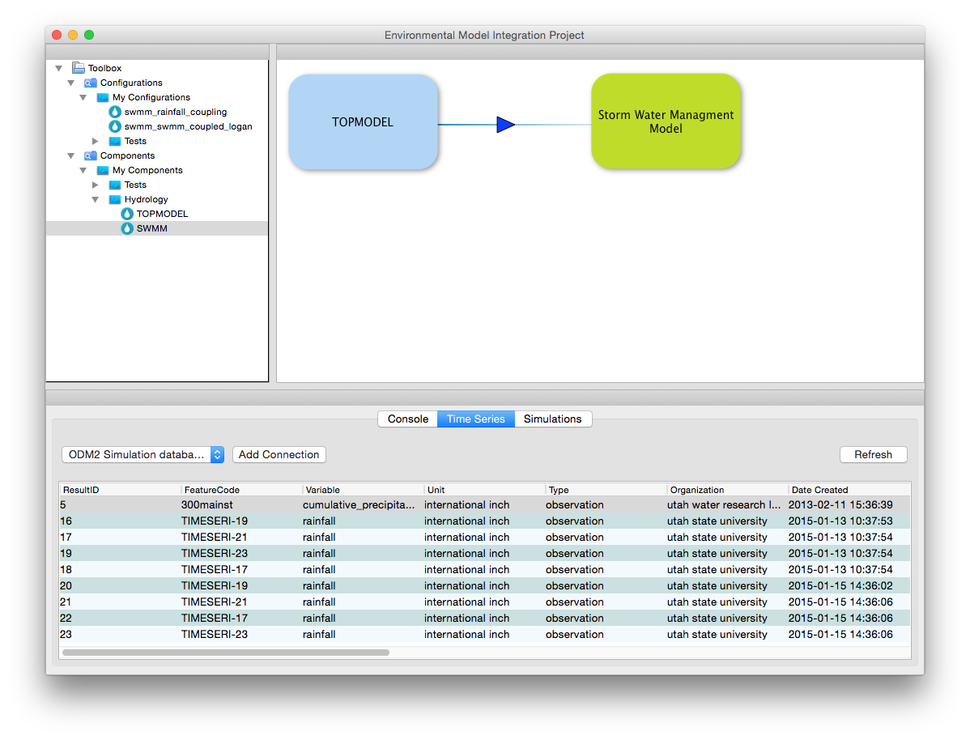
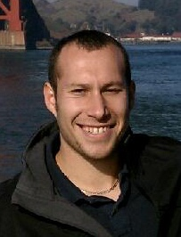
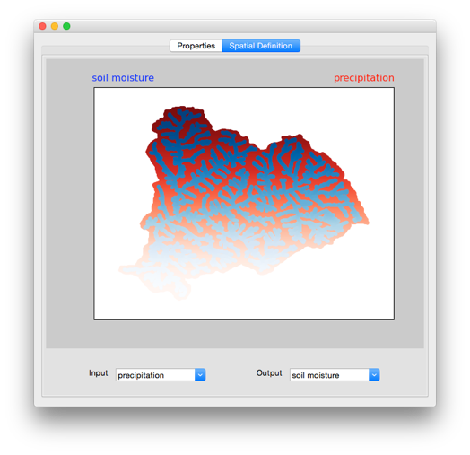
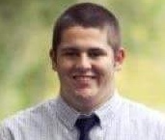
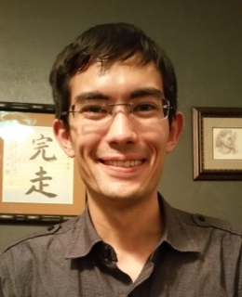
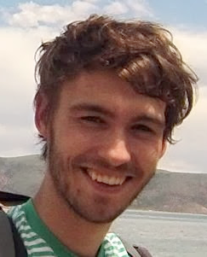
Software for Coupling Environmental Models
Extend existing coupled modeling architectures for broad audience
Facilitate transfer/ingestion of data between models
Support functionality of legacy and newly developed software models
Automatic transformation of temporally and spatially misaligned data between coupled models
Access to environmental data (e.g., GAMUT) and server-side simulation results (e.g., NetCDF)
Modeling Environment
Wrapper API
spatial transformation
Wrapper API
Model1
Model2
temporal
transformation
unit
conversion
Wrapper API
Model3

Slide 10
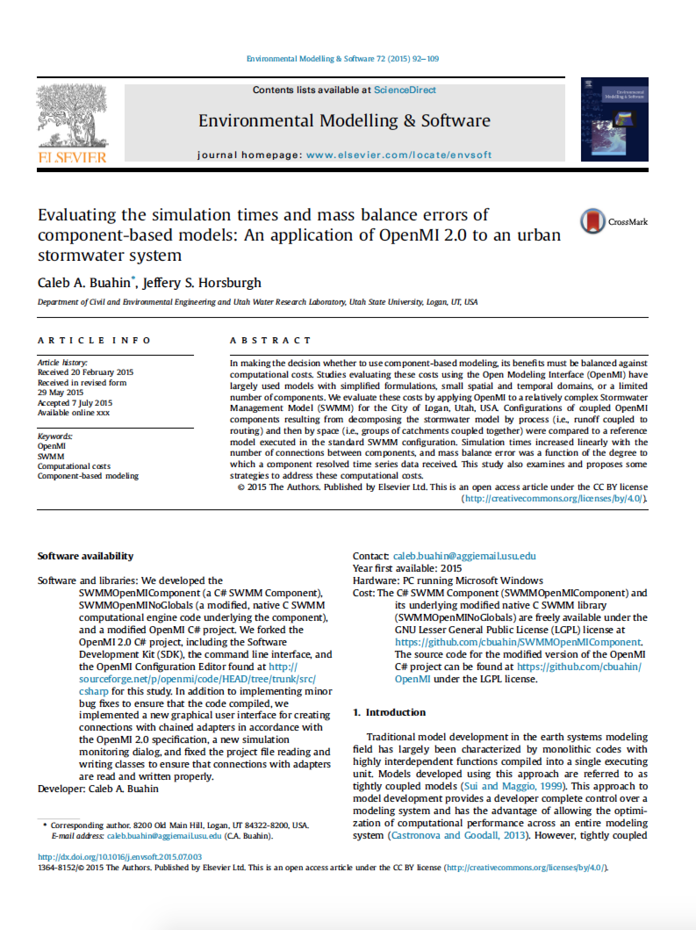
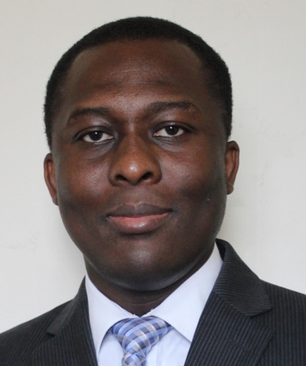
Software for Coupling Environmental Models
Technical Challenges of Model Coupling and Strategies for overcoming:
Computational penalties
Mass balance errors
Space and time mismatches
Buahin, C.A., J.S. Horsburgh (2015). Evaluating the simulation times and mass balance errors of component-based models: An application of OpenMI 2.0 to an urban stormwater system, Environmental Modelling & Software, 72, 92-109, doi:10.1016/j.envsoft.2015.07.003.

Slide 11
Core Questions
How can we visualize and interact with social science survey datasets and present results to diverse audiences?

Slide 12
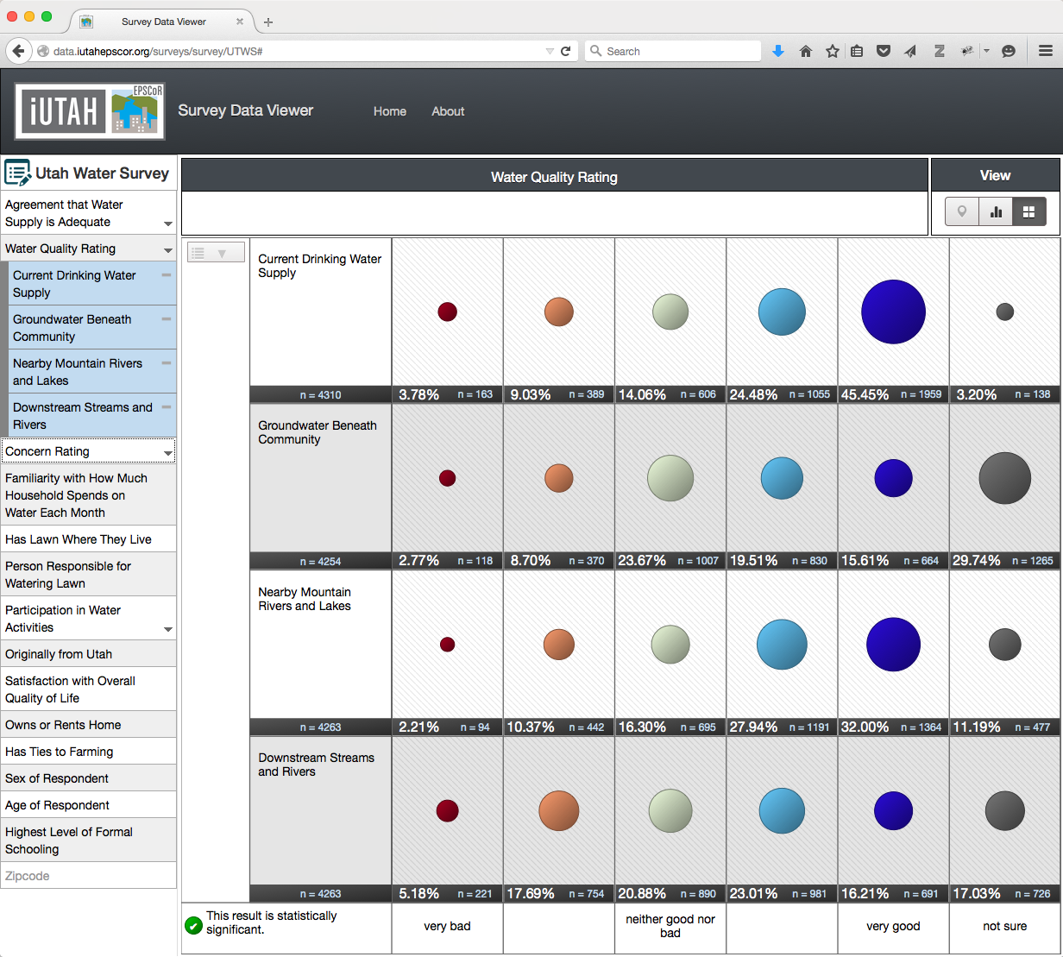
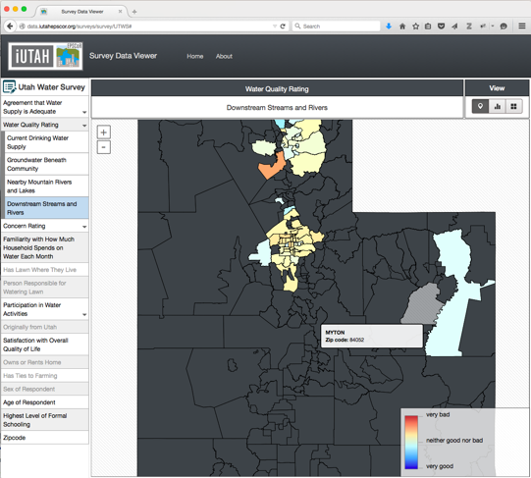
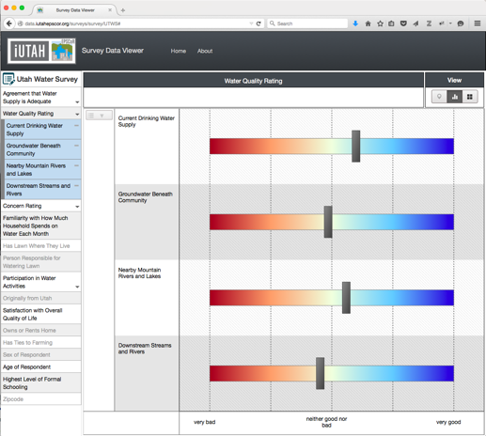
Visualizing Social Science Survey Results
Visualization of public intercept survey results
Generic and reusable survey template
Open source code
http://data.iutahepscor.org/surveys/

Slide 13
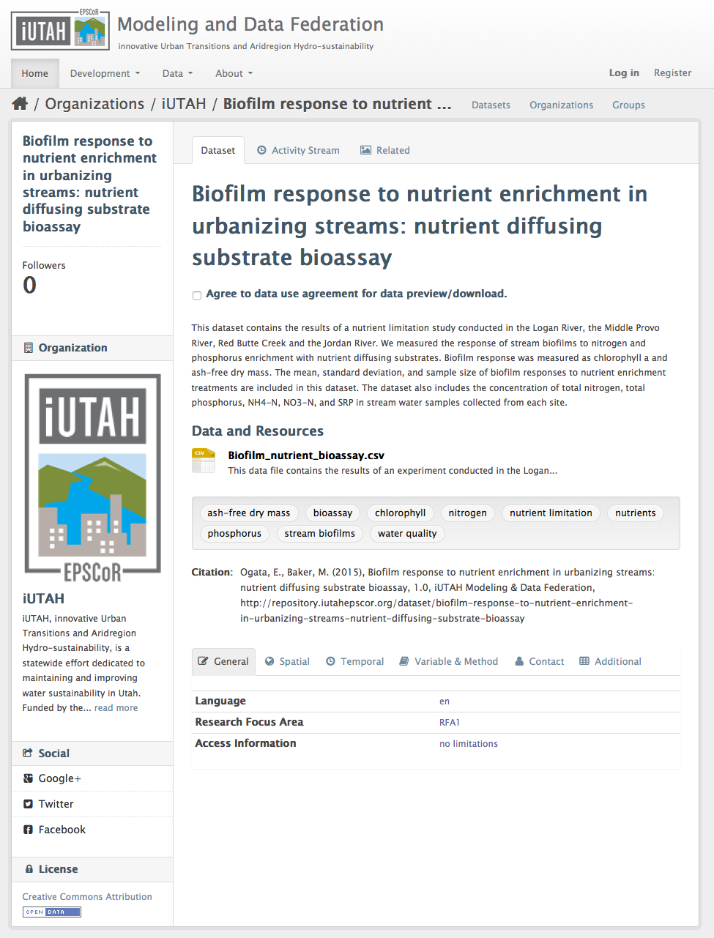
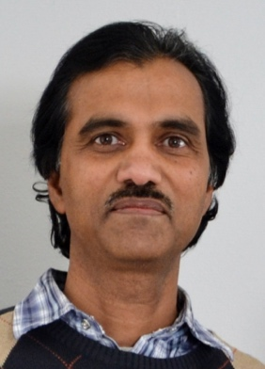
Broader Impact
iUTAH Datasets Published Online and Publicly Available
Individual dataset landing pages
Moderated submission system
Browseable and searchable
Each dataset has a citation:
http://repository.iutahepscor.org

Slide 14
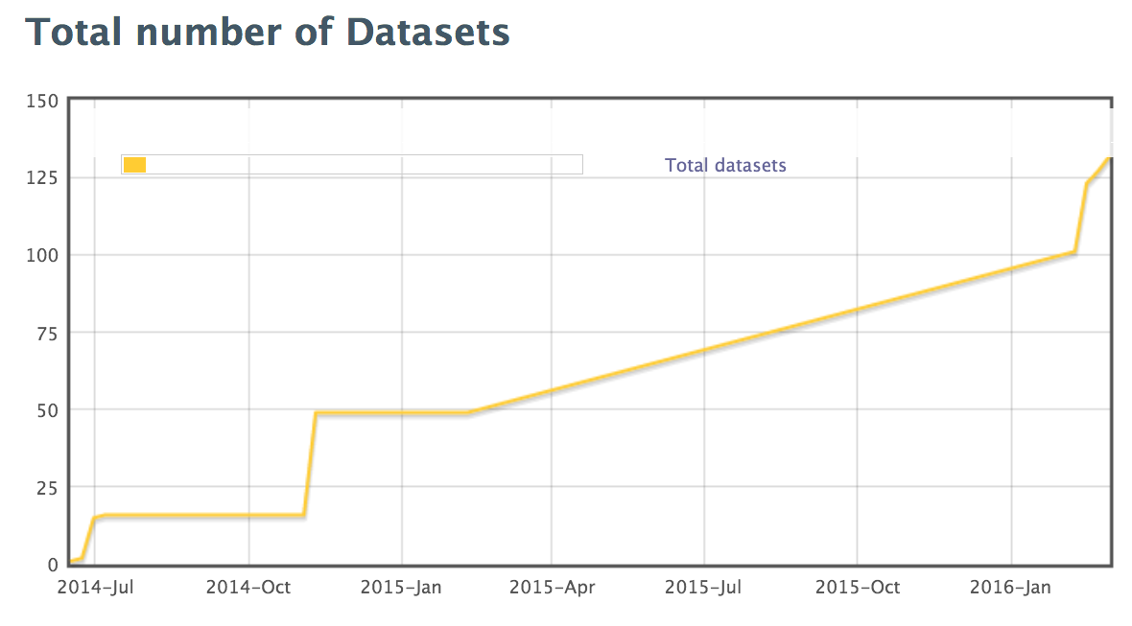
Data Publication Status
64 Data Collection Plans Submitted
55 Data Collection Plans Approved (there are 9 plans in review)
27 Metadata Records Submitted to the Repository
Metadata only either because the date for data submission has not arrived or because the data cannot be released- e.g., human subjects data
30 Data Records Submitted to the Repository
12 Data Collection Plans for which we are completely missing data/metadata
NOTES:
Some data collection plans cover multiple datasets and some datasets have been submitted without a data collection plan
Total number of datasets in plot includes automatically published datasets from GAMUT

Slide 15
Broader Impact
Open Source Code Repositories
All software and code openly available under the Berkeley Software Distribution (BSD3) open source license
Linked to publications from the CI team
WEBTSA – GAMUT time series data visualization
https://github.com/UCHIC/WEBTSA
ODM Streaming Data Loader
https://github.com/ODM2/ODM2StreamingDataLoader
ODM Tools Python – Sensor data management and QC
https://github.com/UCHIC/ODMToolsPython
ODM2 Sensor – Sensor equipment management
https://github.com/UCHIC/ODM2Sensor
iUTAH Utilities – Automated alerts, etc.
https://github.com/UCHIC/iUtahUtilities
iUTAH Survey Data Viewer – Visualization of survey data
https://github.com/UCHIC/SurveyDataViewer
iUTAH Data – Modeling and Data Federation Website
https://github.com/UCHIC/iUTAHData

Slide 16
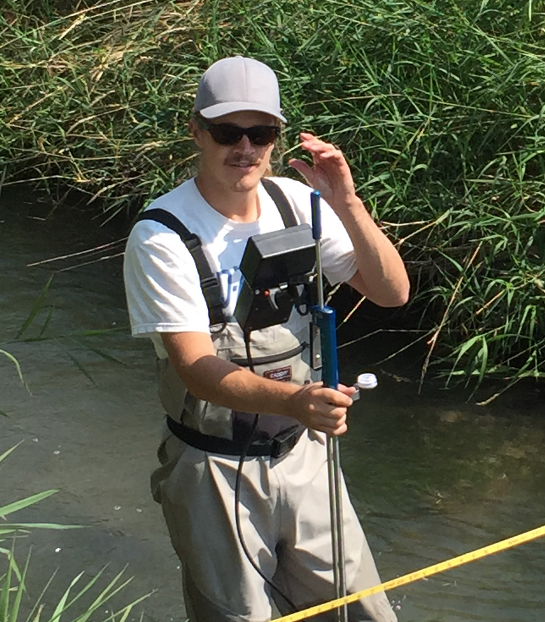
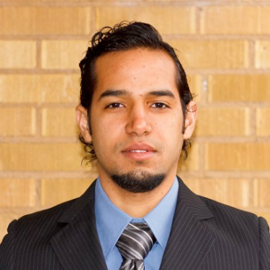
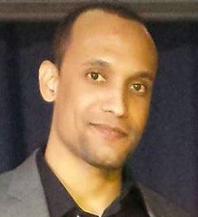
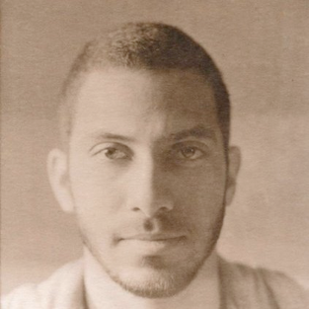
Broader Impact
Undergraduate Training
Creating the next generation of “Cyber-savvy” engineers and scientists
Prototyping and developing new software applications
Collaborating with iUTAH scientists
Co-authoring CI-related papers
Gaining practical experience and improving job prospects

Slide 17
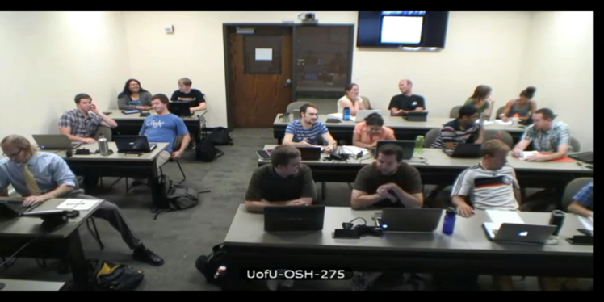
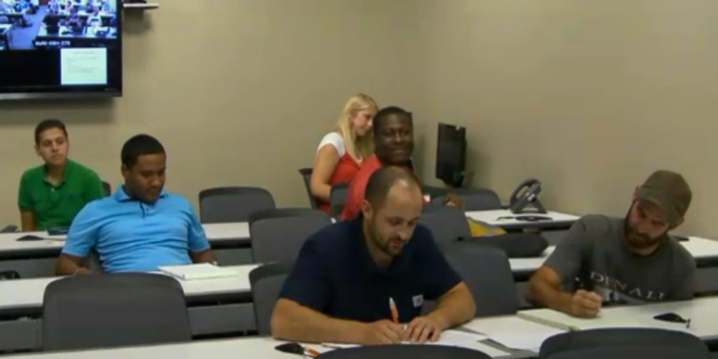
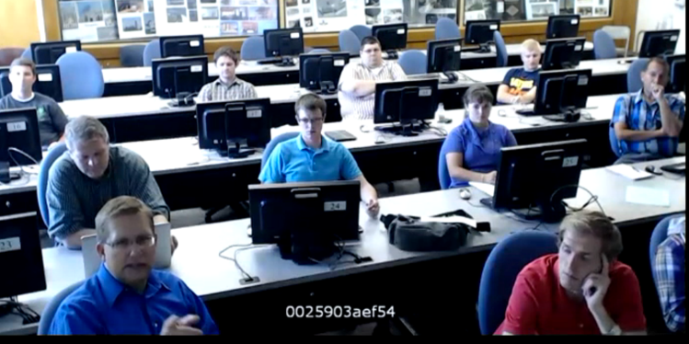
Broader Impact
Hydroinformatics Course
Creating the next generation of “Cyber-savvy” engineers and scientists
Expanded in 2014 to 5 partner universities
~30-40 students total across the campuses
Offered again this fall at USU, BYU, and UofU
“I'm learning so many new techniques that will be incredibly helpful in my research. I never knew about data management plans and while they are tedious, they are so helpful once they're implemented. I also have only ever dabbled in SQL up to this point and now I find myself using it more often than not.”
“I have enjoyed the distance learning with multiple professors and input from other students.”
“My team used basic concepts from almost every class period and topic section in our term project. It was cool to see how all the individual skills added up to help us create and maintain hydrologic information.”

Slide 18
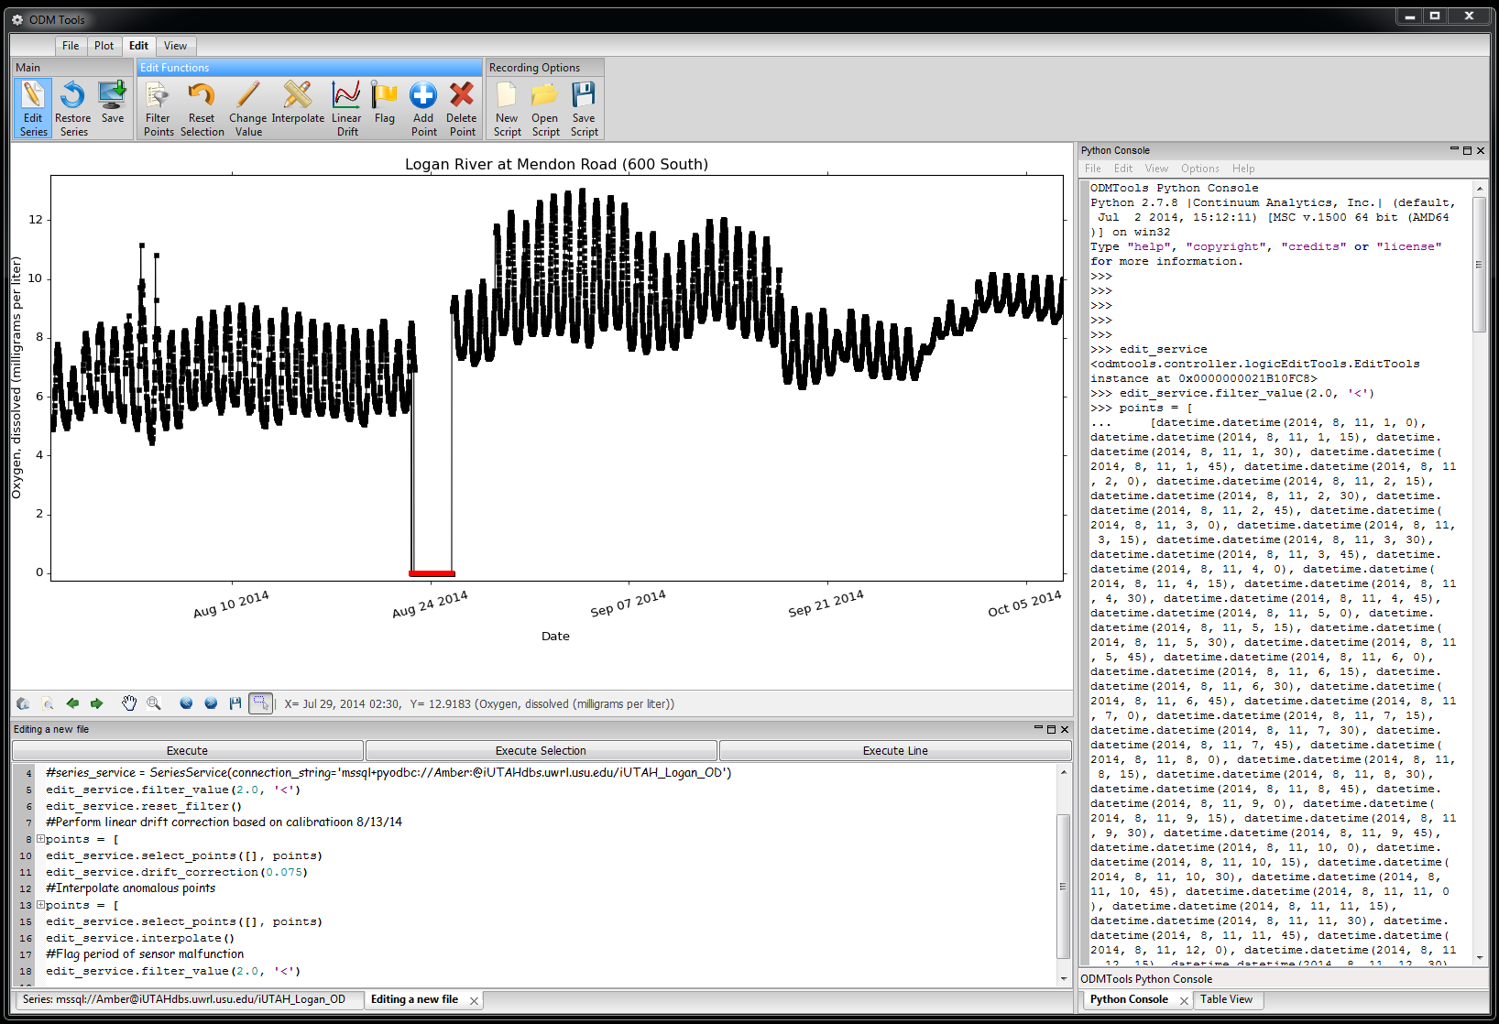
Broader Impact
Data Policy and Data Management Training
Raising awareness of data management needs and requirements across iUTAH
Conducted training for 25 attendees, including:
Visualizing sensor data streams
Scripted and reproducible quality control of sensor data streams
Quality control workflow
Data publication tutorials
Changing the culture from “My Data” to “Our Data”

Slide 19
Summary of Accomplishments
Physical Infrastructure
Established linkages to PB storage array built collaboratively with CI-WATER (Utah Track II CI award)
Built virtualization server capacity (6 host servers, ~70 TB in tiered storage for virtualization)
Software
iUTAH Modeling and Data Federation website
GAMUT data publication workflow and
Sensor data management and scripted quality control
Web-based access and visualization of GAMUT data
Web-based repository for research data products
Web-based visualization of social science datasets
Model coupling

Slide 20
Summary of Accomplishments
Established data policy and training
Recruitment, Training, and Professional Development
Trained one GRA
Trained and mentored 9 undergraduate student programmers
Development of software and hardware cyberinfrastructure
Co-authoring papers
Offered Hydroinformatics graduate course in collaboration with 5 partner institutions and an annual enrollment of ~30-40 students
Presentations: > 30 professional presentations at conferences and meetings
Manuscripts: 4 published papers, multiple conference proceedings papers
New proposals: 3 funded (~$1 M)

Slide 21
Questions?

Slide 22
Plans for Year 4
Identify needs and build infrastructure in support of BUGI
Add new features to GAMUT QA/QC software in collaboration with watershed technicians
Implement data management/publication workflows for sample-based datasets (Building on ODM2 and CZOData work)
Implement new release of the field equipment management database and website
Continue development of coupled modeling software and scenarios
Continue interaction and collaboration with iVL

Slide 23
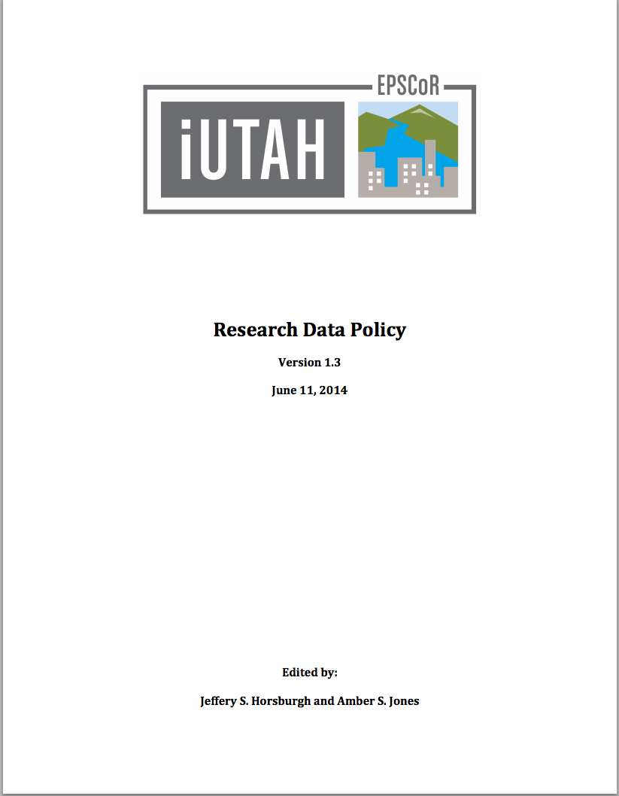
Data Policy, Publication and Training
Policy fully implemented after Year 3 modifications
Data collection plans are submitted, reviewed, approved, and being implemented
Data publication system running—a number of datasets and metadata records submitted
Developed video tutorials to train researchers on iUTAH data management and publication

Slide 24
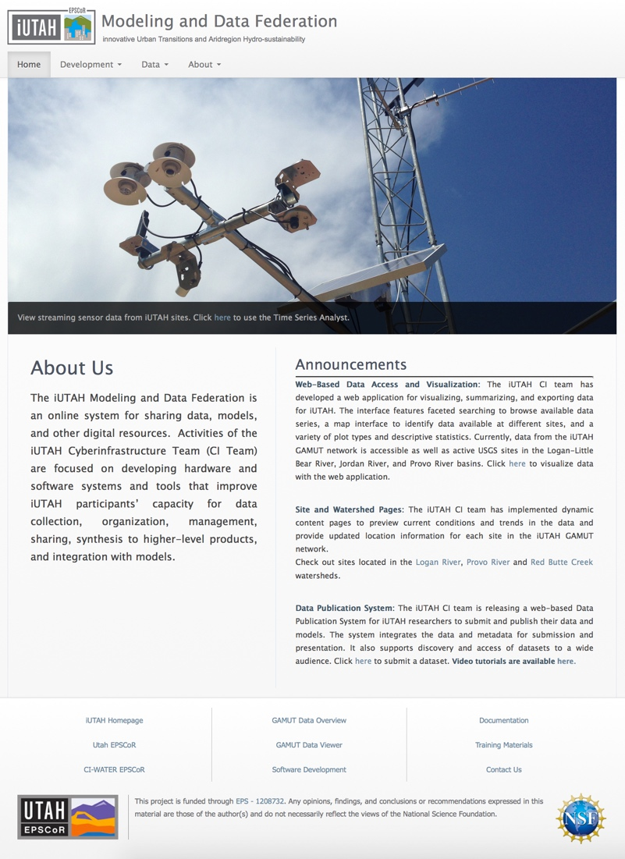
Project Milestones
Develop infrastructure to support data collection and management activities of iUTAH facilities and researchers
Enable iUTAH researchers to share and access data using standard formats, protocols, and services
Support iUTAH participants in discovering and accessing iUTAH and relevant external data
Support iUTAH researchers in identifying and prioritizing modeling needs, models to be used, and access to computational resources
Provide online resources for citizens, K-12, undergraduate, and graduate students throughout Utah

Slide 25
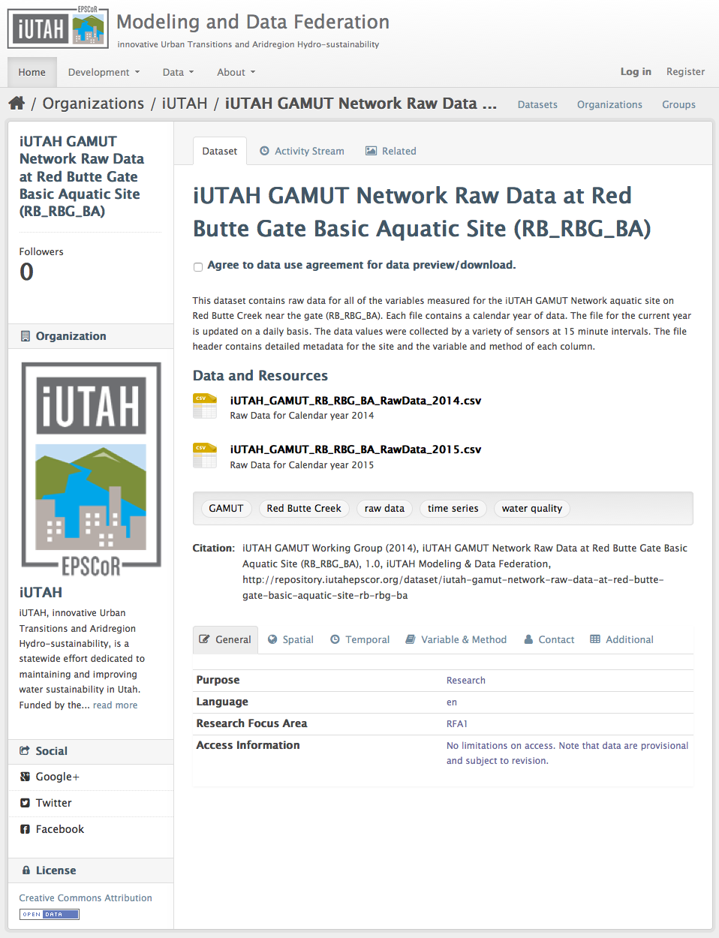
Automated Archival of Raw GAMUT Data
Investigators wanted easy file-based access to the GAMUT data
We automated publication to the iUTAH Data Repository
Data are “chunked” yearly and the current year is updated daily

Slide 26
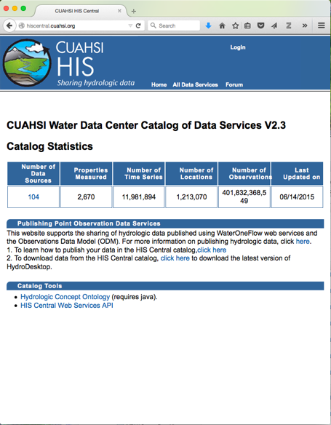
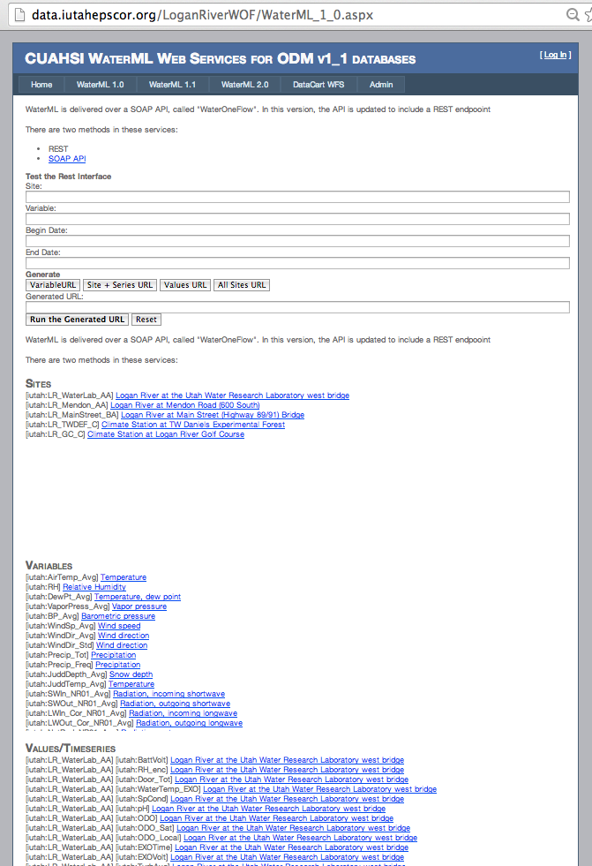
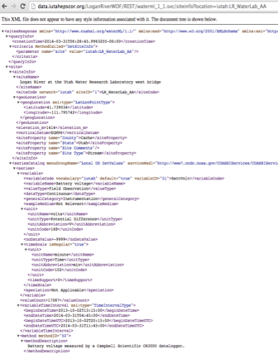
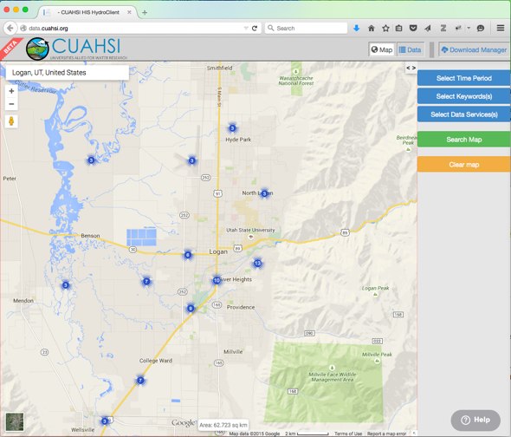
CUAHSI HIS Web Services for GAMUT
Register with Water
Data Center
Established CUAHSI HIS web services for GAMUT databases
Registered with the CUAHSI Water Data Center
Data are searchable using HydroDesktop and the new CUAHSI HIS web client
Deploy Web Services
Discover Data in the
National Catalog

Slide 27
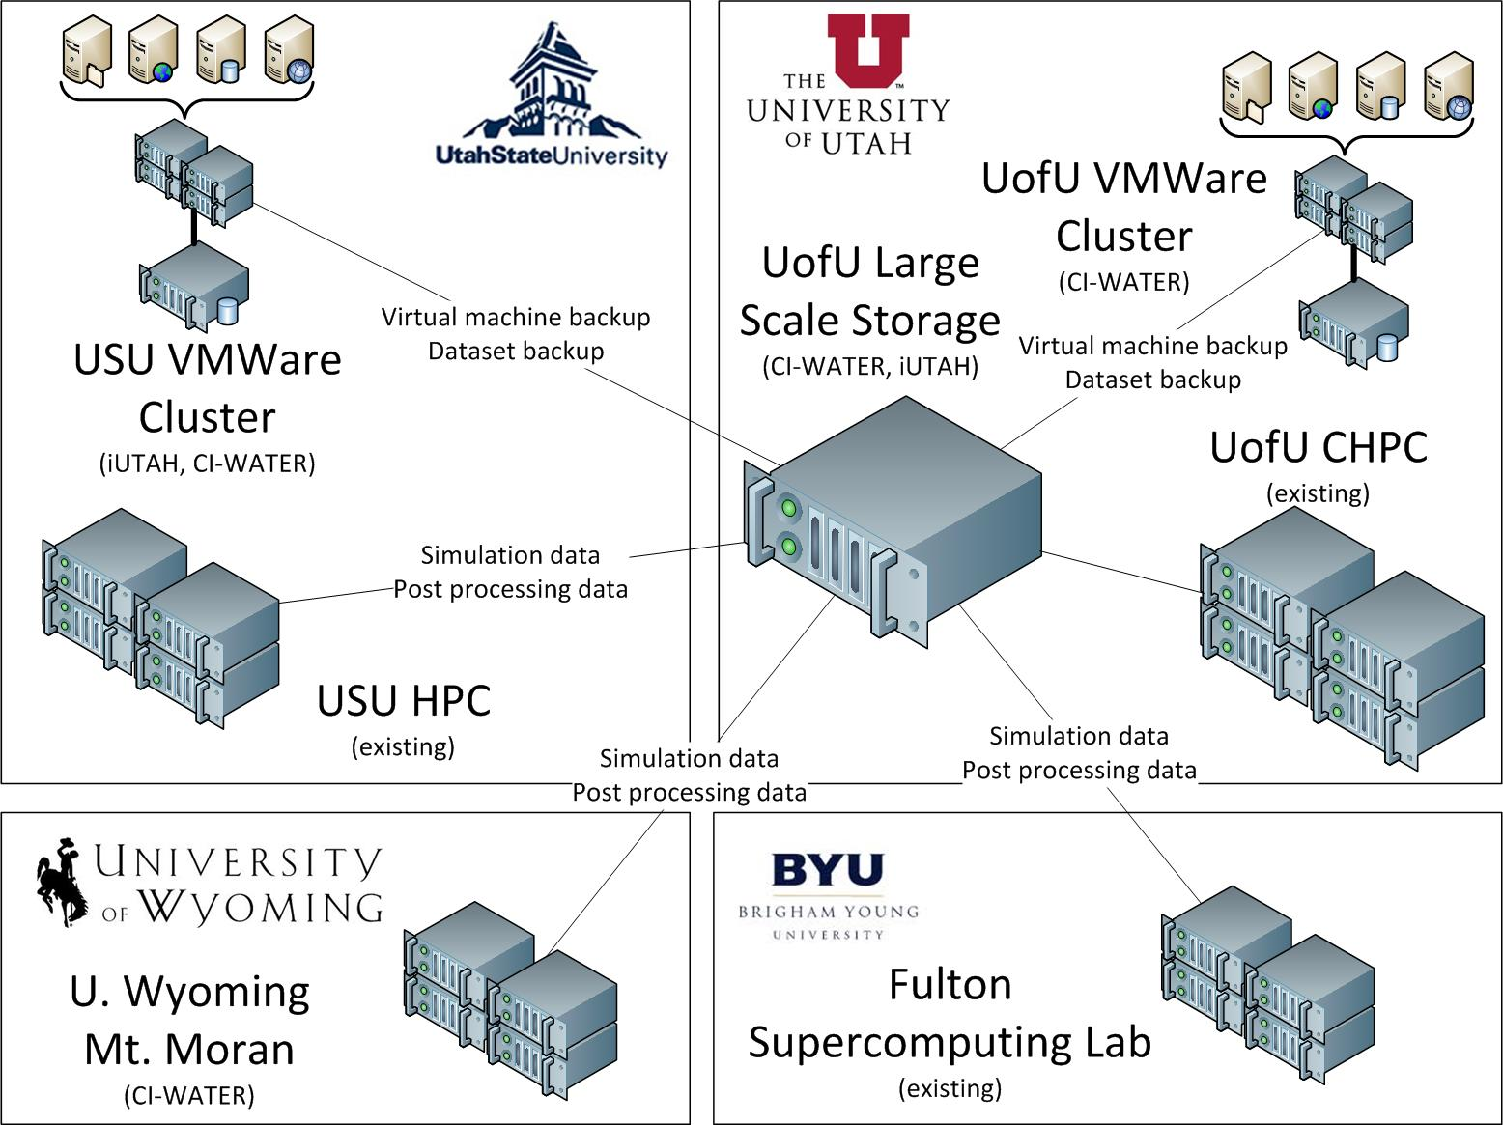
iUTAH CI is . . .
. . . a cross-institutional effort, delivering innovative data management, integration, and visualization tools to iUTAH users across research focus areas and beyond.

Slide 28
iUTAH CI is . . .
. . . an innovative and highly productive scientific enterprise.

