Slide 1
Cyberinfrastructure: Year 3
Amber Jones
Jeff Horsburgh, Tony Castronova and the rest of the CI Team
iUTAH External Advisory Board Meeting
July 16, 2015

Slide 2
Goals and Objectives
Goals
Increase capacity for data collection, organization, management, sharing, and synthesis to higher-level products and increase capacity for integration of data and models
Objectives
Develop infrastructure to support data collection and management activities of iUTAH facilities and researchers
Identify, prioritize, and facilitate access to external datasets needed by iUTAH researchers
Enable iUTAH researchers to share and access data using standard formats, protocols, and services
Support iUTAH participants in discovering and accessing iUTAH and relevant external data
Support iUTAH researchers in identifying and prioritizing modeling needs, models to be used, and access to computational resources
Provide online resources for citizens, K-12, undergraduate, and graduate students throughout Utah

Slide 3
Results, Outcomes, and Accomplishments Summary
General
Three journal publications – 2 published, one in revision
Added additional hardware capacity to iUTAH virtualization infrastructure
Data policy implemented and data publication system running
Continued offering of cross-campus Hydroinformatics course
RFA1
Formalized GAMUT data workflow
Published CUAHSI HIS web services for GAMUT datasets
Automated archival of raw GAMUT data in iUTAH Data Repository
Software and training for quality control of GAMUT sensor data
RFA2
Development of new visualization capabilities for social science survey datasets
Added support for additional storm drain monitoring sites
RFA3
Software interface for coupled modeling
Investigation of computational challenges of coupled modeling

Slide 4
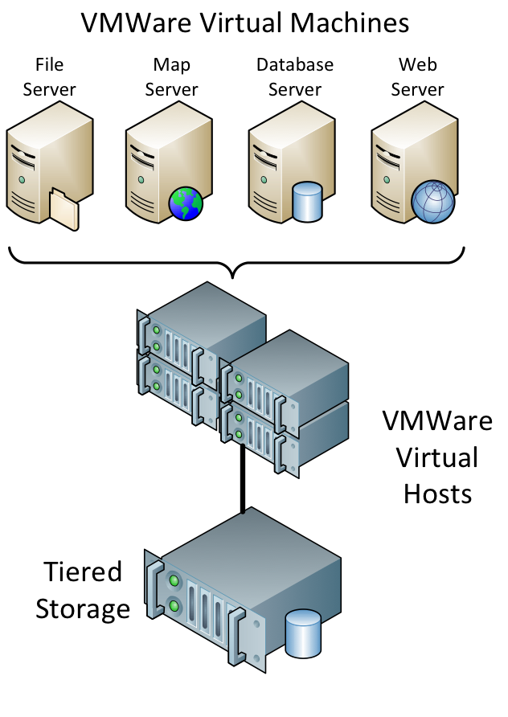
Hardware Upgrades
Services and applications hosted by the iUTAH Modeling and Data Federation are all virtualized.
In collaboration with CI-WATER doubled the number of virtual hosts (6)
Increased capacity of virtualization storage by 20TB

Slide 5
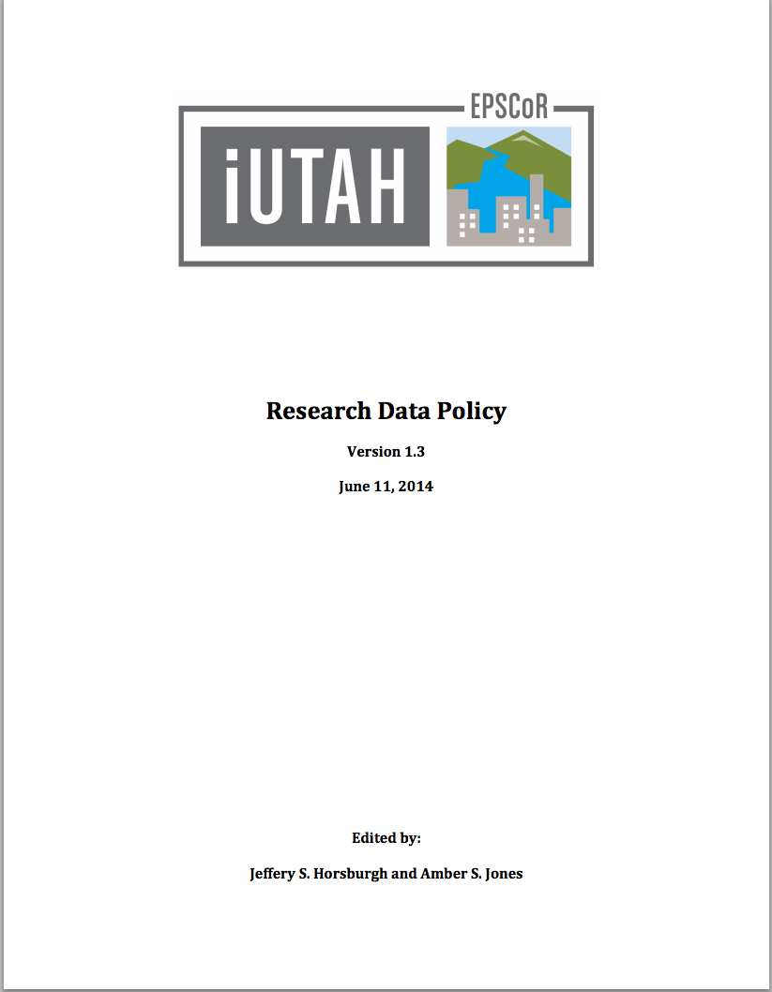
Data Policy, Publication, and Training
Policy fully implemented after Year 3 modifications
Data collection plans are submitted, reviewed, approved, etc.
Data publication system running- a number of datasets and metadata records submitted
Developed video tutorials to train on iUTAH data management and publication

Slide 6
Formalized GAMUT Data Workflow
Notes:
This figure show the overall data workflow that we’ve designed and deployed
Management of the GAMUT data is centralized at Utah State University, where the data from all of the remote sites are aggregated, loaded into operational databases, and shared on the Internet via a suite of web applications. Each of the components is described in more detail.
SERVERS: workflow is spread across three virtual servers
Runs Campbell Scientific’s Loggernet software and manages communication with and download of data from each monitoring site.
Runs Microsoft SQL Server and hosts the operational databases into which the data are loaded.
Hosts web applications for sharing the iUTAH data on the Internet.
Although all of these software programs could be run on a single server, we have chosen to separate them into 3 separate virtual machines for security purposes. The Loggernet and database servers can be protected behind firewalls with very little external exposure to the Internet, whereas the web server provides unrestricted access to the data via web application interfaces.
Include backups as a separate slide or just discuss here?

Slide 7
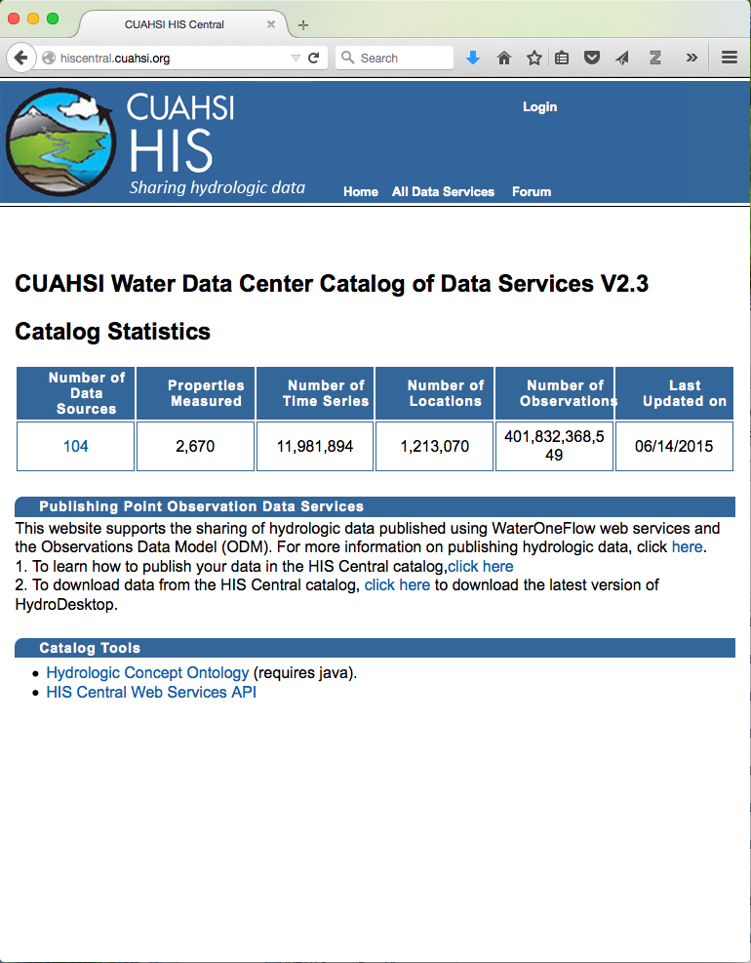
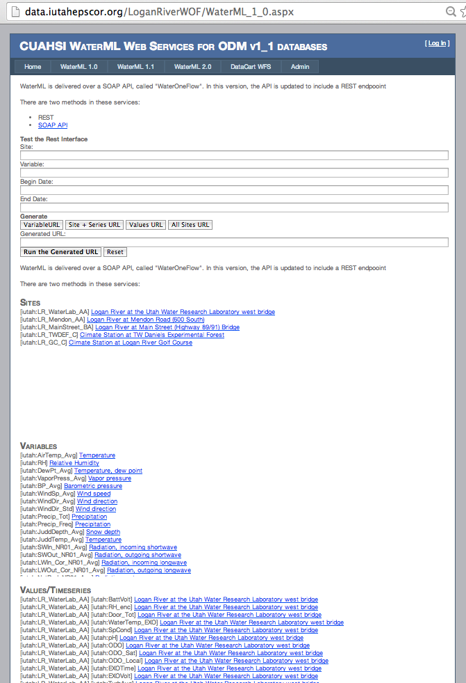
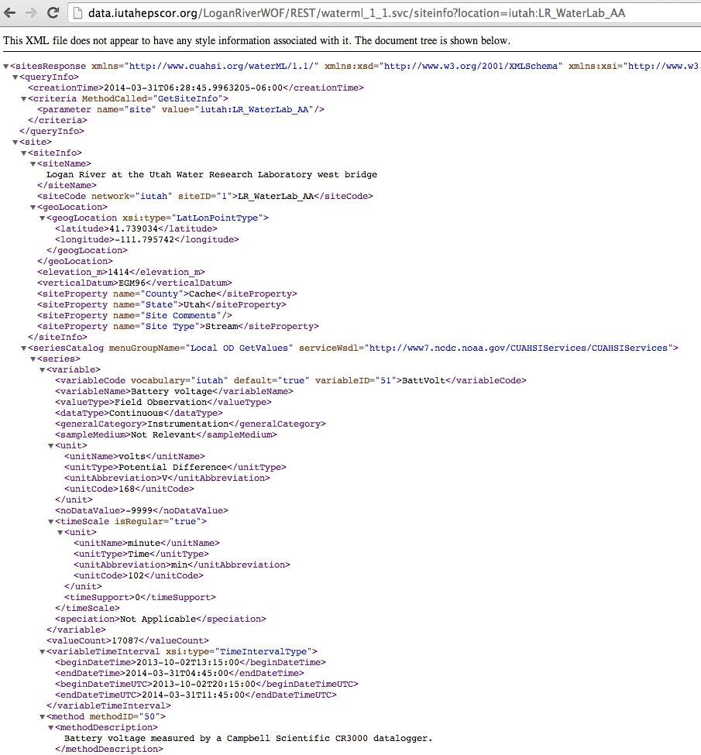
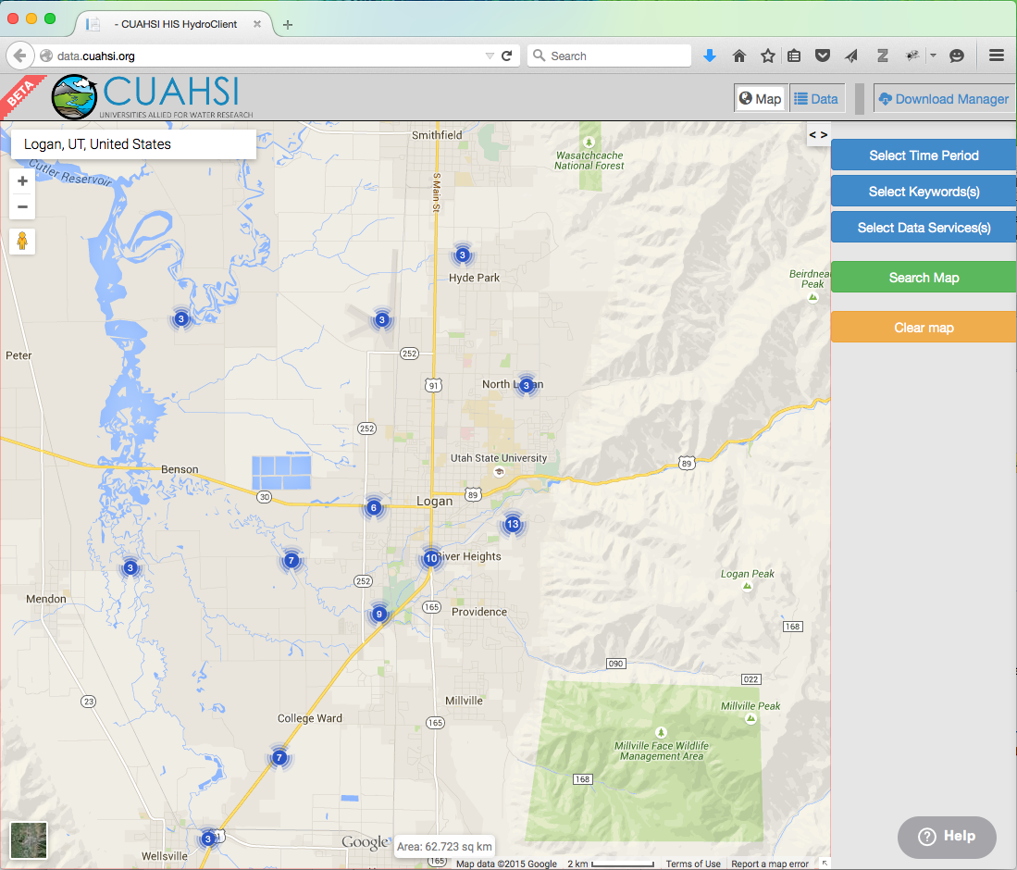
CUAHSI HIS Web Services for GAMUT
Register with Water
Data Center
Established CUAHSI HIS web services for GAMUT databases
Registered with the CUAHSI Water Data Center
Data are searchable using HydroDesktop and the new CUAHSI HIS web client
Deploy Web Services
Discover Data in the
National Catalog

Slide 8
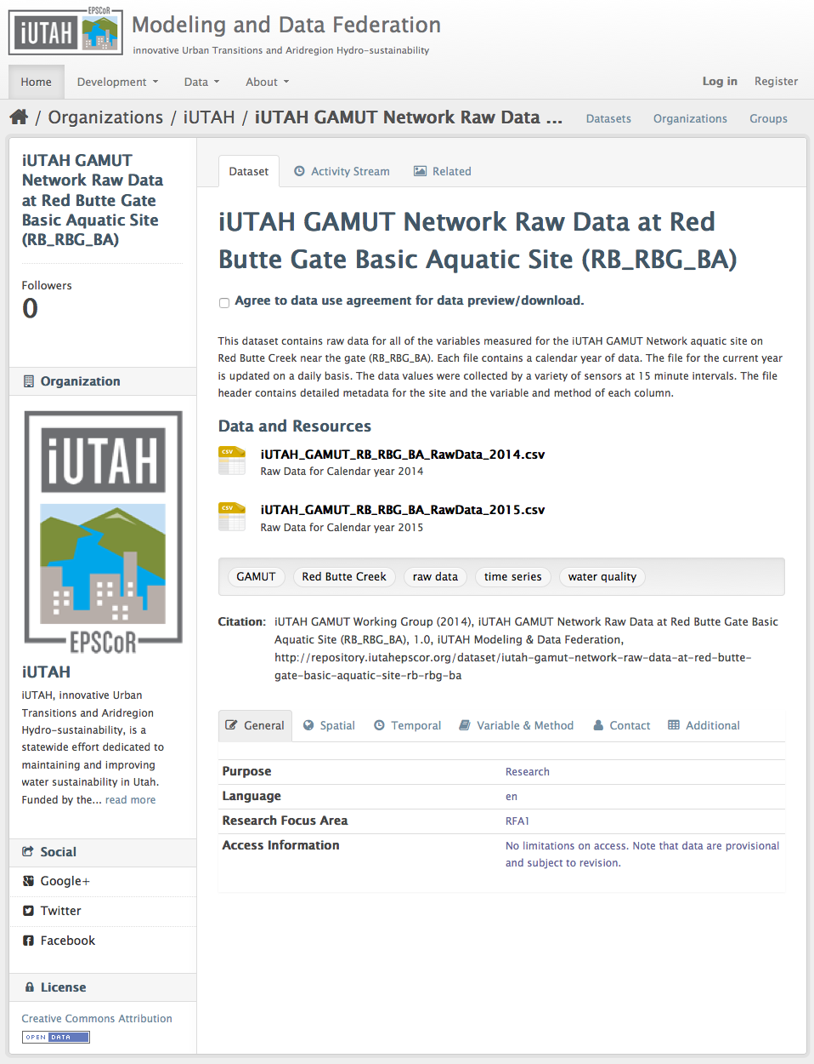
Automated Archival of Raw GAMUT Data
RFA1 investigators wanted easy file-based access to the GAMUT data
We automated publication to the iUTAH data Repository
Data are chunked yearly and the current year is updated daily

Slide 9
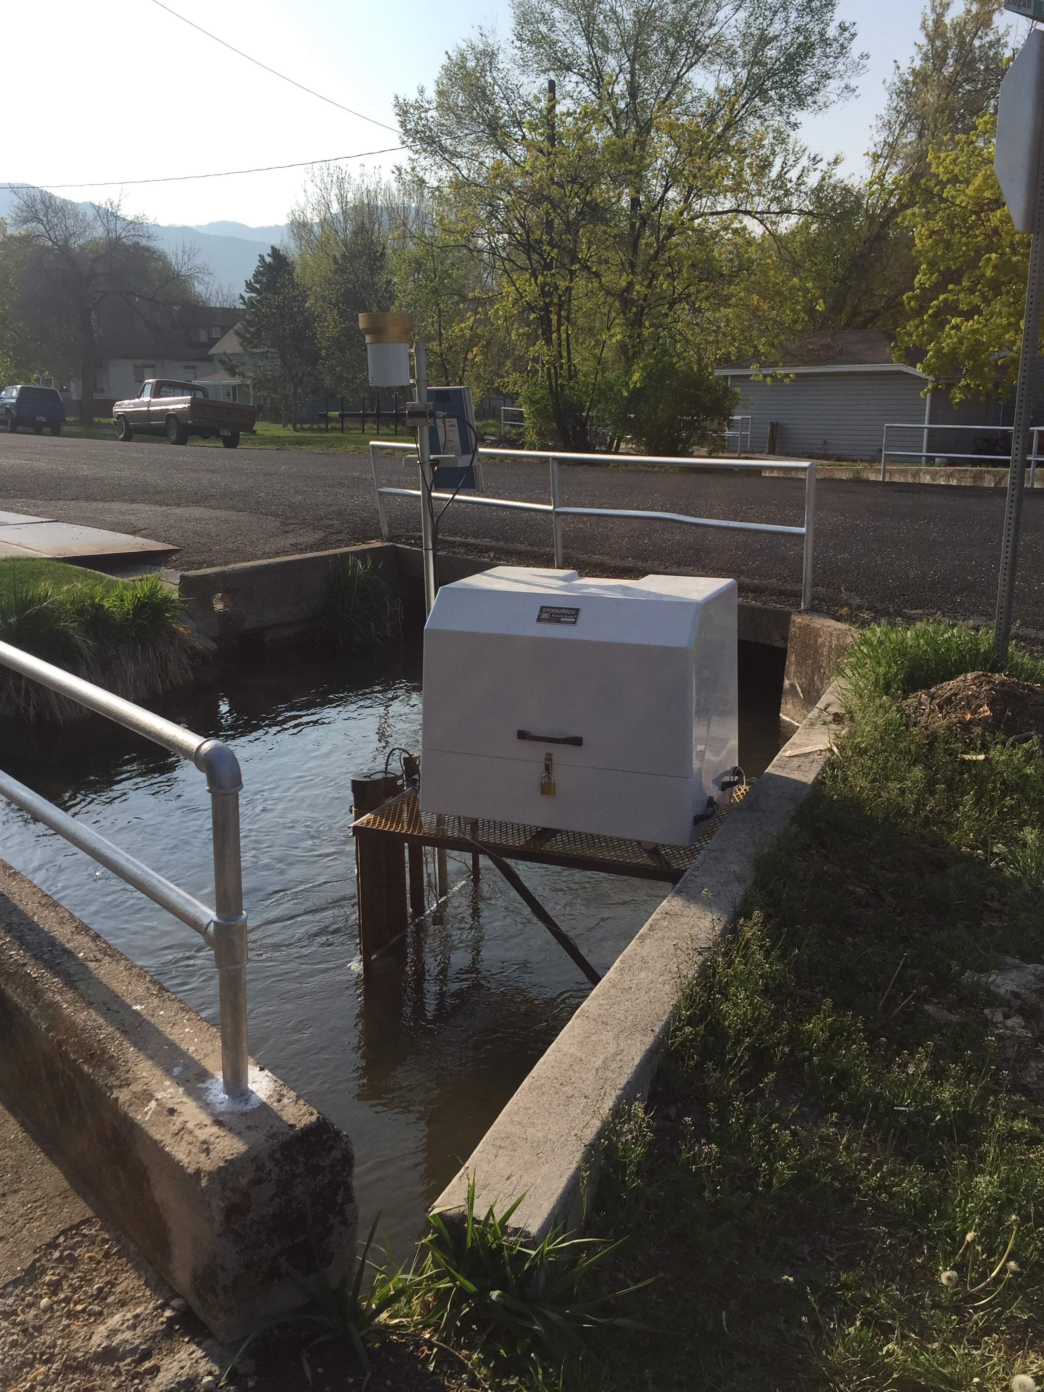
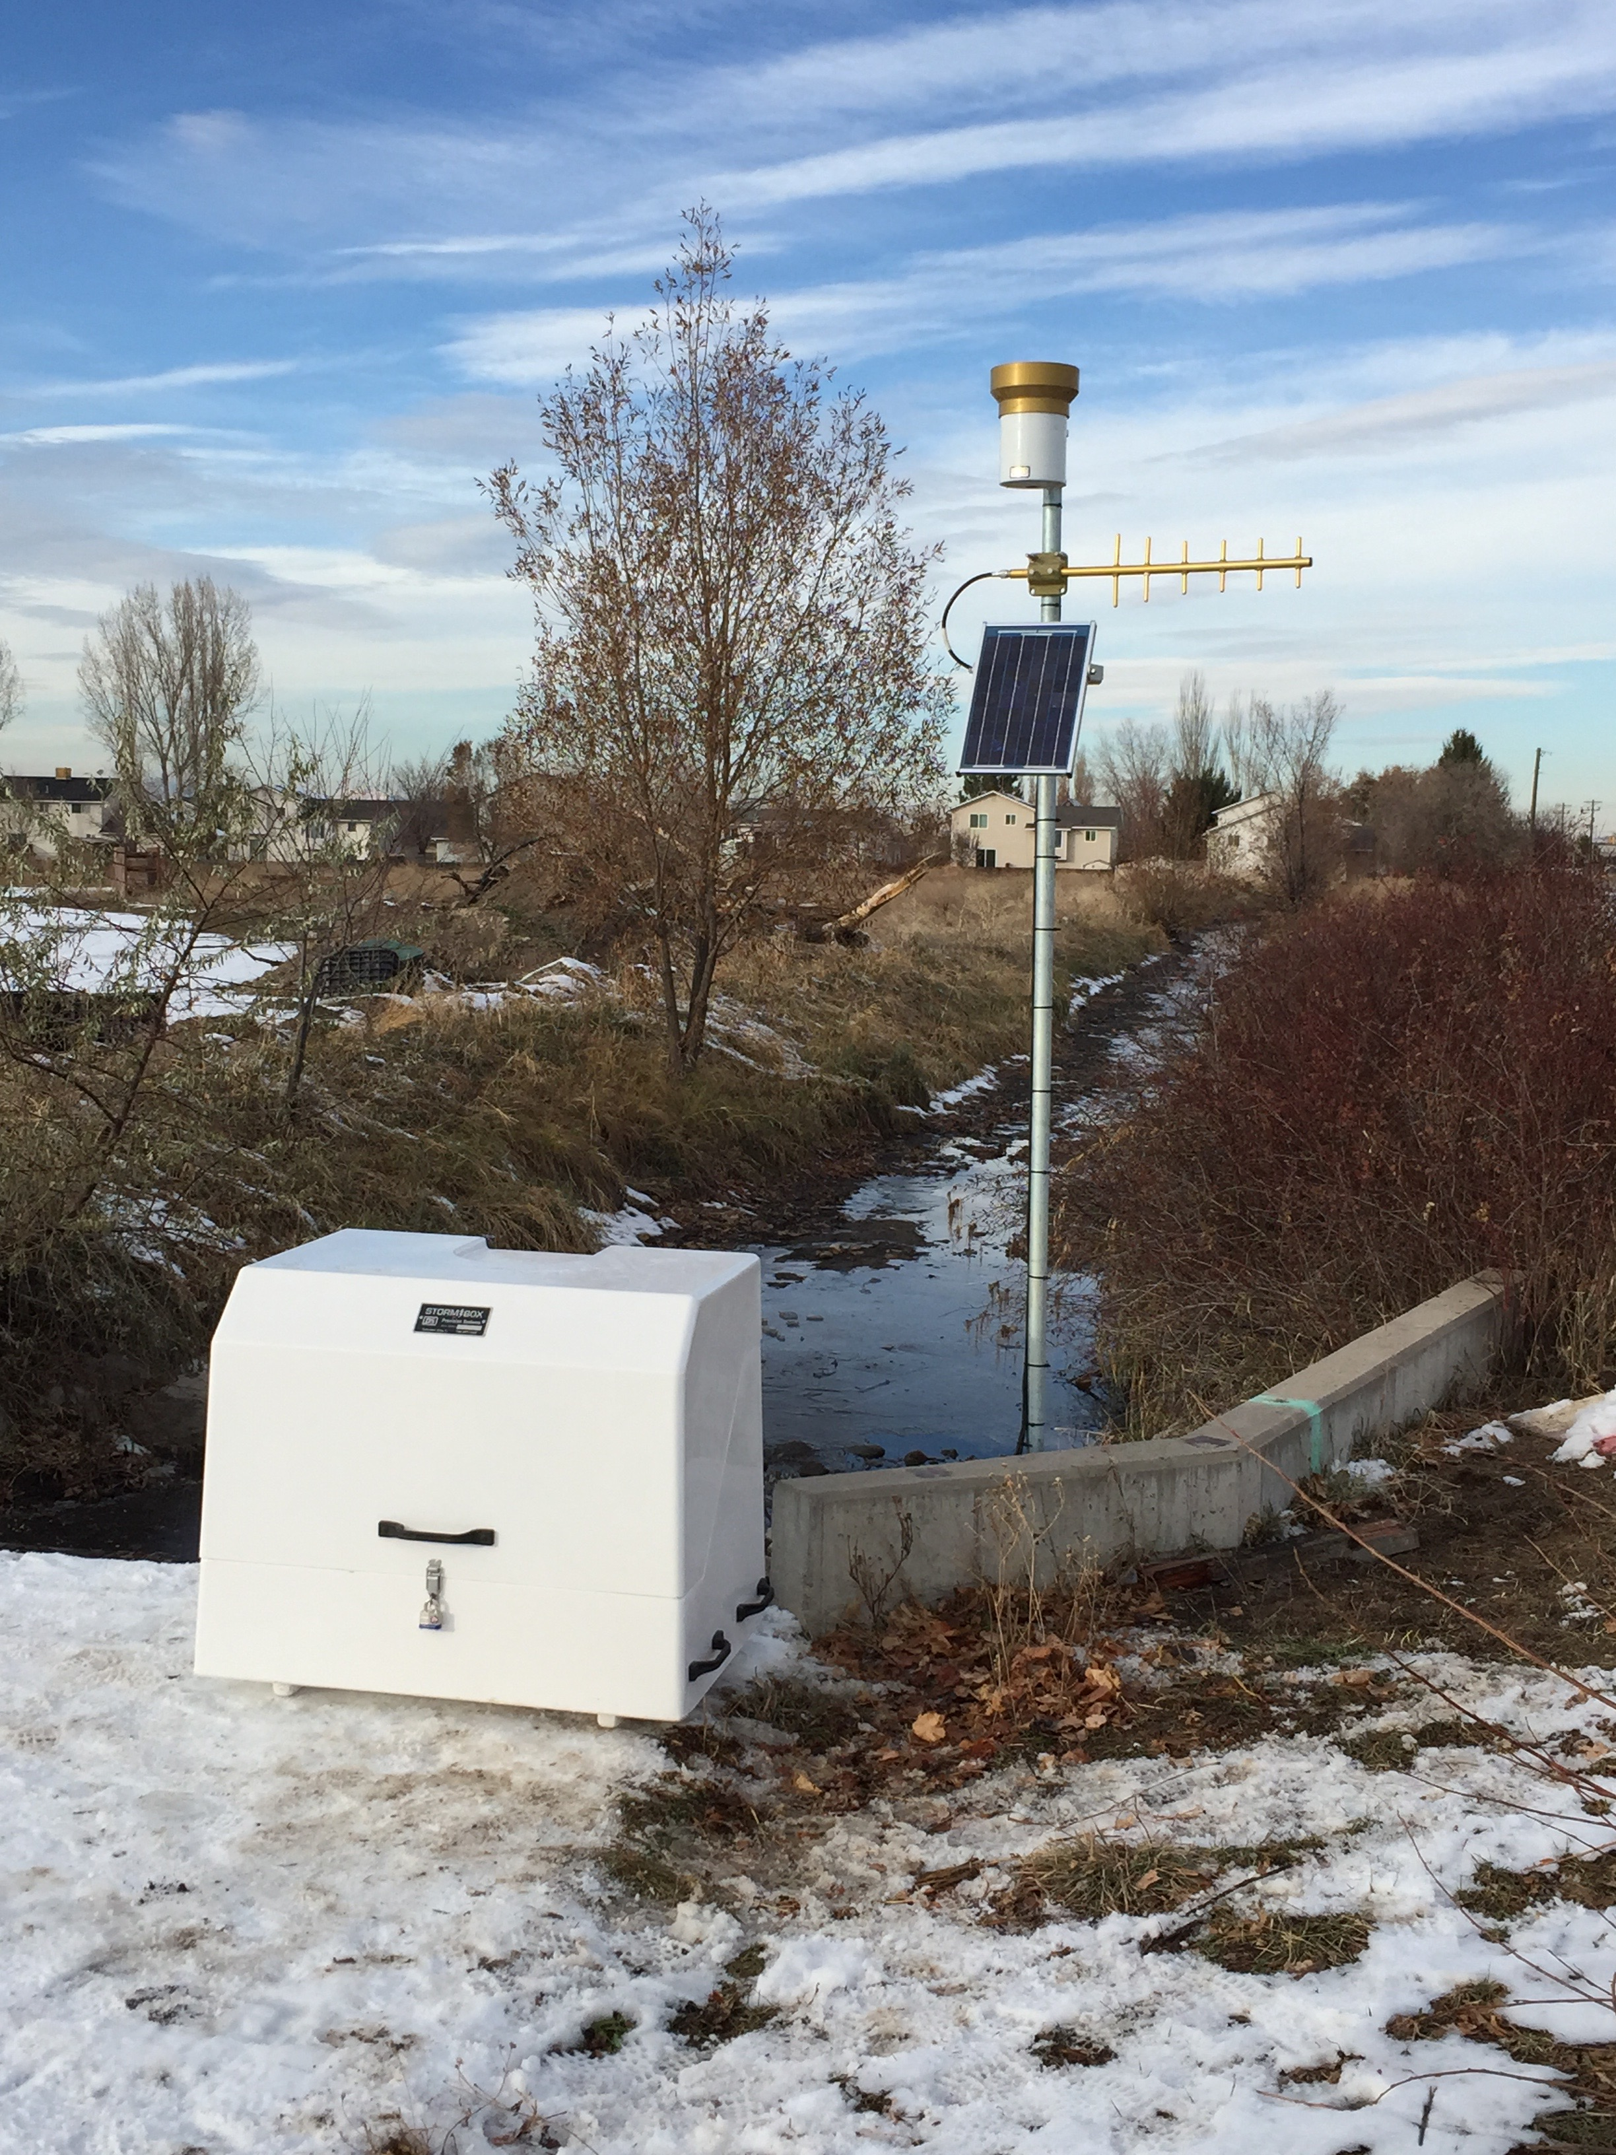
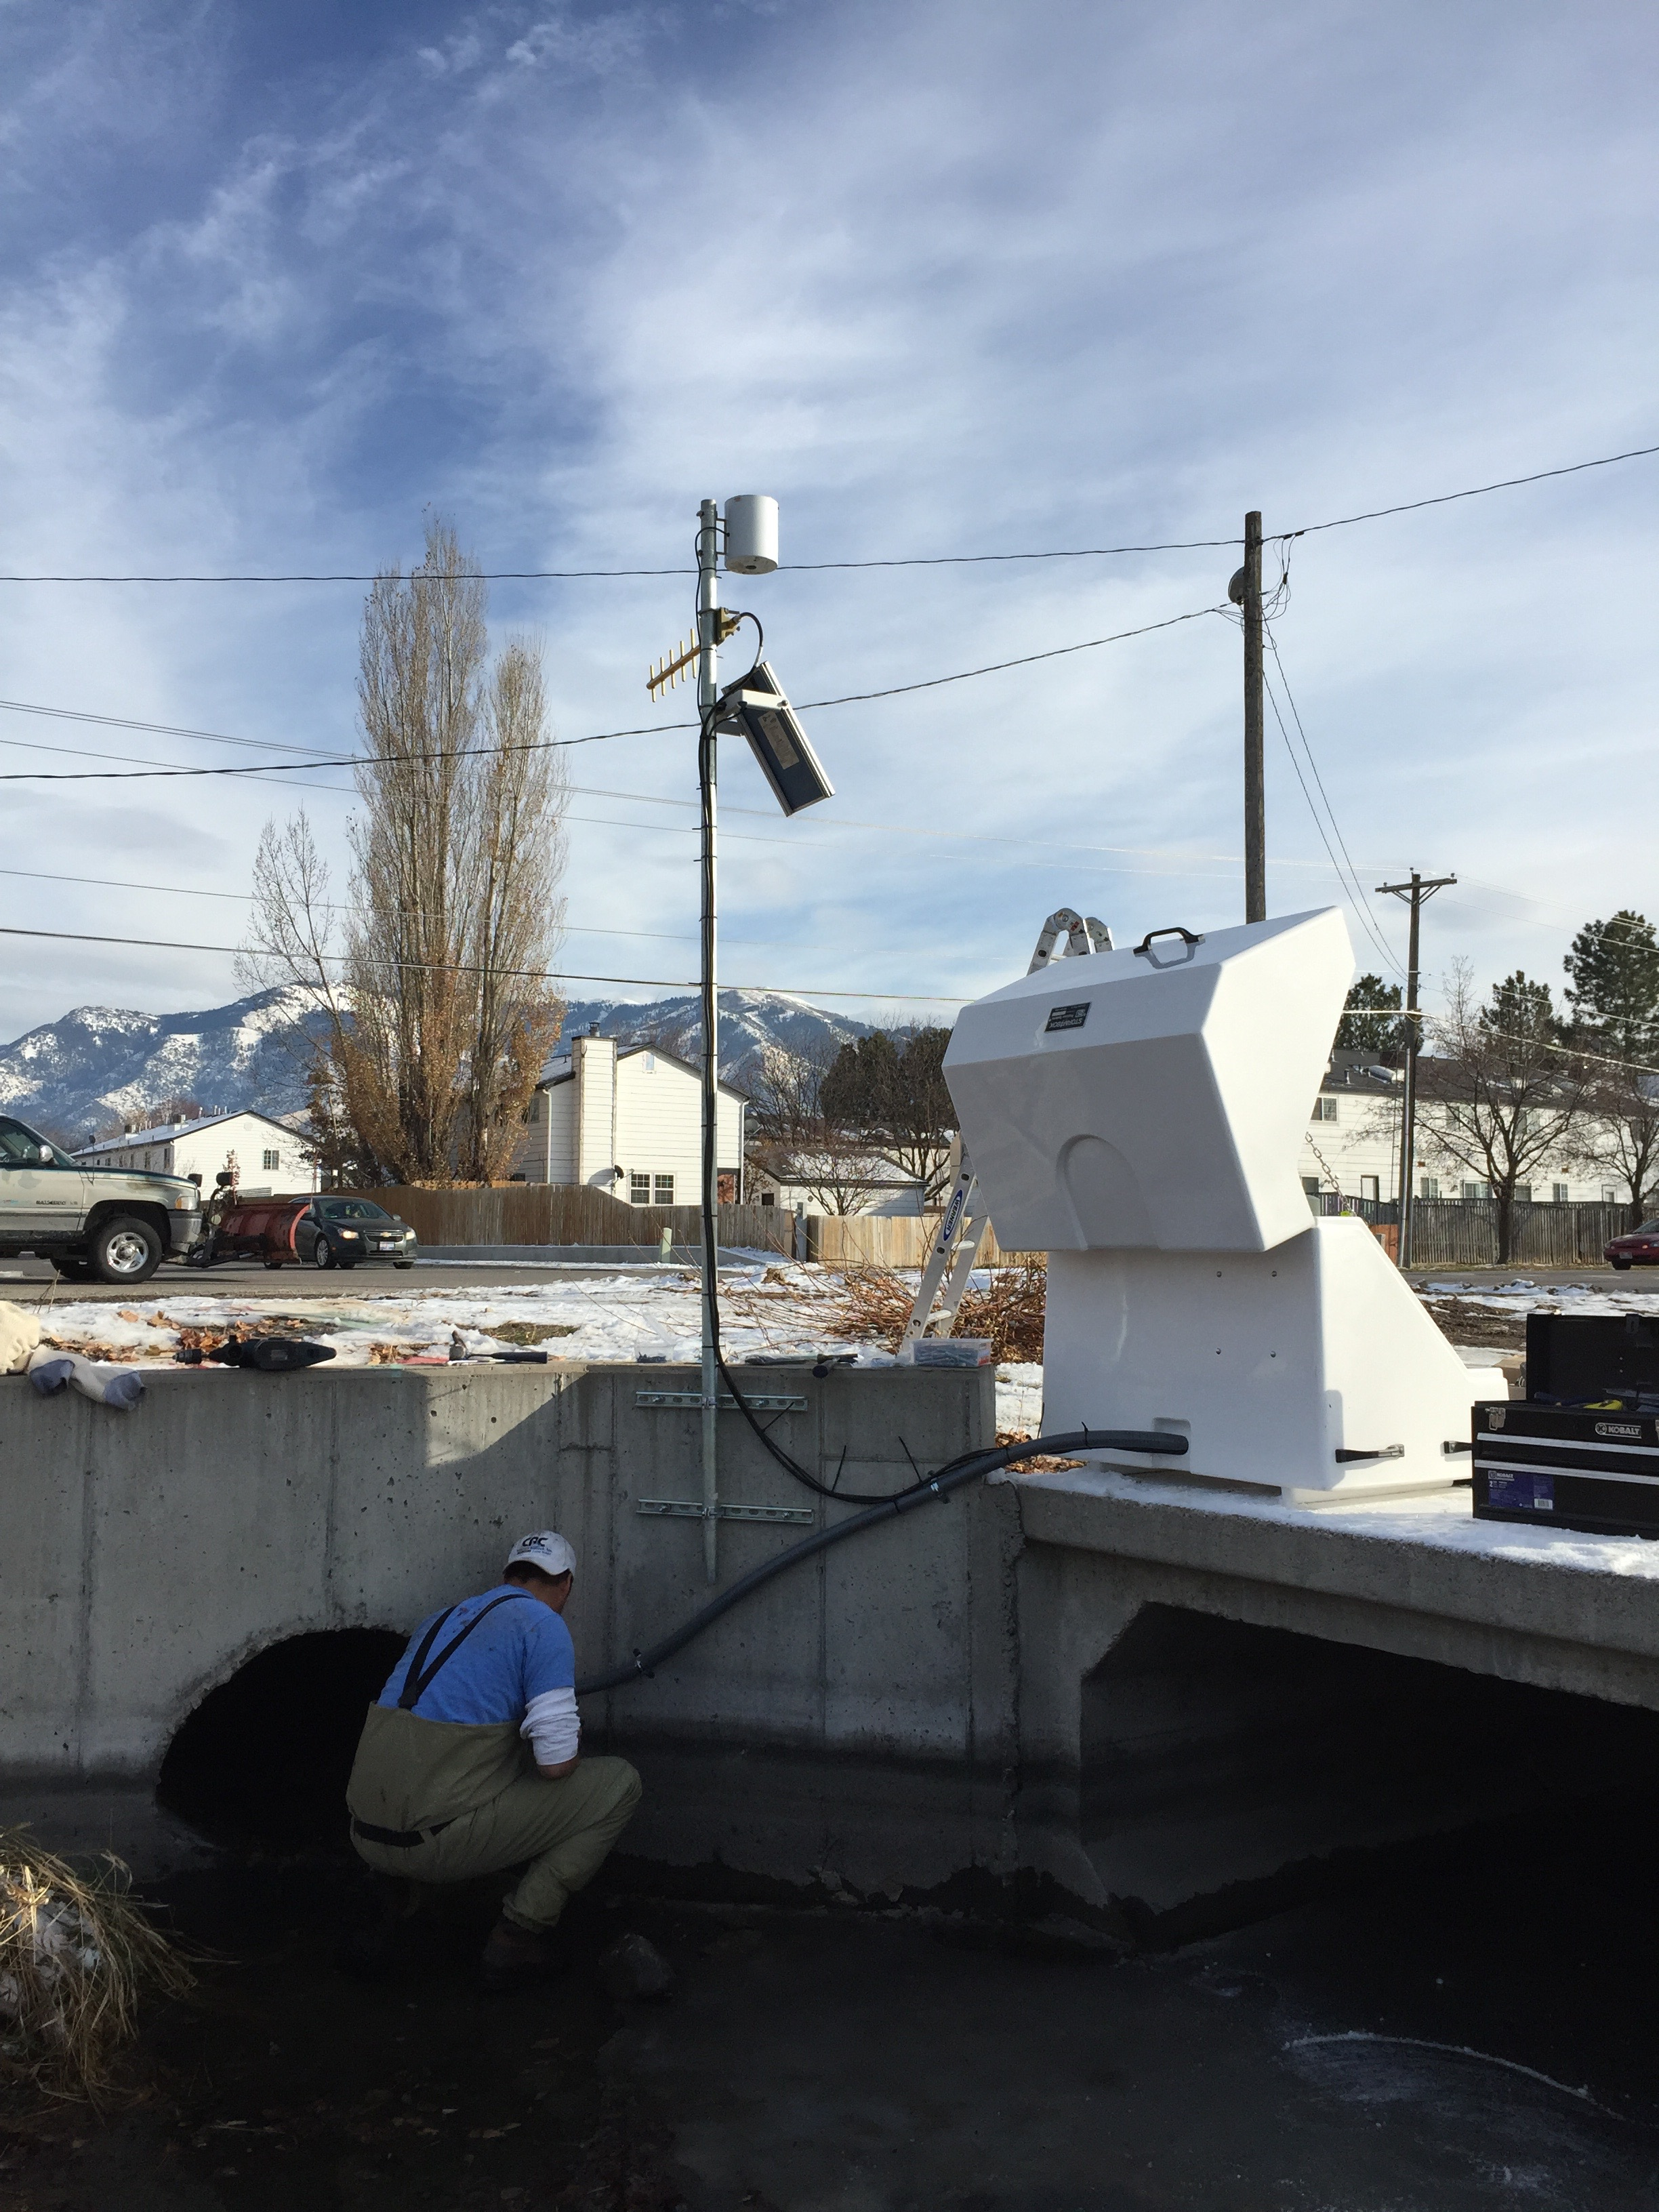
Support for New Monitoring Sites Coming Online
Stormdrain sites
New GAMUT sites
Sapflux sites
Canal sites

Slide 10
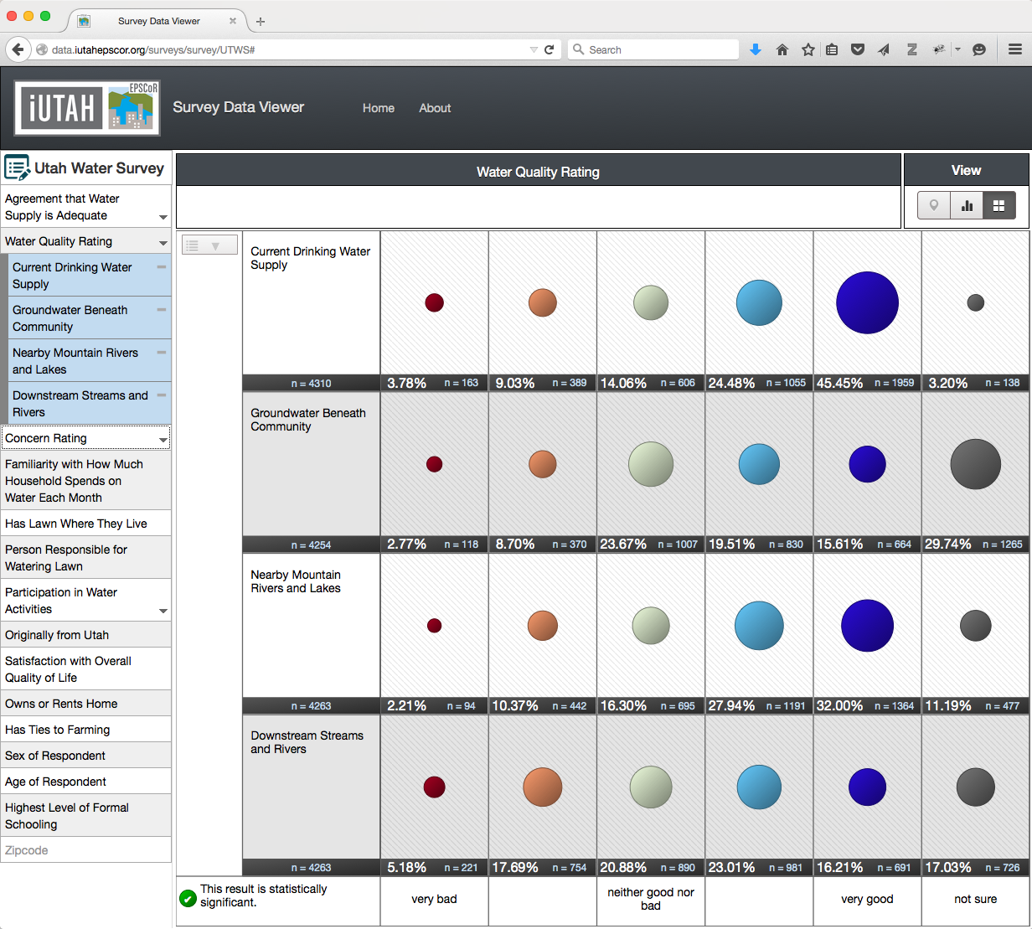
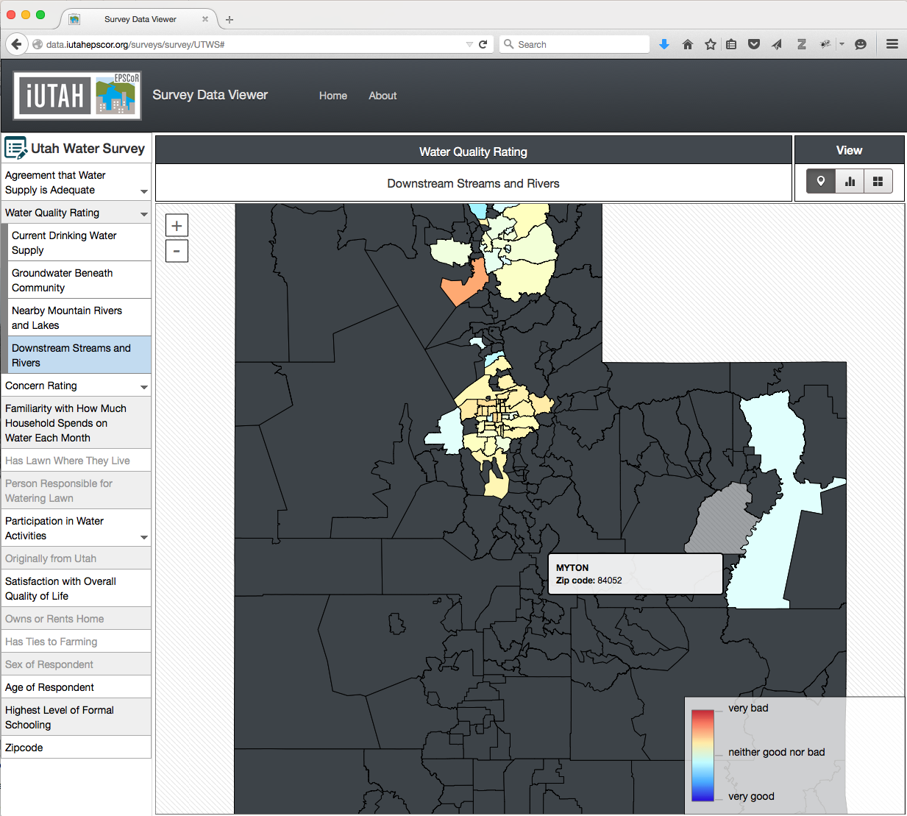
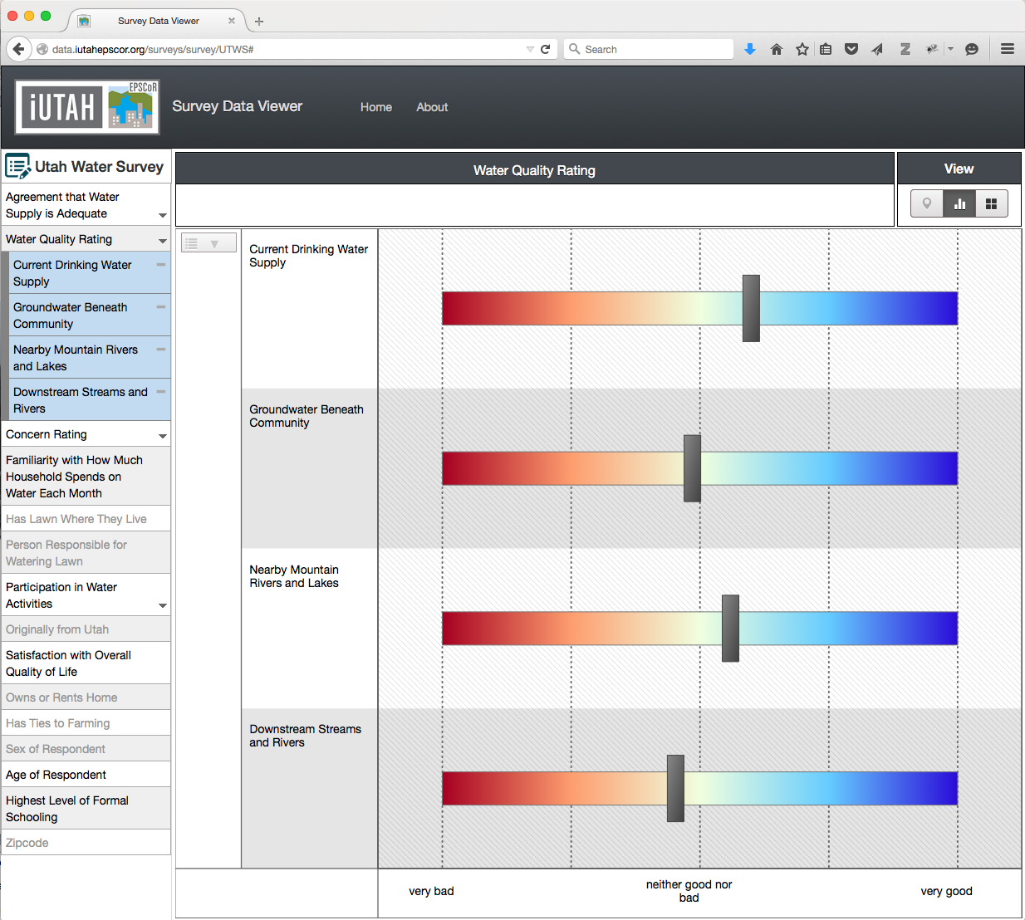
Visualizing Social Science Survey Results http://data.iutahepscor.org/surveys/
Visualization of public intercept survey results
Generic and reusable survey template
Open source code

Slide 11
Software for Coupling Environmental Models
GAMUT
National Weather
Data
Extend existing coupled modeling architectures to engage a broad audience of modelers
Design software wrappers to facilitate the transfer and ingestion of data between models in a generic manner
Develop code that does not obstruct the functionality of legacy and newly developed software models
Automatic transformation of temporally and spatially misaligned data between coupled models during simulations
Access to environmental data (e.g. GAMUT) and server-side simulation results (e.g. NetCDF)
Maintain platform independent software to appeal to a diverse audience of modelers and models
Database Application Programming Interface
Modeling Environment
Wrapper API
spatial transformation
Wrapper API
Model1
Model2
temporal
transformation
unit
conversion
Wrapper API
Model3

Slide 12
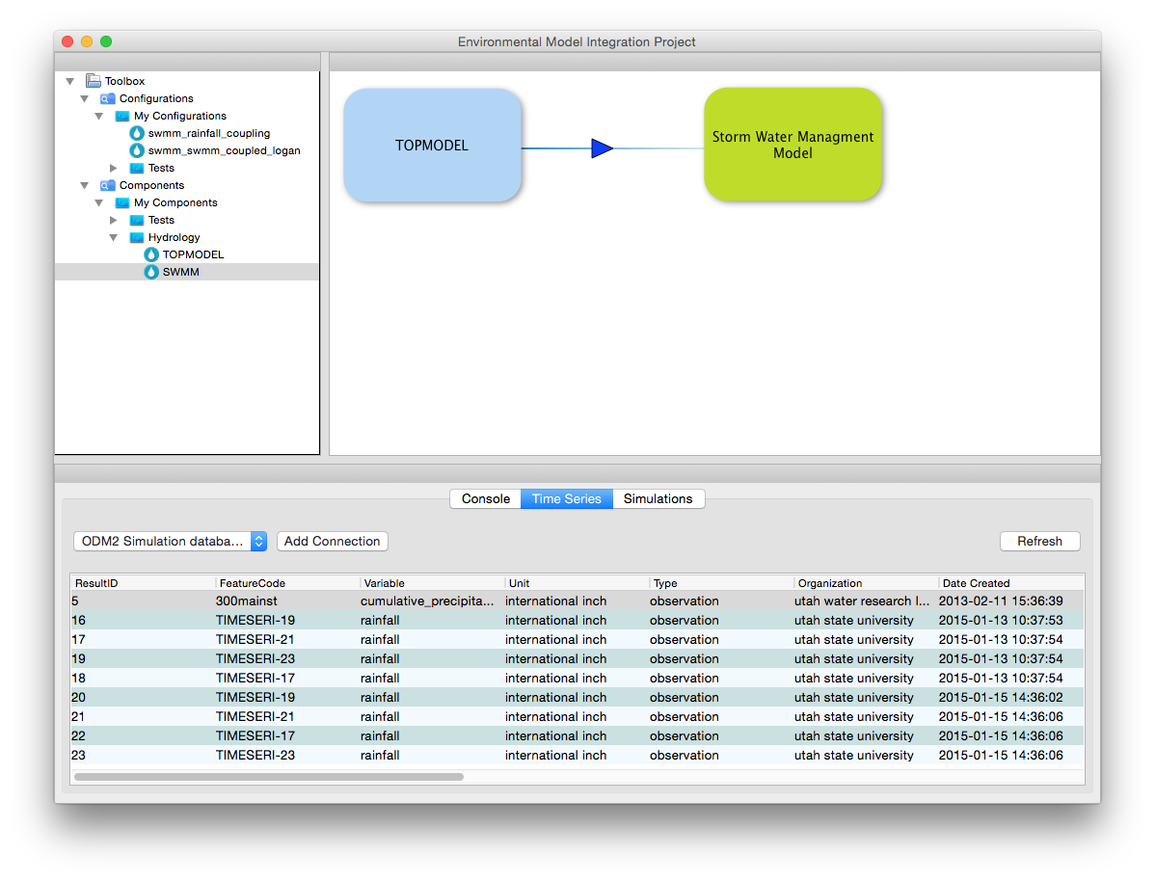
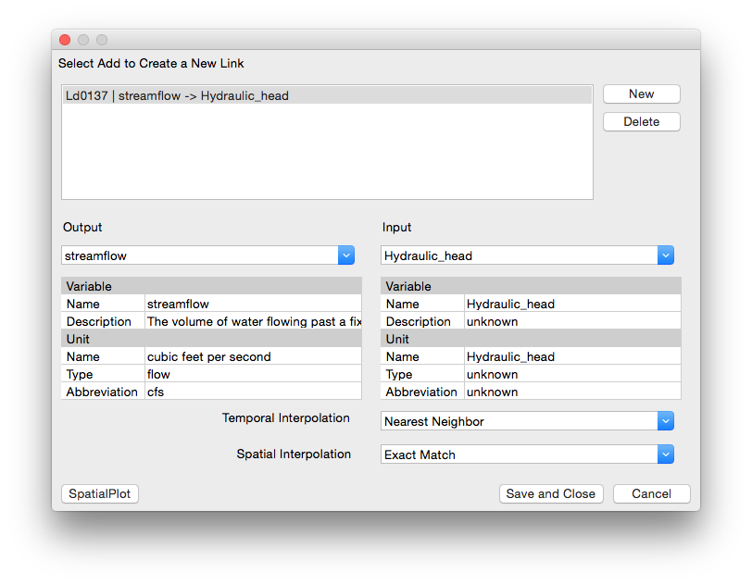
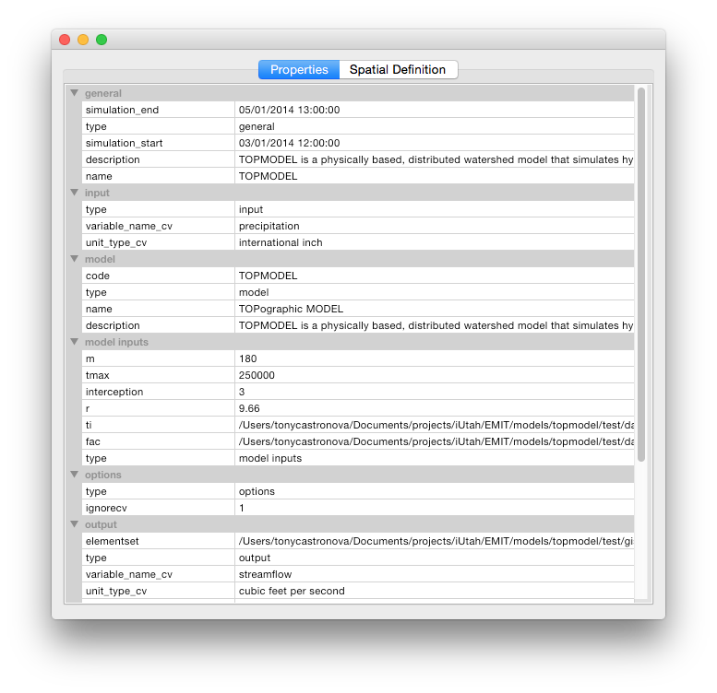
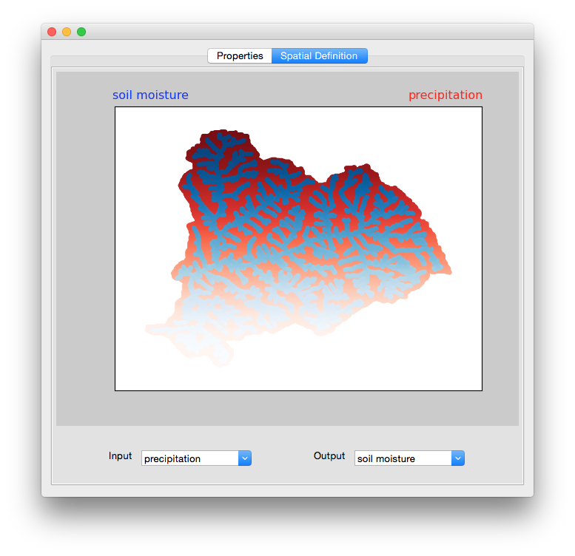
Software to Facilitate Model Coupling
Provide a intuitive entry point to the coupled modeling API to facilitate model coupling and sharing
Provide tools to lower the learning curve for creating coupled modeling workflows
Engage iUTAH scientists to collaboratively develop the next generation of coupled environmental models
Key Features
Graphical workflow builder
Database integration provides easy access to environmental sensor data
Simulation result storage in server-side databases to provide archival and sharing
Spatial and temporal results visualization
Metadata display and edit capabilities

Slide 13
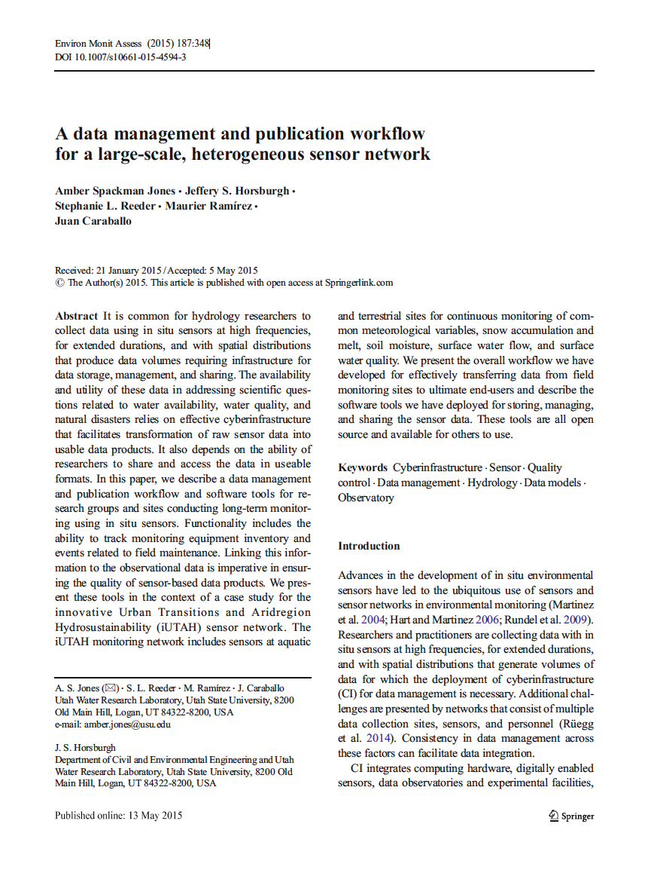
Impacts GAMUT Data Workflow
Hardware and software cyberinfrastructure workflow used for managing GAMUT data
Focused on describing how others could implement
Jones, A.S., J.S. Horsburgh, S.L. Reeder, M. Ramirez, J. Caraballo (2015). A data management and publication workflow for a large-scale, heterogeneous sensor network, Environmental Monitoring and Assessment, 187:348, doi:10.1007/s10661-015-4594-3.

Slide 14
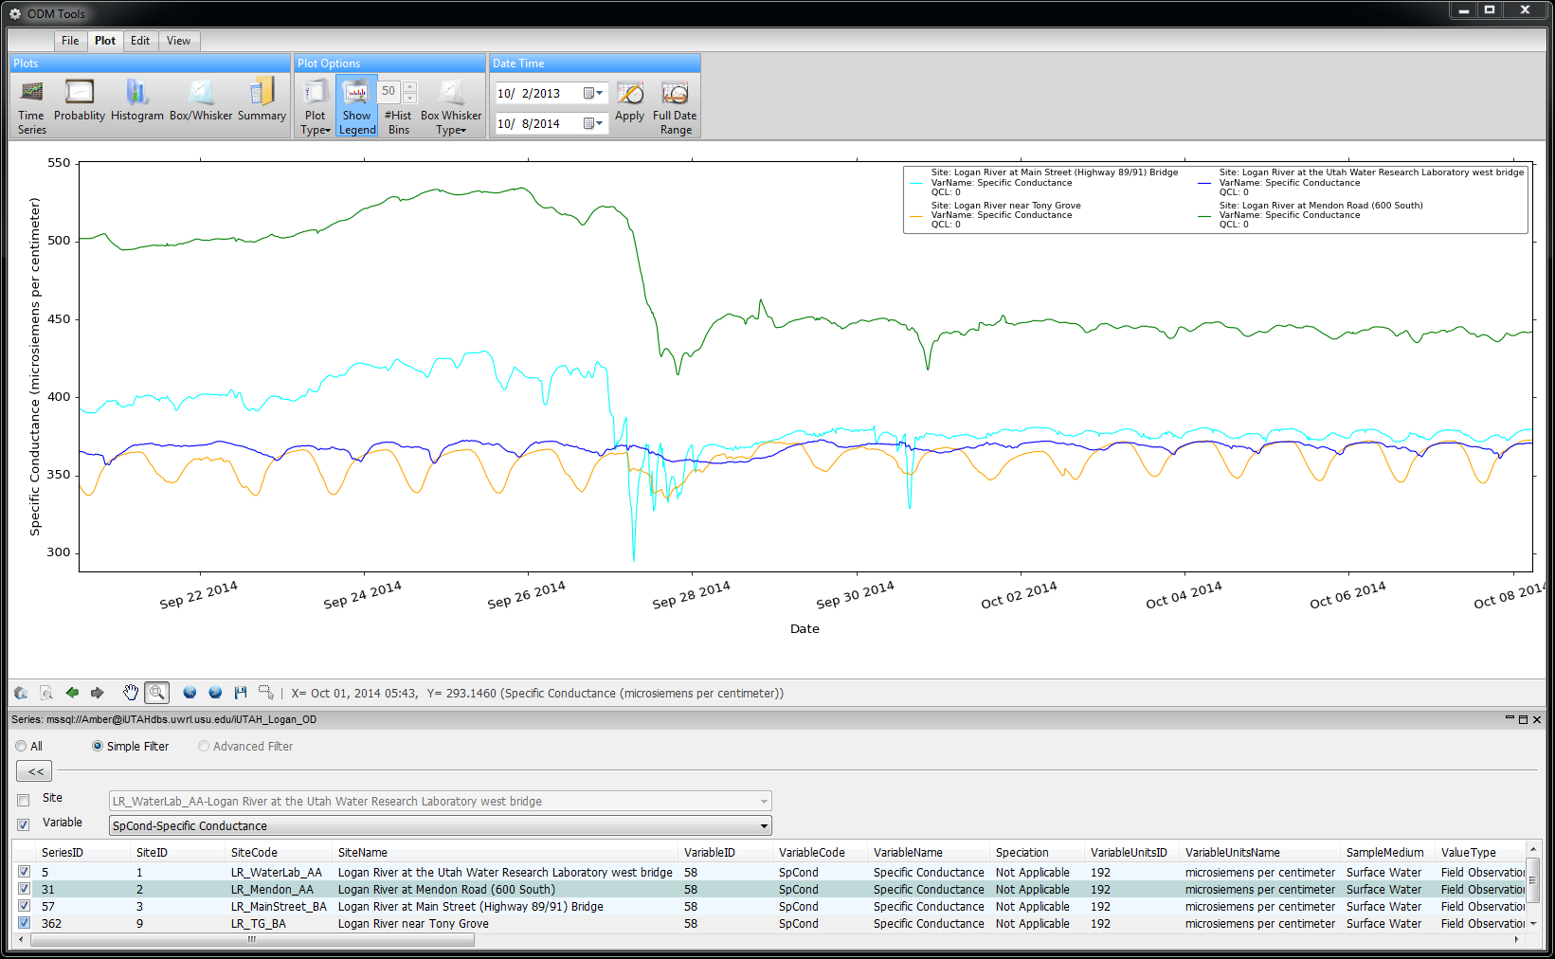
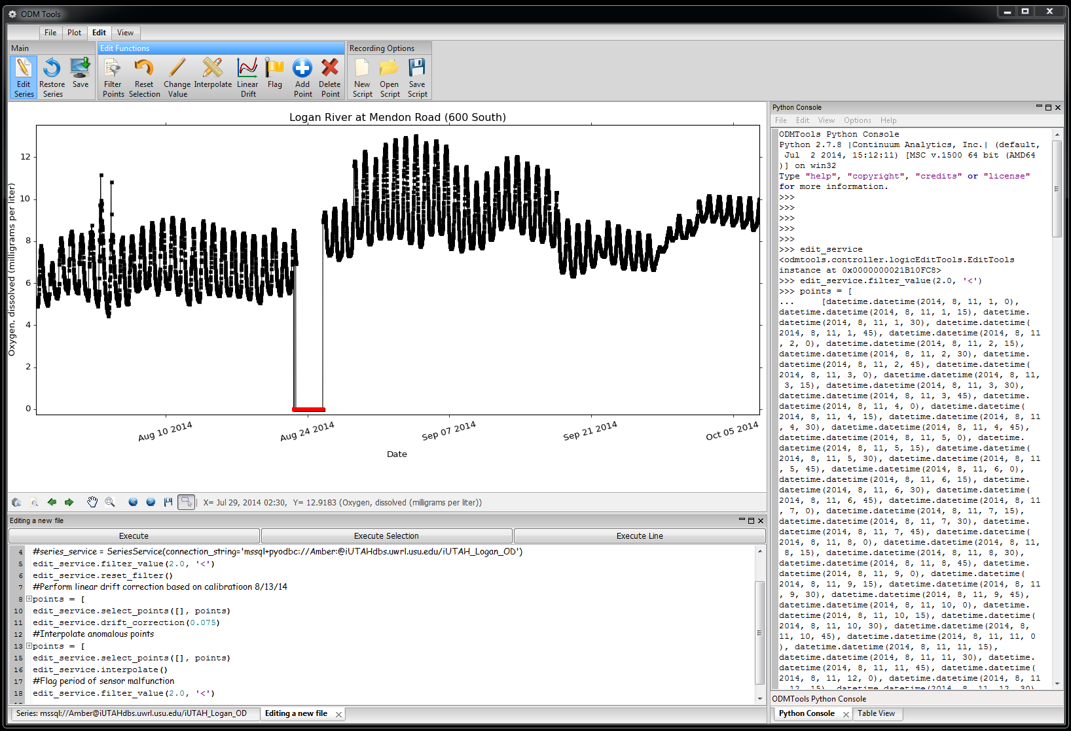
Impacts GAMUT Data Quality Control Training
Conducted training for 25 attendees
Training included:
Visualizing sensor data streams
Scripted and reproducible quality control of sensor data streams
Quality control workflow
Continued software development to meet watershed technicians’ needs

Slide 15
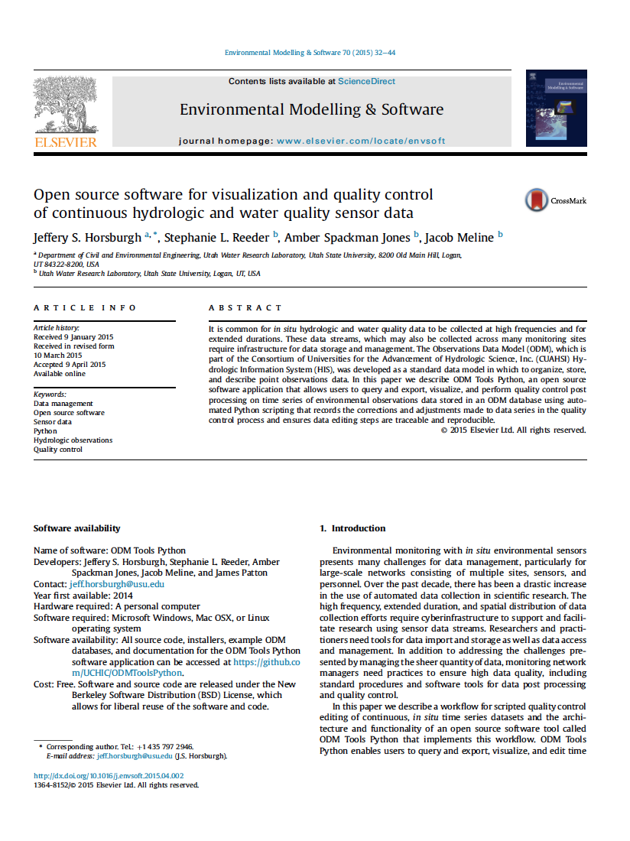
Impacts Software for Sensor Data Management
Scripted and reproducible QC of sensor data streams
Integrated with CUAHSI HIS
Open source
Cross platform
Horsburgh, J. S., S. L. Reeder, A. Spackman Jones, J. Meline (2015). Open source software for visualization and quality control of continuous hydrologic and water quality sensor data, Environmental Modelling & Software, 70, 32-44, doi:10.1016/j.envsoft.2015.04.002.

Slide 16
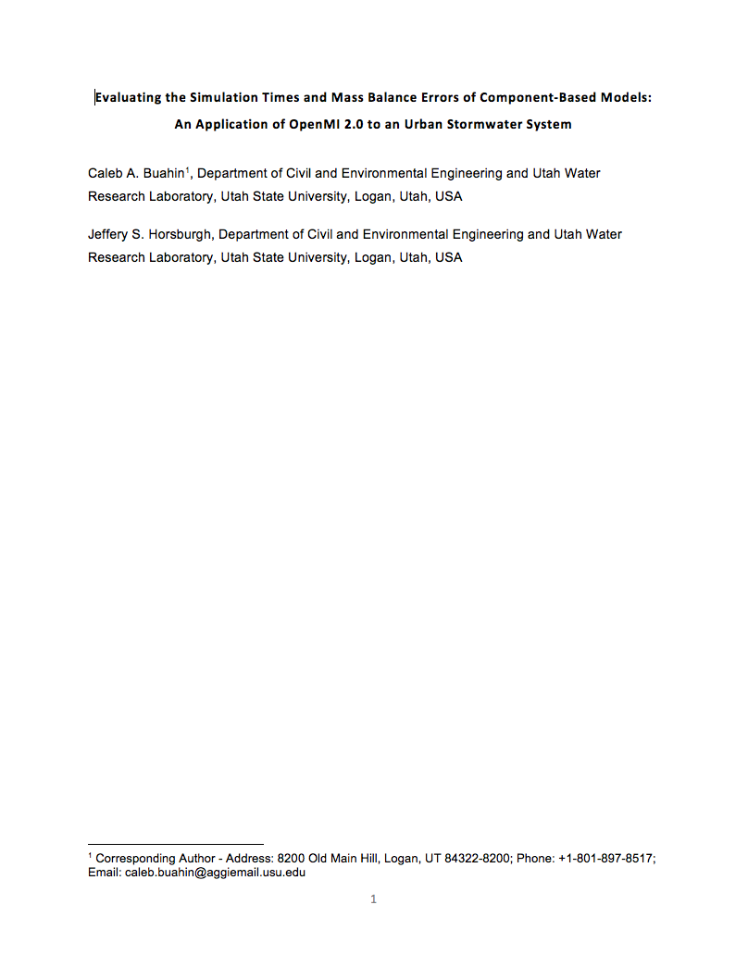
Impacts Computational Challenges of Coupled Modeling
What are the computational challenges in coupling hydrologic models?
Mass balance errors
Simulation time
How can they be overcome?
Paper resubmitted after revision

Slide 17
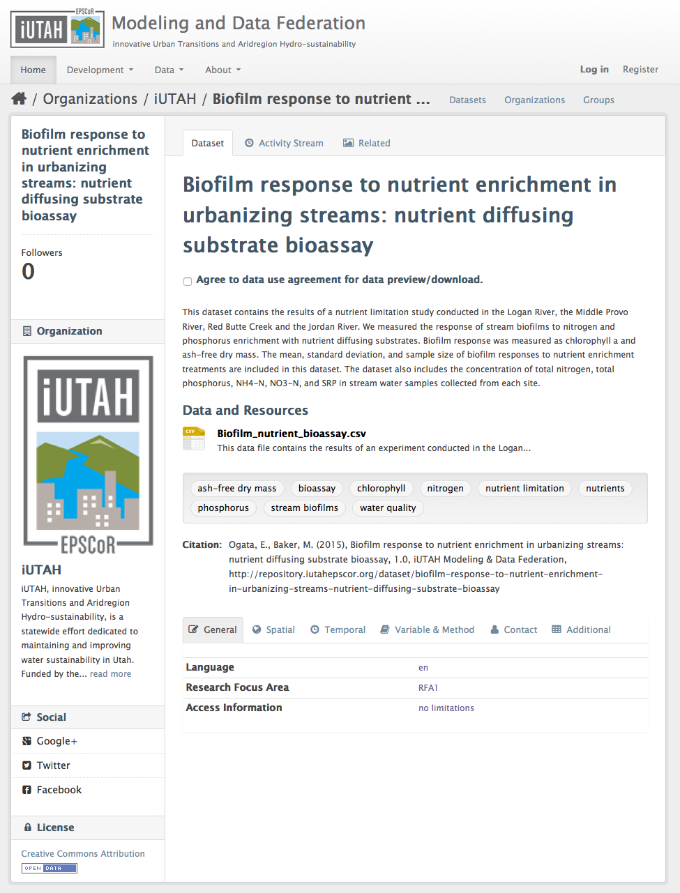
Impacts Published Datasets
iUTAH datasets published online
Individual dataset landing pages
Browseable and searchable
Publicly available
Citable

Slide 18
Impacts Open Source Code Repositories
WEBTSA – GAMUT time series data visualization
https://github.com/UCHIC/WEBTSA
ODM Streaming Data Loader
https://github.com/ODM2/ODM2StreamingDataLoader
ODM Tools Python – Sensor data management and QC
https://github.com/UCHIC/ODMToolsPython
ODM2 Sensor – Sensor equipment management
https://github.com/UCHIC/ODM2Sensor
iUTAH Utilities – Automated alerts, etc.
https://github.com/UCHIC/iUtahUtilities
iUTAH Survey Data Viewer – Visualization of survey data
https://github.com/UCHIC/SurveyDataViewer
iUTAH Data – Modeling and Data Federation Website
https://github.com/UCHIC/iUTAHData
Notes:
We’re using open source repositories for all of our development.
This is an important practice because others might want to implement these tools, or contribute or collaborate with us.

Slide 19
Impacts Hydroinformatics Course
Expanded in 2014 to 5 partner universities
45 students total across the campuses
Will be offered at USU, BYU, and UofU again this fall
“I'm learning so many new techniques that will be incredibly helpful in my research. I never knew about data management plans and while they are tedious, they are so helpful once they're implemented. I also have only ever dabbled in SQL up to this point and now I find myself using it more often than not.”
“My team used basic concepts from almost every class period and topic section in our term project. It was cool to see how all the individual skills added up to help us create and maintain hydrologic information.”
Creating the Next Generation of “Cyber-Savvy” Engineers and Scientists
“I have enjoyed the distance learning with multiple professors and input from other students.”

Slide 20
Questions?
Jeff Horsburgh
jeff.horsburgh@usu.edu
Amber Jones
amber.jones@usu.edu

