Slide 1
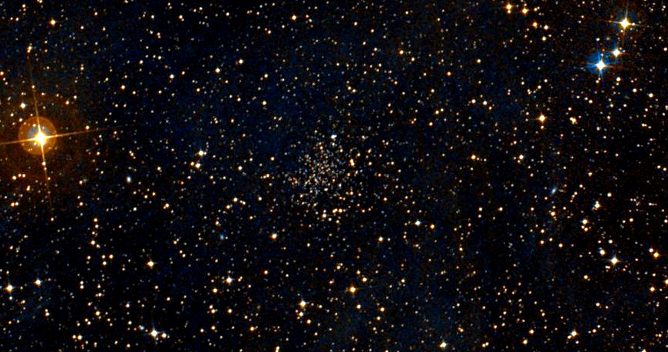
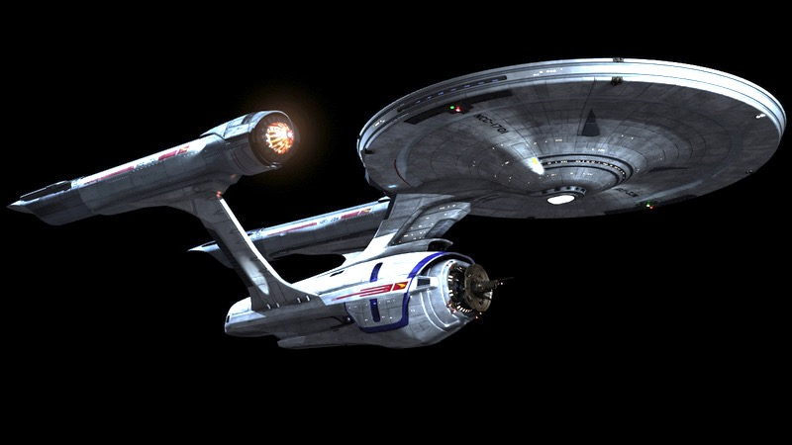
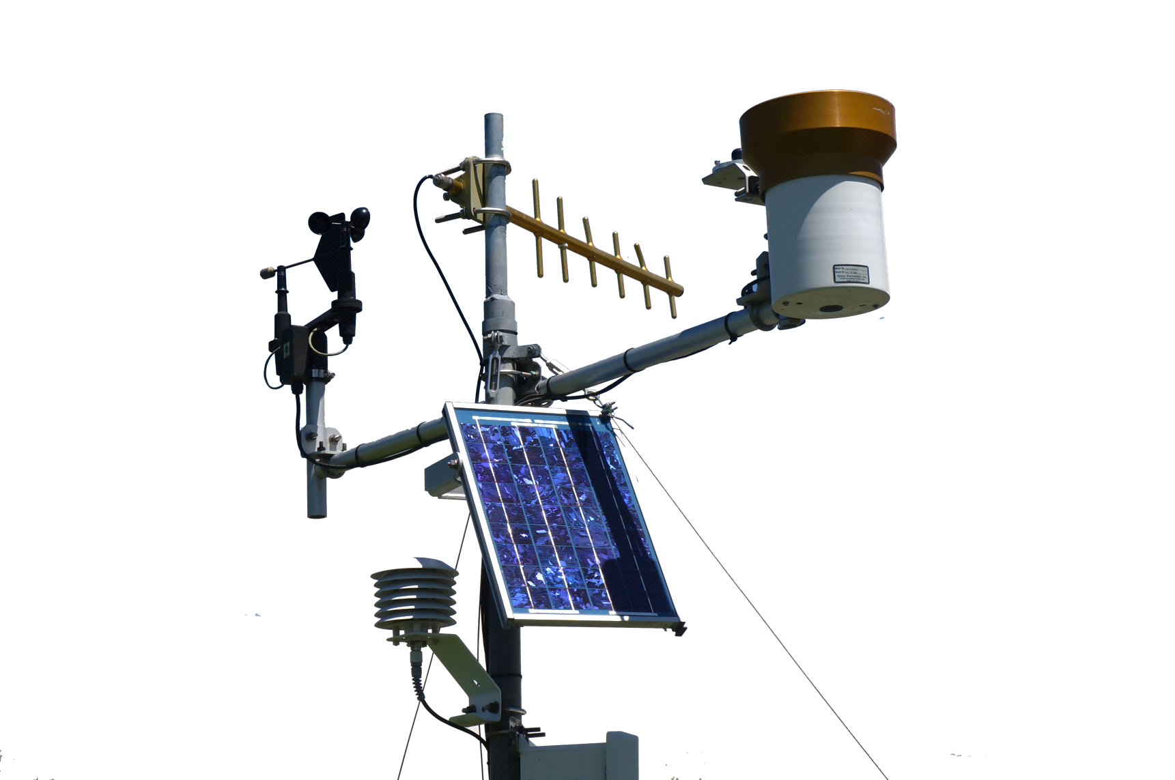
GAMUT: The Final Frontier
Amber Jones
iUTAH Data Manager
Notes:
I’m crossing over from the cyberinfrastructure team, and I’ve got to bring a little federation flair.
I’ve become somewhat of a champion for GAMUT, but there are many other contributors to the material here.

Slide 2
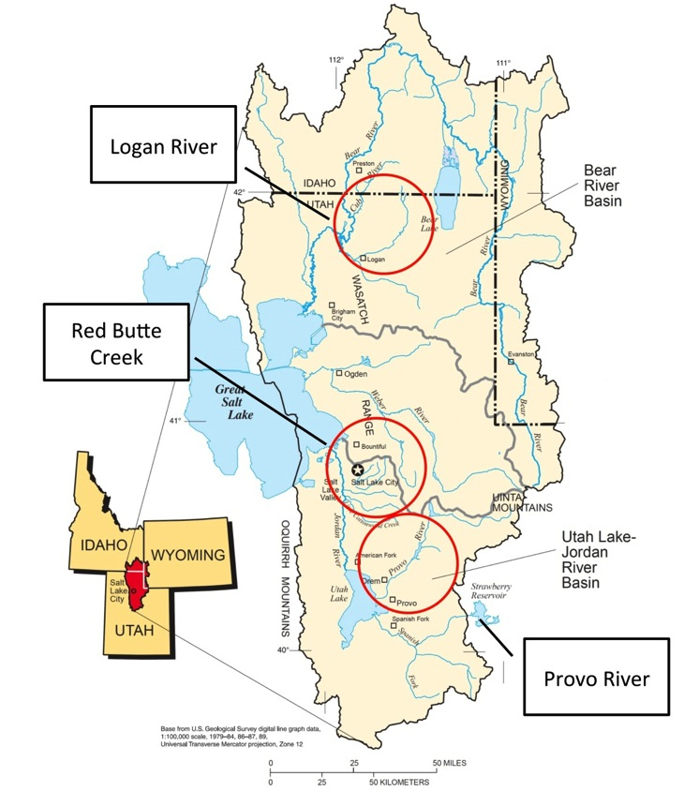
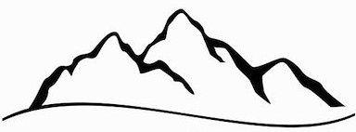
GAMUT: Gradients Along Mountain to Urban Transitions
Major iUTAH infrastructure
Three watersheds instrumented from a mountain to urban gradient
Mountain to Valley Transition
Fundamental Aquatic Sites
Enhanced Aquatic Sites
Climate/Terrestrial Sites
Notes:
GAMUT started with an idea. Standardize in situ data collection at aquatic and terrestrial climate sites in three different watersheds.
Three different watersheds that represent differing types and patterns of urbanization.
The streams originate with mountain snowpack, flow through canyons, and exit to populated valleys. In all cases, we have mountain water being used by urban people.

Slide 3
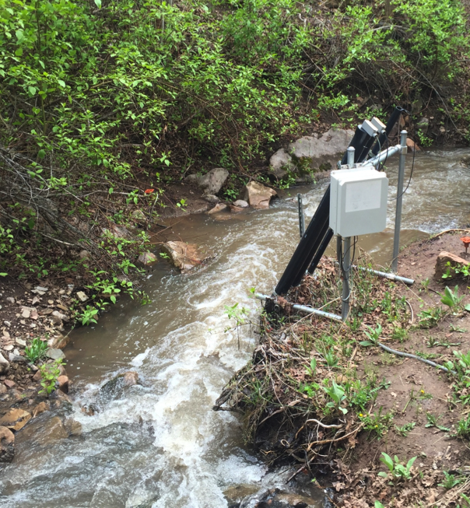
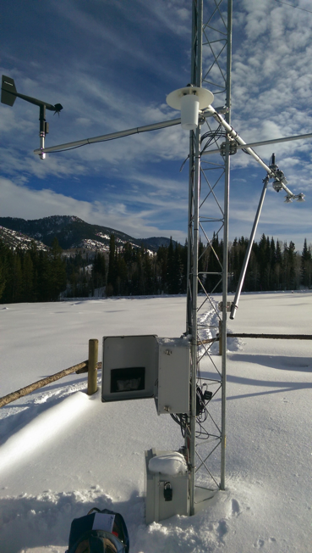
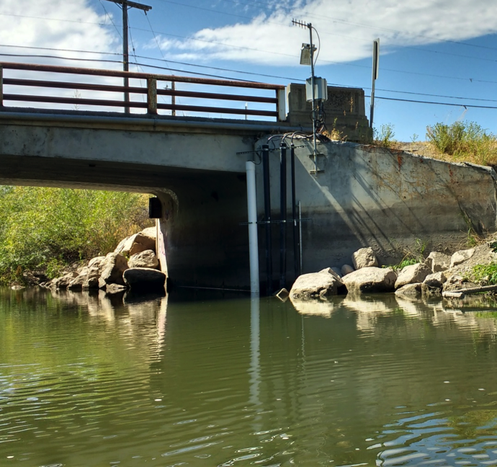
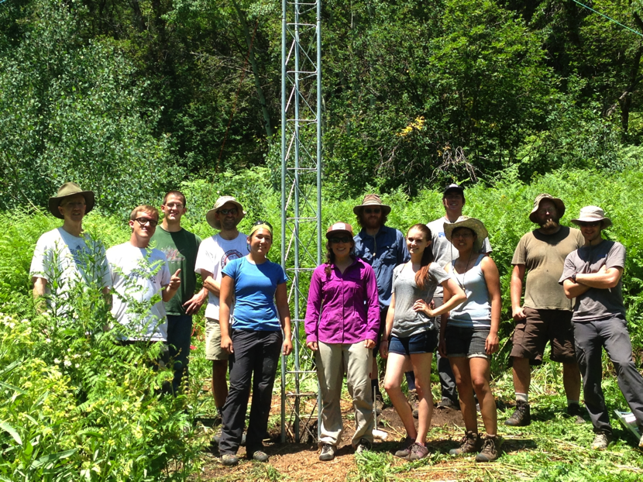
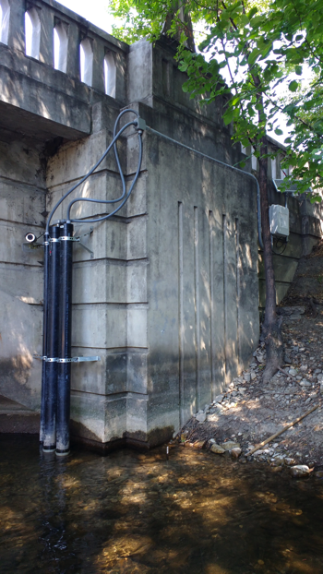
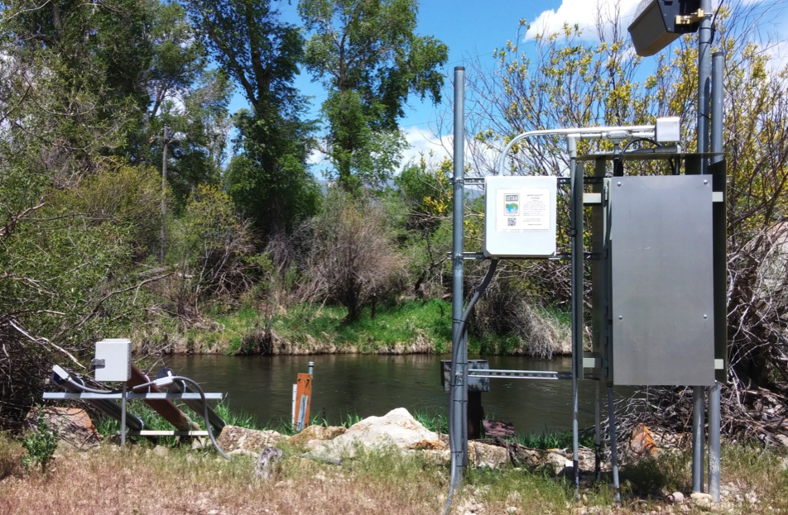
GAMUT: Gradients Along Mountain to Urban Transitions
Notes:
The idea became a reality as the GAMUT technicians and others deployed sites throughout elevation and urbanization gradients in each watershed.
Show part of Red Butte Creek video here?

Slide 4
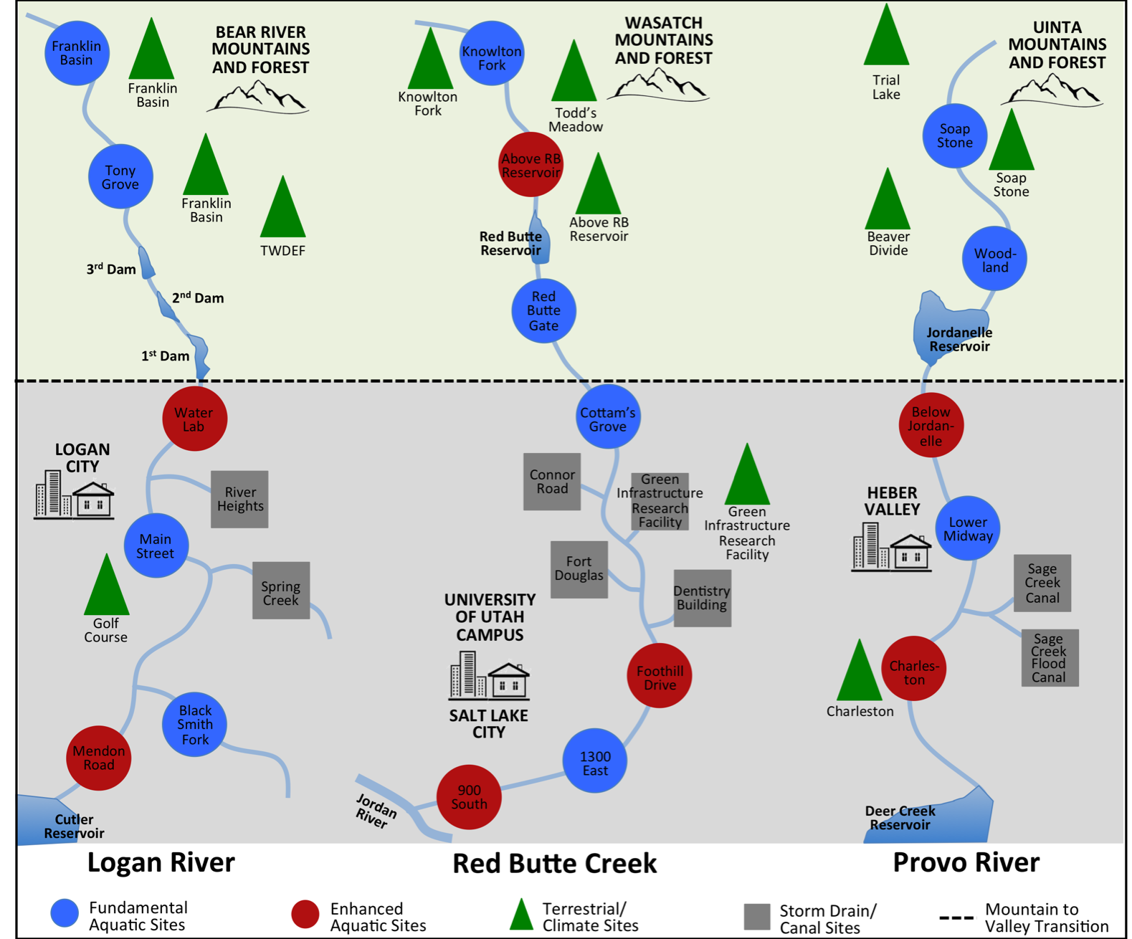
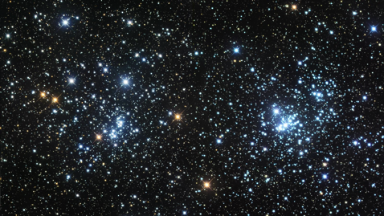
GAMUT: Gradients Along Mountain to Urban Transitions
39 sites
1800 data series
141 million+ values over 3 years
Notes:
Now each watershed includes several aquatic, climate and storm drain sites.
So, when I was asked to talk about GAMUT, I thought, what? Everyone knows GAMUT. But- do you? Maybe you are aware of what I just covered. But you may not be aware of some updates and extensions to GAMUT. So, I will give some updates on the status of aspects of GAMUT and then describe ways in which GAMUT is being extended.

Slide 5
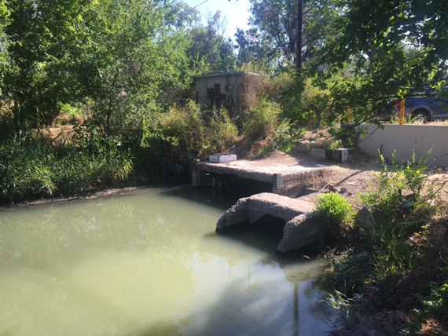
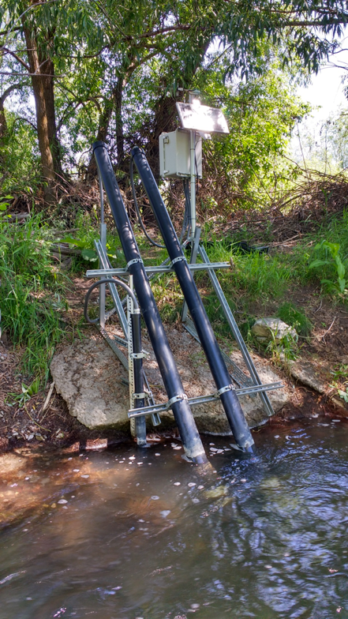
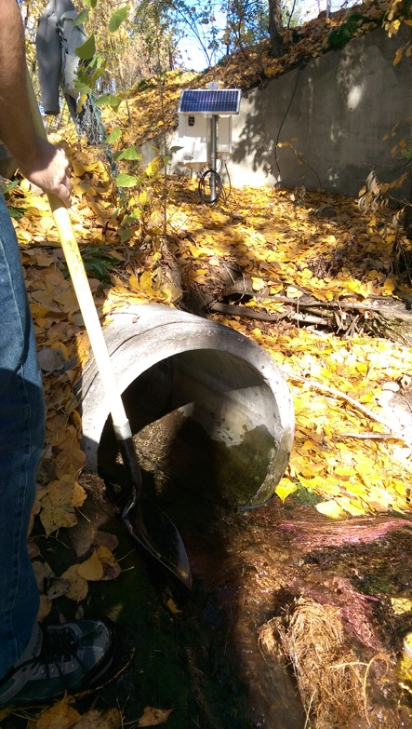
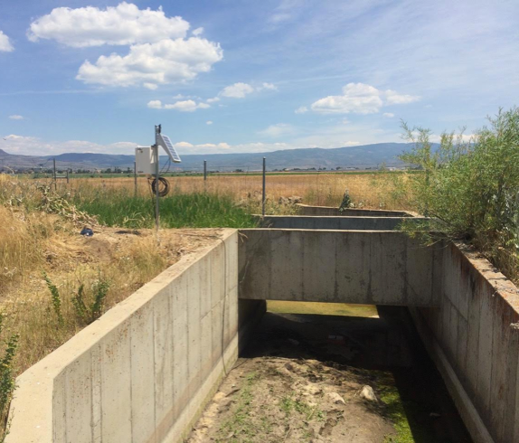
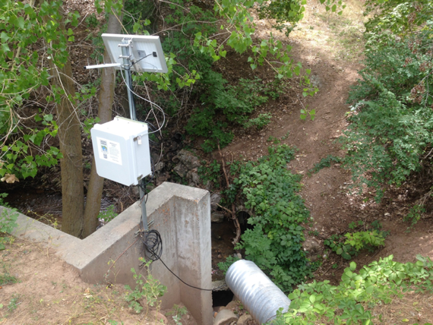
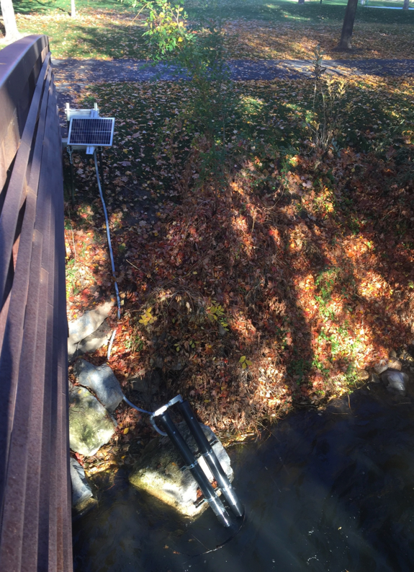
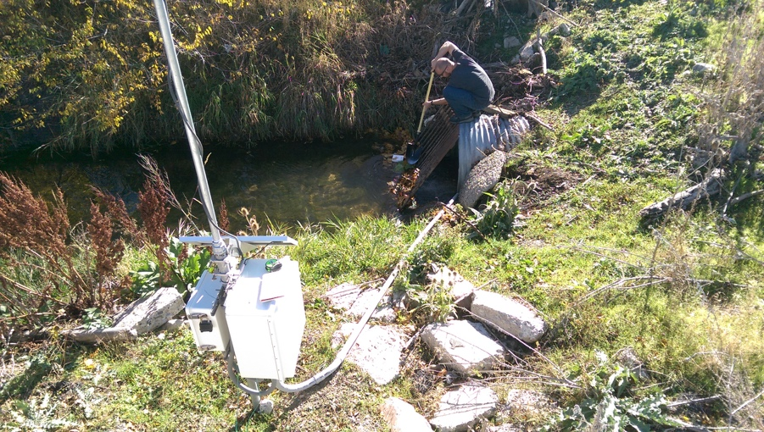
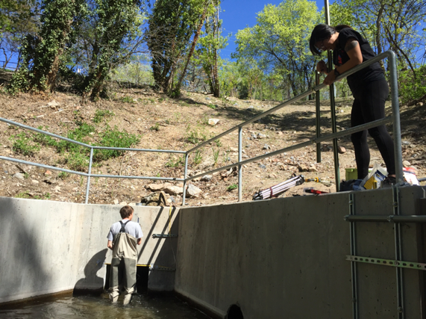
GAMUT Update: Additional Monitoring Sites
Notes:
But did you know:
Storm drain sites were added to capture important return flows from urban areas.
We have added sites downstream of the University of Utah campus, important tributaries are being monitored in Logan, a canal site in Provo, and we’re shifting the monitoring in the Provo River downstream below Provo Canyon.

Slide 6
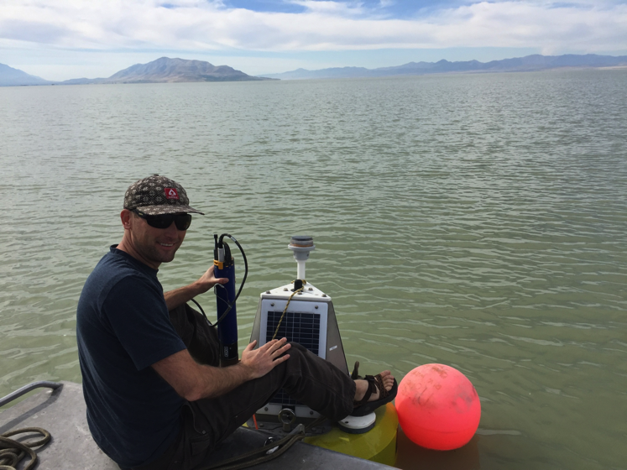
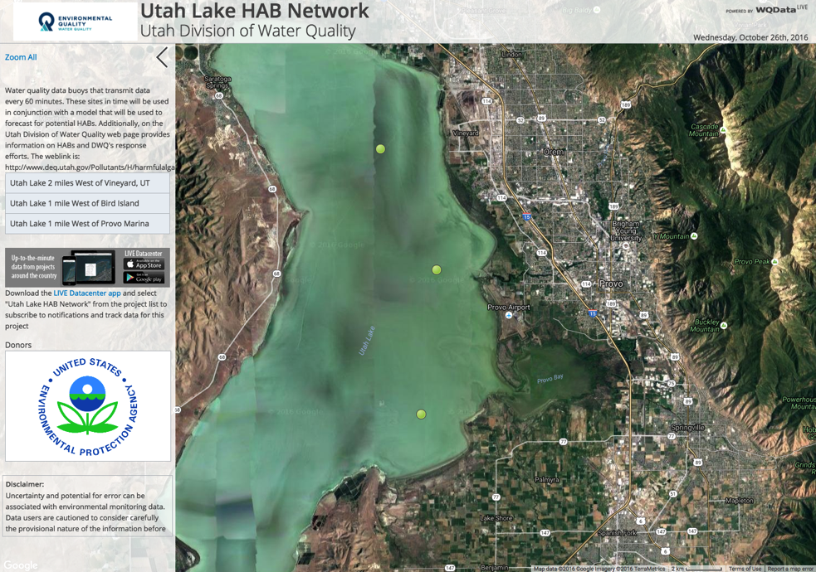
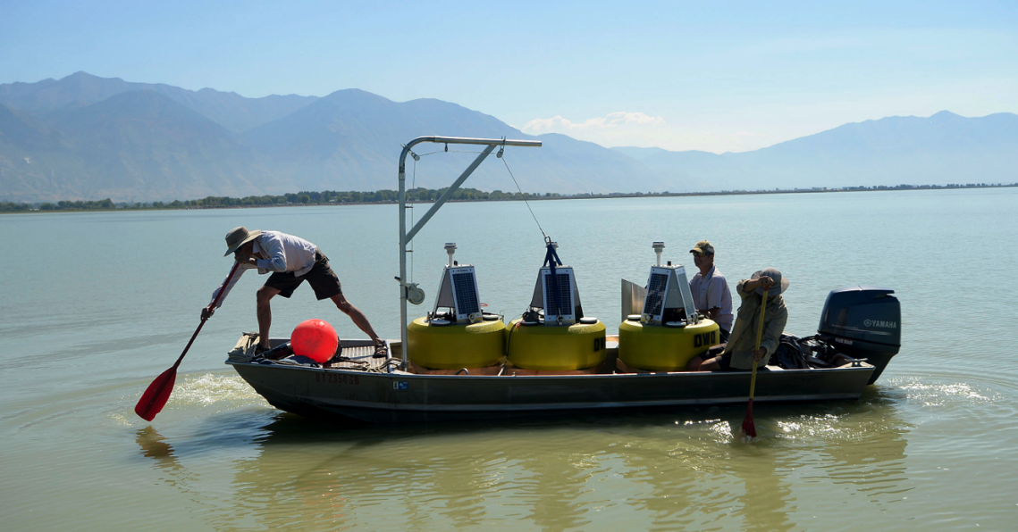
GAMUT Update: Utah Lake Buoys
GAMUT staff working with State DEQ
Assisting with installation and maintenance
Will stream buoy data
photo: Al Hartman, Salt Lake Tribune
Notes:
Did you know:
GAMUT staff have worked with the state DEQ to deploy buoys with water quality monitoring sensors to Utah Lake, and we are working to stream the resulting data alongside other GAMUT data

Slide 7
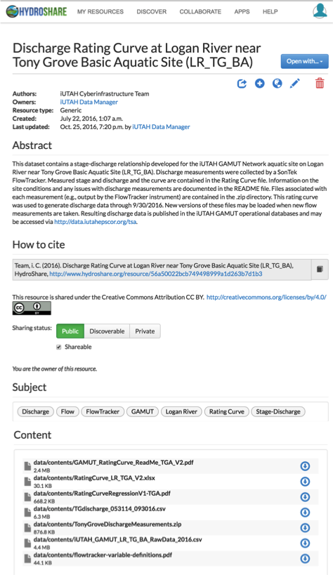
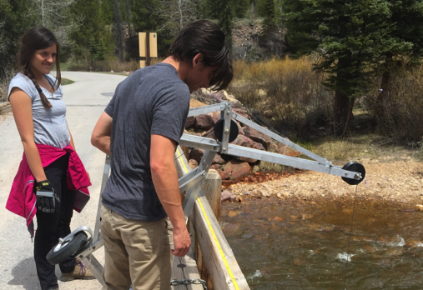
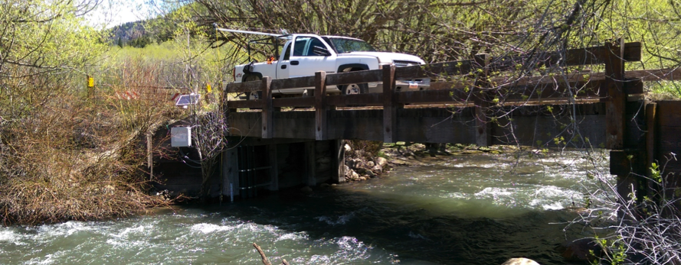
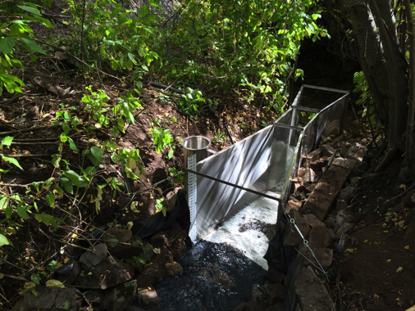
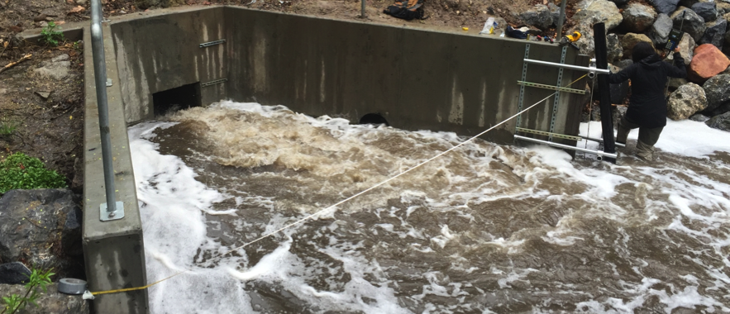
GAMUT Update: Discharge Data
Variety of new methods implemented to manually measure discharge
Stage-discharge relationships shared to HydroShare
Time series of discharge accessible with other GAMUT data
Notes:
Did you know:
Efforts made in the past year toward measuring discharge over a range of flows- bridge carts and trucks at high water levels, a flume installed in upper Red Butte Creek to capture very low flows. For all aquatic sites, stage-discharge relationships along with information on each discharge measurement and how the relationship was developed are packaged as a resource and shared on HydroShare. Furthermore, time series of discharge are accessible alongside other GAMUT data.

Slide 8
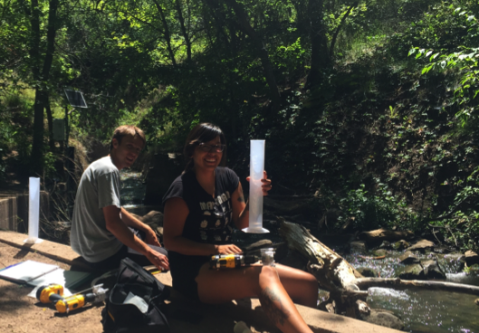
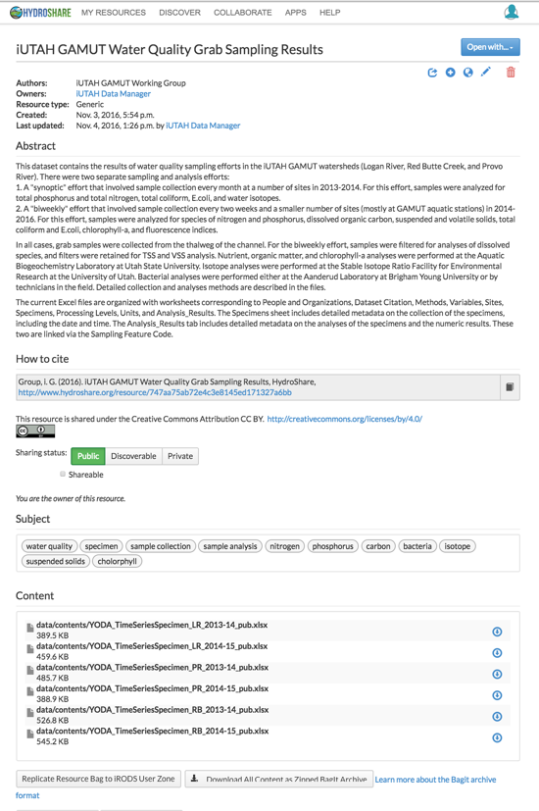
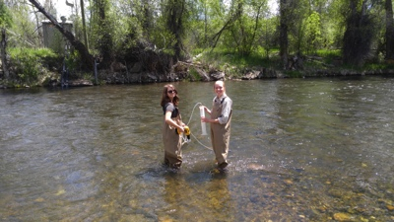
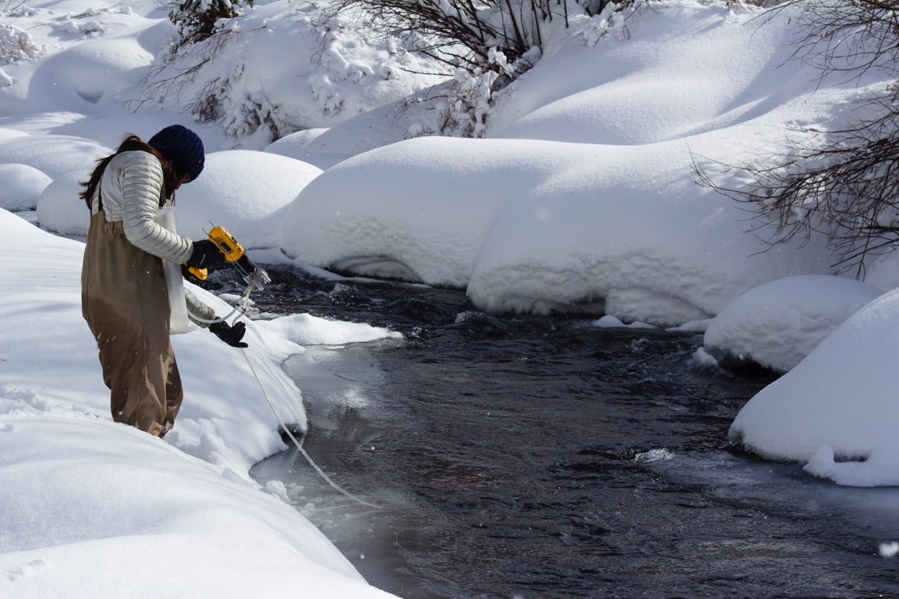
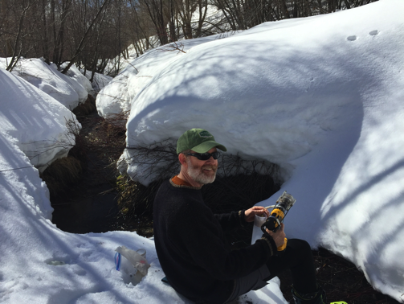
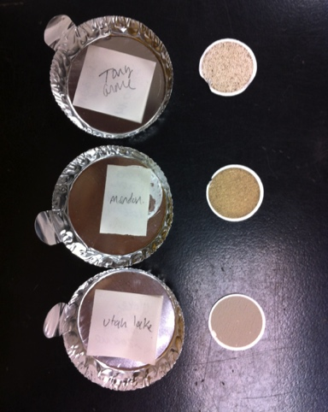
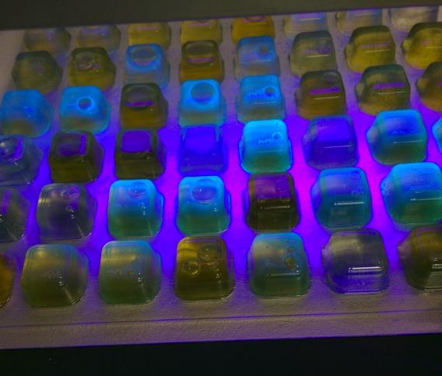
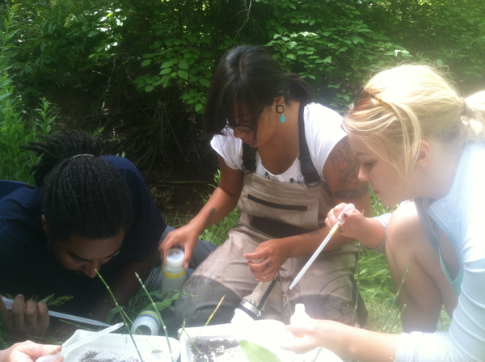
GAMUT Update: Regular Sampling Results
Two efforts:
Synoptic sampling: 2013-2014
Biweekly sampling: 2014-2016
Results of sample analyses now shared on HydroShare
Notes:
Did you know:
The results from the collection and analysis of grab samples at the GAMUT sites and other sites within GAMUT watersheds are newly published to HydroShare.
We’ve worked to compile results into an excel file, which is a preliminary format. It is complicated because sample based data have a lot of metadata, which can be complex. All in one place and includes the detailed metadata. We’ll be building some tools and a viewer that will make it easier to access individual samples from individual sites and provide a more approachable format. Need to get some input on how you want the data organized.

Slide 9
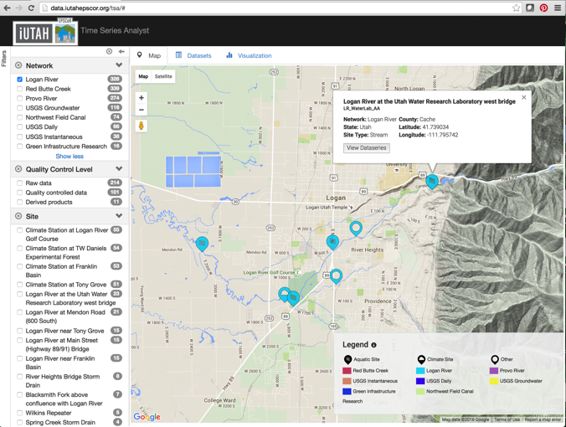
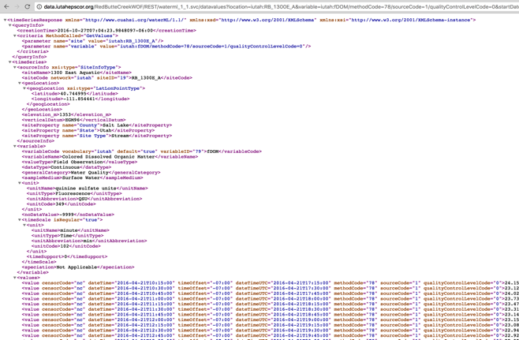
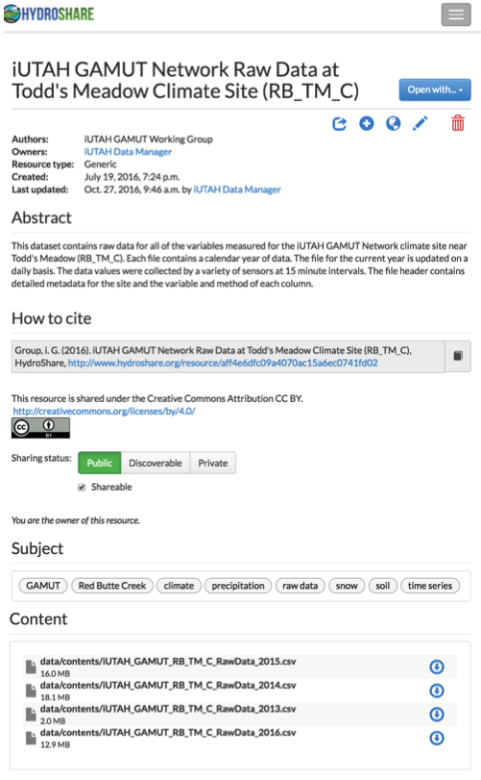
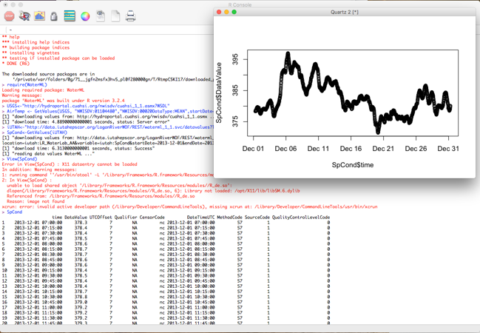
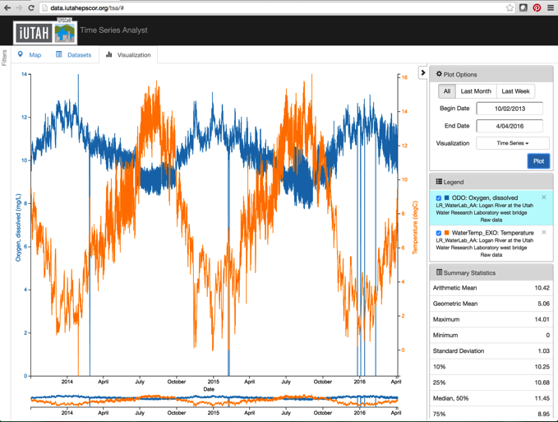
GAMUT Update: Accessing Sensor Data
HydroShare:
Raw by site (QC0)
Quality controlled by site and by variable (QC1)
Time Series Analyst: Web interface, map and plot tools, and data export
Web Services: Programmatic data access
Notes:
Did you know:
GAMUT data are available via several mechanisms. As Jeff mentioned, raw and quality controlled data are shared via HydroShare.
The time series analyst web interface provides map based data discovery, data export,and plotting tools.
The GAMUT data are also published via web services, and registered with the CUAHSI Water Data Center, which makes them available in a national context alongside other data. Web services gives programmatic access and can be called from Python or R or choose your favorite programming interface.

Slide 10
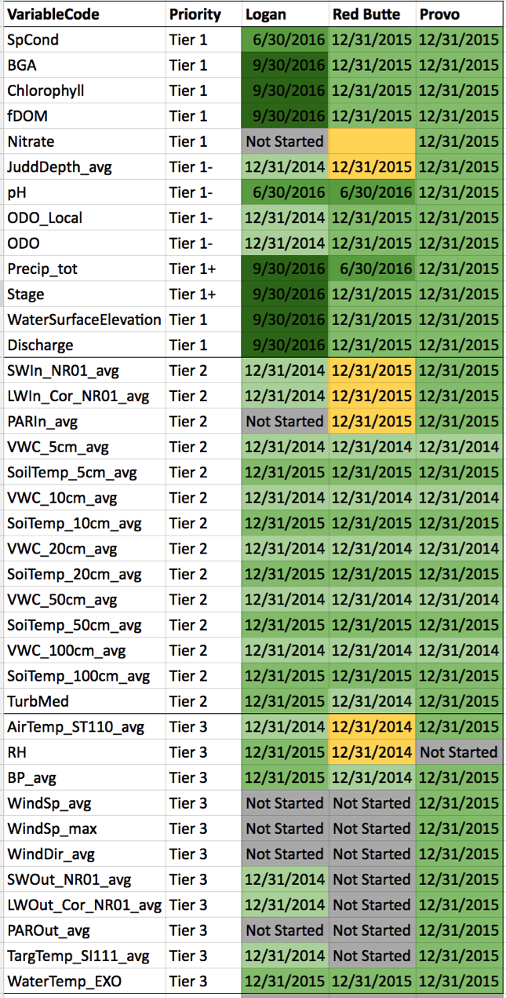
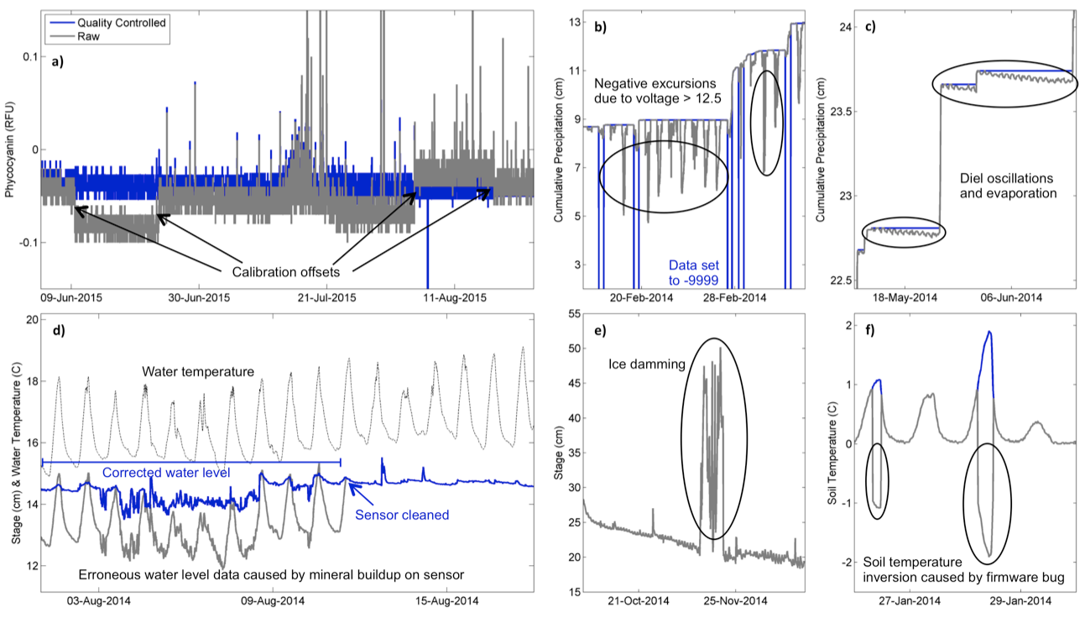
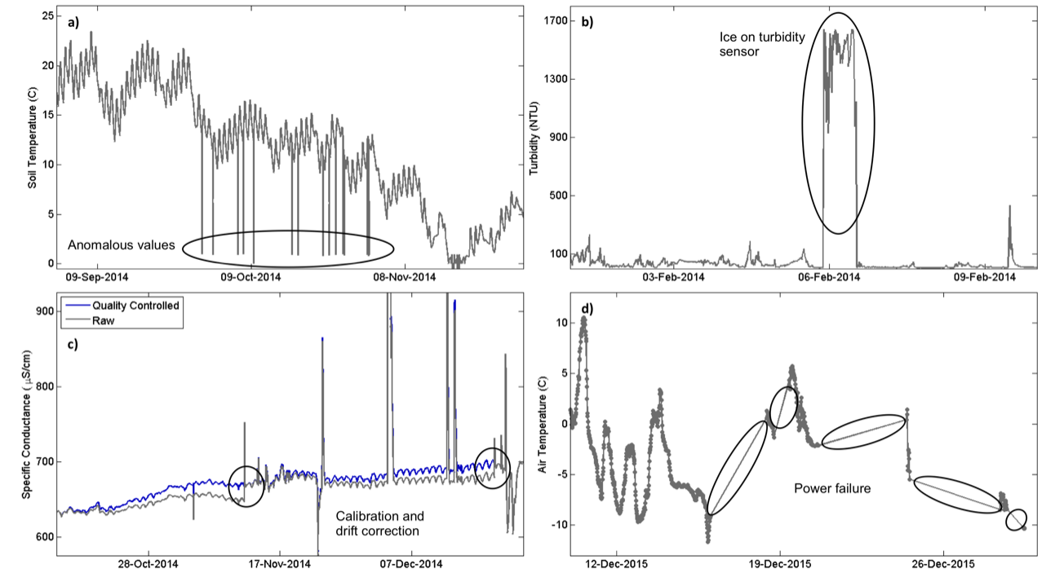
GAMUT Update: Quality Control Status
Variables sorted into tiers depending on their priority for QC
Tier 1: Most completed through 2015, some through 2016
Tier 2: Most completed through 2015, others through 2014
Tier 3: Many completed through 2015
Notes:
Did you know:
GAMUT Technicians and their staff have been working hard to perform data post processing to generate approved, quality controlled datasets that remove erroneous outliers, correct for sensor drift, remove periods of sensor malfunction, etc. This image shows typical quality control scenarios, and post processing several of the GAMUT variables included innovative quality control solutions. The shade of green indicates the level of QC completion.
This is an ongoing effort.

Slide 11
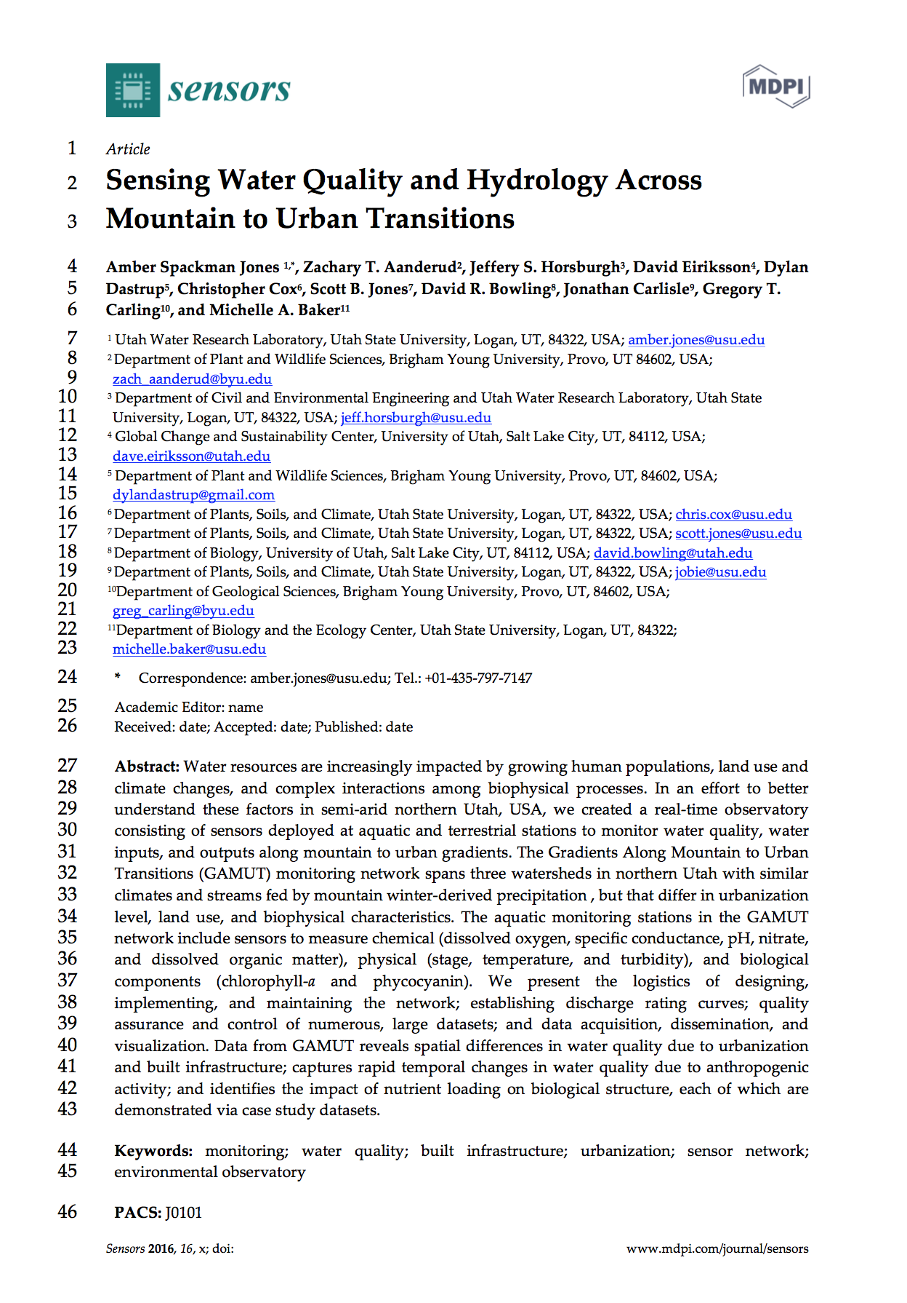
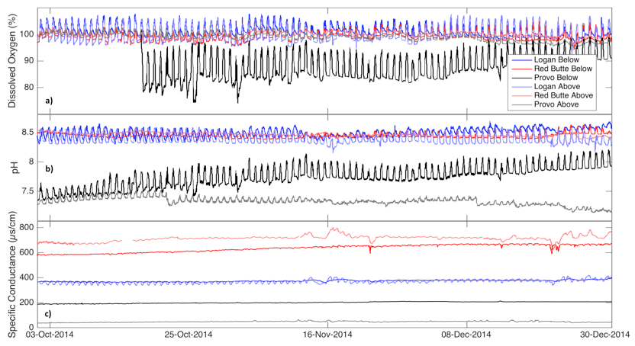
GAMUT Update: Paper Submitted!
Sumitted to the open source journal Sensors
Special issue on water quality sensing
Jones AS, Aanderud ZT, Horsburgh JS, Eiriksson D, Dastrup D, Cox C, Jones SB, Bowling DR, Carlisle J, Baker MA. Sensing Water Quality Across Mountain to Urban Transitions. Sensors. Submitted 14 Oct 2016. In Review.
Notes:
Did you know:
We very recently submitted a paper that documents the GAMUT Network and in particular, the standardization across the watersheds, the QA/QC process, and the solutions to challenges encountered by GAMUT. The idea is that the paper can be used as a reference so that anyone using GAMUT data or GAMUT infrastructure need not write about the network itself.
The paper also includes some examples of what we’re learning from the GAMUT data. Really, we’ve only scratched the surface on what we can learn from GAMUT data.

Slide 12
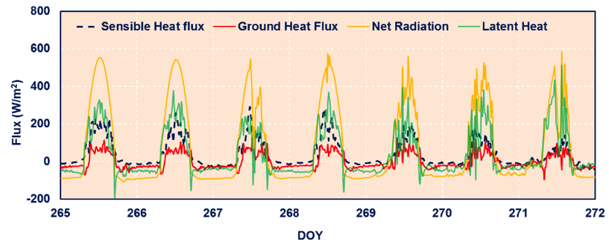
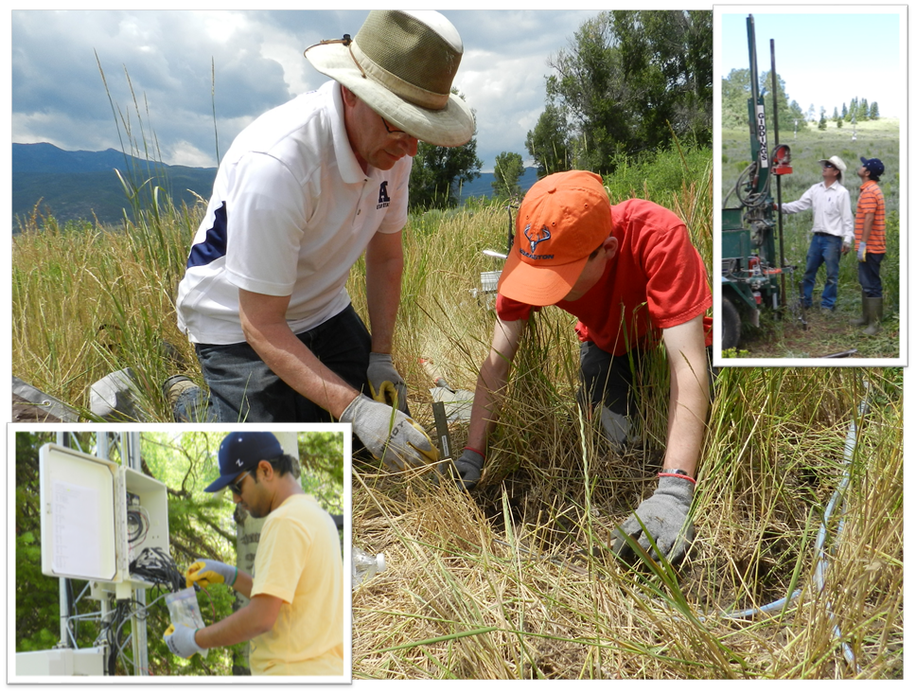
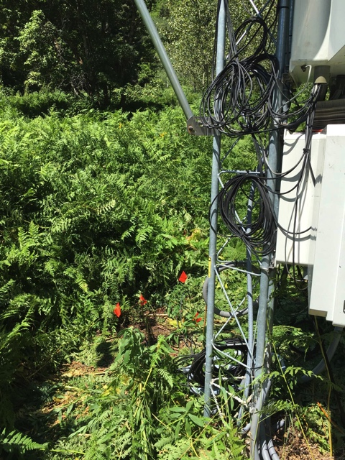
GAMUT Extensions: Additional Sensors
Soil heat flux plates (Scott Jones and Kay Parajuli)
Soil CO2 and O2 (Zach Aanderud and Kerri Russell)
Notes:
But did you know:
Researchers have added sensors that expand beyond the original GAMUT sensor suite.
Soil heat flux: Scott Jones and Kay Parajuli installed soil heat flux plates, and the resulting data will be used to model ET.
O2 and CO2: Kerri Russell and Zach Aanderud added CO2 and O2 sensors to evaluate the seasonal sensitivity of soil respiration to rainfall and snowmelt in forest and urban ecosystems.

Slide 13
GAMUT Extensions: Additional Efforts
Sapflux monitoring (Dave Bowling and Dave Eiriksson)
Stormwater/canal network (Jeff Horsburgh and Tony Melcher)
Residential stormwater and stormwater harvesting (Ryan Dupont)
Notes:
But did you know:
Researchers are piggybacking on GAMUT infrastructure to expand research questions.
Sapflux: Dave Bowling and Dave Eiriksson are using GAMUT infrastructure and cyberinfrastructure to implement their own sapflux monitoring network. Dave Eiriksson will discuss this further.
Stormwater/canal: Jeff Horsburgh and Tony Melcher have instrumented a combined stormwater/canal system in Logan similar to GAMUT aquatic sites. Tony will cover their work.
Residential stormwater: Ryan Dupont and others have instrumented a green infrastructure system where they are studying plant uptake and pollutant removal. Using GAMUT telemety and cyberinfrastructure for some of these data.
Ryan is also heading a stormwater harvesting project with sites in the Logan River and Red Butte watersheds to assess effectiveness of nutrient and metals removal of biofiltration units and roof types. Using data from GAMUT site to investigating stormwater organic matter.

Slide 14
GAMUT Extensions: Biophysical Research
Notes:
But did you know:
Because of the infrastructure, breadth of data collection, standard data practices, researchers are choosing to work in GAMUT watersheds.
There is synergy around GAMUT as sites for studying biophysical processes
Steven Hall: has published the results of his studies focused on Nitrogen dynamics in soil, water, snow, and riparian areas in GAMUT watersheds.
Greg Carling: has published results of monitoring trace elements along the mountain to urban gradient in the Provo River. Is also using GAMUT data to understand water quality during snowmelt and storm events on the Provo River focused on diurnal and seasonal timescales.
Erin Jones: Is studying bacterial communities within GAMUT watersheds- particularly how they change along the mountain to urban gradient.
Beth Ogata: performed nutrient and pharmaceutical addition experiments to test how these pollutants impact the structure and function of stream biofilms. She used GAMUT water quality and climate data to understand how various environmental factors influence this process.
Julie Kelso: has been analyzing water samples to characterize organic matter in all three watersheds and the Jordan River and to identify terrestrial, instream or urban sources. She plans to use dissolved oxygen data to model metabolism.
Rachel Gabor: is focused on identifying how water chemistry changes in the urban system and what flowpaths transport solutes to the stream. Rachel led multiple synoptic surveys to collect samples, and she is using sampled results and discharge to identify urban and canyon end members.
Beth Neilson’s research group has been working with Rachel and Paul Brooks to combine instream flow and chemical measurements to understand longitudinal trends in chemistry and the role of groundwater exchanges.
Mallory Millington: is combining precipitation data and stormwater discharge data from GAMUT stations with hydrochemical data collected during rainstorms to understand how stormwater quality evolves from precipitation to urban runoff to stormwater discharging to the creek.
Eric Oerter: Is using GAMUT soil data to calibrate in situ soil water stable isotope measurements and is using meteorological data from Red Butte GAMUT sites to determine energy balance for isotope and heat flux modeling.

Slide 15
GAMUT Extensions: Social Science Research
Notes:
But did you know:
Researchers are also centering socio-hydrological research in or adjacent to GAMUT watersheds
Doug Jackson-Smith and Martin Buchert worked to develop an urban typology the watersheds and surrounding communities.
The household survey was conducted in many neighborhoods situated within or near stretches of the Logan River, the Provo River, and Red Butte Creek.
RFA2 researchers are working to integrate actual water use data from municipalities with results of the household survey.
Melissa Haeffner is conducting key informant interviews with associated municipal leaders and water managers focused on water management issues and priorities.

Slide 16
GAMUT Extensions: Social Science Research
Notes:
*Images in slide still under development.*
But did you know:
Researchers are also centering socio-hydrological research in or adjacent to GAMUT watersheds
Courtney Flint’s group has conducted public intercept interviews along the Logan River and Red Butte Creek.
Mark Brunson and Taya Carouthers conducted a public intercept survey near the Three Creeks confluence with the Jordan River.
Additional interview and survey projects being conducted throughout the region related to water sustainabilitity and perceptions.
Joanna Endter-Wada and others are working on land use projections and planning in nearby areas.

Slide 17
GAMUT Extensions: Education and Training
Notes:
But did you know:
GAMUT watersheds have also become hubs for outreach and education efforts.
Summer institutes for students and educators, iFellows undergraduate research program
Tours for college courses, water professionals, and community members
All of the watershed technicians have trained undergraduates
GAMUT watersheds have been featured in public media outlets
NHMU digital interactive touch screen display
Estimate that over 500 students have interacted with GAMUT sites in the past 3 years

Slide 18
GAMUT: Leveraging the Infrastructure
How can we leverage GAMUT data and infrastructure? Topics for research or training? Funding opportunities?
https://youtu.be/iWsTGLRJHqU?t=1m54s
Notes:
We have done very well with GAMUT. We are up and running relatively quickly with post processing procedures mostly standardized and documented. We have a great deal of data available as well as physical infrastructure that can be used for further research as well as education and training activities. We have cyberinfrastructure that is scalable so we can bring new sites and new sensors online with relative ease. The CI also make data available to researchers and public in a variety of ways.
I’ve tried to give you a flavor of what GAMUT is, the data being produced, how people have extended it, we should discuss what might be done for future projects.
This could involve:
1. Using existing data
2. Building on the GAMUT backbone- just build own pieces. Can we include some funds for maintaining GAMUT infrastructure? To contribute some to maintenance and upkeep of network.
NSF Solicitation: Training based workforce development for advanced cyberinfrastructure
NSF Solicitation: Improving Undergraduate STEM Education
Citizen science initiatives
Collaboration with the State of Utah DEQ
Show part of Red Butte Creek video here?

Slide 19
How can we boldly go where no one has gone before?
Notes:
Beyond the five year mission…

Slide 20
Adaptive Stormwater Sampling using GAMUT Infrastructure
Tony Melcher, PhD Candidate, Civil Engineering, USU
Notes:
In this vignette, I will describe how my research has benefited from existing GAMUT infrastructure and protocol.

Slide 21
Background – Research Objectives
Objective – Examine the spatial and temporal variability of pollutant loading events in urban catchments
Study Area – Northwest Field Canal, Logan, UT
Design an observatory capable of inter-site communication and adaptive sampling
Notes:
The objective of my research is to examine the spatial and temporal scales involved in pollutant loading events in urban catchments. This includes a case study in the Northwest Field Canal, an irrigation/stormwater conveyance in Logan, UT.
In order to examine spatial and temporal variability I needed to be able to collect data at varying frequencies at multiple locations, and for those monitoring locations to have the ability to interact and communicate during storm events.

Slide 22
GAMUT – Inter-Site Communication and Adaptive Sampling
Subcatchment Outfall Site
Downstream Canal Site
Notes:
This meant that when stormwater runoff was detected at a subcatchment outlet, this detection could be communicated to downstream canal sites. The downstream canal site would then alter data observation frequencies and trigger automated samplers based on turbidity values.
My research takes advantage existing aquatic site designs in the GAMUT network, as well as existing communication infrastructure during data retrievals and inter-site communication. It was really convenient being able to add my monitoring sites to the already existing network.

Slide 23
GAMUT – Programs, Variables, and QC
Notes:
My research has also benefitted from existing data logger programs and quality control procedures. As many of my monitoring sites are equipped with a similar suite of sensors as some of the GAMUT sites, it was convenient to use some of their datalogger programs and variable names as a template.
I also was able to take advantage of the existing cyberinfrastructure. For example, my subcatchment outlet sites collect multiple data values every minute during storm events, so using the existing observation data model and quality control protocol was extremely helpful when considering the volume of observations made at each site.

